Slide 1
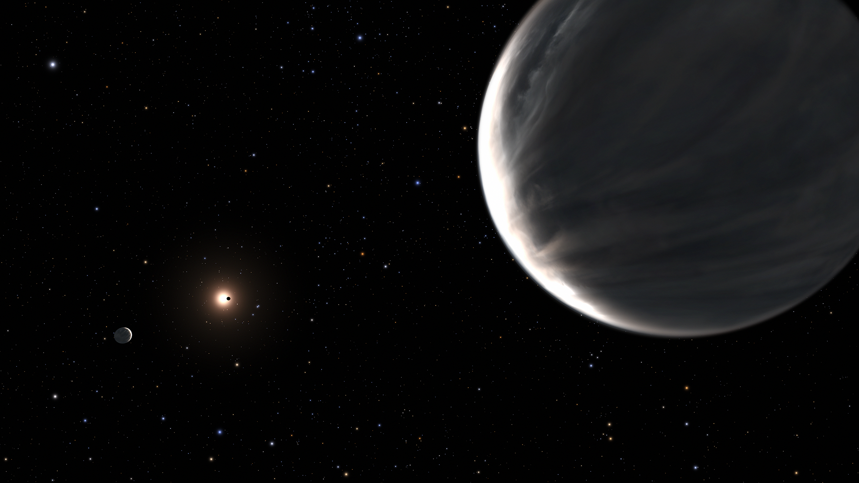
Water worlds or super-Earths?
Manuel Peralta Fuentes, Francisco J. Pozuelos
Characterizing mini-Neptunes to break planetary formation degeneracies
NASA, ESA, and Leah Hustak (STScI)

Slide 2
Contents
1. Introduction: exoplanets and detection methods
- Transits method
- Radial velocities method
2. Characterization and classification of exoplanets
- Exoplanet size distribution
3. Mini-Neptunes: planetary formation degeneracies
- Mini-Neptunes: characteristics
- Puffy super-Earths or Water Worlds?
- Do water worlds exist?
- Astrobiology and water worlds
4. Conclusions and future perspectives

Slide 3
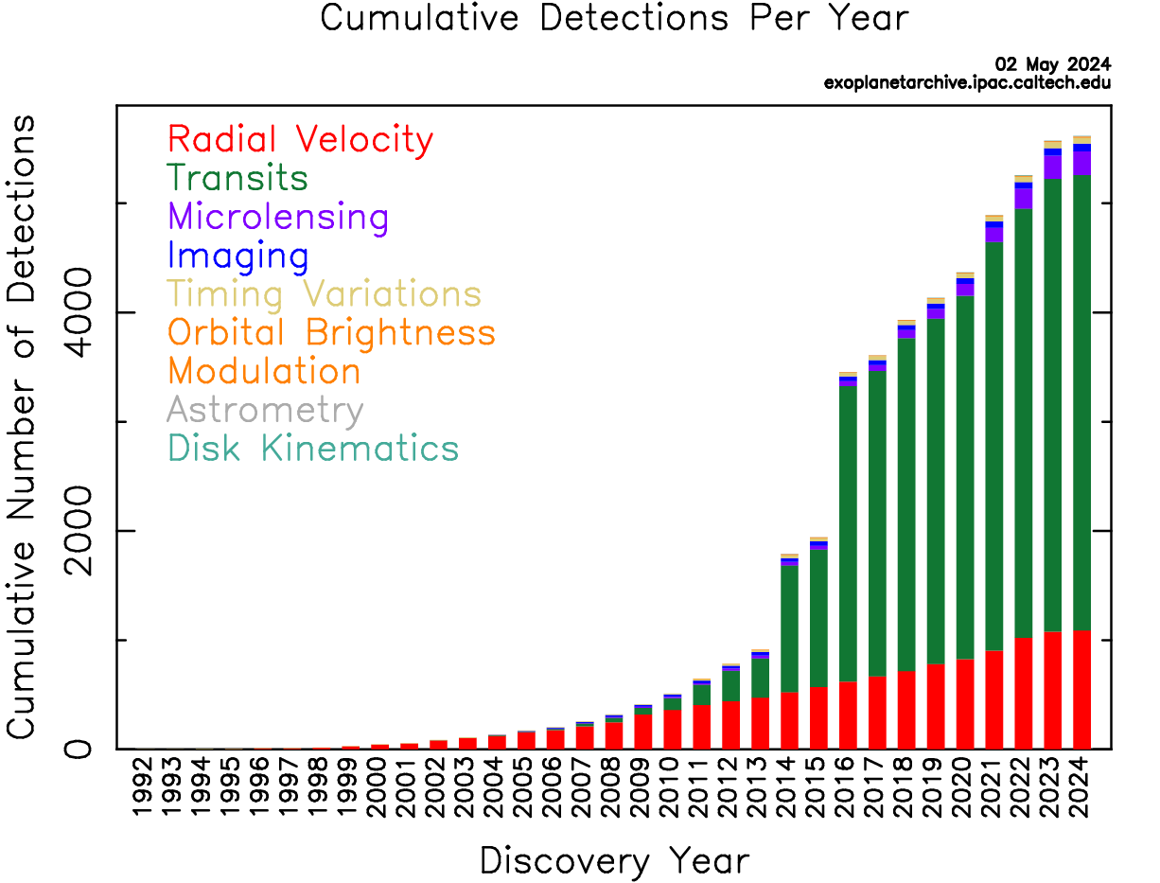
Introduction: exoplanets and detection methods
Exoplanets: planets outside the Solar System
+5600 confirmed exoplanets (big, exponential growth)
Main detection methods: Transits and RVs
NASA Exoplanet Archive

Slide 4
Introduction: exoplanets and detection methods
Transits method
Most (75%) of exoplanet discoveries so far
Measurements of the radius of the planet and its period
Better for large planets, small orbits and small host stars
ESA – European Space Agency

Slide 5
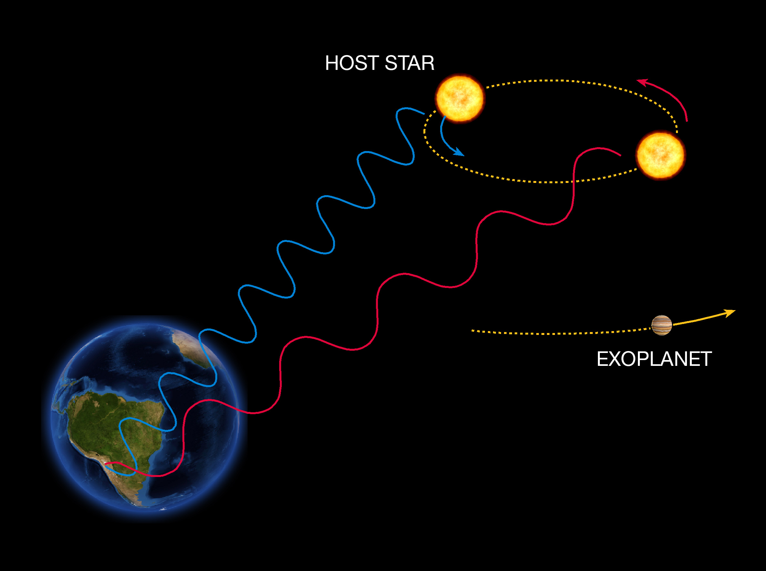
Introduction: exoplanets and detection methods
Radial velocities method
Observations of Doppler shift of the moving star’s spectrum
Measurements of the minimum mass of the planet
Transits + RVs = Radius and Mass = Density!
ESO – European Southern Observatory

Slide 6
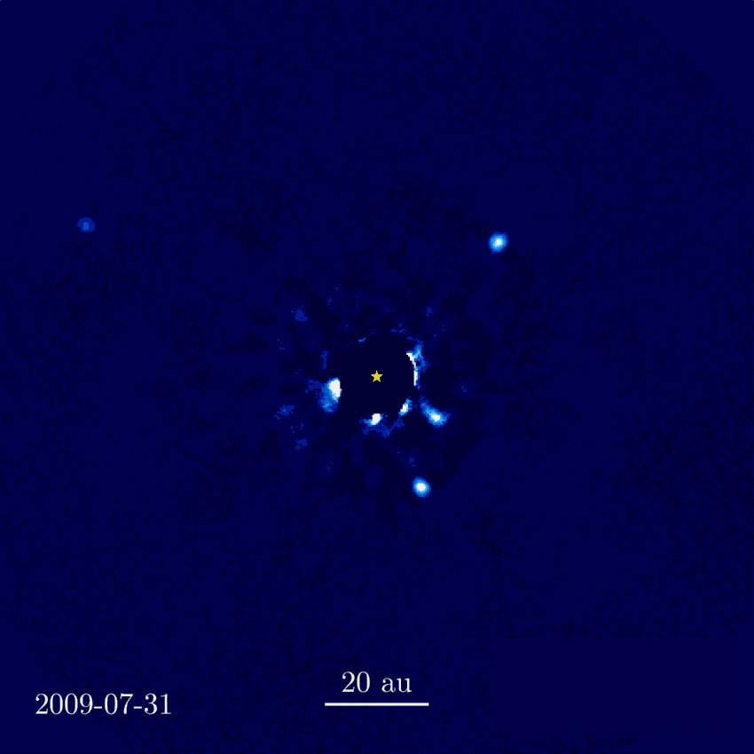
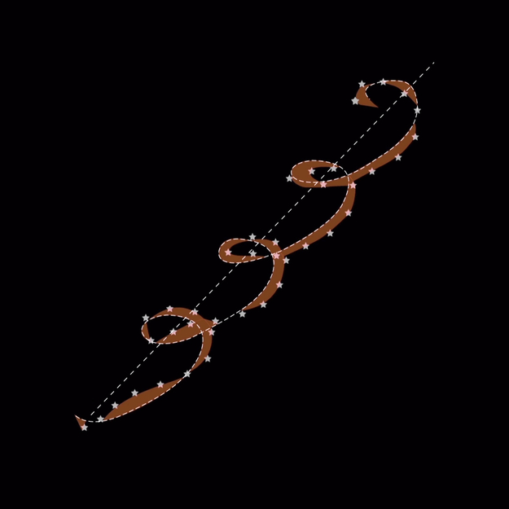
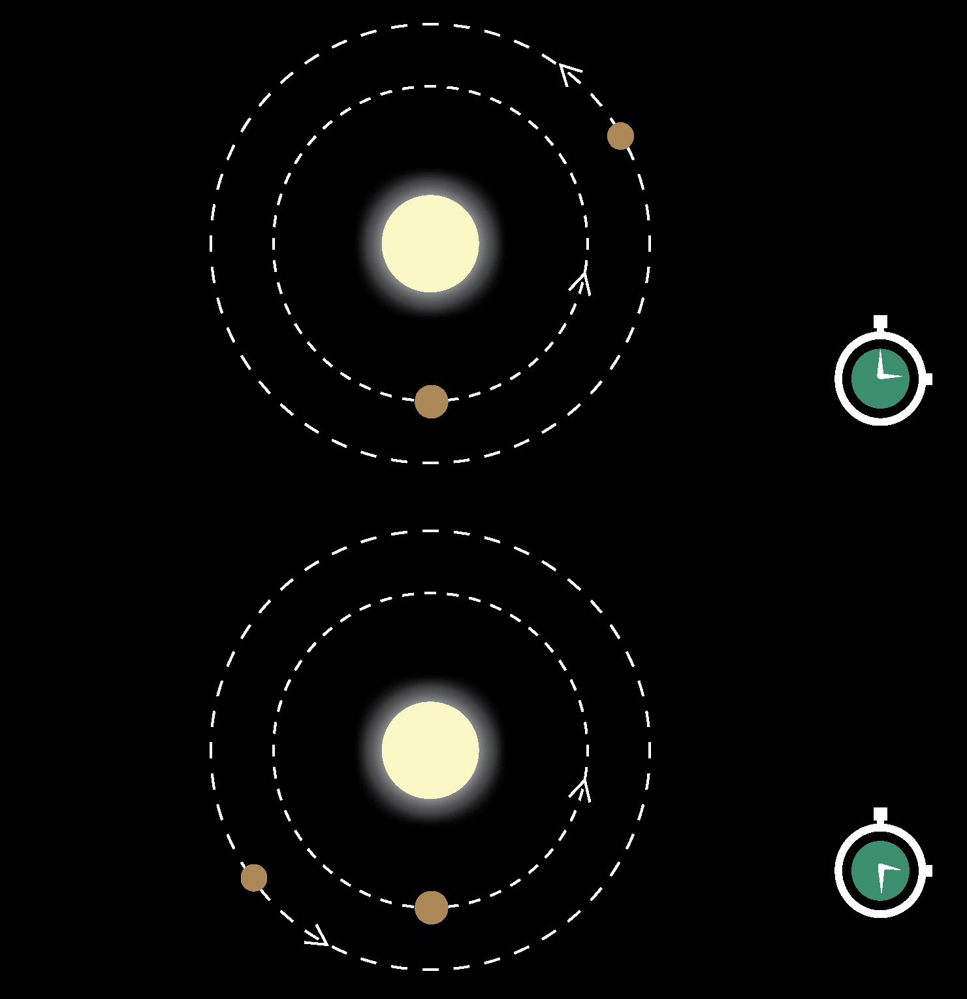
Introduction: exoplanets and detection methods
Direct imaging
Astrometry
TTVs
Wang et al. (2017)
ESA
ESA

Slide 7
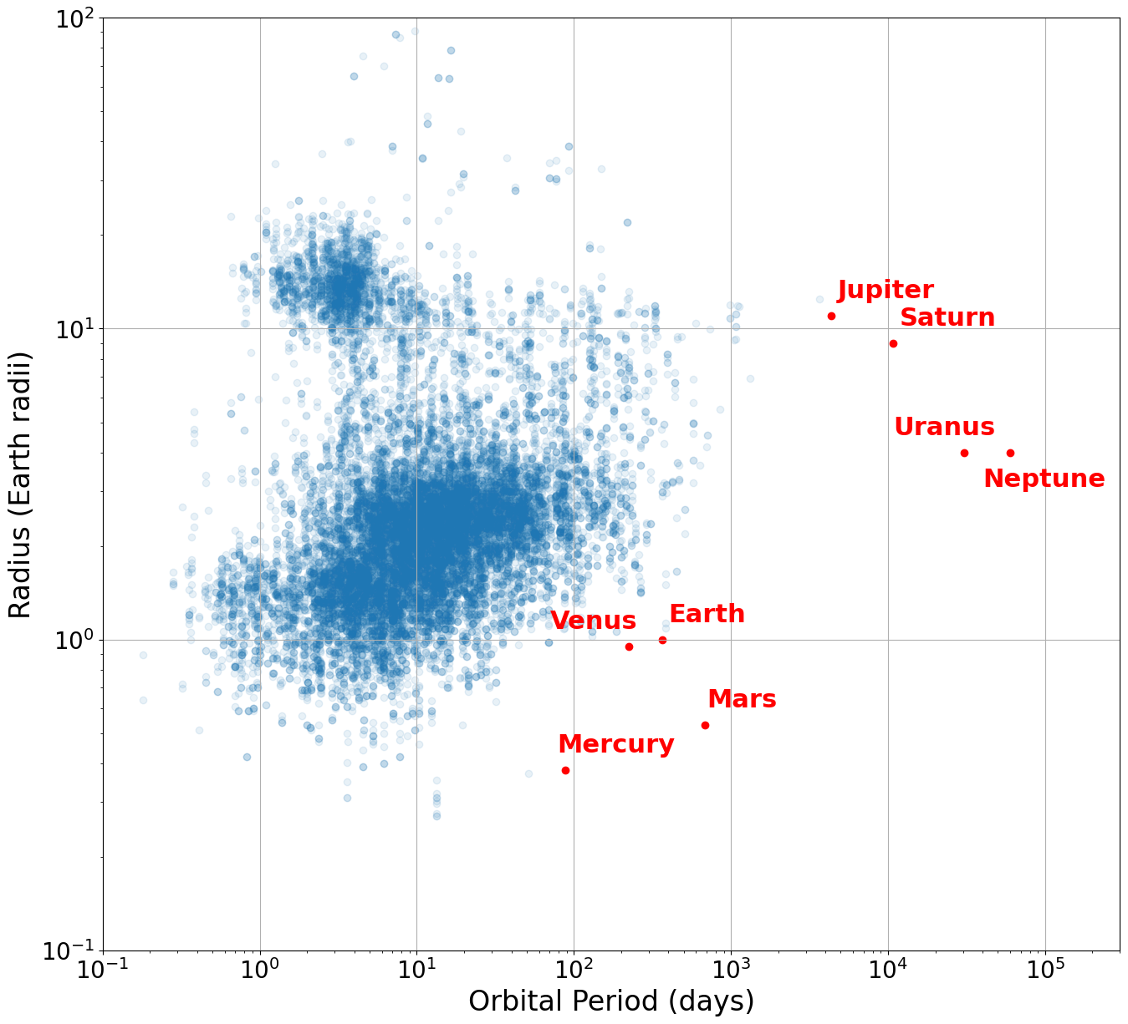
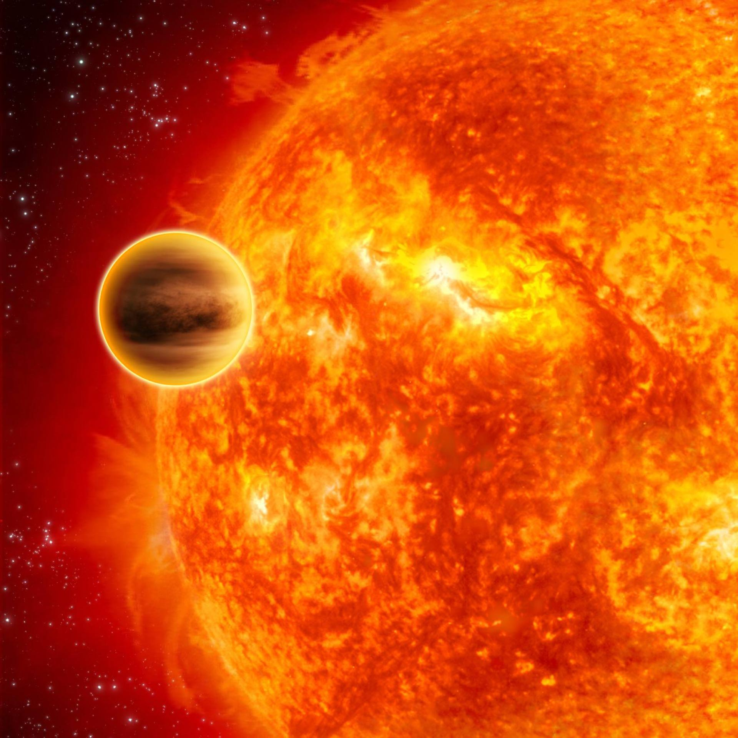
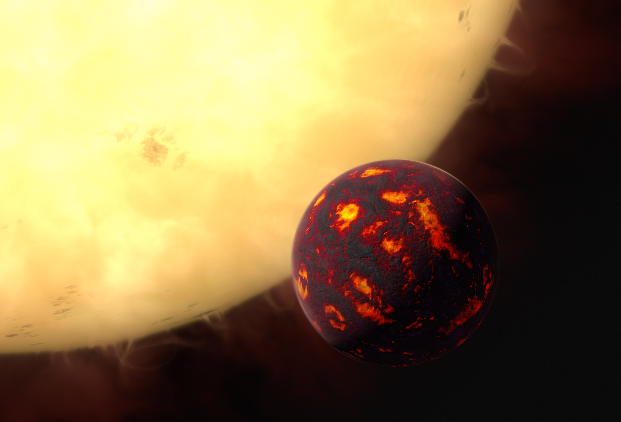
2. Characterization and classification of exoplanets
Huge diversity of exoplanets, very different from those in the Solar System
Lava planets
Hot Jupiters
ESA / Hubble, M. Kornmesser
C. Carreau / ESA
NASA Exoplanet Archive

Slide 8
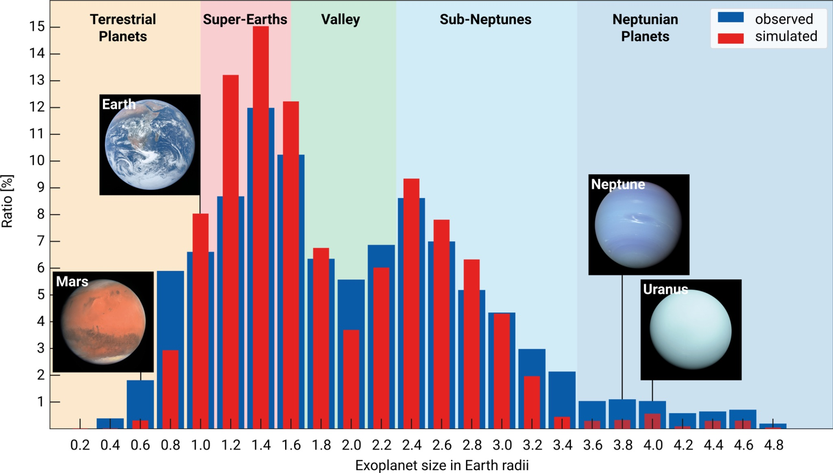
2. Characterization and classification of exoplanets
Exoplanet size distribution
Most exoplanets are bigger than Earth and smaller than Neptune (no Solar System planets in this region)
Bimodal distribution: two main clusters (Super-Earths and mini-Neptunes) with a minima in between (radius valley)
R. Burn, C. Mordasini / MPIA

Slide 9
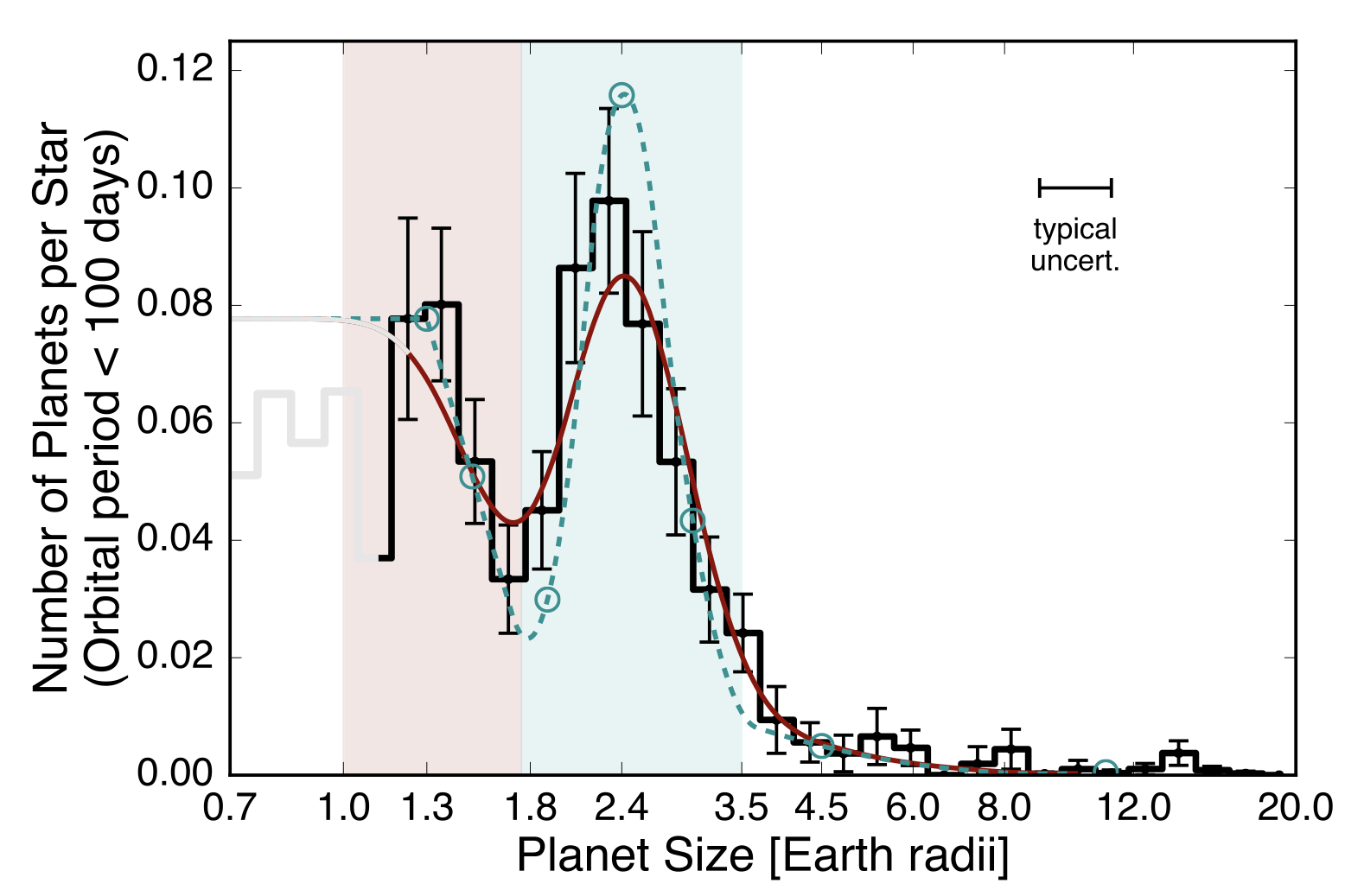
3. Mini-Neptunes: planetary formation degeneracies
Mini-Neptunes: characteristics
Radius between 1.8 and 3.5 $R_{♁}$
Data from Kepler Survey
Different masses and densities
What about their compositions?
Different theories and models:
Super Earths with H/He envelopes
Water Worlds
Fulton et al. (2017)

Slide 10
3. Mini-Neptunes: planetary formation degeneracies
Puffy super-Earths
Water worlds
?
Which one is right?
ESA – European Space Agency
ESA – European Space Agency
Super Earths that did not lose their gas-rich, original atmospheres
Ice giants that migrated into a smaller orbit and had their ice melted

Slide 11
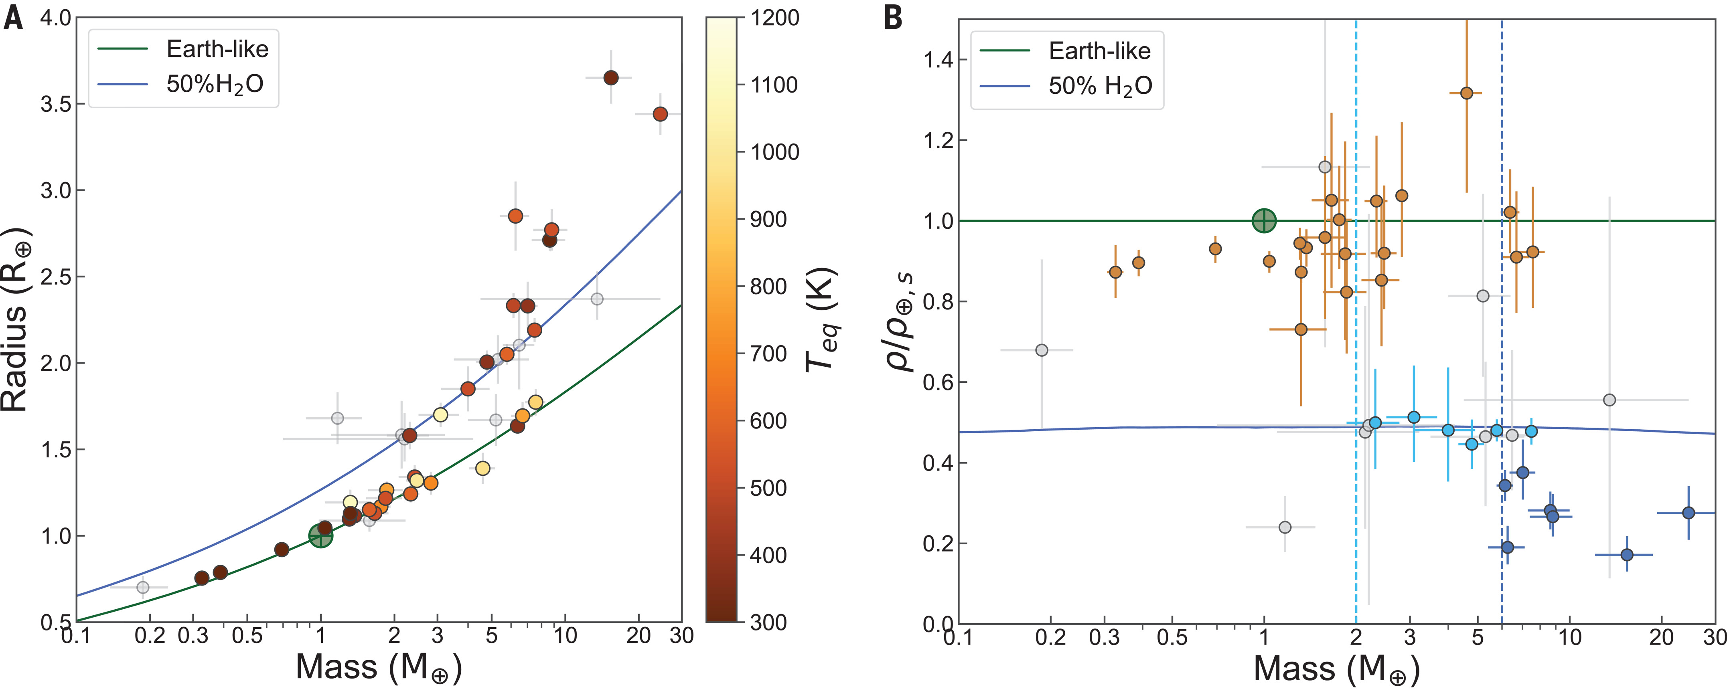
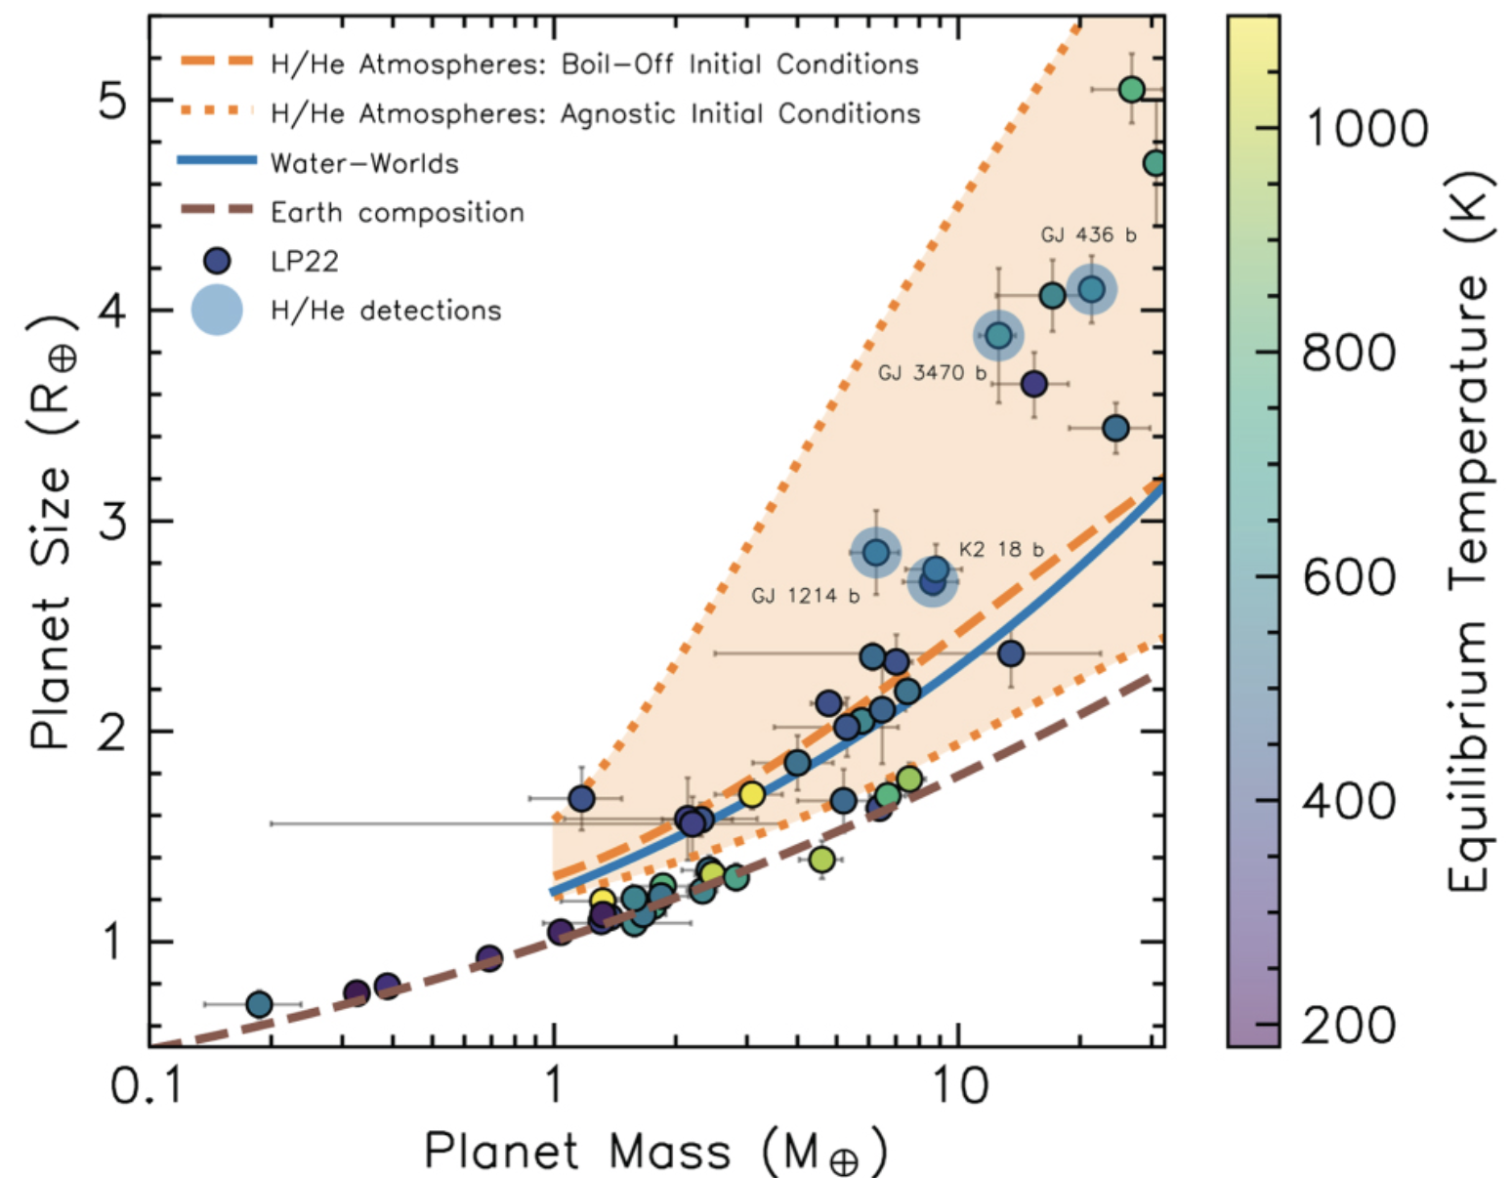
3. Mini-Neptunes: planetary formation degeneracies
Do water worlds exist?
But…
Luque et al. (2022)
Rogers et al. (2023)
Some mini-Neptunes’ densities are consistent with a water world model!
Density is not enough to determine whether a planet is water-rich!

Slide 12
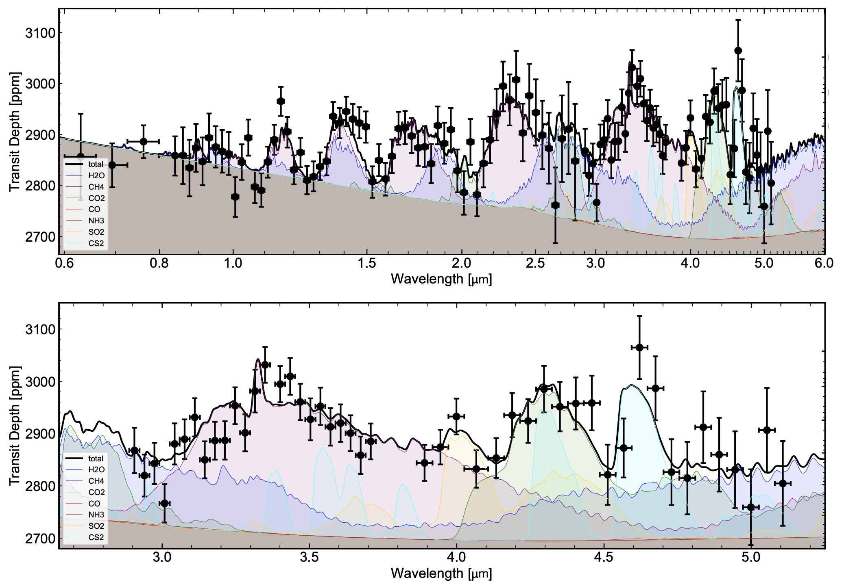
3. Mini-Neptunes: planetary formation degeneracies
Astrobiology and water worlds
Astrobiology: search for life beyond the Earth
Atmospheric characterization, biomarkers: gases produced by extraterrestrial life
Example 1: CH4, CO2 and H2O in the atmosphere of TOI-270d (2.2 $R_{♁}$)
Benneke et al. (2024)

Slide 13
3. Mini-Neptunes: planetary formation degeneracies
Astrobiology and water worlds
Astrobiology: search for life beyond the Earth
Atmospheric characterization, biomarkers: gases produced by extraterrestrial life
Example 2: DMS in K2-18 b (2.6 $R_{♁}$, ~ 280 K), a water world candidate
Madhusudhan et al. (2023)

Slide 14
4. Conclusions and future perspectives
Exoplanets are diverse and most of them are unlike the solar system’s planets
Mini-Neptunes are very interesting and leave many questions open:
Are mini-Neptunes puffy super-Earths or water worlds?
Are super-Earths and mini-Neptunes the same kind of planet with different evolution? Are they different kinds of planets from their origin?

Slide 15
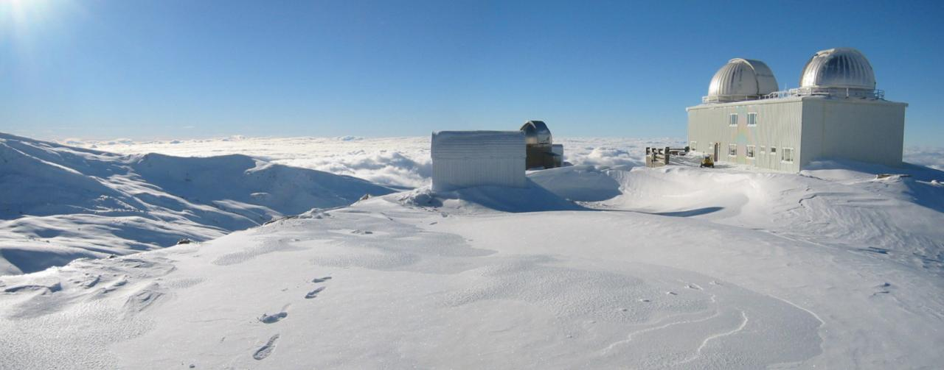
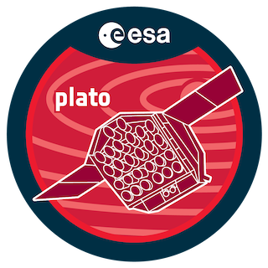
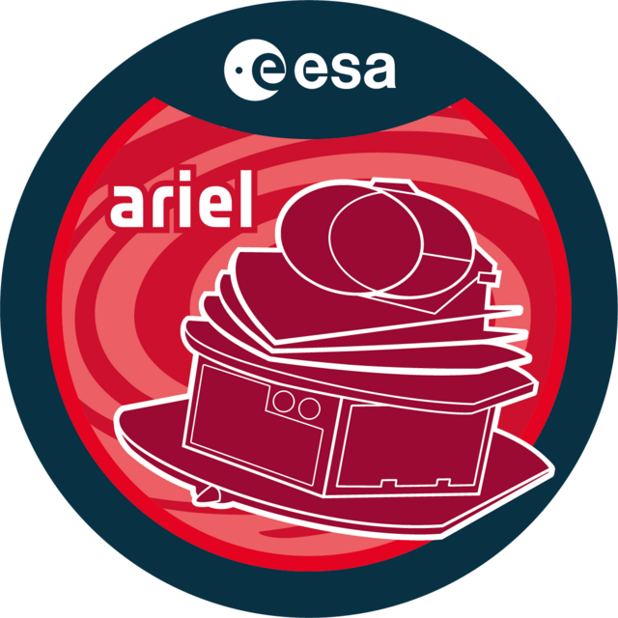
4. Conclusions and future perspectives
Steps to answer these questions:
1. Find and confirm mini-Neptunes using the transits method
3. Learn more about them using alternative paths (for example, atmospheric characterization)
2. Find their masses and densities using RVs method
Sierra Nevada Astronomical Observatory
Promising future missions!
TOIs: 6814.01, 6787.01, 6777.01, 6771.01…

Slide 16
Thanks for your attention!
Please, don’t hesitate to contact me:
linkedin.com/in/mperaltaf
mperalta@correo.ugr.es

