Slide 1
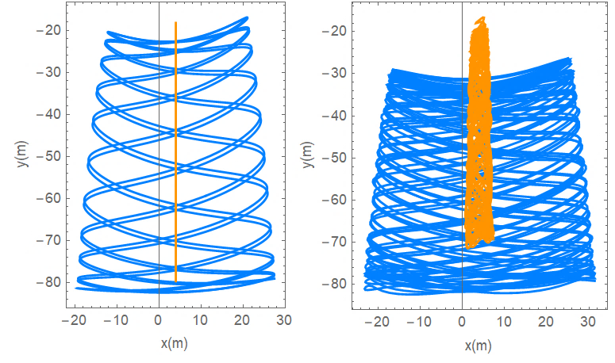
Deciphering Complexity: Machine Learning Insights into Chaotic Dynamical Systems
AI Poincare is a machine-learning algorithm that determines the number of conserved quantities in a system.
Our goal is to use the algorithm to solve some main problems that chaos theory presents us…
Reporter:lazare osmanov

Slide 2
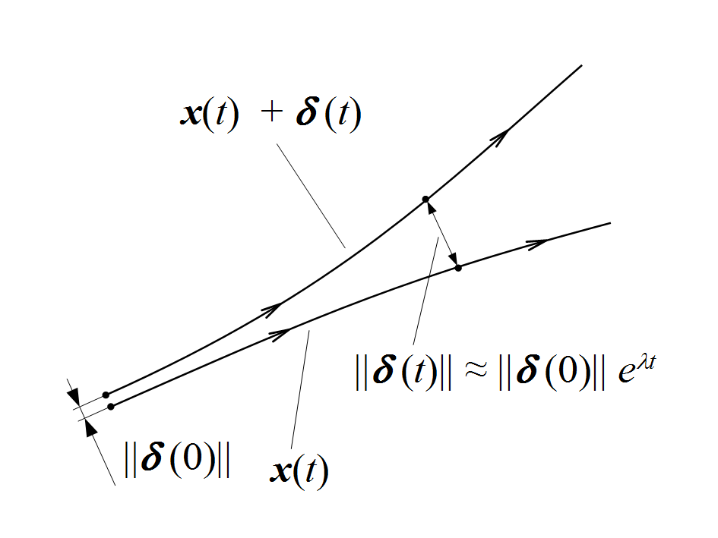
What is the chaos?
Periodic
Quasi-Periodic
No theoretical prediction is possible
Chaos

Slide 3
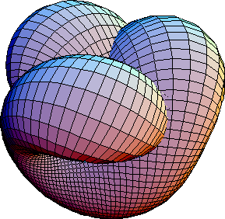
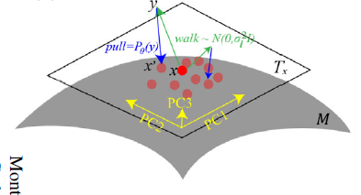
AI Poincare
We estimate the dimensionality of local tangent space
$$loss\left(θ\right)=\frac{1}{N}\sum_{i=1}^{N}{{\left((pulled point)−x_{i}\right)}^{2}}$$
Calculate the average of the values of dimension

Slide 4
Training
Algorithm tries to minimize d
d

Slide 5
AI Poincare
We estimate the dimensionality of local tangent space
$$loss\left(θ\right)=\frac{1}{N}\sum_{i=1}^{N}{{\left((pulled point)−x_{i}\right)}^{2}}$$
Calculate the average of the values of dimension

Slide 6
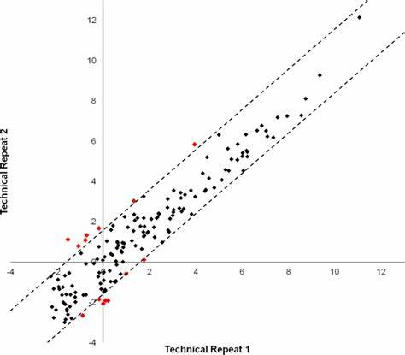
PCA
$${projection of x}_{i} on u_{1}=u_{1}^{T}x_{i}$$
$$var=\frac{1}{N}\sum_{i=1}^{N}{{\left(u_{1}^{T}x_{i}−u_{1}^{T}<x>\right)}^{2}}$$
$$var=u_{1}^{T}\left(\frac{1}{N}\sum_{i=1}^{N}{\left(x_{i}−<x>\right){\left(x_{i}−<x>\right)}^{T}}\right)u_{1}$$
$$u_{1}^{T}u_{1}=1$$
$$\frac{d}{du_{1}}\left(u_{1}^{T}Su_{1}+γ\left(1−u_{1}^{T}u_{1}\right)\right)=0$$
$$Su_{1}=γu_{1}$$
$$u_{1}^{T}Su_{1}=γ$$
If eigenvalue is too small we decrease the dimension

Slide 7
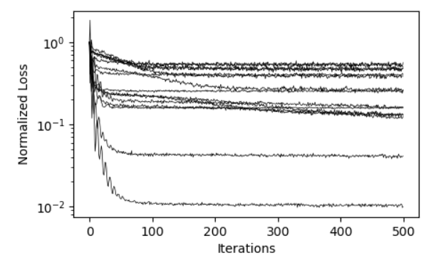
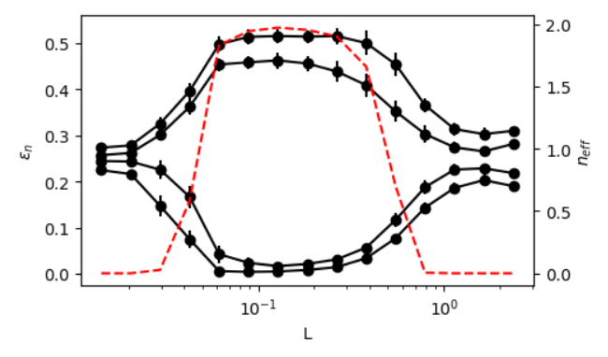
Final calculation of conserved quantities
Index of the length scale
1 | 2 | 3 | 4 | 5 | 6 | 7 | 8 | 9 | 10 | . | . | .
$$Then what?$$
Clear indication of 2 conserved quantities

Slide 8
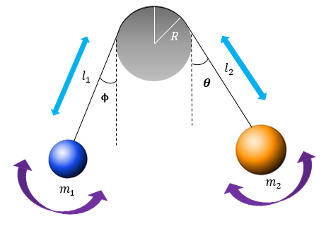
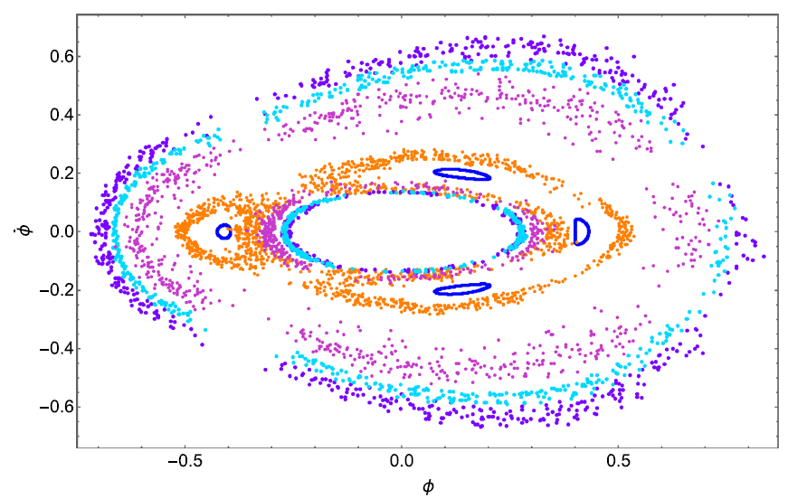
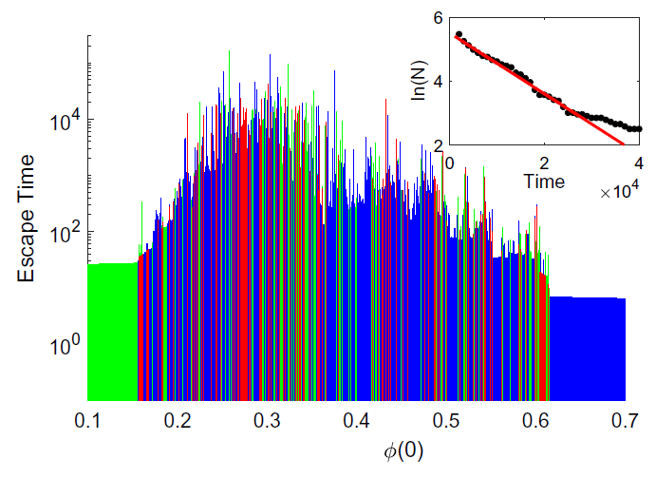
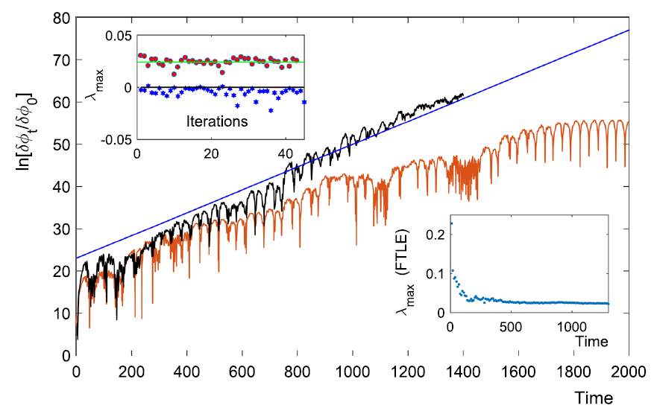
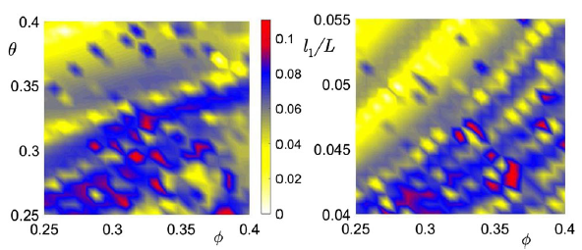
Two masses swinging on a rod

Slide 9
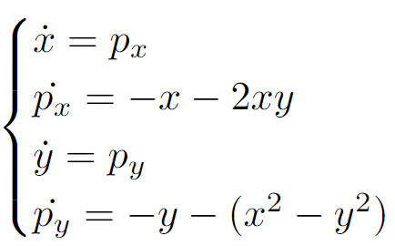
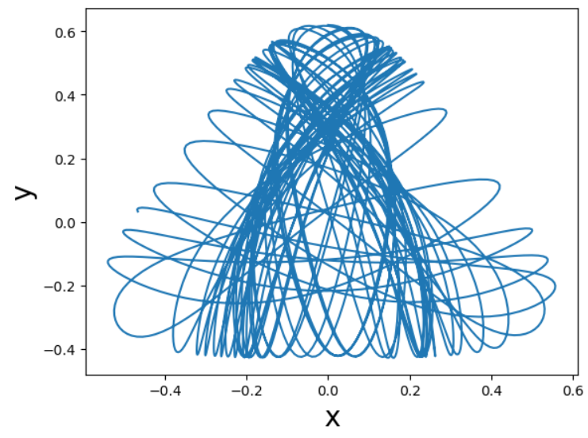
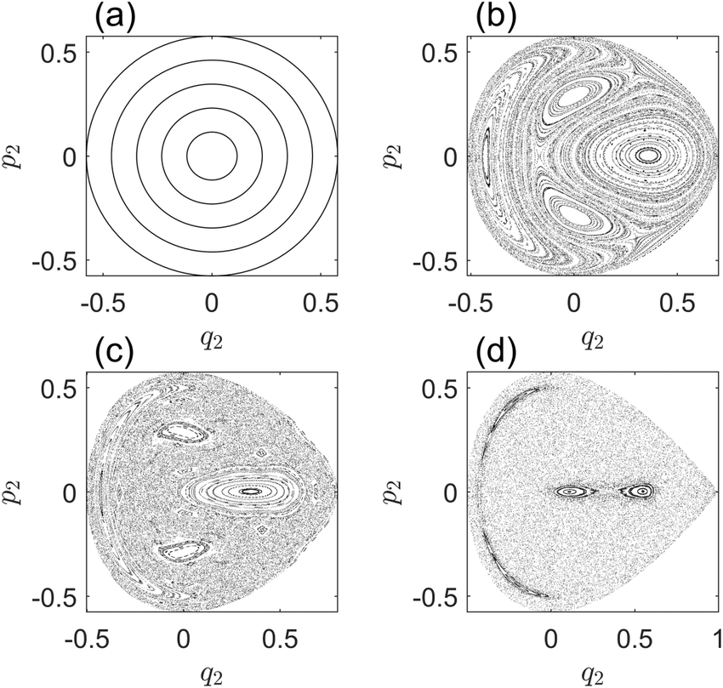
Henon-Heiles system

Slide 10
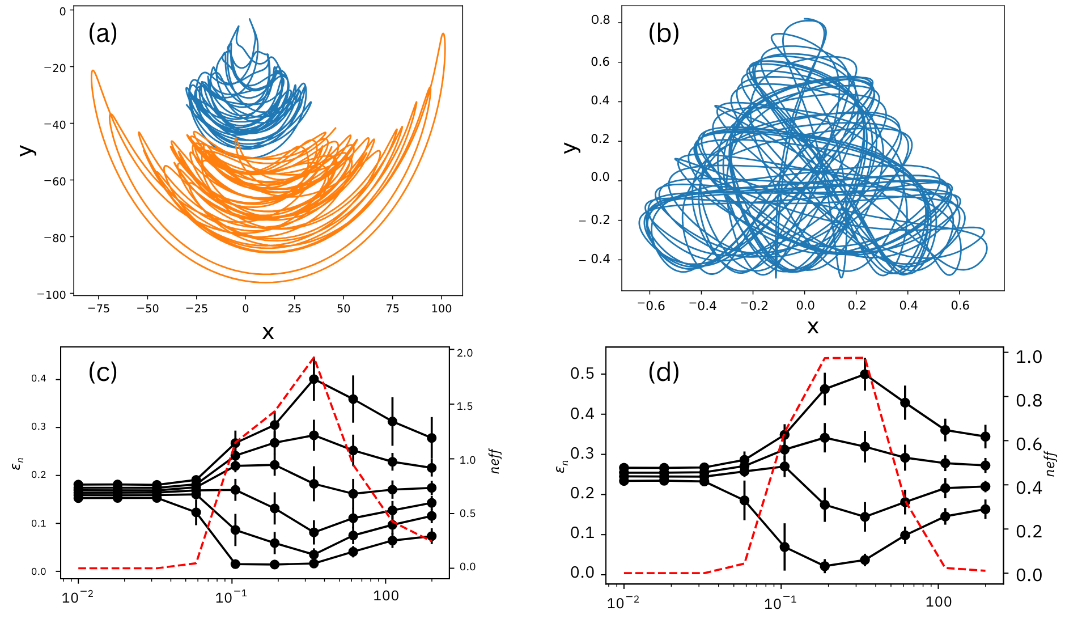
Primary results
Both systems exhibit chaotic dynamics

Slide 11
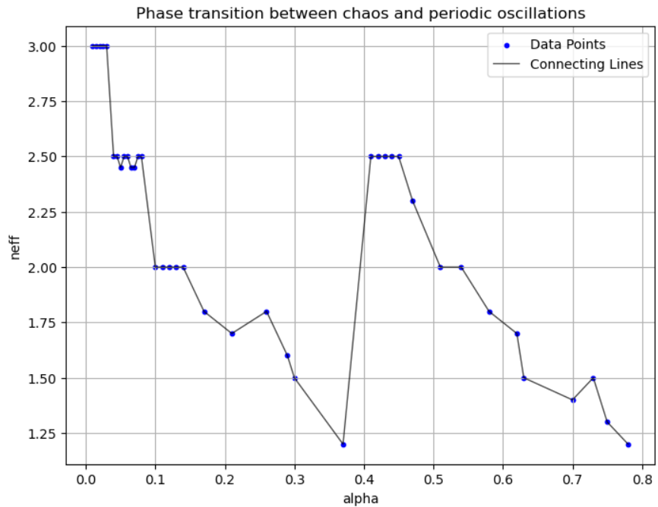
Phase transitions
Integrable region
Lets check
Chaotic region
Interesting region

Slide 12
Phase transitions

Slide 13
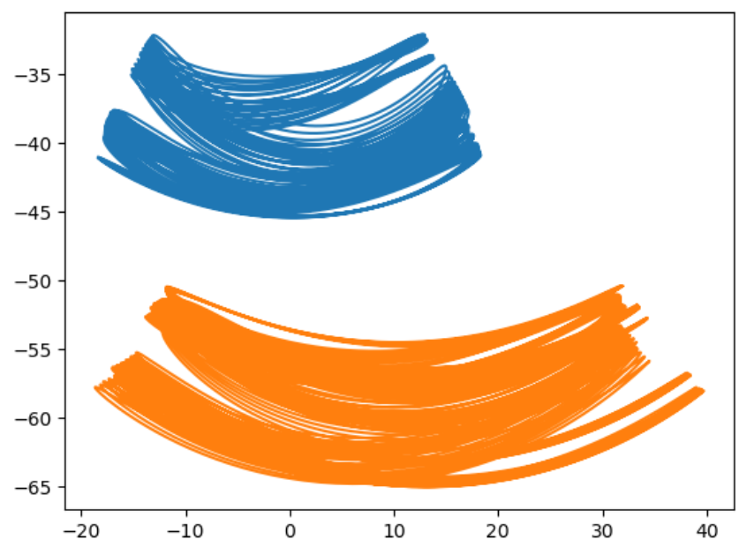
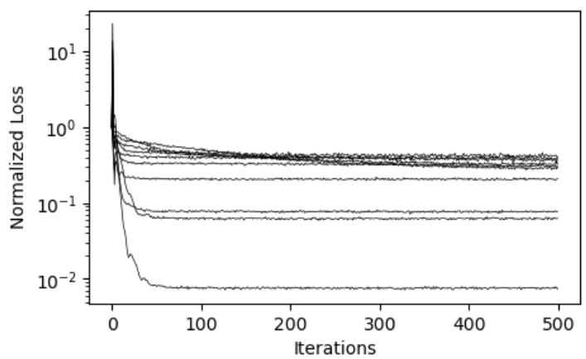
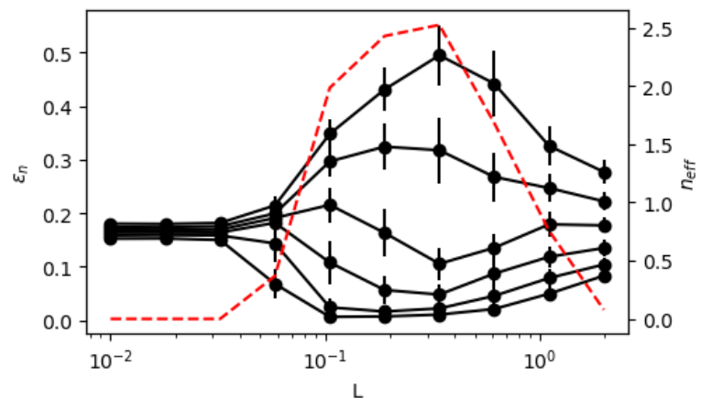
“Almost” conserved quantity

Slide 14
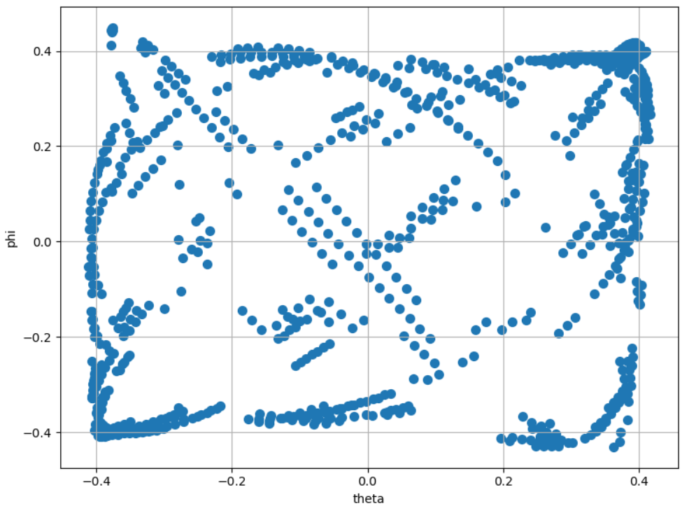
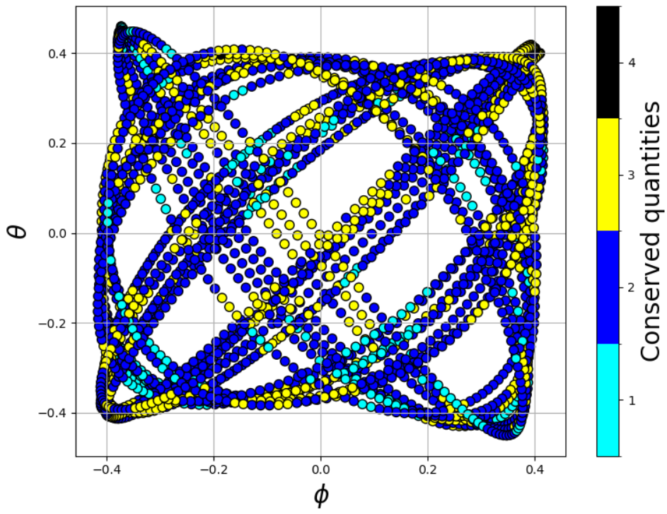
Almost integrable regions
$$T\sim \frac{1}{γ}$$
$$d\sim d_{0}e^{γt}$$

Slide 15
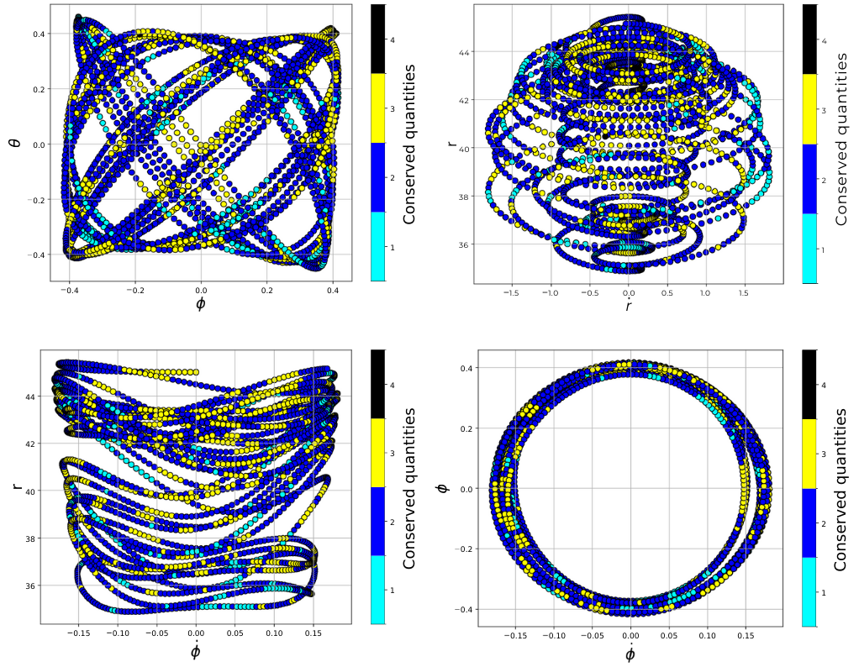
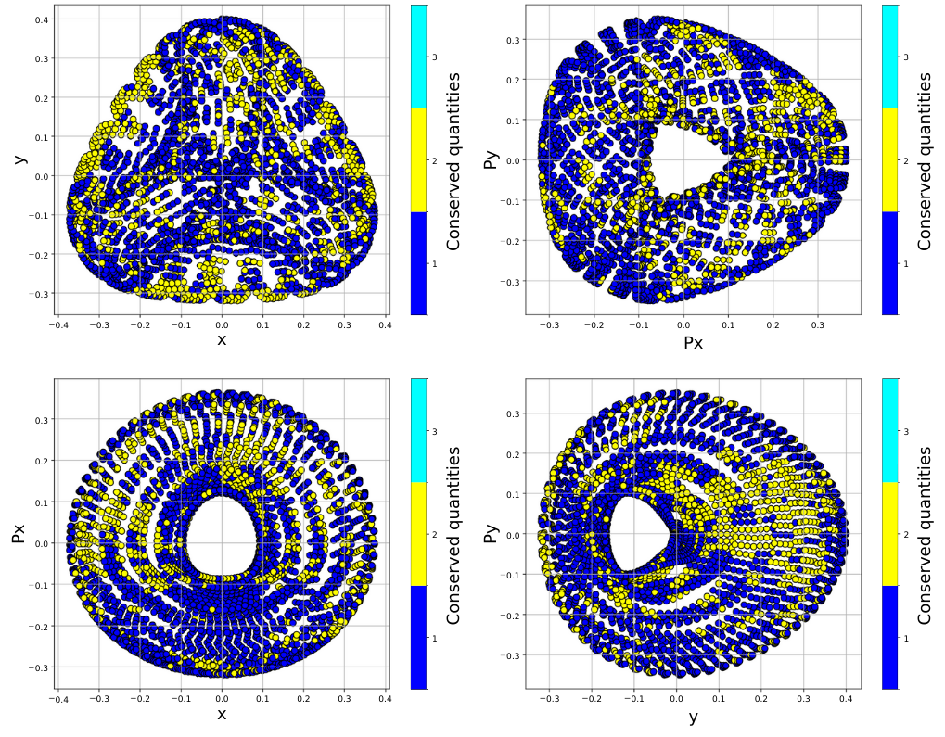
Integrable regions
Two bodies swinging on a rod
Henon-Heiles system

Slide 16
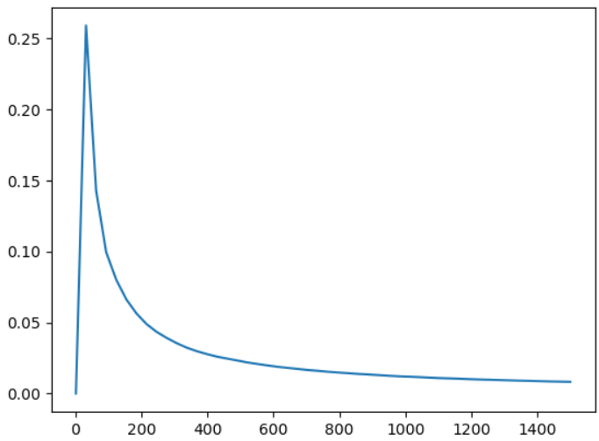
Lyapunov exponent
$$d\sim d_{0}e^{γt}$$
$$γ=0.015$$
$$new data=trajectory\left(r_{0}+dr\right)−trajectory(r_0)$$
$$γ_{1}$$
$$γ_{2}$$
$$MLE=\frac{1}{t}ln\left(\frac{\sqrt{\left(γ_{1}^{2}+γ_{2}^{2}+…+γ_{2n}^{2}\right)}}{\sqrt{\left(γ_{01}^{2}+γ_{02}^{2}+…+γ_{02n}^{2}\right)}}\right)$$
Time

Slide 17
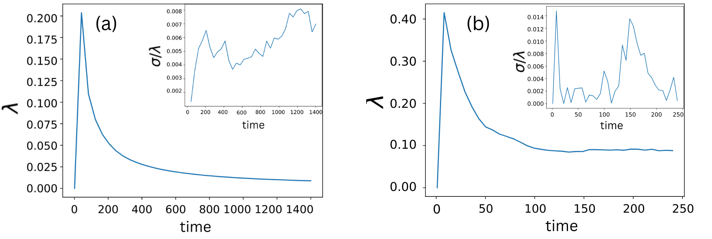
Lyapunov exponent

Slide 18
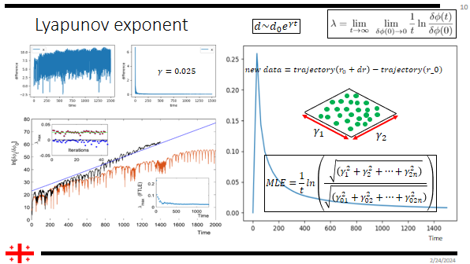
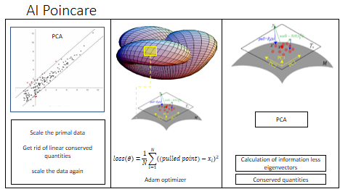
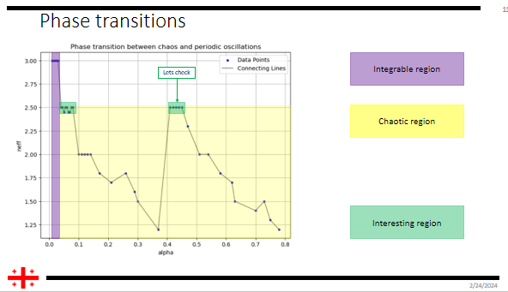
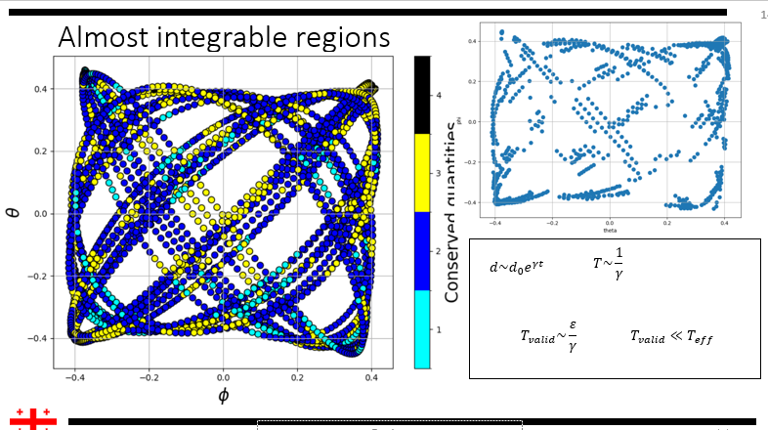
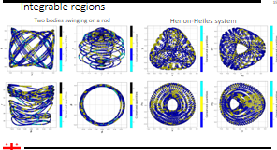

Slide 19
Thanks for your attention

