Slide 1
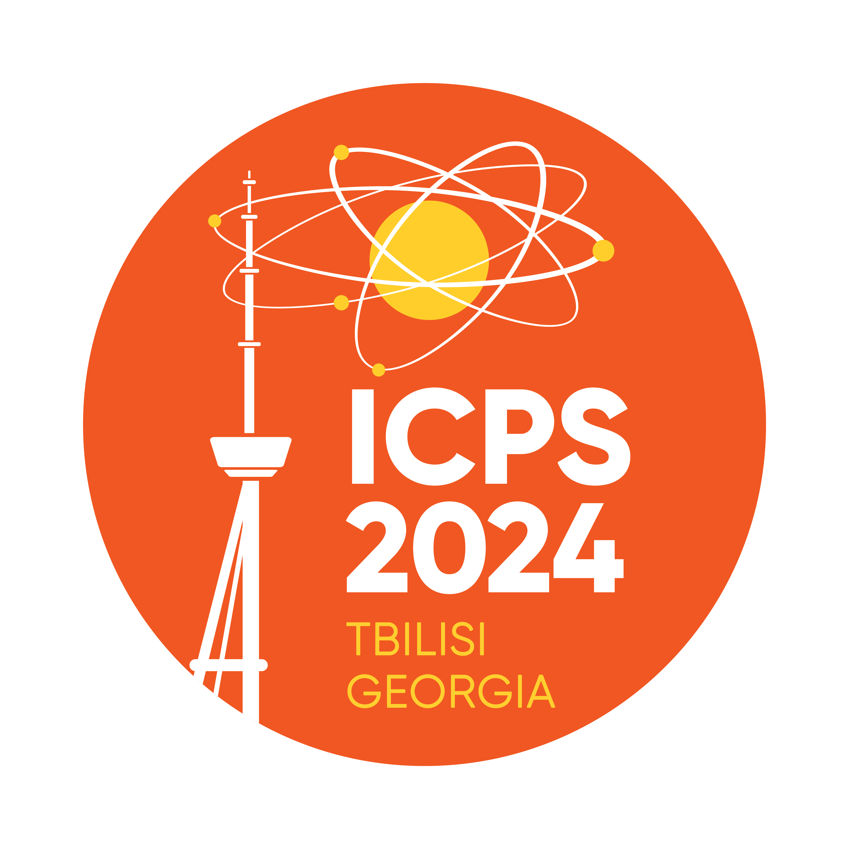
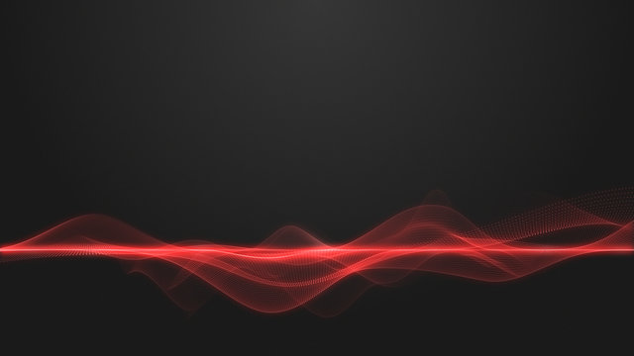


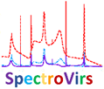
New opportunity to look insight the viral world using optical methods
International conference of physics students 2024
Author: Sergi Kapanadze
Supervisor: prof. Tamar Bzhalava
Work is supported by Shota Rustaveli National Science Foundation of Georgia (SRNSFG) [FR-23-4069]

Slide 2
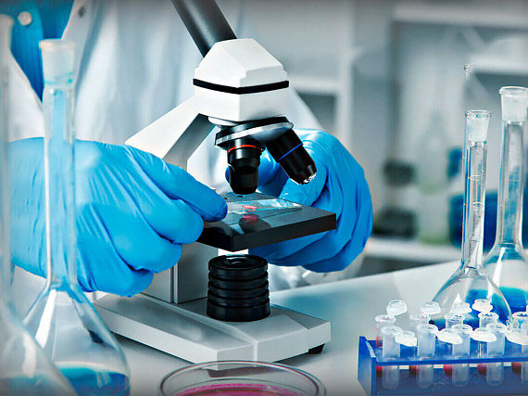
Introduction
In this talk will be discussed the possibility of identification and research of viral particles using spectroscopic methods.
This is relatively new approach compared to other research methods, however, it gives quite a good prospects and in the near future it may become a regular method of identification of viral diseases in medical practice.

Slide 3
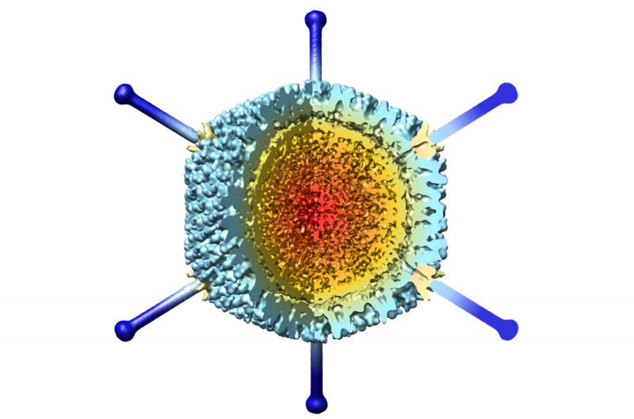
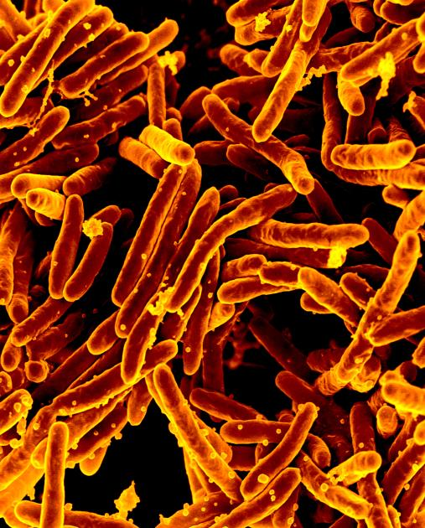
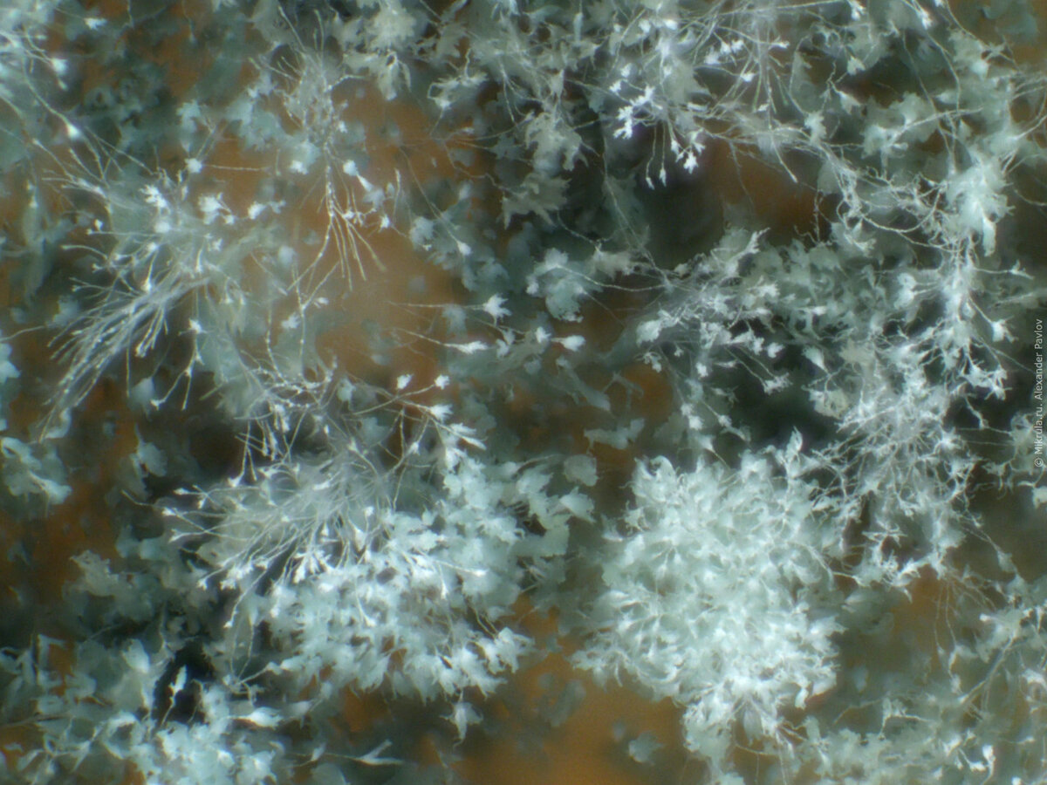
The most common types of microbes
Viruses
Bacteria
Fungus
Fig.1 Model of Adenovirus [1]
Fig.3 Tuberculosis bacteria [3]
Fig.2 Bread mold under the microscope [2]

Slide 4

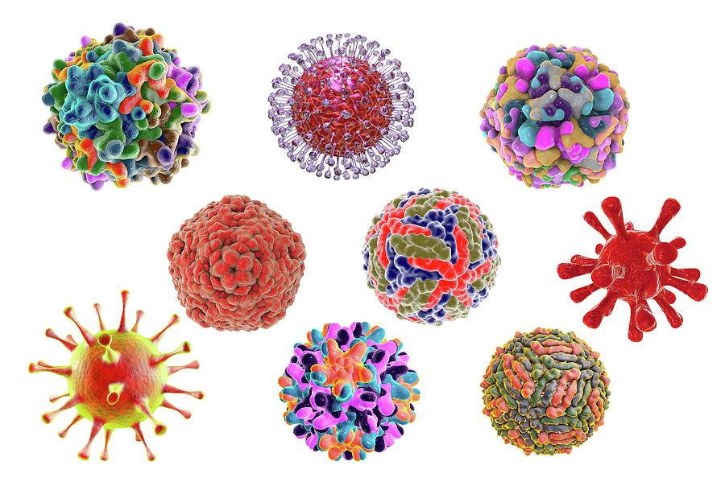
Why is identification of viral particles so important?
To prescribe appropriate treatment is impossible without identifying the cause of the disease
Studying the physical and biological properties of a viral particle allows us to better understand its mechanism of action, find ways to inactivate the virus or develop a vaccine against the disease caused by it.

Slide 5
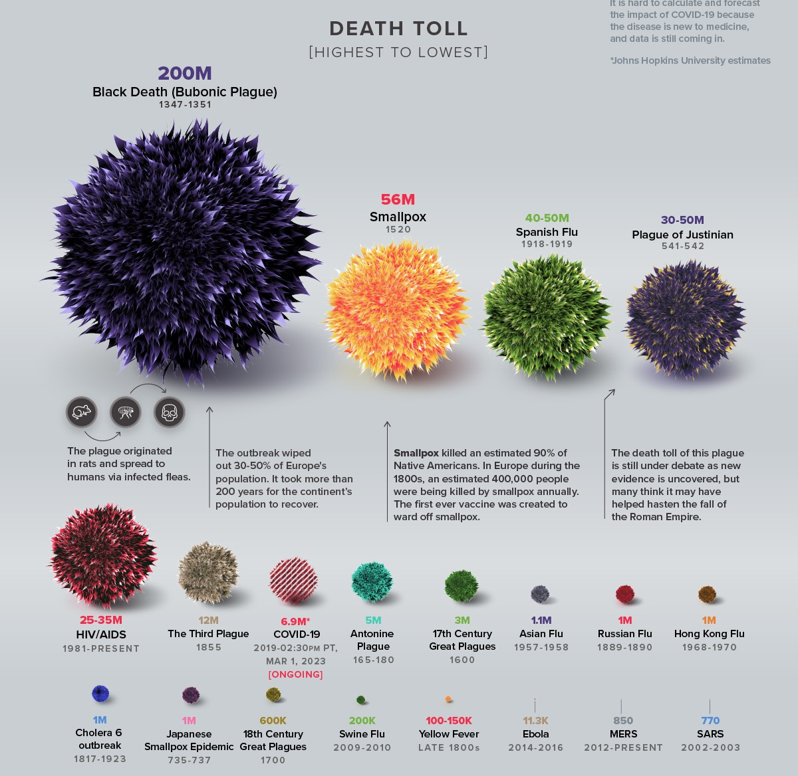
Why is identification of viral particles so important?
Fig.4 Deaths caused by
different types of viruces [4]

Slide 6
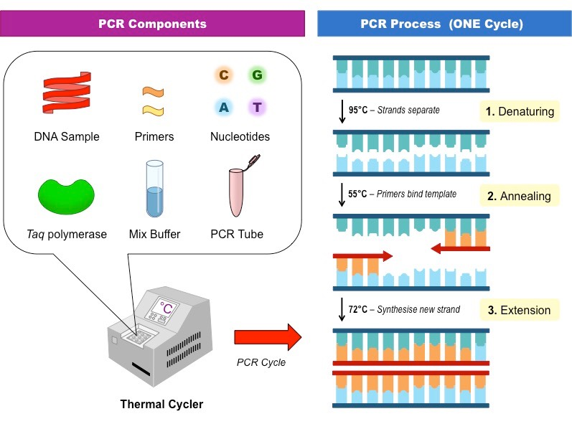
Biophysical and biochemical methods for identification of viral particles
Polimerized-Chain Reaction (PCR)
Allows increasing the concentration of DNA fragments in biological material by copying them multiple times.
The process takes place in the amplifier.
Need to create special environmental conditions (PH, ionic strength of the solvent, etc.)
It requires special enzymes, primers and other substances.
Primer - building material for new DNA strands.

Slide 7
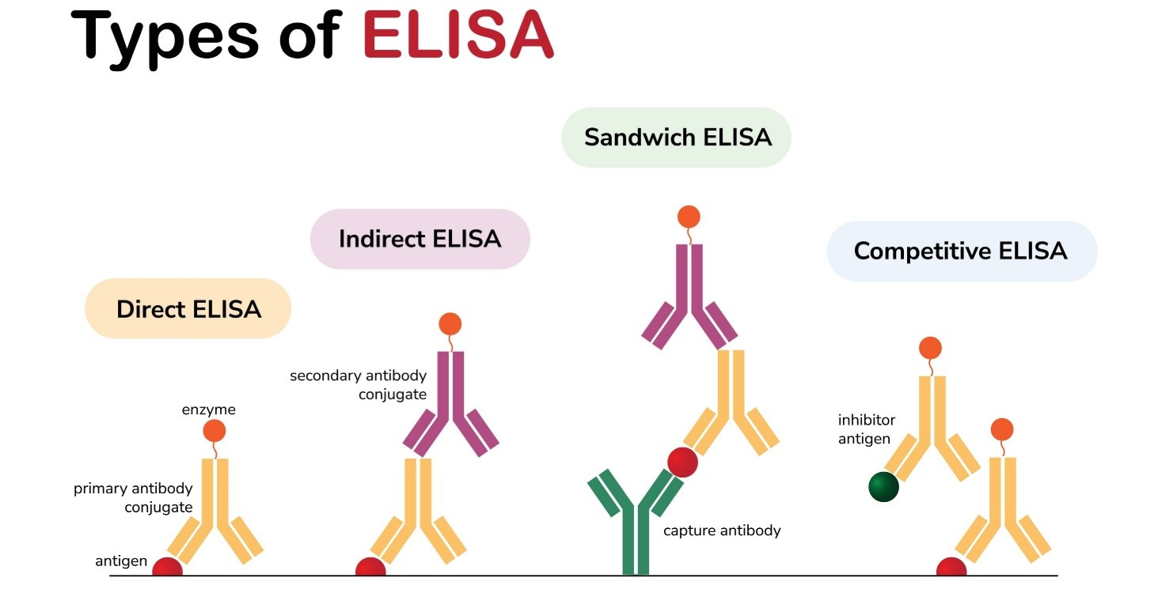
Biophysical and biochemical methods for identification of viral particles
Enzyme-Linked Immunosorbent Assays (ELISA)
Laboratory immunological method of qualitative or quantitative determination of various low-molecular compounds, macromolecules, viruses, etc.
It is based on the antigen-antibody reaction.
Antigens from the sample to be tested are attached to a surface.
Matching antibodies is applied over the surface.
Antibody is linked to an enzyme.
In the final step, a substance containing the enzyme's substrate is added.
If there was binding, the subsequent reaction produces a detectable signal, most commonly a color change.
Antigen - "foreign" body invading the body.
Antibody - the response of the immune system to antigens.

Slide 8
Are PCR-tests and Elisa methods an ideal instruments for identification of viral particles?
Disadvantages of PCR
Disadvantages of ELISA
It requires absolute cleanliness in the analysis environment.
Presence of special materials to conduct each reaction ("primers").
Samples taken needs to be prepared before analysis.
It takes a long time to get the test results.
The main biomaterial for analysis – blood serum.
The need to comply with the rules before passing biomaterial
The need to process biomaterial before analysis.
Analysis requires special reagents.

Slide 9
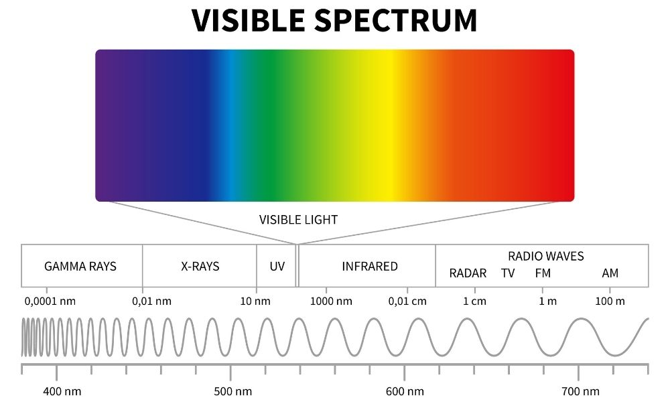
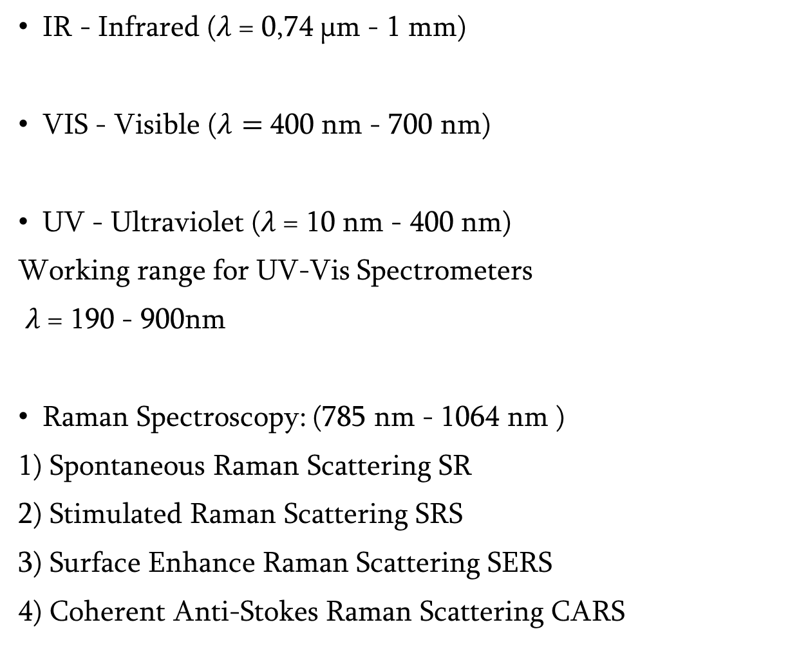
Spectroscopy
IR - Infrared ($λ$= 0,74 μm - 1 mm)
VIS - Visible ($λ=$ 400 nm - 700 nm)
UV - Ultraviolet ($λ$= 10 nm - 400 nm)
Working range for UV-Vis Spectrometers
$λ$= 190 - 900nm
Raman Spectroscopy: (785 nm - 1064 nm )
1) Spontaneous Raman Scattering SR
2) Stimulated Raman Scattering SRS
3) Surface Enhance Raman Scattering SERS
4) Coherent Anti-Stokes Raman Scattering CARS
Fig.5 Electromagnetic speqtrum [5]

Slide 10
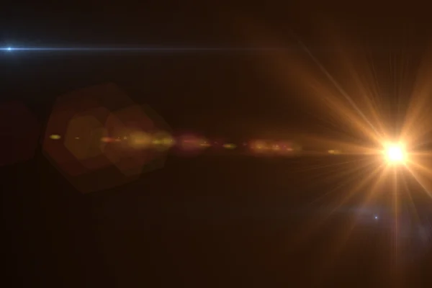

Light interaction with matter
Elastic Scattering
Inelastic Scattering (Raman Effect)
Brillouin scattering
Compton effect
Free electrons
Atoms and molecules
Stokes or Anti-Stokes scattering
Thomson effect
Raileigh scattering
Mie scattering

Slide 11
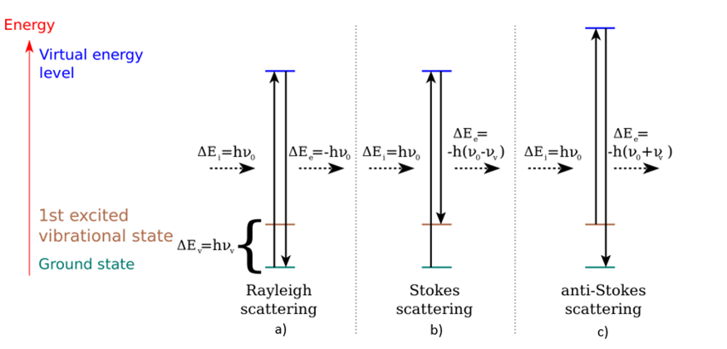
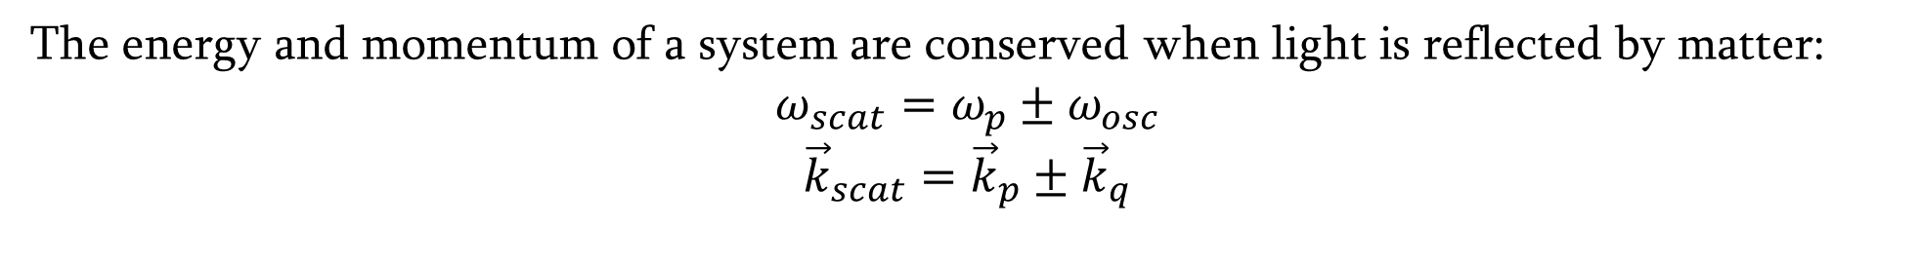
Light interaction with matter
The energy and momentum of a system are conserved when light is reflected by matter:
$$ω_{scat}=ω_{p}±ω_{osc}$$
$${\vec{k}}_{scat}={\vec{k}}_{p}±{\vec{k}}_{q}$$
Elastic scattering
Inelastic scattering
fig.6 Types of light scattering [6]

Slide 12
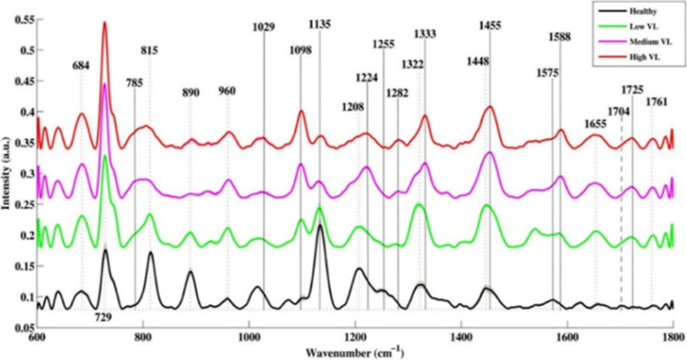
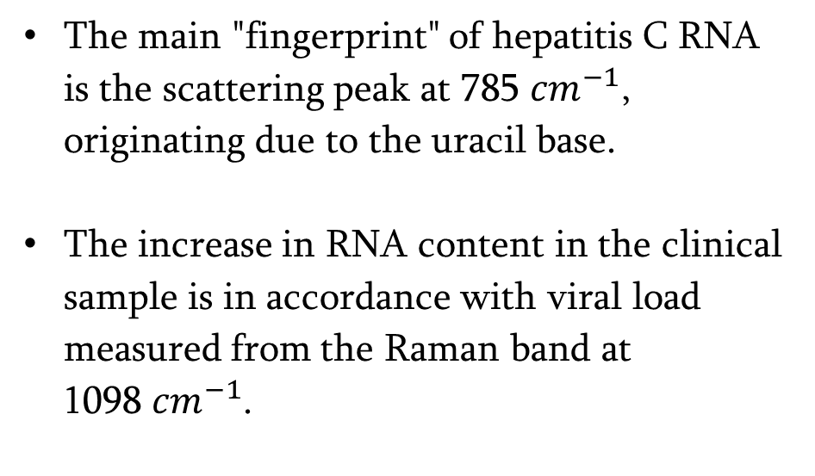
How can we use spectroscopic methods for identification of viral particles?
„Fingerprints“ of viral particles can be considered as absorption/scattering peaks of spectra that appear due to the presence of viral particle components in biomaterials.
The main "fingerprint" of hepatitis C RNA is the scattering peak at 785 ${cm}^{−1}$, originating due to the uracil base.
The increase in RNA content in the clinical sample is in accordance with viral load measured from the Raman band at
1098 ${cm}^{−1}$.
Fig.7 SERS spectra of healthy and hepatitis C infected serum samples with different viral load [7]
Note: Uracil is one of the four nucleobases in the nucleic acid RNA

Slide 13
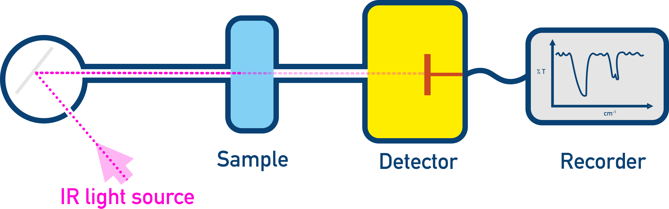
IR spectroscopy
IR spectroscopy - a type of spectroscopy that studies the interaction of infrared radiation with matter.
The infrared portion of the electromagnetic spectrum is usually divided into three regions; the near-, mid- and far- infrared, named for their relation to the visible spectrum.
The higher-energy near-IR, approximately 14,000–4,000 cm⁻¹ (0.7–2.5 μm wavelength) can excite overtone or combination modes of molecular vibrations.
The mid-infrared, approximately 4,000–400 cm⁻¹ (2.5–25 μm) is generally used to study the fundamental vibrations and associated rotational–vibrational structure.
The far-infrared, approximately 400–10 cm⁻¹ (25–1,000 μm) has low energy and may be used for rotational spectroscopy and low frequency vibrations.

Slide 14
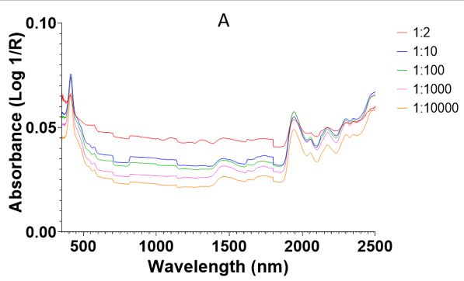
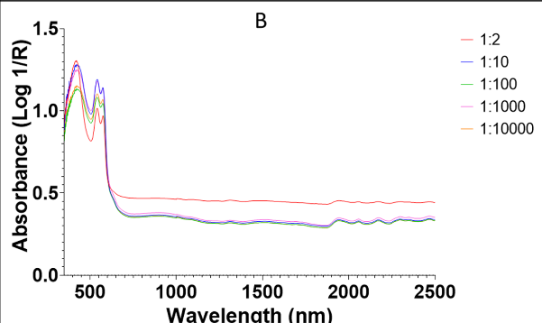
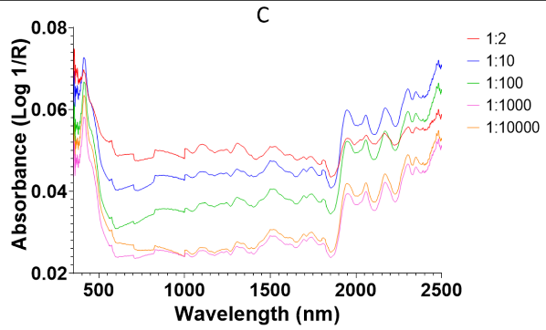
IR spectroscopy for virus identification
Fig.8 NIR spectra of DENV1-infected samples split by concentration for plasma (A), wholeblood (B) and serum (C) [8].

Slide 15
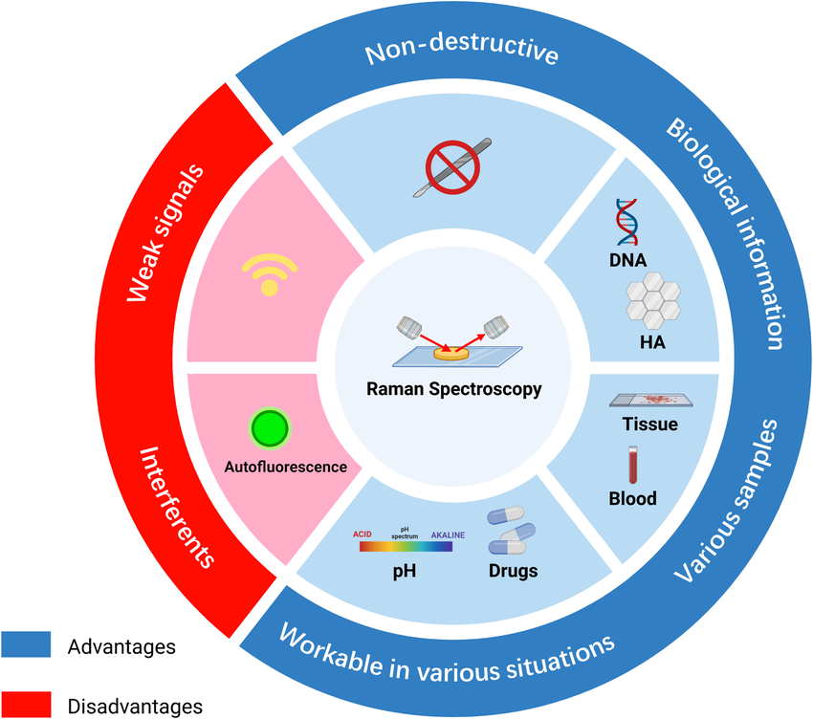
Raman Spectroscopy for virus identification
Raman spectroscopy has many advantages compared to other research methods:
Compared to IR spectroscopy, when the material is studied in water or another polar solvent, the strong absorption of infrared radiation occurs in such environments.
Compared to PSR and "ELISA" - the Raman method is non-destructive and allows working with samples in various forms (solids, solutions, gels, etc.). The majority of research samples do not need special preparation for Raman spectroscopy.
Major disadvantage - The intensity of Raman-scattered light is extremely weak

Slide 16
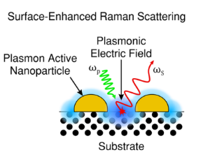
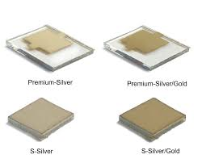
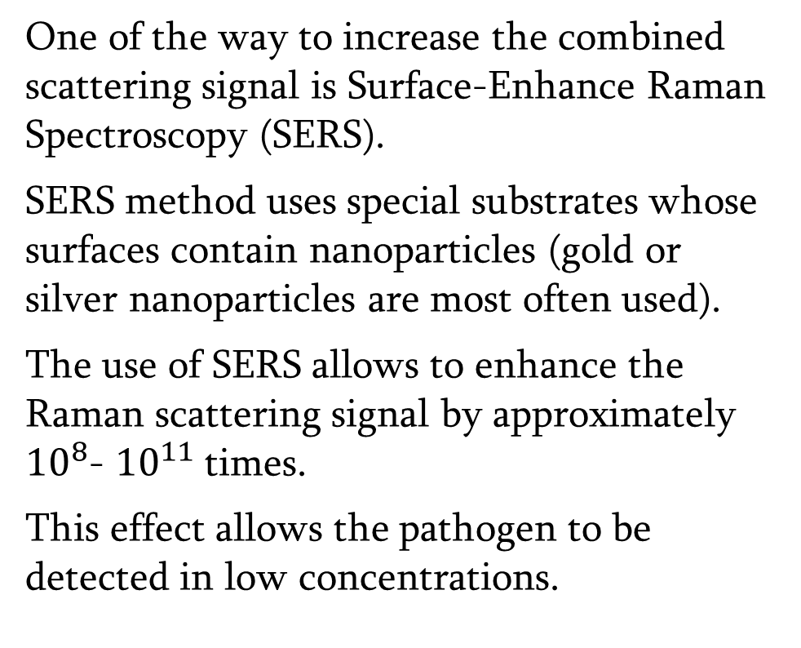
How can we increase the signal?
Surface-Enhance Raman Spectroscopy (SERS)
One of the way to increase the combined scattering signal is Surface-Enhance Raman Spectroscopy (SERS).
SERS method uses special substrates whose surfaces contain nanoparticles (gold or silver nanoparticles are most often used).
The use of SERS allows to enhance the Raman scattering signal by approximately ${10}^{8}$- ${10}^{11}$ times.
This effect allows the pathogen to be detected in low concentrations.

Slide 17
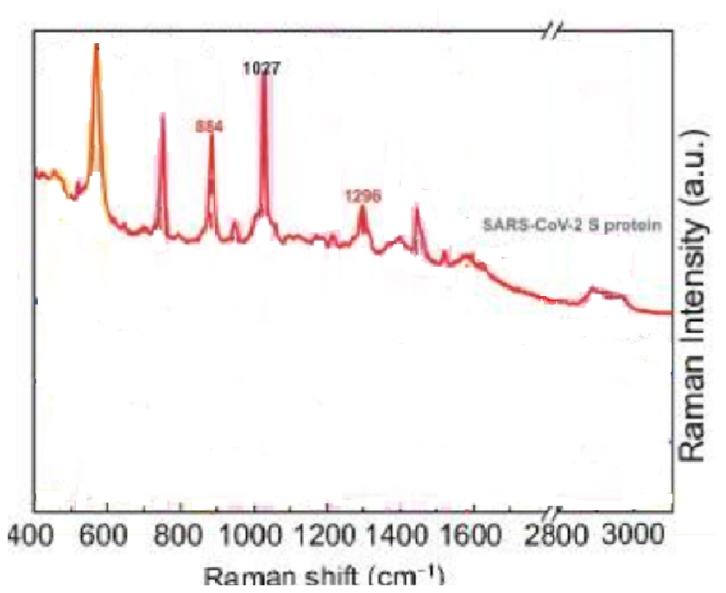
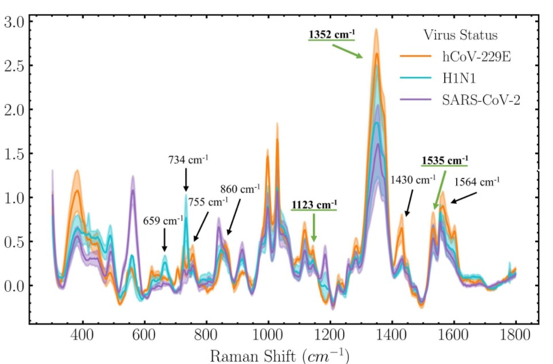
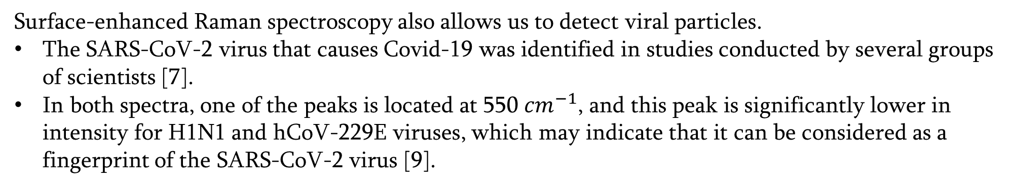


Raman Spectroscopy for virus identificatin
Surface-enhanced Raman spectroscopy also allows us to detect viral particles.
The SARS-CoV-2 virus that causes Covid-19 was identified in studies conducted by several groups of scientists [7].
In both spectra, one of the peaks is located at 550 ${cm}^{−1}$, and this peak is significantly lower in intensity for H1N1 and hCoV-229E viruses, which may indicate that it can be considered as a fingerprint of the SARS-CoV-2 virus [9].
Approximately 550 ${cm}^{−1}$
Approximately 550 ${cm}^{−1}$
Fig.9
Fig.10

Slide 18
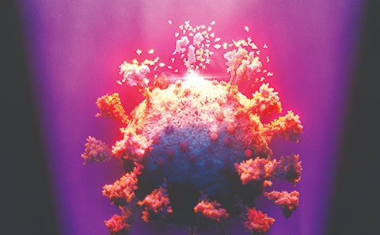
UV Spectroscopy
Ultraviolet (UV) spectroscopy uses the ultraviolet region of electromagnetic radiation, which lies in the wavelength range from 10 to 400 nm.
In ultraviolet spectroscopy, absorption of visible and ultraviolet radiation may occur due to the transition of electrons from low energy levels to high energy levels in molecules and atoms.
UV radiation, depending on its intensity, can have a destructive effect on the virus. For this reason, the ultraviolet spectrum is may be used as a disinfectant.

Slide 19
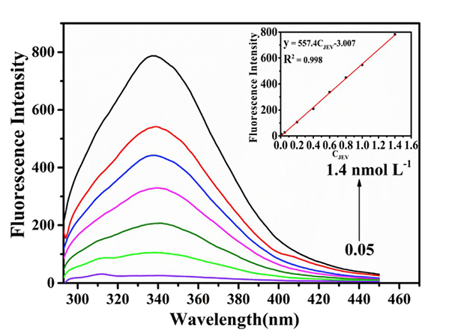
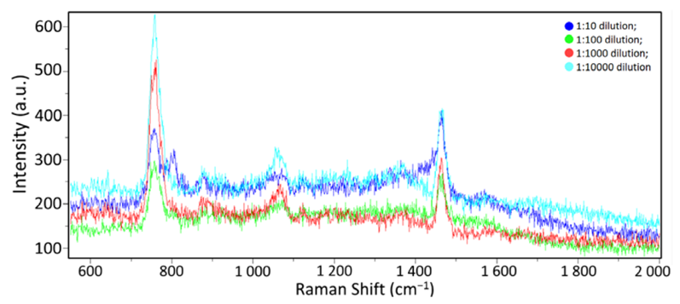
Dependence of the spectral signal on the concentration of microorganisms in the bioenviroment
Analysis of spectra in various studies shows that an increase in the concentration of pathogens in the studied biomaterial is accompanied by an increase in the signal (an increase in the corresponding intensity peaks).
Fig.12 Fluorescence spectra of molecularly imprinted polymers at different concentrations of Japanese encephalitis virus [11]
Fig.11 Raman spectra for different concentrations of influenza A virus in a buffer medium [10]
Note: STE solution - NaCl (100mM), Tris-HCl, pH 8.0 (10mM), EDTA, pH 8.0 (1mM).

Slide 20
Possibility of studying viral particles using computer modeling
An alternative method to the experimental methods of studying the optical (spectroscopic) properties of pathogenic microorganisms is the simulation research method.
Two icosahedral shapeless bacteriophages - MS2 and T7 - ​​were selected for simulation.
Information about the physical and geometrical parameters of given bacteriophages was extracted from various scientific works and databases.
May's theory was used to solve the problem of electromagnetic wave scattering on given particles.
Fig.13 Structural model of the bacteriophage T7 capsid [12]

Slide 21
Scattering spectra of MS2 bacteriophage
Air (𝜀=1)
Water (𝜀=4.5)
Fig.14
Fig.15
Scattering cross sections: Total, Forward, Backward. The inner diameter of the virus capsid 𝑑1=21 nm, the outer diameter 𝑑2=28.8 nm. Dielectric constants of core, shell are $ε_{1}$=10 and $ε_{2}$=2, respectively.

Slide 22
Scattering spectra of T7 bacteriophage
Air (𝜀=1)
Water (𝜀=4.5)
Fig.16
Fig.17
Scattering cross sections: Total, Forward, Backward. The inner diameter of the virus capsid 𝑑1=42.6 nm, the outer diameter 𝑑2=56.6 nm. Dielectric constants of core, shell are $ε_{1}$=8 and $ε_{2}$=3.5, respectively.

Slide 23
Concluisons
An increase in the concentration of pathogens is accompanied by an amplification of the signal.
The uniqueness of the spectral “fingerprint” allows it to be used as an identifier of viral particles.
Electro-geometric parameters of viral particles significantly determine the shape of EM spectra, as well as the number and location of peaks in the resonance range.
The shape of the obtained spectrum is strongly influenced by the biological environment being studied.

Slide 24
References
[1] Model of Adenovirus - https://www.cnb.csic.es/index.php/en/science-society/news/item/1415-hallada-la-fabrica-de-los-adenovirus
[2] Bread mold under the microscope - https://dzen.ru/a/X1sSjztKATv4I1a_
[3] Tuberculosis bacteria - https://www.niaid.nih.gov/diseases-conditions/tuberculosis
[4] Visualizing the History of Pandemics- https://www.visualcapitalist.com/history-of-pandemics-deadliest/
[5] Eleqtromagnetic spectrum - https://byjus.com/jee/electromagnetic-spectrum-and-electromagnetic-waves/
[6] Types of light scattering - https://en.wikipedia.org/wiki/Raman_scattering
[7] jijo Lukose, Ajaya Kumar Barik, Mithun N, Sanoop Pavithran M, Sajan D. George, V. M. Murukeshan, and Santhosh Chidangil. Raman spectroscopy for viral diagnostics. Biophys Rev. 2023 Apr; 15(2): 199–221.
[8] Brendon Goh, Paul Visendi, Anton R. Lord, Silvia Ciocchetta, Wenjun Liu and Maggy T. Sikulu-Lord. First Report of the Detection of DENV1 in Human Blood Plasma with Near-Infrared Spectroscopy, J. Viruses, 2022, 14, 2248, pp. 1-12.
[9] Delfine Garsuault, Sannaa el Messaoudi, Mookkan Prabakaran. Detection of several respiratory viruses with Surface-Enhanced Raman Spectroscopy coupled with Artificial Intelligence, Elsevier, December 2023, 100025

Slide 25
References
[11] Muhammad Izzuddin Rumaling, Fuei Pien Chee, Abdullah Bade, Nur Hasshima Hasbi, Sylvia Daim, Floressy Juhim, Mivolil Duinong, Rosfayanti Rasmidi. Methods of optical spectroscopy in detection of virus in infected samples: A review. Heliyon, August 2022, 8(2):e10472, pp. 3-4
[12] Virus Particle Explorer - https://viperdb.org/Info_Page.php?VDB=3izg
[13] Ana Cuervo, Pablo D. Dans, José L. Carrascosa, Modesto Orozco, Gabriel Gomila, and Laura Fumagalli. Direct measurement of the dielectric polarization properties of DNA, Aplied Physical Sciences, 2014, 111 (35) E3624-E3630, pp 1-6.
[14] Robin R. Jones, David C. Hooper, Liwu Zhang, Daniel Wolverson, and Ventsislav K. Valev. Raman Techniques: Fundamentals and Frontiers. Jones et al. Nanoscale Research Letters (2019) 14:231
[15] Raman scattering - http://hyperphysics.phy-astr.gsu.edu/hbase/atmos/raman.html#c1
[16] Tianyi Dou, Zhandong Li, Junjie Zhang, Alex Evilevitch and Dmitry Kurouski. Nanoscale Structural Characterization of Individual Viral Particles Using Atomic Force Microscope Infrared (AFM-IR) and Tip-Enhanced Raman Spectroscopy (TERS)
[10] Artem Tabarov, Vladimir Vitkin, Olga Andreeva, Arina Shemanaeva, Evgeniy Popov, Alexander Dobroslavin, Valeria Kurikova, Olga Kuznetsova, Konstantin Grigorenko, Ivan Tzibizov,Anton Kovalev, Vitaliy Savchenko, Alyona Zheltuhina, Andrey Gorshkov and Daria Danilenko. Detection of A and B Influenza Viruses by Surface-Enhanced Raman Scattering Spectroscopy and Machine Learning, Biosensors 2022 November, 12: 1065, pp. 1-7.

