Slide 1

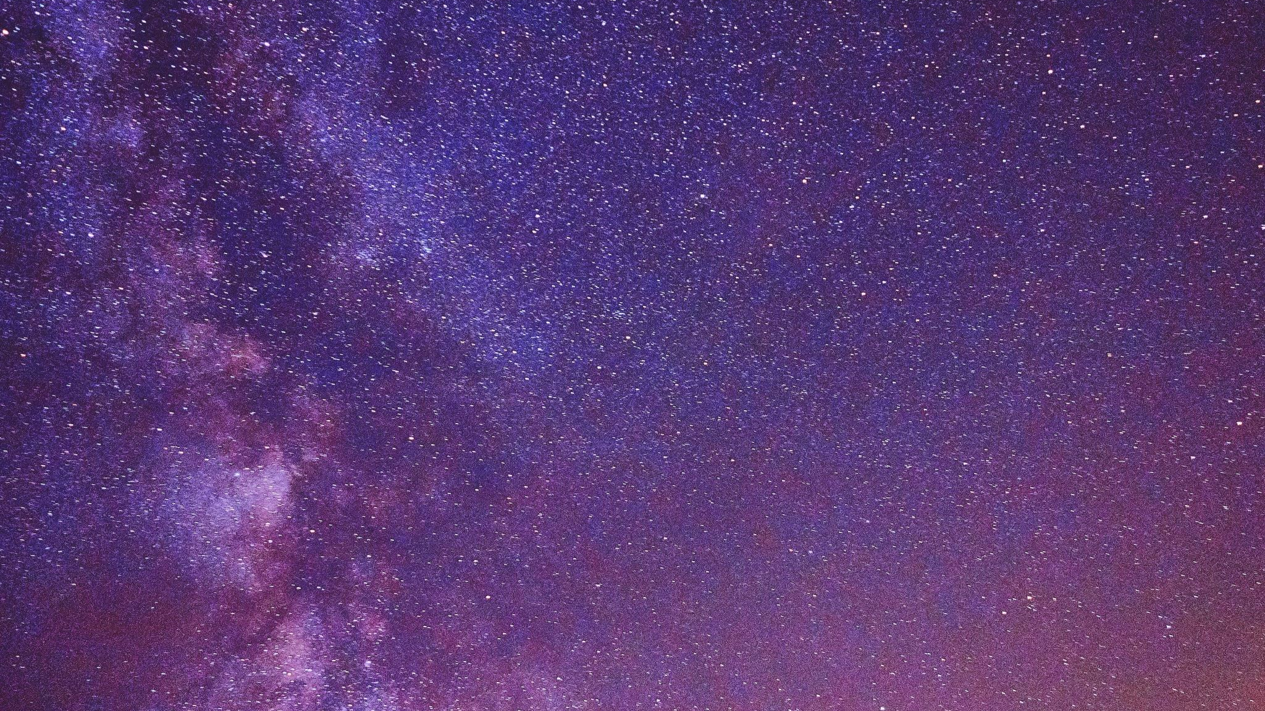


Photocenter shifts caused by magnetic activity
Presenter: Petra Sági
Supervisor: Kriskovics Levente
Co-authors: Anna Görgei, Zsolt Kővári
2024.08.05. ICPS 2024
Funded by: ELTE Eötvös Loránd University, Budapest, Hungary;
HUN-REN CSFK Konkoly Observatory

Slide 2
Introduction

Slide 3
Stellar activity
Sunspot study since the ancient times, first observation with telescope: Galilei
α-Ω dinamo ⇨ magnetic field in the Sun
Flux tubes break trough the surface ⇨ sunspots
The ratio of convection decreases due to the magnetic freezing, that’s why they are darker
The spots cause decreament in the flux
Not only on the Sun, on other variable stars as well: BY Draconis, FK Comae, RS CVn, W UMa

Slide 4
Doppler imaging
With our current technology we cannot really observe starspots dricetly
Indirect spectroscopic method: Doppler imaging
Gives back the spot’s location and width from their „wandering trough the phases”
Gives back surface temperature distribution more precisely
Cutting up the disk of the target into equal parallel bands
The doppler-shift is different in each band’s line-profile ⇨ the superposition gives back the rotationally broadened line
The spot causes flux decreament in the continuum ⇨ a bump „moves during rotation” on the line-profile
Notes:
1-2 csillag interferometriás leképezését már megcsinálták (zeta And, sigma Gem, Roettenbacher et al), de kevés ilyen célpont van, amire ezt meg lehet csinálni jelenleg

Slide 5
Source: Rice, 1996

Slide 6
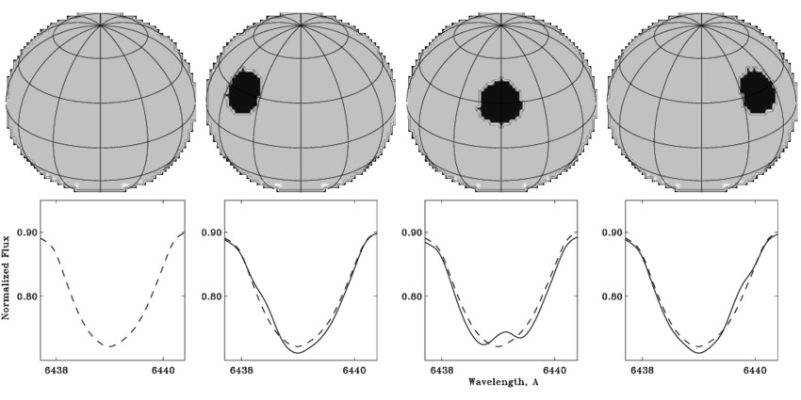
Source: Svetlana V. Berdyugina, 2005

Slide 7
Data processing and temperature maps

Slide 8
Data and analysis
Utilization of previous data from the spectrograph of Piszkéstető Observatory’s 102 cm RCC telescope
Reduction: according to CCD reduction
Spectral sythesis with Spectroscopy Made Easy (SME) software
Creation of surface temperature maps with iMap Doppler Imaging program

Slide 9
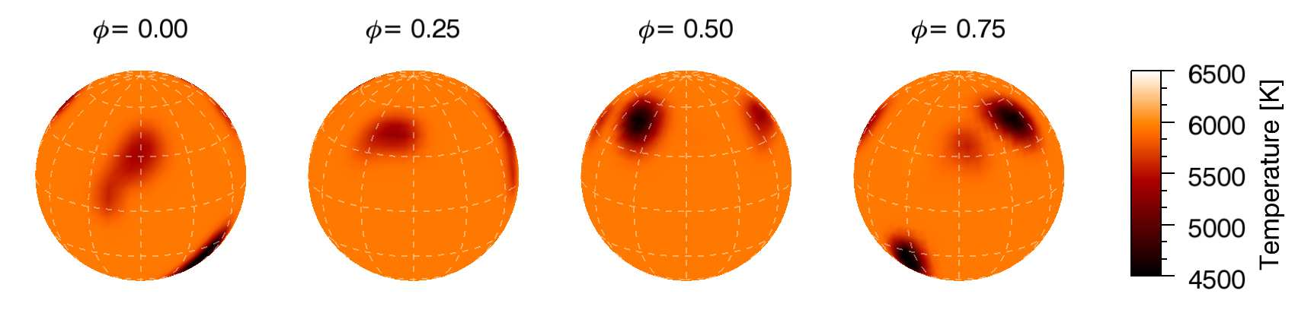
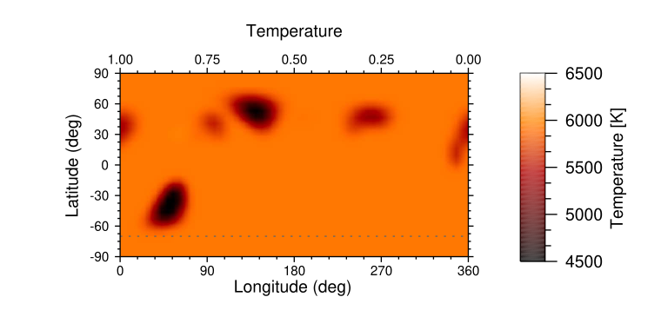
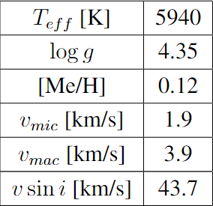
V889 Her

Slide 10
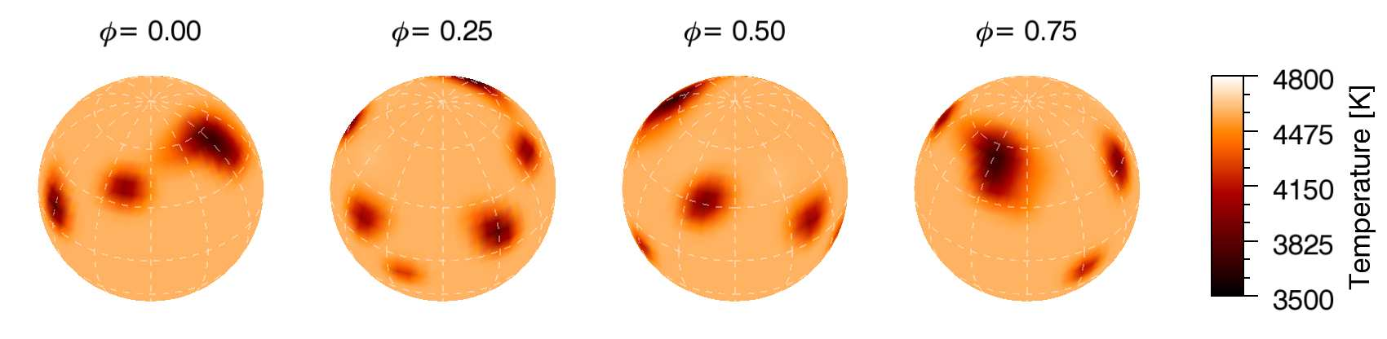
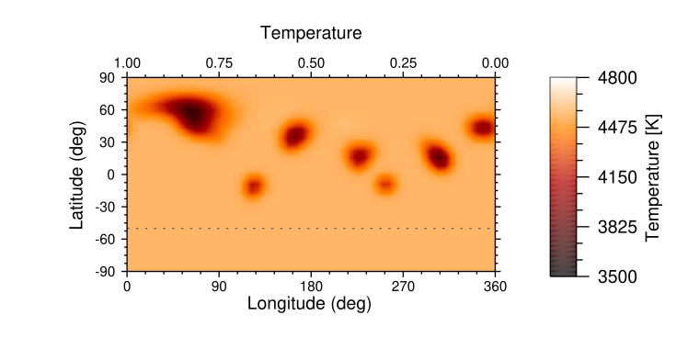
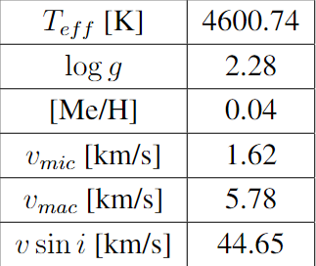
DI Psc
Notes:
DI Psc-n meg elég sok ilyen apróbb fícsört láttunk korábban szintén (Isik et al 2018)

Slide 11
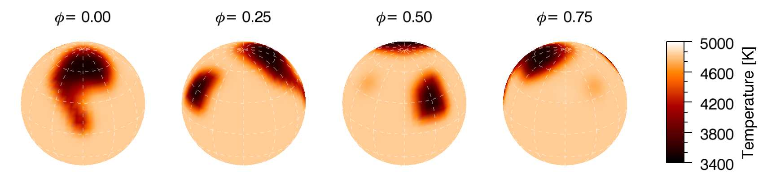
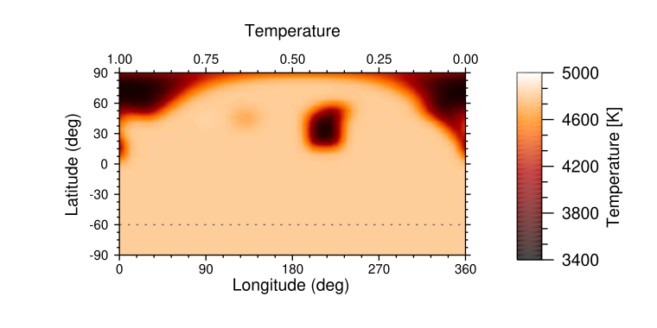
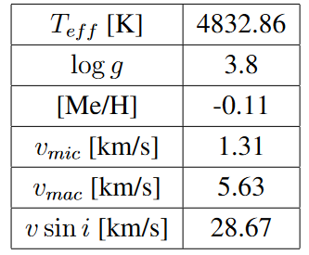
II Peg
Notes:
DI Psc-n meg elég sok ilyen apróbb fícsört láttunk korábban szintén (Isik et al 2018)

Slide 12
Photocenter

Slide 13
Calculating the shifts
Python code to calculate the coordinates of the photocenter for each star in at least 180 different rotational phases
Calculates the angular diameter of the distance between the two farthest point of the curve
With this the maximum angular variation of the photocenter can be determined

Slide 14
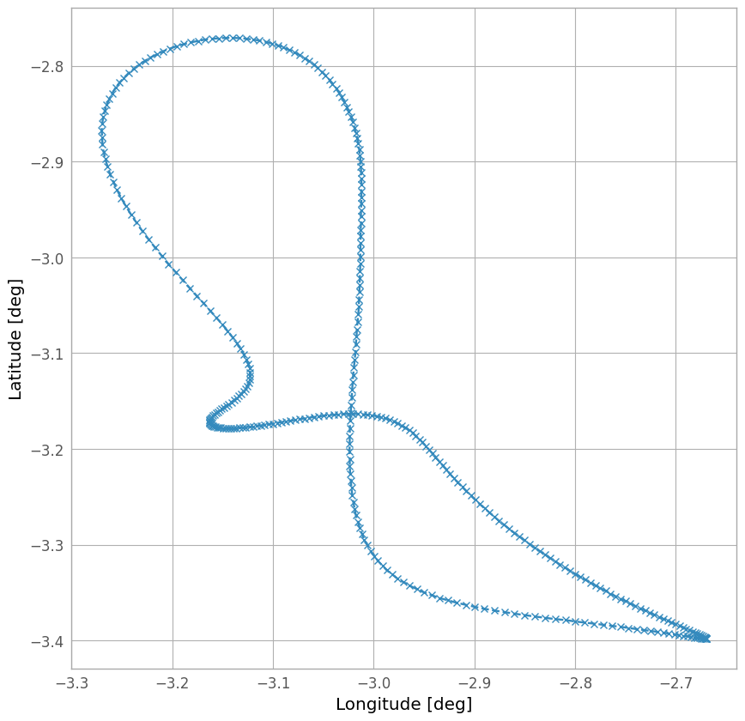
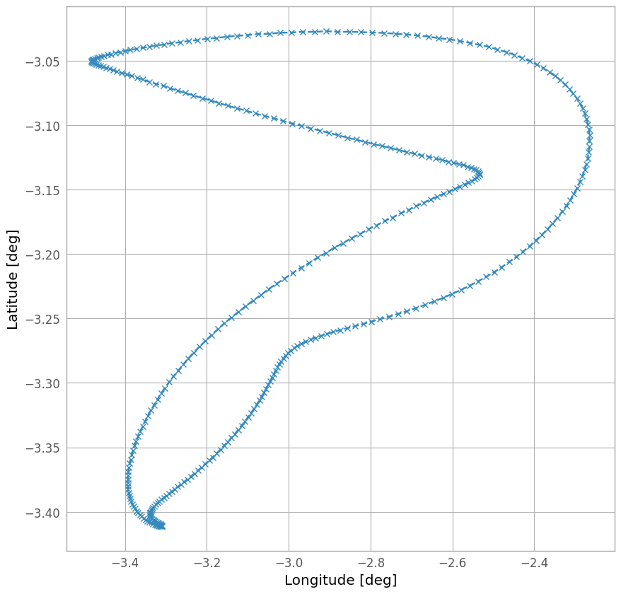
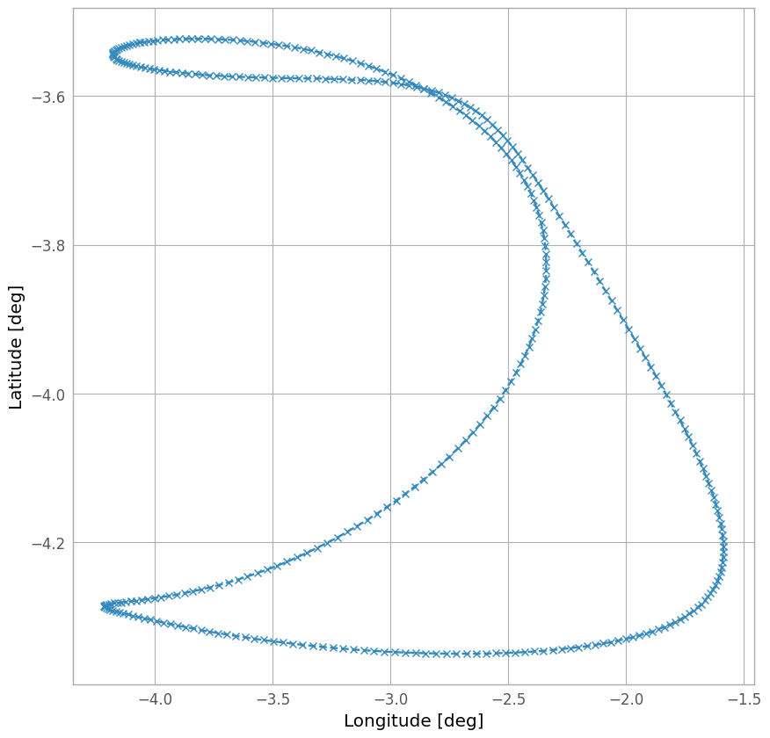
V889 Herculis
DI Piscium
II Pegasi

Slide 15
Results

Slide 16
Star | Gaia DR3 error [mas] | Angular size of the shift [mas]
V889 Herculis | 0.0188 | 0.0012
DI Piscium | 0.0261 | 0.0065
II Pegasi | 0.0504 | 0.0118
A factor of 4 and 2-2.5 difference!

Slide 17
Conclusion
Photocenter shifts caused by starspots and stellar rotation can theoretically affect the precision of parallax measurements
We showed that this indeed can be the case with certain spot configurations
We conclude that certain asymmetrical spot configurations which not uncommon could be in the order of the Gaia parallax measurement errors
In the case of the expected higher precision of DR4 in the future the shifts might exceed the errors

Slide 18

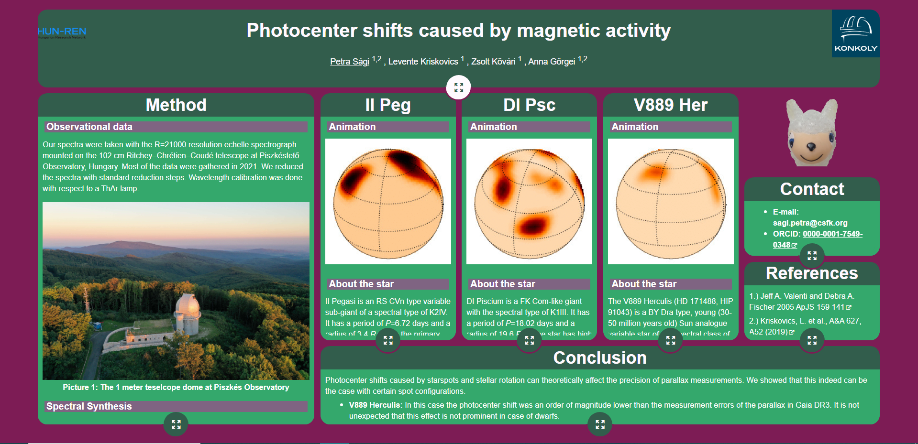

Slide 19
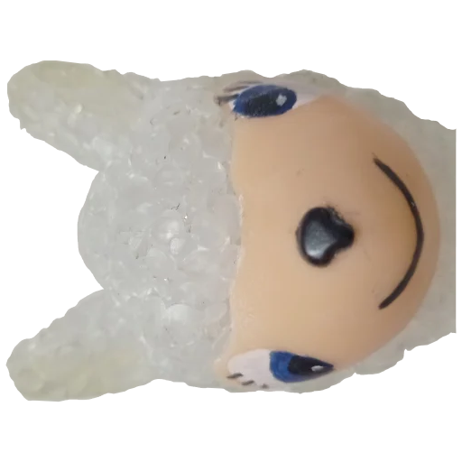
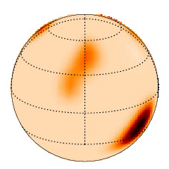
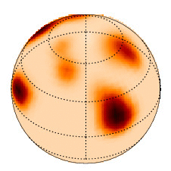
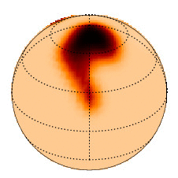

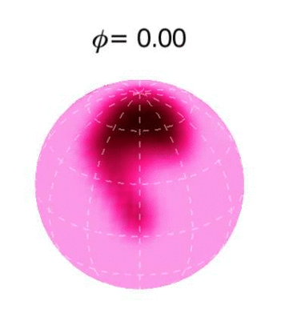
Take home message
With Doppler Imaging we can recreate the surface of distant stars
We can „see” the spots which is cool!
Maybe they are causing error in parallax data ⇨ we will find out!

