Slide 1
Non-equilibrium Dynamics of Lennard-Jones Liquids
Giorgi Tsereteli
Washington University in Saint Louis
07/08/2024

Slide 2
Supercooling and Crystallization
Systems typically exhibit phase transitions at certain temperatures
The character of conventional transitions usually depends on universal quantities such as the symmetries of the Hamiltonian and the number of dimensions.
In supercooled or superheated systems, the behavior of the systems may depend on the rate of cooling or heating.
In systems that are rapidly cooled or heated, kinetics may play dominant roles. For instance, even if the usual conditions are met, solidification need not occur.

Slide 3
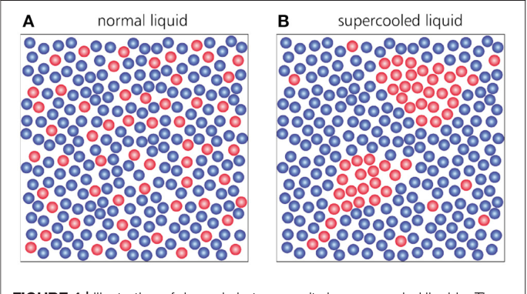
Dynamical Heterogeneity

Slide 4
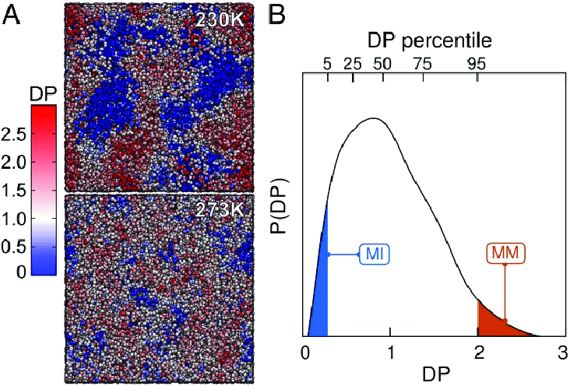
Dynamical Heterogeneity
Dynamical Propensity – Mean square displacement in a sample time segment

Slide 5
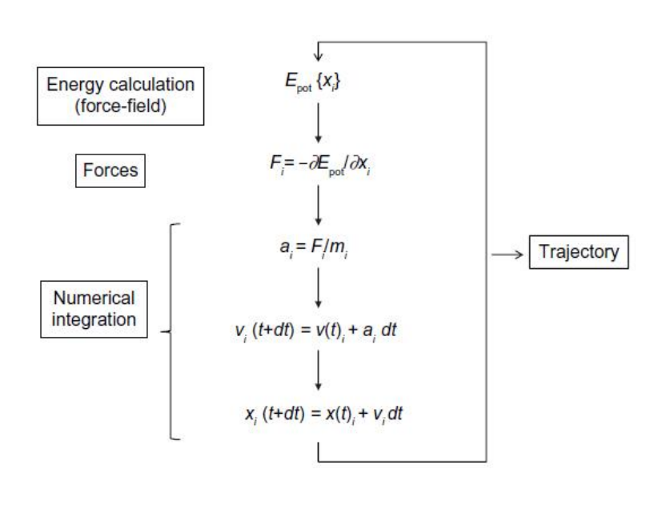
Molecular Dynamics

Slide 6
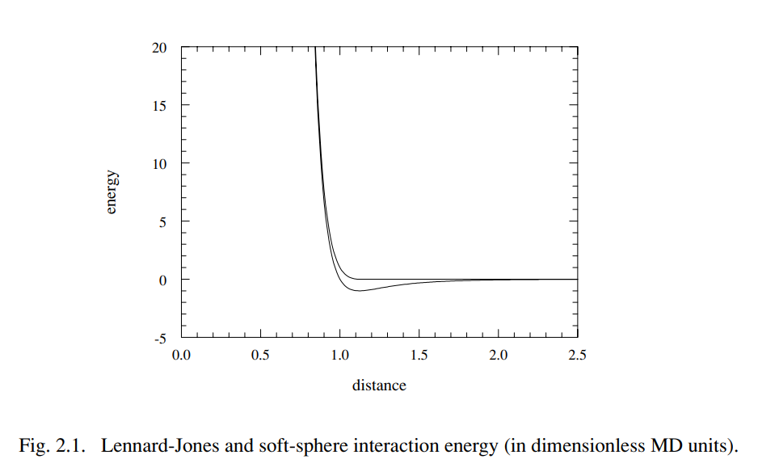
Lennard-Jones Potential
r is the distance between two interacting particles.
σ is the the equilibrium distance between two particles.
ε is the strength of the bond. (depth of potential)
Notes:
How realistic is LJ potential?

Slide 7
Thermostats
Important part of MD simulations are defining the statistical ensemble and Temperature of the system.
This is usually done through employment of numerical thermostats which scale all velocities to align them with expected distributions.
Nose-Hoover, Berendsen etc.

Slide 8
2D Lennard-Jones Molecular Dynamics

Slide 9
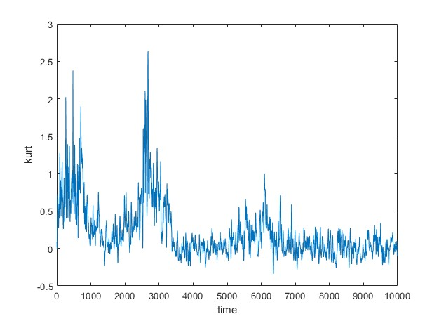
Kurtosis of Velocity of the 2d MD model
The volatility of Kurtosis prompts us to used a relaxed temporal mean as a relevant Parameter.

Slide 10
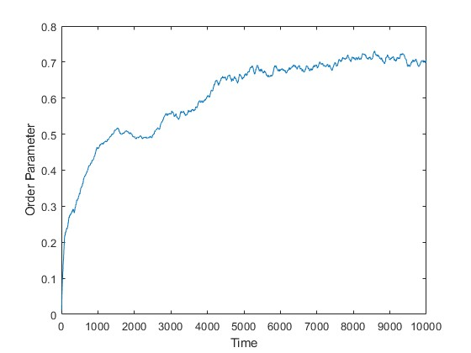
Order Parameter
ϴ - The Bond Angle
N - number of the particles

Slide 11
Thermostat
The thermostat employed here has the MD particles stochastically collide with imaginary particles with a lower Temperature canonical ensemble.

Slide 12
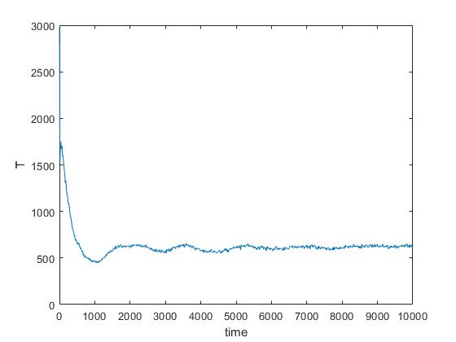
Thermostat Off
The oscillation seen in the temperature before relaxation is due to natural vibrations in the liquid while the thermostat is off.

Slide 13
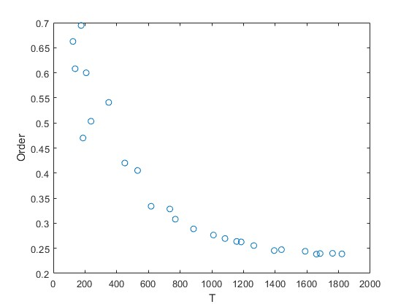
Order Vs Temp
“Melting”

Slide 14
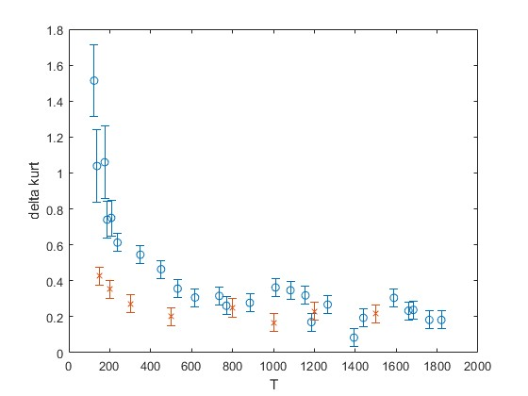
Mean Kurtosis with and without the thermostat

Slide 15
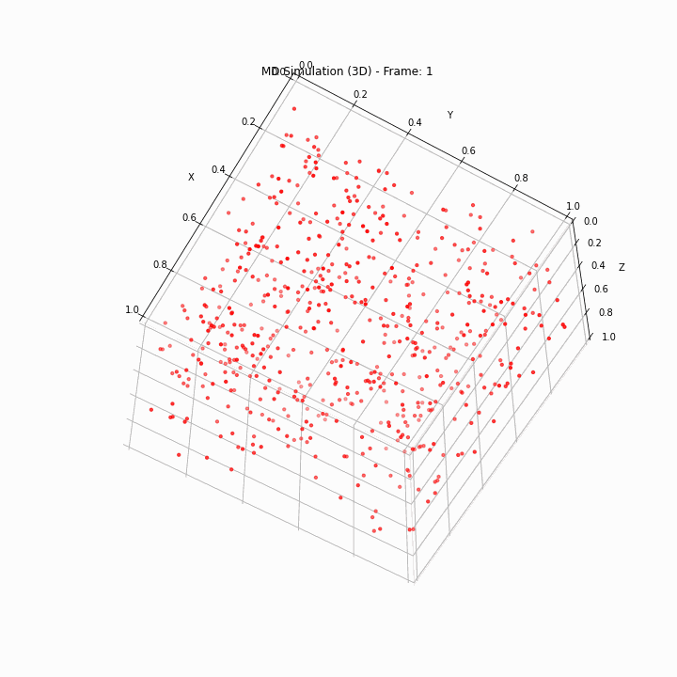
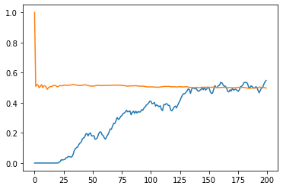
3D model
Orange – Self Correlation, Memory parameter
Blue – Bond Orientational Order

Slide 16
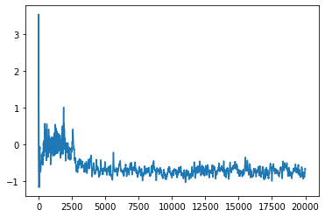
Results for 3D Crystals
K
Time Parameter
Orange – Self Correlation, Memory parameter
Blue – Bond Orientational Order

Slide 17
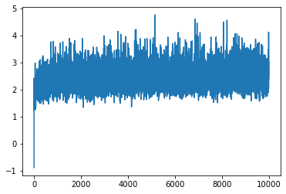
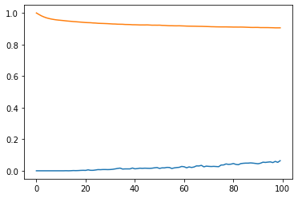
Supercooling in 3D
K
Time Parameter
Orange – Self Correlation, Memory parameter
Blue – Bond Orientational Order

Slide 18
Conclusions
Our Results show a trend of non-equilibrium dynamics resulting in the system having distributions wider than the conventional Maxwell-Boltzmann distributions.
The most wide-spread Thermostats in the MD community enforce a said Gaussian distribution which results in these simulations failing to accurately recreate non-equilibrium phenomena such as Supercooling and glass-transitions.

Slide 19
3D lammps model
25000 MD particles of Al, Ni, Zr
Melting Temperature ~ 1550K
Particle Number
Epot

Slide 20
Distance between humps

Slide 21
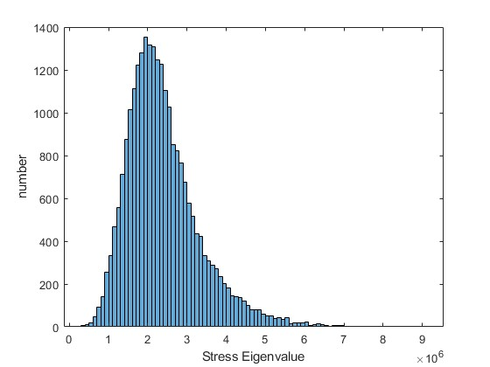
Distribution for per atom Stress
B
A
C

Slide 22
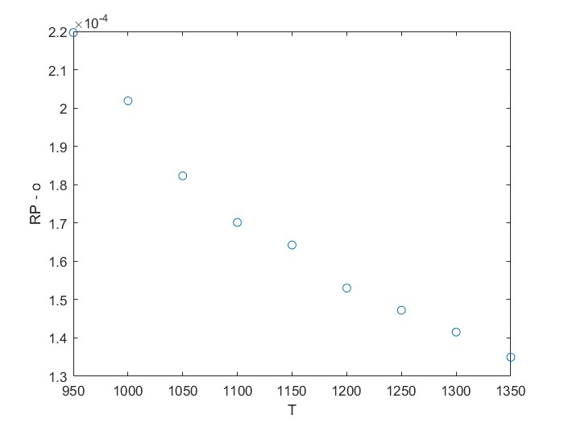
Results for stress distributions versus viscosity

Slide 23
Different Cutoffs
RP

Slide 24
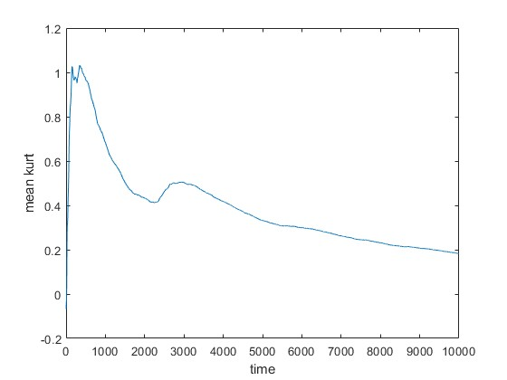
Mean Kurt V Time

Slide 25
Future Plans.
2D paper kurtosis and order parameter, energy densities, structure, dynamical measures (submit Jan-Feb 2024)
Rework of my previous thermostat project (March -April 2024)
3D paper (same measures as in 2D as well as stresses, ....)- a system that crystallizes with a thermostat at long times in comparison to the lammps model. (~ June-August 2024)

