Slide 1
Exploring biological tissue through optical spectroscopy: Modelling and Experiment
38th International Conference of Physics Students
$$Luka Tsulukidze^{1},Mariam Tsindeliani^{1}$$
Supervisors:$Prof. Oleg Kharshiladze^{1}, Zaza Melikishvili^{2}$
$$Ivane Javakhishvili Tbilisi state university^{1}$$
$$Vladimer Chavchanidze institute of cybernetics^{2}$$
Modelling Laboratory for Students
Tbilisi, 2024

Slide 2
Outline
01
02
03
Random Walk of photons
Photon Diffusion
Simulation Results
04
05
PPG
Signals
Heart rate variability

Slide 3
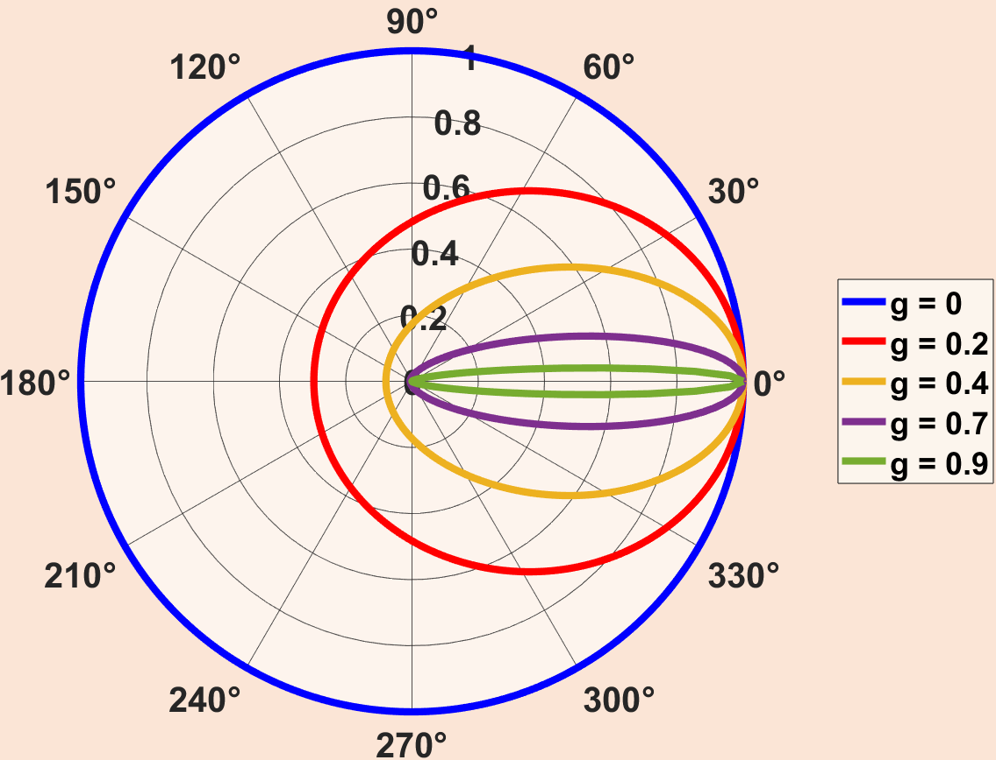
Photon Random Walk Anisotropy factor and light scattering
$$ξ −random number from 0 to 1$$
The scattering angle distribution depends on the anisotropy factor, as modeled by the Henyey-Greenstein phase function:
$$r=−\frac{lnξ}{μ_{s}}$$
$$≺r≻ =λ=μ_{s}^{−1}$$
$$p\left(\cos{θ}\right)=\frac{1}{2}\frac{1−g^{2}}{{\left(1+g^{2}−2gcosθ\right)}^{\frac{3}{2}}}$$
𝑔 - the anisotropy factor is the average cosine value of the scattering angle, in the case of 𝑔 = 0 we have an isotropic environment, and 𝑔 different from 0 indicates anisotropy

Slide 4
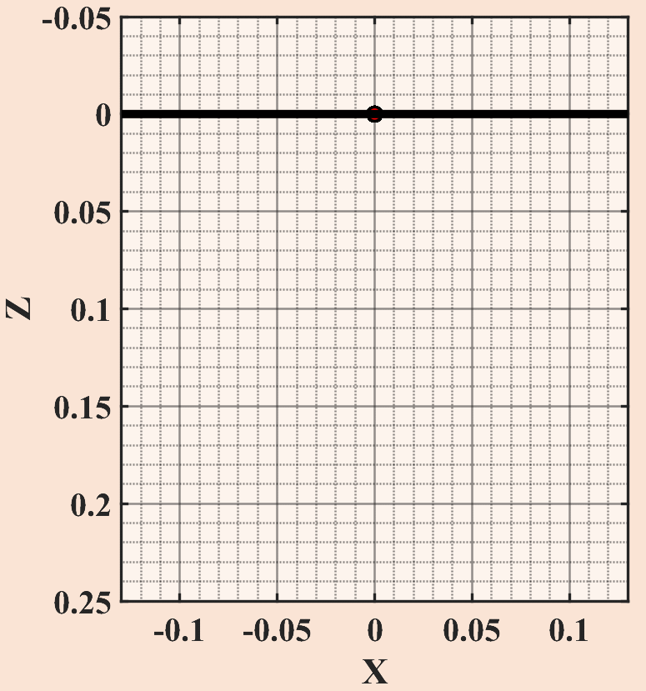
Visualization of Simulation For isotropic and anisotropic mediums
$$g≅0$$
$$g=0.95$$
In the case of $g=0.95$, the transition from ballistic to diffuse mode will be observed. Packets of reflected photons are marked with a green marker.

Slide 5
Photon Diffusion Anomalous and normal diffusion
$$Isotropic −g=0$$
$$Anisotropic −g=0.9$$
For $g=0$ we have normal diffusion
For $g≫0$ we have anomalous diffusion that becomes normal over time

Slide 6
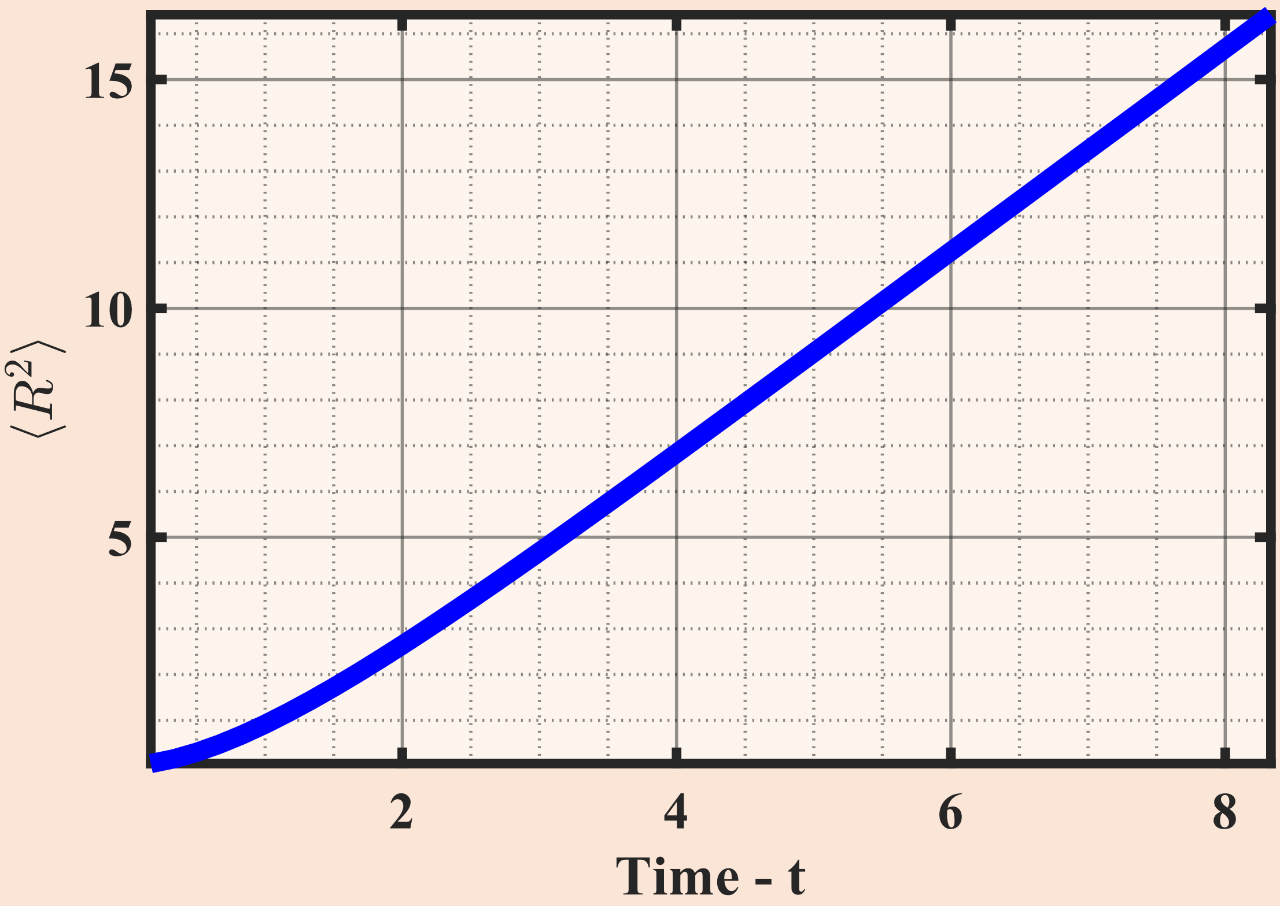
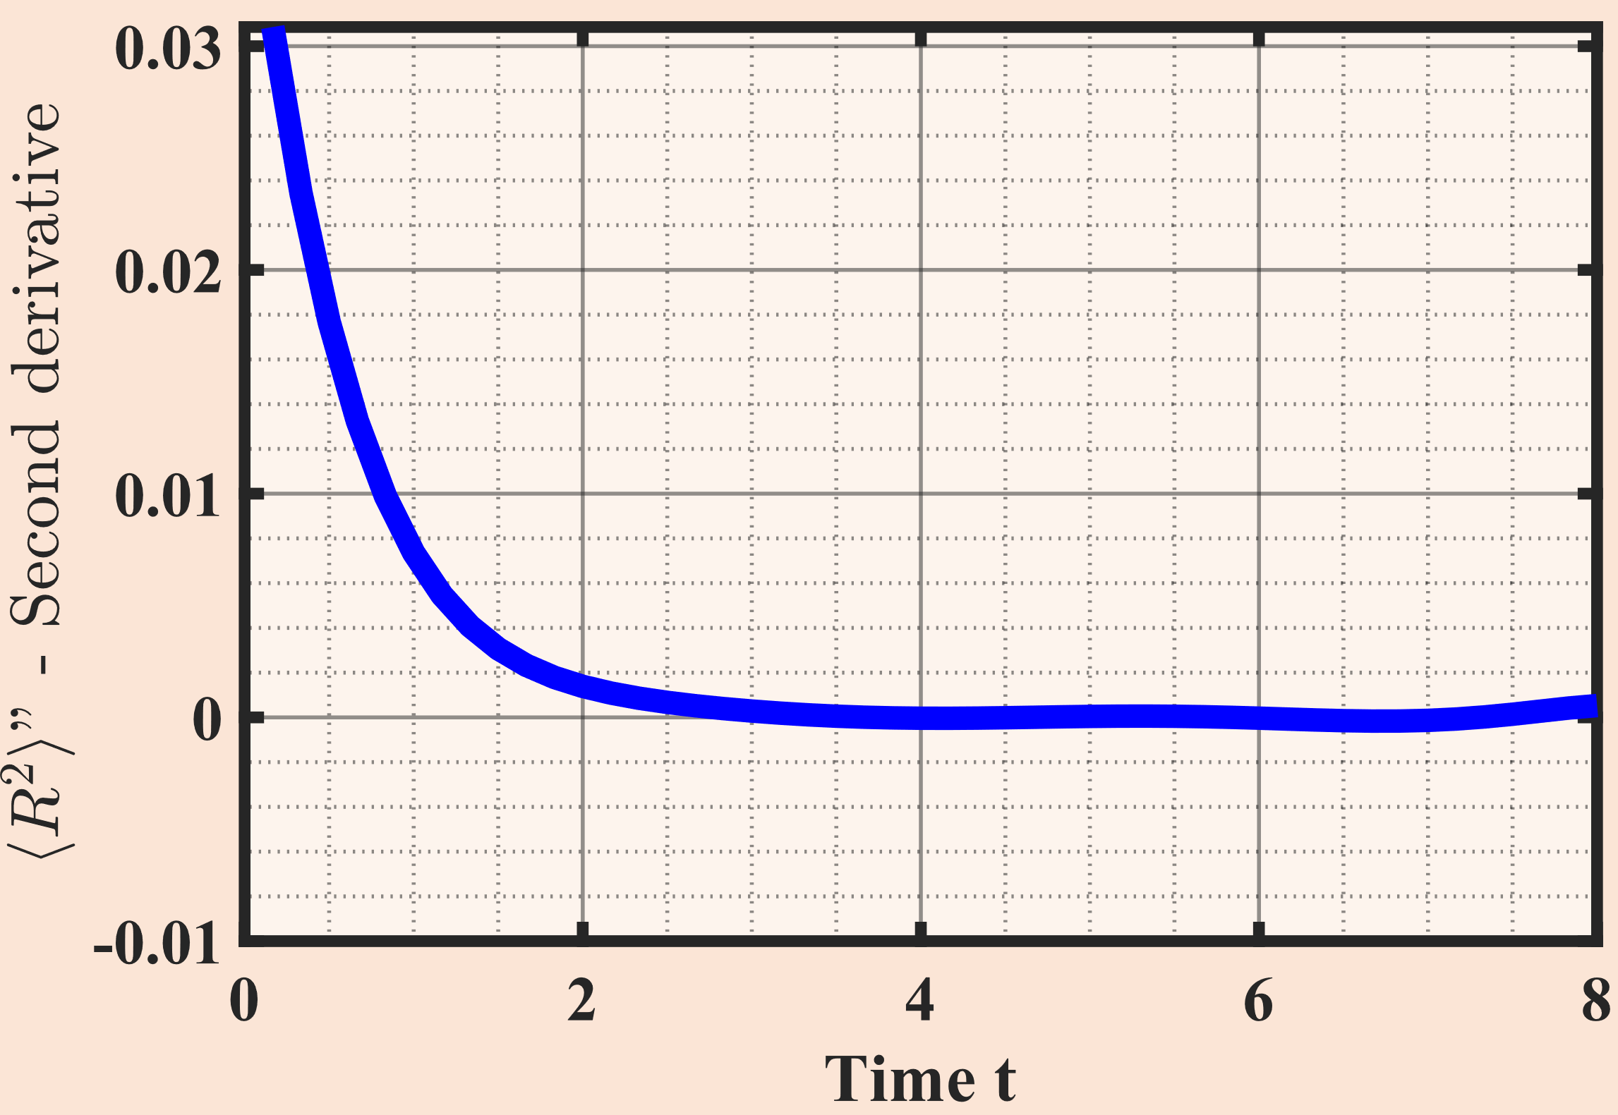
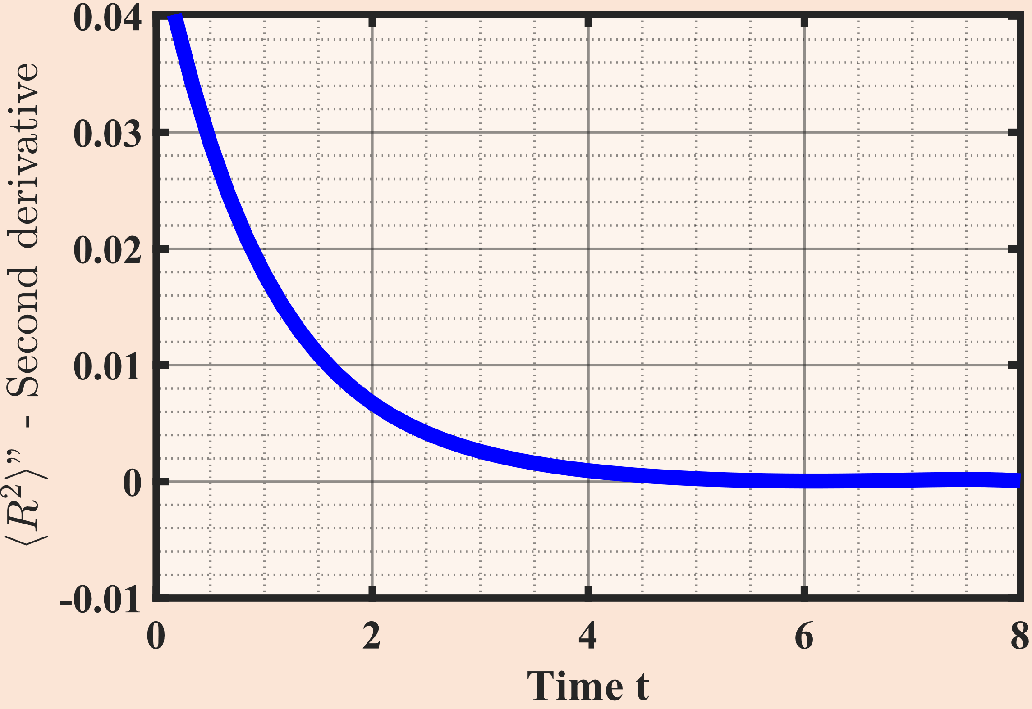
Observing the regime change
By observing the second de-rivative of the mean square dis-placement, we can identify the point at which the regime cha-nges. This is the moment when the second derivative becomes zero, therefore the time de-pendence of ⟨𝑅²⟩ becomes linear
$$g=0.75$$
$$g=0.85$$
We observe that a change in the isotropy factor $g$results in a change in the transition time from the ballistic mode to the diffuse mode.

Slide 7
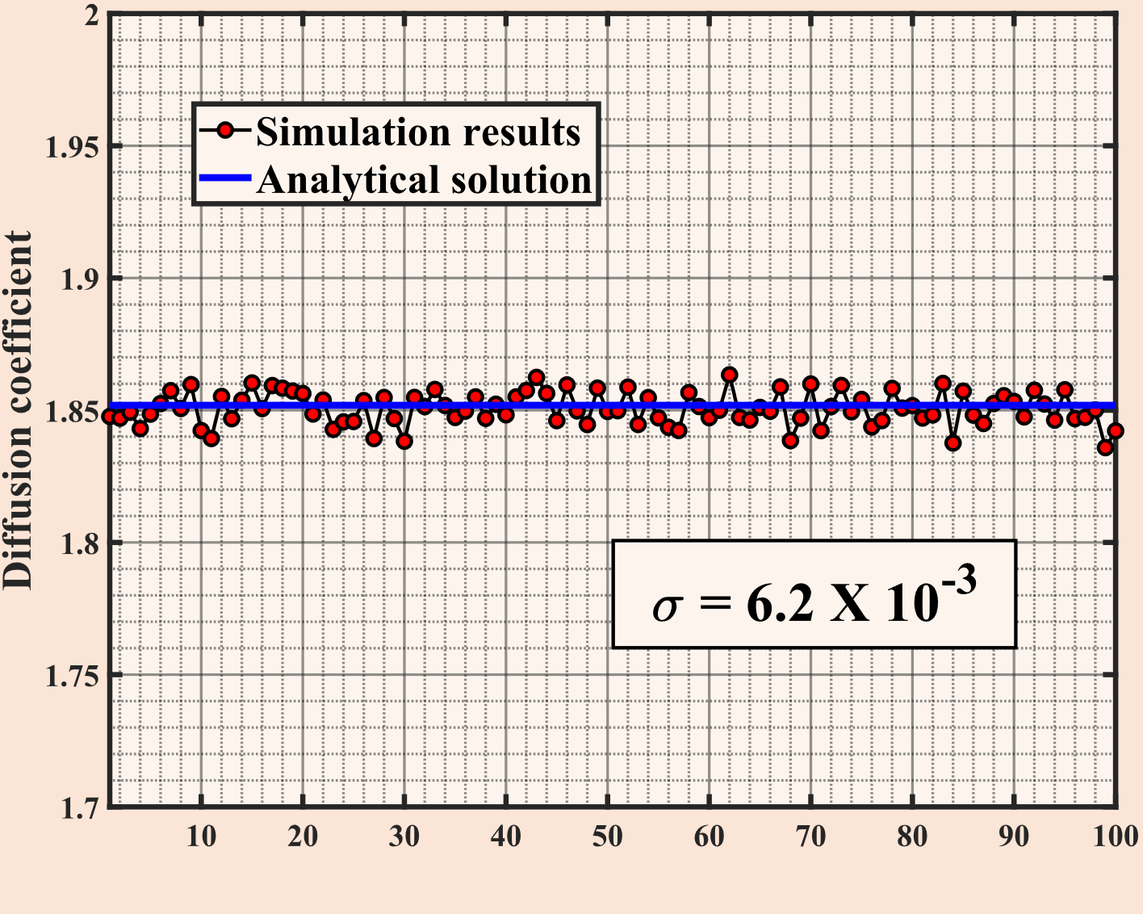
Calculating diffusion coefficient Analytical and Numerical solutions
$$σ=5.6×10^{−3}$$
$$N$$
In the case of normal diffusion, the diffusion coefficient calculated numerically by us coincided with the theoretically determined diffusion coefficient for the scattering medium: $D=\frac{1}{3μ_{s}\left(1−g\right)}$
We calculated the diffusion coefficient using a Monte Carlo simulation based on the formula describing the dependence of mean square displacement on time:
$$≺ R^{2}≻ =2dDt$$
Photon diffusion coefficient in scattering and absorbing media. Romain Pierrat

Slide 8
Skin model And it’s optical characteristics
Each layer has assigned optical characteristics, including the scattering coefficient$− μ_{s}$, absorption coefficient $− μ_{a}$ , and anisotropy factor $− g$.
The absorption coefficient is determined by the following equation:
$$μ_{a}\left(λ\right)=BS{μ_{a}}_{oxy}\left(λ\right)+B\left(1−S\right){μ_{a}}_{deoxy}\left(λ\right)…$$
$$+ M{μ_{a}}_{mel}\left(λ\right)+W{μ_{a}}_{water}(λ)+F{μ_{a}}_{fat}(λ)$$
Each photon bundle starts with a normalized intensity of $w=1$, which decreases as light is absorbed by tissue chromophores according to the Lambert-Beer law. When a bundle is fully absorbed, it is terminated. We have tracked the distribution of absorbed energy in each voxel, enabling us to calculate both absorption and reflectance
Four layer model of the human skin

Slide 9
Skin Reflectance spectrum Experiment and Monte-Carlo simulation
 | Stratum Corneum | Epidermis | Dermis | Dermis II
Thickness (cm) | 0.003 | 0.009 | 0.03 | 0.058
$$f_{ray}$$ | 0.8 | 0.328 | 0.368 | 0.43
$$b_{mie}$$ | 0.83 | 0.541 | 0.93 | 0.8053
$μ_{s}^{′}$ | 46.5 | 45.8 | 84.5 | 81.64
B | 0 | 0 | 0.086 | 0.01
S | 0 | 0 | 0.88 | 0.99
W | 0.1 | 0.5 | 0.9 | 0.7
M | 0 | 0.01578 | 0 | 0
F | 0 | 0 | 0 | 0.01
n | 1.48 | 1.38 | 1.4 | 1.43
$$σ_{MC}=1.1×{10}^{−2}$$
$$σ_{exp}=4.6×{10}^{−3}$$
Comparison of averaged skin reflectance spectra from healthy subjects to the simulated reflectance spectrum. With this result we were able to extract optical parameters of the skin

Slide 10
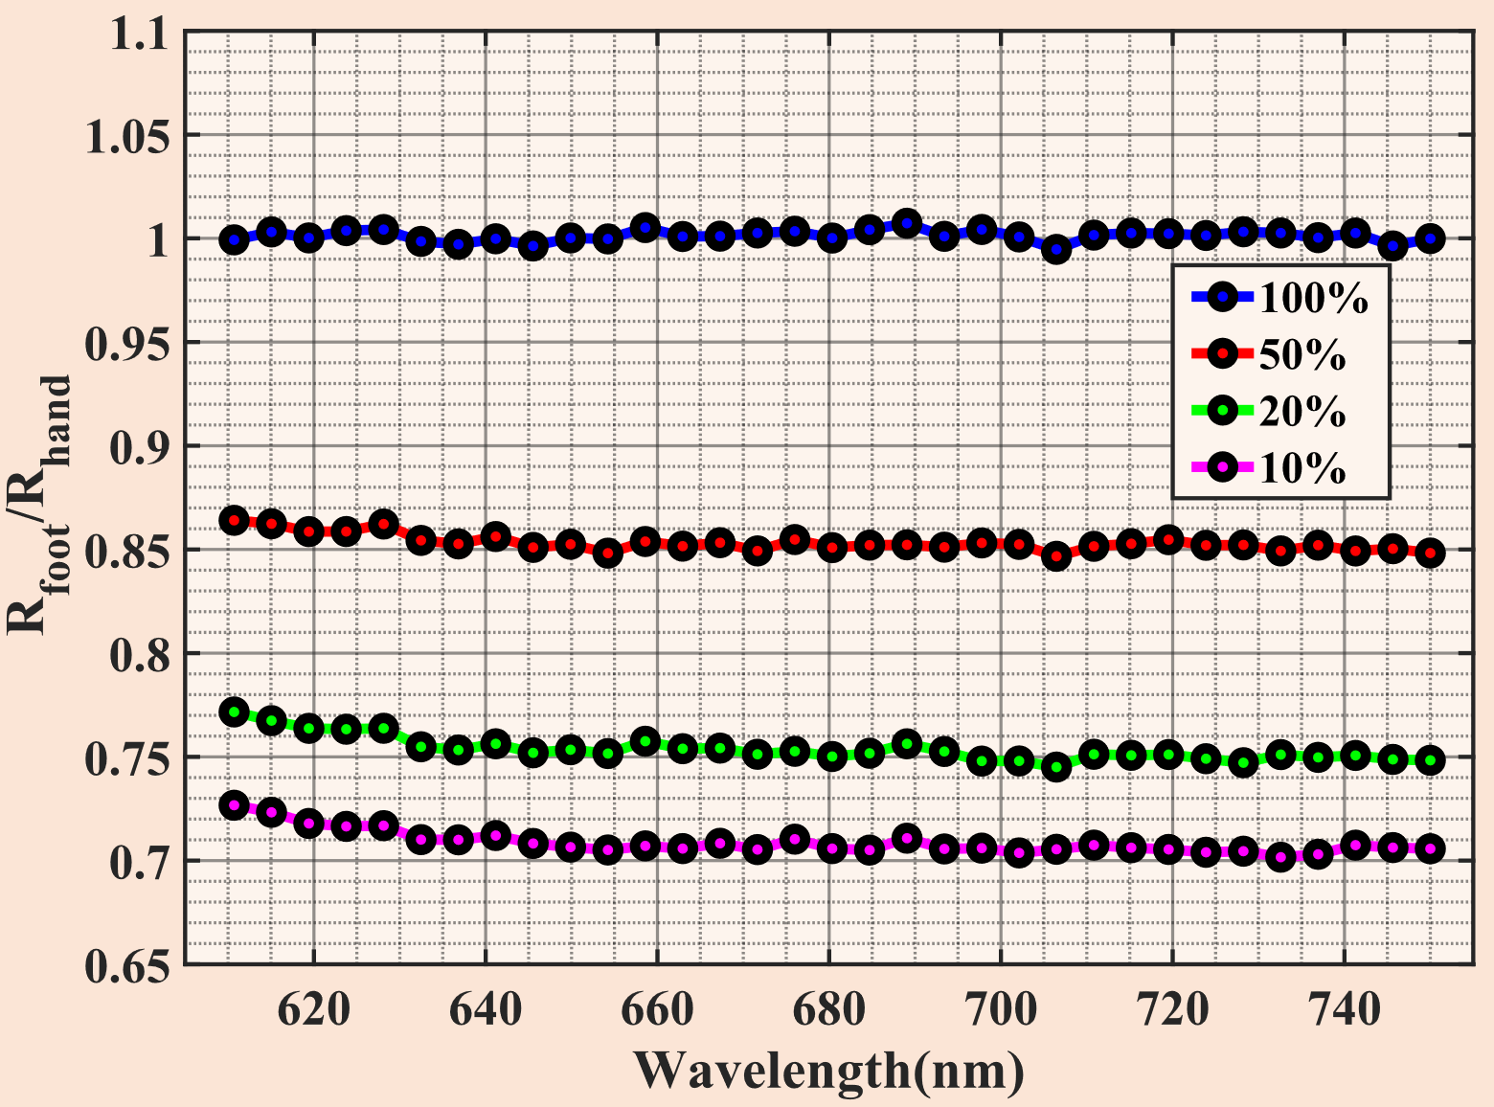
Simulation results Optical arm - brachial index
R - Rreflectance
Simulated optical arm - brachial index (spectrum of the foot compared to the spectrum of the finger) for both healthy individuals and those with reduced blood content.
Simulated optical arm-brachial index for healthy subjects and those with 50%, 20%, and 10% blood flow in their feet, measured in the red region of visible light (610-750 nm)

Slide 11
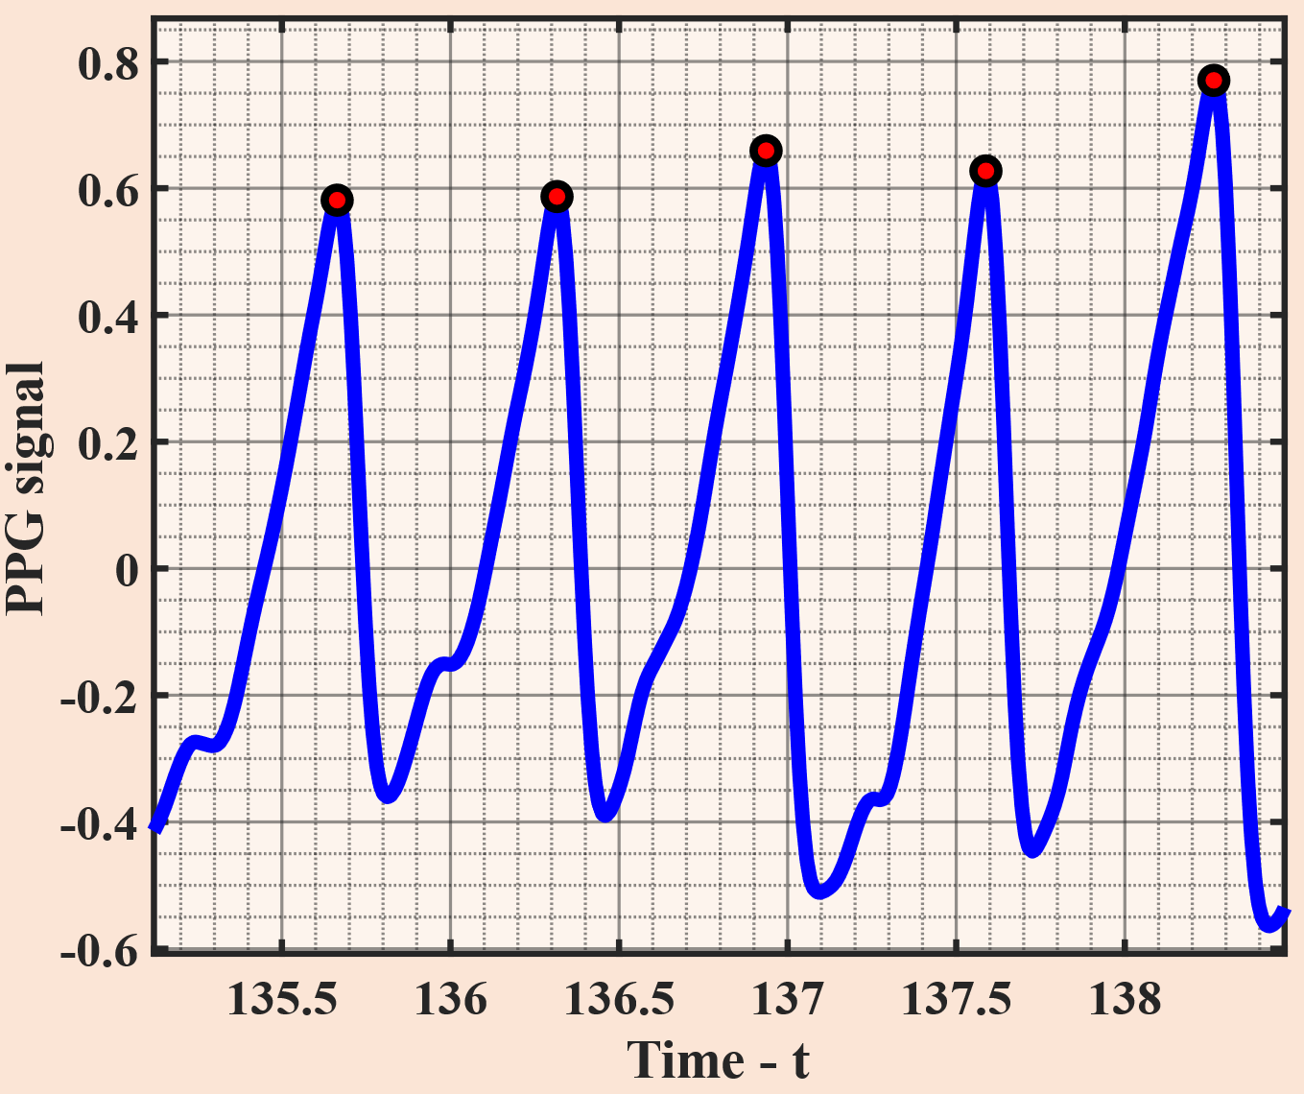
Photopletysmography (PPG) General concept of PPG signals
The red-marked points in the image represent systolic peaks in the PPG signal, which convey information about the heart's rhythm
Fluctuations in the reflected light spectrum provide a crucial physiological signal that allows us to assess the state of the human cardiovascular system

Slide 12
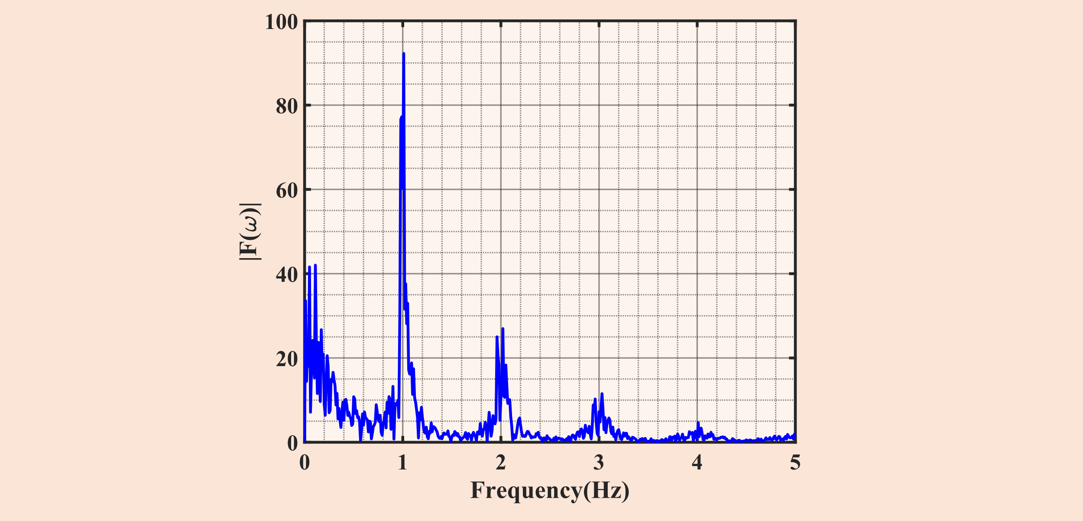
Spectral analysis Fourier analysis of PPG signals
$$f\left(t\right)=A_{0}+\sum_{n=1}^{N}{(A_{n}\cos\left(2πω_{n}t\right)+B_{n}\sin\left(2πω_{n}t\right))}$$
Expanding $f\left(t\right)$ function in harmonic functions
As a result of the Fourier analysis, we determined the frequency characteristics of the signal, we notice several peaks, including those near 1 Hz, which represent the heart rate.
$$F\left(ω\right)=\int_{−∞}^{+∞}{f\left(t\right)}e^{−i2πωt}dt$$

Slide 13
Spectral analysis Wavelet analysis of PPG signals
Unlike the Fourier transform, the wavelet transform decomposes the series into time and space-localized "wavelets", allowing us to observe the change in frequency chara-cteristics over time.
$$ψ_{τ,s}\left(t\right)=\frac{1}{\sqrt{s}} ψ\left(\frac{t−τ}{s}\right)$$
Wavelet transform of the $f\left(t\right)$ function :
$$W\left(τ.s\right)=\int_{−∞}^{+∞}{f\left(t\right)\frac{1}{\sqrt{s}}ψ^{∗}\left(\frac{t−τ}{s}\right)dt}$$

Slide 14
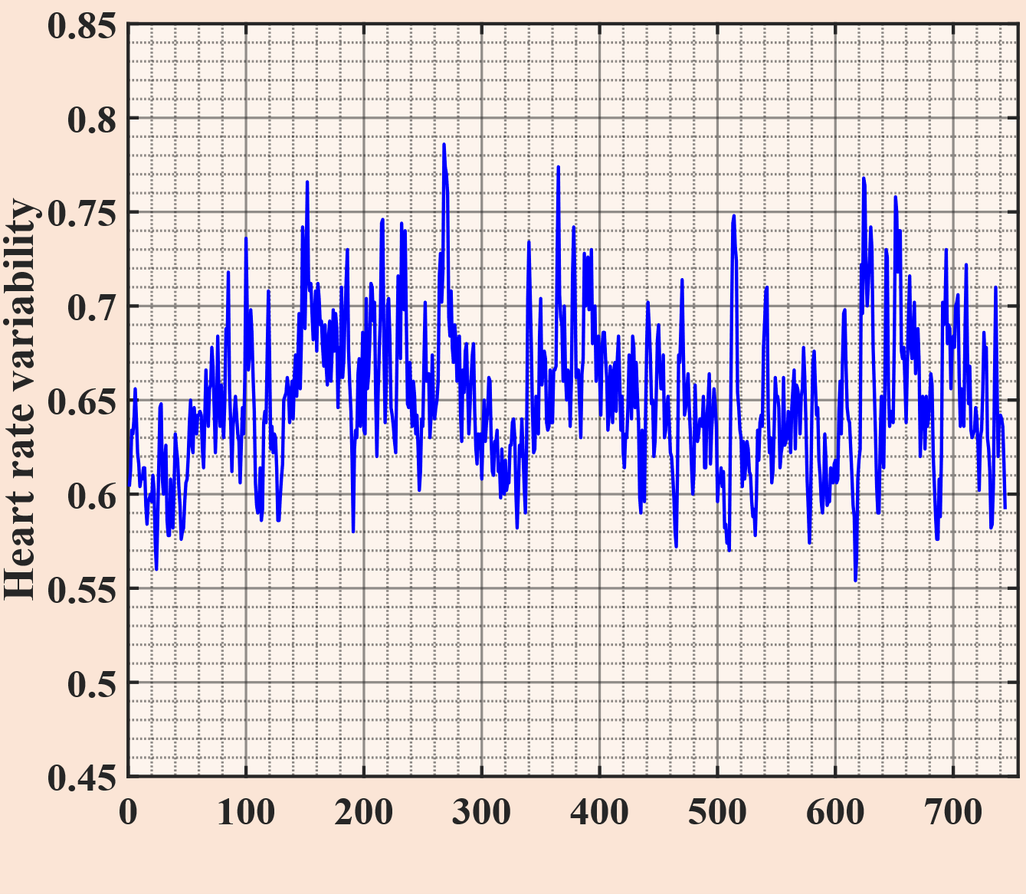
Heart rate variability
Heart beat interval
$$N$$
The elapsed time between systolic peaks in the PPG signal is known as Heart rate variability. The image demonstrates that while the human heart is not strictly periodic, this variability has a certain structure. Studying this structure can provide us with additional insights.

Slide 15
Parametrization of HRV Calculating Hurst exponent with Detrended Fluctuation Analysis (DFA)
$$F \sim S^{H}$$
$$\ln\left(F\right)\sim H∗ln(S)$$
Power law relationship be-tween scales and local flu-ctuations
We observe different Hurst exponents for heart rate variabilities in healthy and unhealthy subjects. For healthy individuals, the exponent is near 1, indi-cating pink noise, while for unhealthy patients, it is near 0.5, indicating white noise.
Data was taken from physionet.org

Slide 16
Conclusion
01
Our simulations reveal both anomalous and normal diffusion, highlighting the impact of isotropy and anisotropy on photon behavior
02
Determine the relationship between changes in the diffusion mode and the $g$ anisotropy factor
03
The diffusion coefficient obtained numerically through simulation matches the known analytical result with an accuracy of ${10}^{−3}$ order
04
The simulated reflectance spectrum of human skin matched our experimental results, allowing us to determine the optical parameters of healthy skin
05
Using detrended fluctuation analysis (DFA), we determined the Hurst exponent, which allowed us to parameterize heart rhythm variability in both healthy and diseased individuals

Slide 17
Literature
Optics, 5th edition, Eugene Hecht
Light Spectroscopy. David A Harris.
Optics. A.N. Matveev
მონაცემთა ანალიზი, გიორგი მაჭარაშვილი
https://omlc.org/classroom/ece532/class4/index.html
https://omlc.org/classroom/ece532/class3/index.html
Tutorial on Monte Carlo simulation of photon transport in biological tissues . Steven L. Jacques. Vol. 14, No. 2 / 1 Feb 2023 / Biomedical Optics Express
Biomedical Optics: Principles and Imaging - Hsin-i Wu, Lihong V. Wang
Alteration of skin light-scattering and absorption properties by application of sunscreen nanoparticles: A Monte Carlo study. - Alexey P. Popov.
Photon diffusion coefficient in scattering and absorbing media. Romain Pierrat ¹ , Jean-Jacques Greffet, Rémi Carminati.
PPG Signal Processing and Analysis by George Muhn.
Introduction to the MFDFA - Espen A. F. Ihlen
Marti, Dominik, et al. “MCmatlab: an Open-Source, User-Friendly, MATLAB-Integrated Three-Dimensional Monte Carlo Light Transport Solver with Heat Diffusion and Tissue Damage.” Journal of Biomedical Optics, vol. 23, no. 12, SPIE-Intl Soc Optical Eng, Dec. 2018, p. 1, doi:10.1117/1.jbo.23.12.121622.
https://physionet.org/about/database/

Slide 18
Thank you for your Attention!

