Slide 1
The Dynamics of Gravity Waves and Aperiodic Modes in Kinematically Complex Flows
Elene Chkhartishvili
Free University of Tbilisi
Advisor: Andria Rogava

Slide 2
Table of Contents
01
03
02
04
The Phenomenon
Calculations and Findings
Main Formalism
Future Perspectives

Slide 3
01
The Phenomenon
Internal and surface gravity waves, simulation

Slide 4
What Are Gravity Waves ?
Internal gravity waves occur in density stratified fluids in the presence of a gravitational field. They arise as gravitational restoring forces act on vertically displaced fluid.

Slide 5
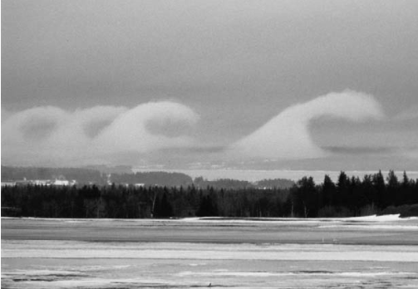
Gravity Waves in Nature

Slide 6
02
Main Formalism
Main theory and formalism

Slide 7
Main Theory
Background Velocity Field
$$U\left(x, y, z\right)=U_{x}\left(x,y,z\right)e_{x}+U_{y}\left(x,y,z\right)e_{y}+U_{z}\left(x, y, z\right)e_{z}$$
Shear Matrix
$$S≡\left(\begin{matrix}U_{x,x} & U_{x,y} & U_{x,z} \\ U_{y,x} & U_{y,y} & U_{y,z} \\ U_{z,x} & U_{z,y} & U_{z,z}\end{matrix}\right)≡\left(\begin{matrix}a_{11} & a_{12} & a_{13} \\ a_{21} & a_{22} & a_{23} \\ a_{31} & a_{32} & a_{33}\end{matrix}\right)$$

Slide 8
Linearization of The Velocity Field
$$U_{i}\left(x, y, z\right)≈U_{i}(x_{0}, y_{0},z_{0})+a_{ik}x_{k}$$
Spatially Inhomogenous Operator
$$𝒟≡∂_{t}+U_{i}(x, y, z)∂_{i}$$
Eliminating The Spatial Dependency
$$F\left(x, y, z;t\right)≡\hat{F}\left[k\left(t\right), t\right]e^{iφ} φ≡k_{i}\left(t\right)x_{i}−U_{0_{i}}\int{k_{i}\left(t\right)dt} 𝒟F= e^{iφ}∂_{t}\hat{F}$$

Slide 9
03
Calculations and Findings
Main equations and the incompressible case

Slide 10
Main Equations
$$∂_{t}k + S^{T}∙k=0$$
$S^{T}−$ The transposed Shear Matrix
$k$ – Time-Dependent Wavenumber Vector
$$S= \left(\begin{matrix}σ & R_{1} \\ R_{2} & −σ\end{matrix}\right)$$
Working Shear Matrix
$$k_{x}^{(1)}=−σk_{x}−R_{2}k_{y}$$
$$k_{y}^{(1)}=−{R_{1}k}_{x}+σk_{y}$$
$$k_{z}^{(1)}=0$$
Equations For The Wavenumber Vector Components

Slide 11
Equations for the Incompressible Case
Equations for the Velocity Vector Components
$P$ – Dimensionless Notation of the Pressure Perturbations
$N^{}−$ Frequency
$$v_{x}^{(1)}=−σv_{x}−R_{1}v_{y}−k_{x}P$$
$$v_{y}^{(1)}=−R_{2}v_{x}+σv_{y}−k_{y}P$$
$$v_{z}^{(1)}=−k_{z}P+iαd$$
$$e^{(1)}=v_{z}$$
$$d=i\frac{N^{2}}{α}e$$
Other Important Equations
$$k_{x}v_{x}+k_{y}v_{y}+k_{z}v_{z}=0$$
$$∆ =k_{x}^{(1)}k_{y}−k_{x}k_{y}^{\left(1\right)}=const$$
$$Ψ≡k_{x}v_{y}−k_{y}v_{x}$$
$$Φ≡k_{x}v_{x}+k_{y}v_{y}$$

Slide 12
Findings and Derivations
$$Ψ^{(2)}−\frac{k_{z}^{2}{\left[\ln\left(k_{⊥}^{2}\right)\right]}^{2}}{k^{2}}Ψ^{\left(1\right)}+\left[N^{2}\frac{k_{⊥}^{2}}{k^{2}}+\frac{2∆\left(R_{1}−R_{2}\right)k_{z}^{2}}{k^{2}k_{⊥}^{2}}\right]Ψ=N^{2}⋅C⋅\frac{k_{⊥}^{2}}{k^{2}}$$
Eliminating the First Order Differential Term
$Χ^{(2)}+\left[\frac{2k_{z}^{2}Λ^{2}}{k_{}^{2}}+2⋅\frac{{\left(k_{⊥}^{\left(1\right)}\right)}^{2}}{k^{2}}(\frac{3k_{⊥}^{2}}{2k_{}^{2}}−\frac{k_{z}^{4}}{k_{⊥}^{2}k^{2}}−\frac{k_{z}^{2}}{2k_{⊥}^{2}}−\frac{3}{2})\right]Χ=$ $N^{2}⋅C⋅\frac{k_{⊥}^{}}{k^{}}$
${Where: k}_{⊥}^{2}=k_{x}^{2}+k_{y}^{2};$ $k_{}^{2}=k_{⊥}^{2}+k_{z}^{2}; Λ^{2}= σ^{2}+R_{1}R_{2}$; $C=const$.

Slide 13
Eliminating the First Order Differential Term
$$Ψ^{(2)}+p\left(k\right)⋅Ψ^{\left(1\right)}+q\left(k\right)∙Ψ=r\left(k\right)$$
$$Ψ=Χ∙φ$$
After differentiating and plugging into the initial equation:
$$φΧ^{(2)}+\left[2φ^{\left(1\right)}+pφ\right]Χ^{\left(1\right)}+\left[qφ+pφ^{\left(1\right)}+φ^{\left(2\right)}\right]Χ=r$$
So, if we choose $2φ^{\left(1\right)}=−pφ$, then the first order derivative will vanish, and we will be left with the equation: $Χ^{(2)}+\left[q +p\frac{φ^{\left(1\right)}}{φ}+\frac{φ^{\left(2\right)}}{φ}\right]Χ=\frac{r}{φ}$.
In our case, $\frac{φ^{(1)}}{φ}=$ $\frac{k_{z}^{2}{\left[\ln\left(k_{⊥}^{2}\right)\right]}^{2}}{2k^{2}}$.
From this, $φ=\sqrt{\frac{k_{⊥}^{2}}{k^{2}}}$, which we can plug into the equation to finish the elimination process.

Slide 14
04
Future Perspectives

Slide 15
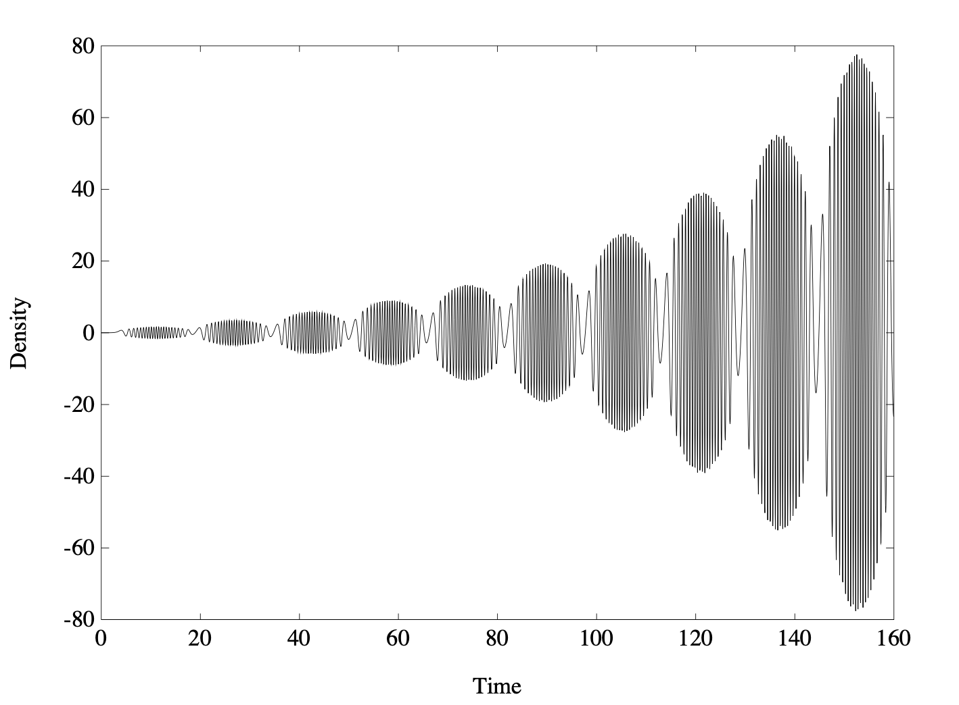
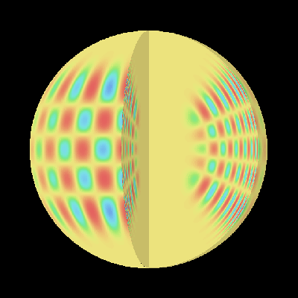
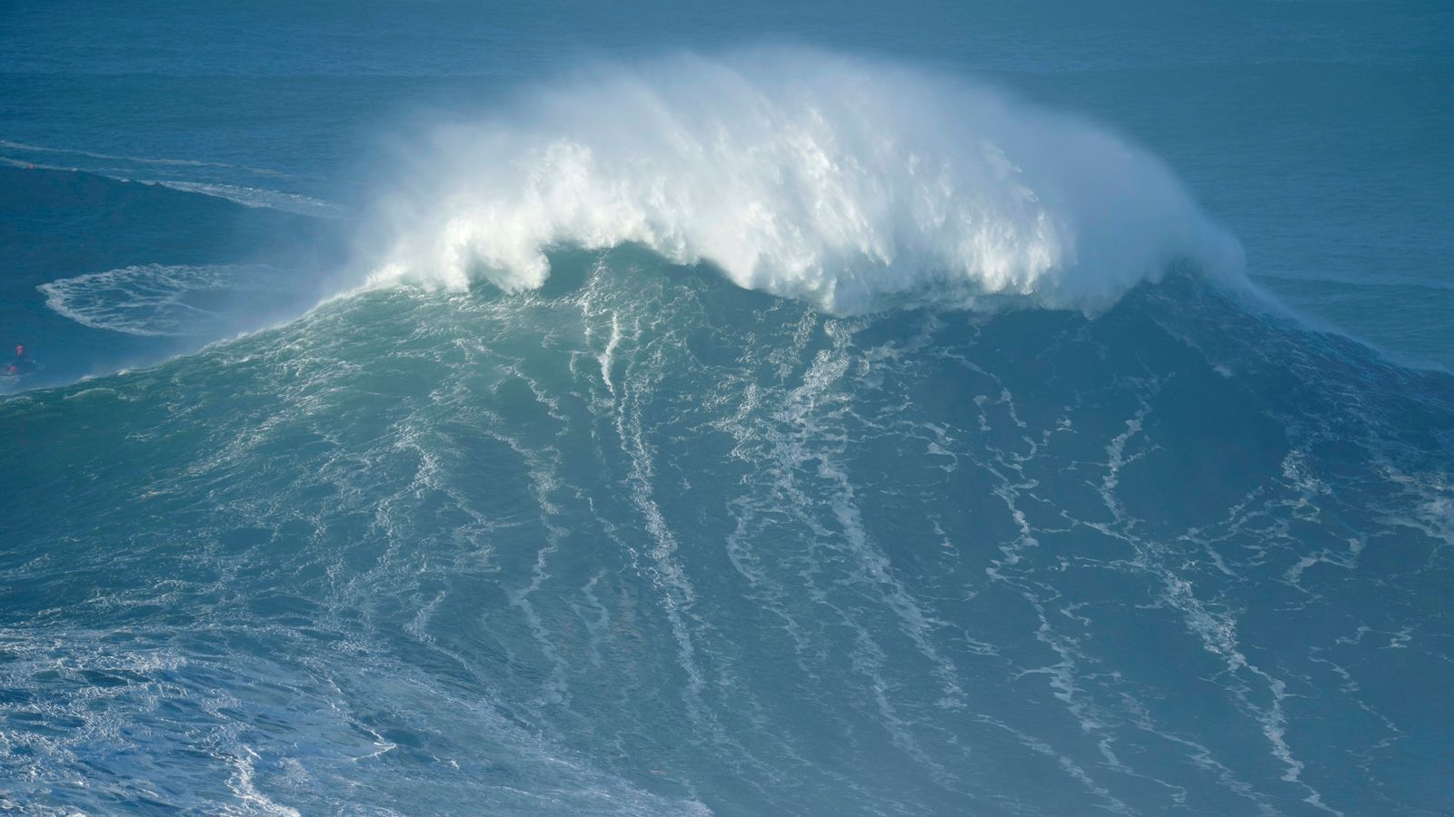
Future Perspectives
Numerical Computations
Natural Phenomena
Helioseismology

Slide 16
Thank you !!
Do you have any questions?
Elene Chkhartishvili
Free University of Tbilisi
Advisor: Andria Rogava

