Slide 1
Central engine of Gamma Ray Bursts and their accretion disk
Presented by Ava Moknatjoo
Supervisor: Dr Soroush Shakeri
Isfahan University of Technology

Slide 2
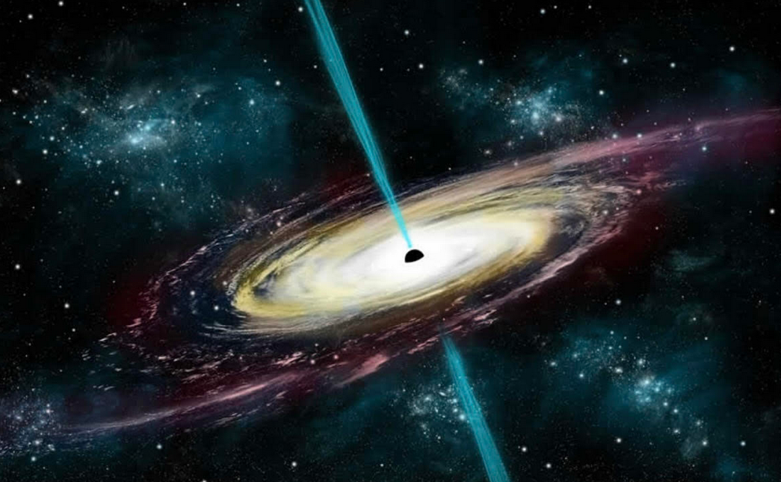
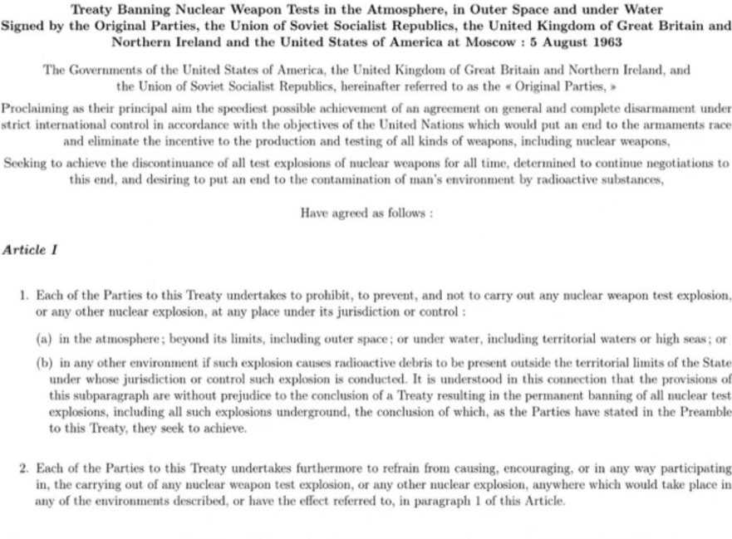
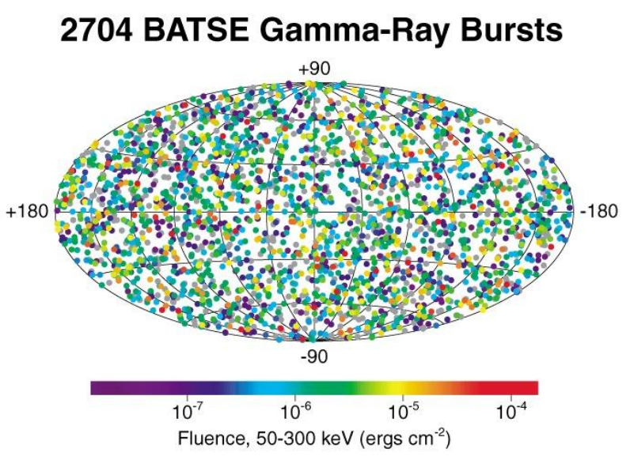
History
The US military VELA program

Slide 3
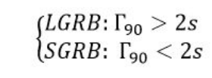
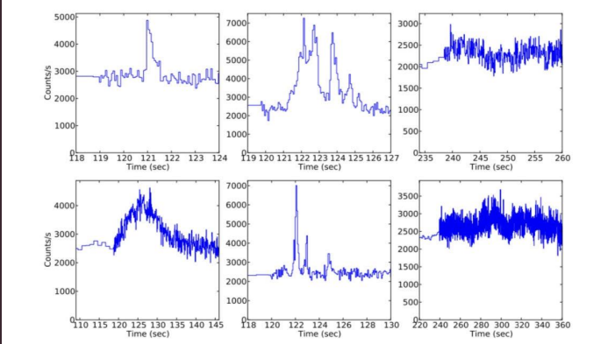
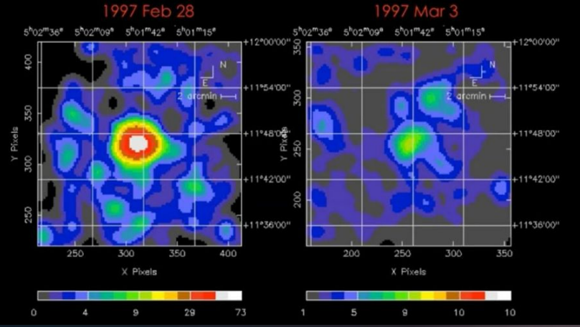
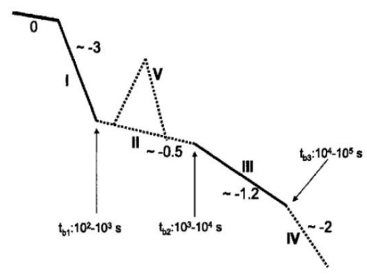
Features
Very high energy and high luminosity:
Different types of GRBs:
Different light curves and afterglows:
Fixed form of GRB’s light curves:

Slide 4
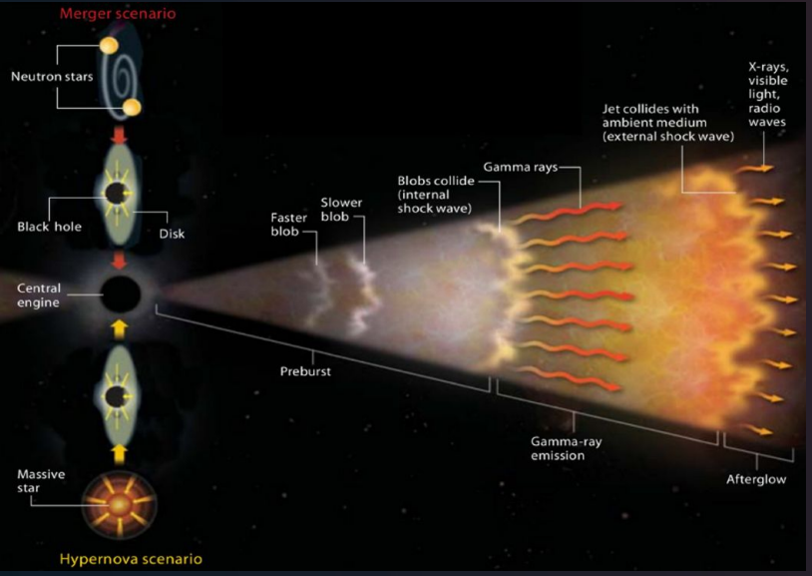
Origins of GRBs
Massive stars
Binaries of compact bodies

Slide 5
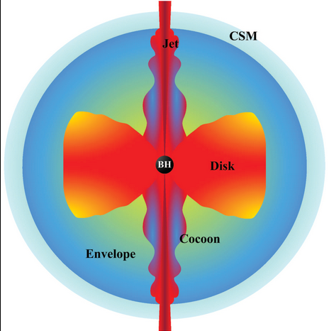
Central engine
Types of central engine:
Rapidly spinning magnetars
Hyper accreting black hole
Quark stars

Slide 6
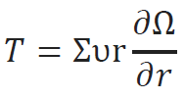
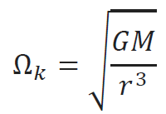
Surface mass density
Navier-Stokes
Continuing equation
Viscosity Tensor
Keplerian disk
Surface mass density:

Slide 7
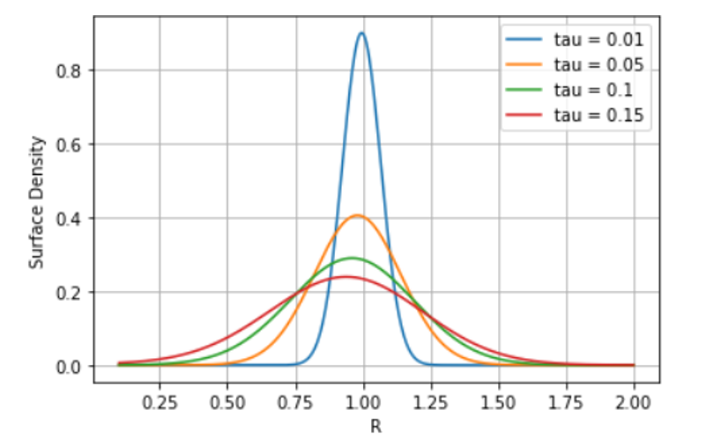
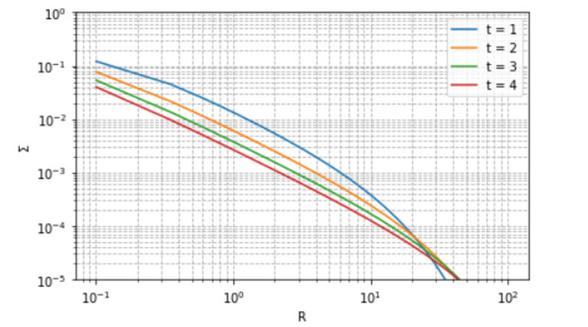
Surface mass density based on radius

Slide 8
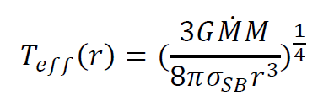
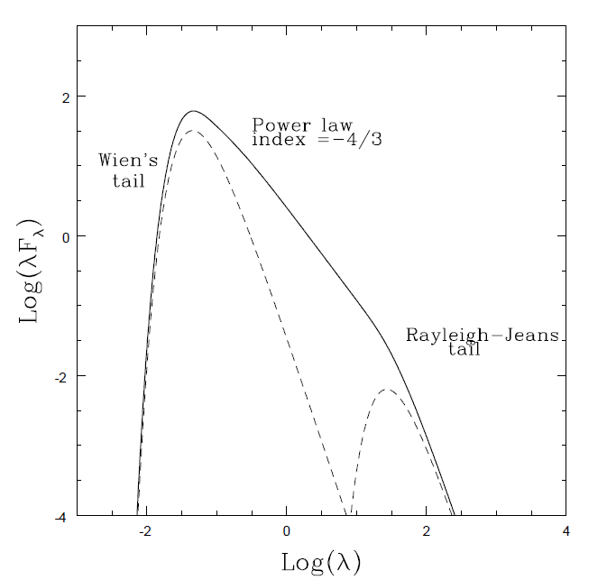
Spectral energy distribution

Slide 9
Conclusion
In the presence or absence of viscosity due to the high heat in the disk, the behavior of the surface mass density as a power-law function of radius will differ. If we consider the surface density to be independent of viscosity, mass accumulation will occur only at a specific radius. However, if we consider viscosity as a function of radius, the surface density will decrease with increasing radius.
For energy distribution, it can be said that in regions close to the black hole, which acts as the central engine, the temperature increases and the wavelength decreases. As the distance from the center increases, the temperature decreases, and the wavelength increases.

Slide 10
Thanks for your attention

Slide 11
Sources
[1]: T. Piran, ”The physics of gamma-ray bursts”, Rev. Mod. Phys. 76, 1143–1210 (2004)
[2]: G. J. Fishman, C.A. Meegan, ”Gamma-ray bursts”, Annu. Rev. Astron. Astrophys. 33, 415–458
(1995)
[3]: A. Velasis, ”Numerical simulations in the afterglow phase of GRBs”, PhD thesis, Leuven University,
(2012)
[4]: A.S. Fruchter, A.J. Levan, L. Strolger, P.M. Vreeswijk, S.E. Thorsett, D. Bersier, I. Burud, J.M.
Castro Cerón, A.J. Castro-Tirado, C. Conselice, T. Dahlen, H.C. Ferguson, J.P.U. Fynbo, P.M.
Garnavich, R.A. Gibbons, J. Gorosabel, T.R. Gull, J. Hjorth, S.T. Holland, C. Kouveliotou, Z.
Levay, M. Livio, M.R. Metzger, P.E. Nugent, L. Petro, E. Pian, J.E. Rhoads, A.G. Riess, K.C.
Sahu, A. Smette, N.R. Tanvir, R.A.M.J. Wijers, S.E. Woosley, ”Long γ-ray bursts and core-collapse
supernovae have different environments”, Nature, 441, 463–468, (2006)
[6]: BING ZHANG, “ The Physics of Gamma-Ray Bursts” , University of Nevada, Las Vegas
[7]: P. Kumar and B. Zhang,”The physics of gamma-ray bursts and relativistic jets”, PhR, 561, 1 (2015)

