Slide 1
Opening up baryon number violating operators
Diana Sokhashvili
Authors: Julian Heeck, Diana Sokhashvili, Anil Thapa

Slide 2
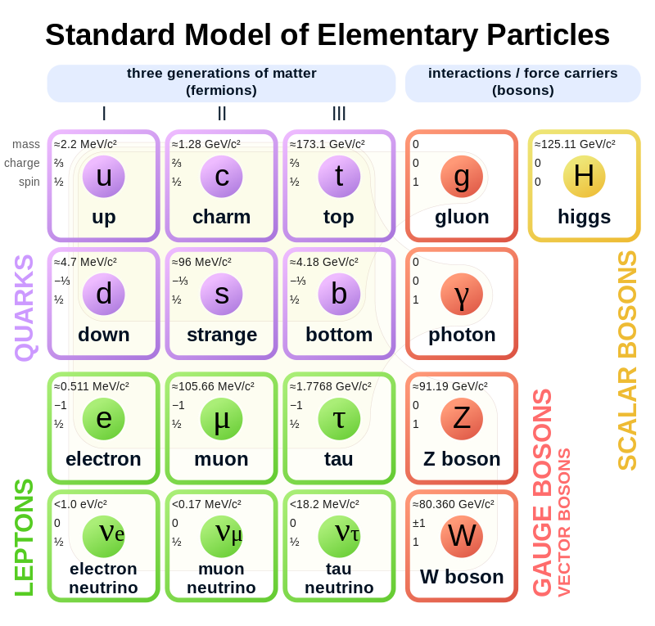
Baryon number violation
Baryon and lepton number violation is sensitive to $d≫6$, unlike any other experiment.
Use SMEFT to describe:
$$ℒ=ℒ_{SM}+\sum_{d=5}{\frac{\sum_{i}{C_{i}𝒪_{i}}}{Λ^{d−4}}}$$
We can assign ${U(1)}_{B}$ charge 1/3 to baryons

Slide 3
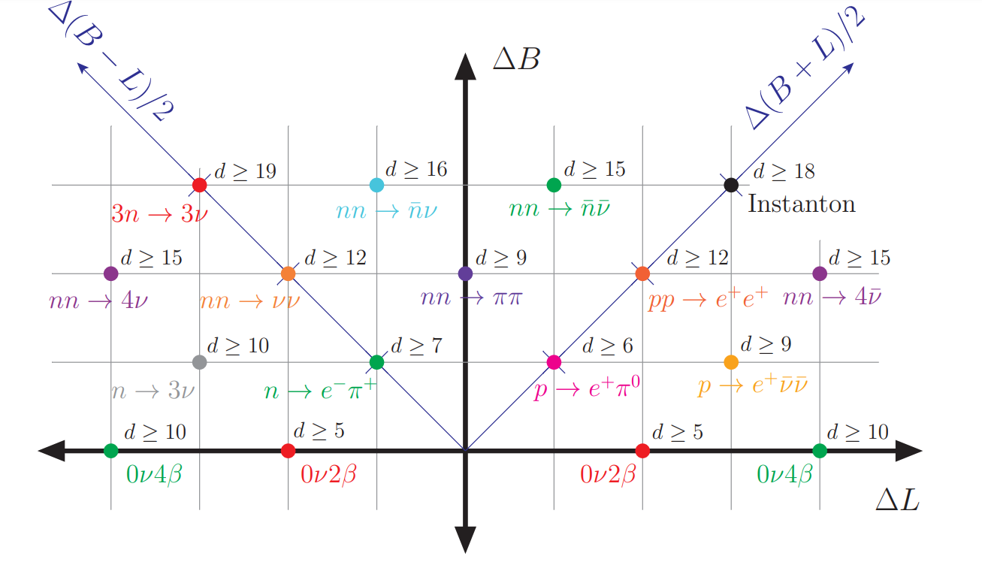
BNV landscape
[J. Heeck, V. Takhistov (arXiv:1910.07647)]

Slide 4
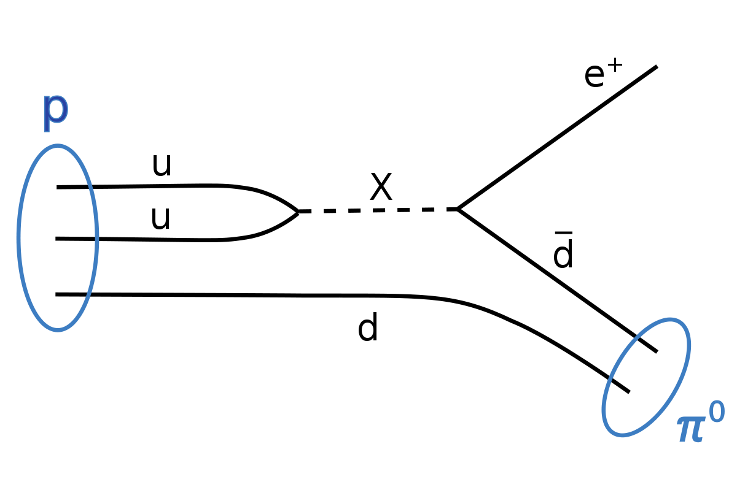
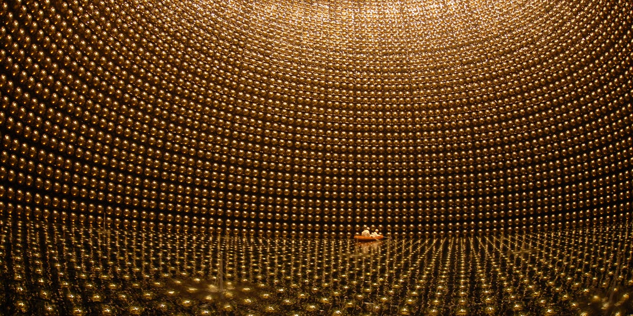
Example: Proton decay
Super-Kamiokande.
$$\frac{uude}{Λ^{2}}→Γ(p→e^{+}π^{0})∼\frac{m_{p}^{5}}{Λ^{4}}∼\frac{1}{{10}^{34} years}{\left(\frac{{10}^{15}GeV}{Λ}\right)}^{4}$$
$τ(p→e^{+}π^{0})$> ${10}^{34}$ yr.

Slide 5
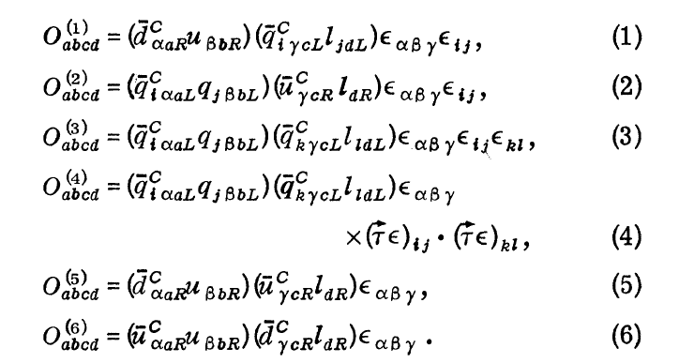
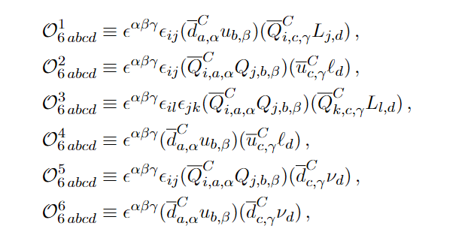
Generate operators
Linearly independent operators
(including right-handed neutrinos).
[Weinberg, 1979 ]
[Weinberg, 1979 ]
[ Beltran, Cepedello, Hirsch (arXiv:2306.12578) ]

Slide 6
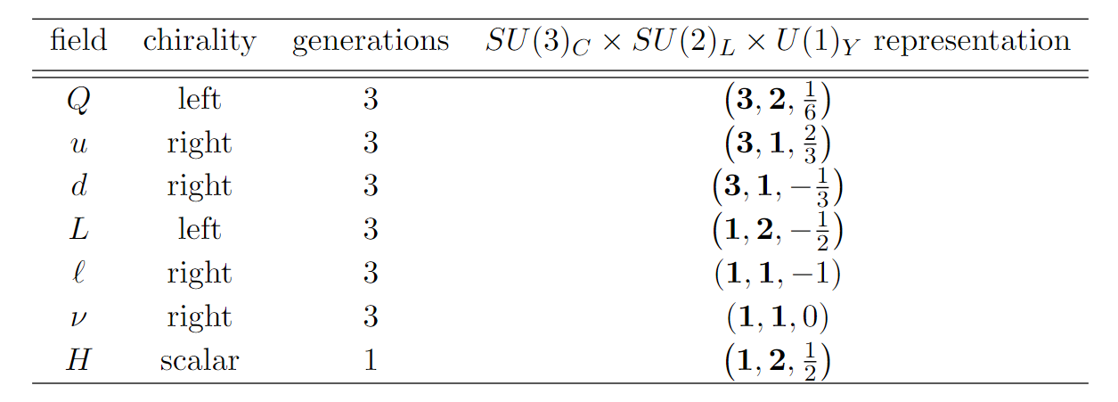
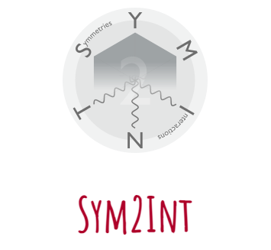
Generate operators
Dim 6
Dim 7
Dim 8
Dim 9
+ 61 more operators
Dim 10
+ 111 more operators
Dim 11
+ 130 more operators
Dim 12
+ 479 more operators
https://renatofonseca.net/sym2int
Dim 13
+ 781 more operators
Dim 14
+ 983 more operators
Dim 15
+ 2626 more operators

Slide 7
Generate topologies
To obtain topologies, we use FeynArts Mathematica package to generate all possible diagrams and removed topologically same ones.
https://feynarts.de

Slide 8
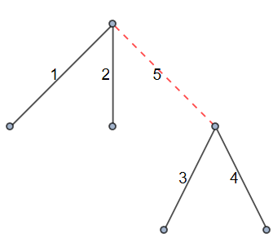
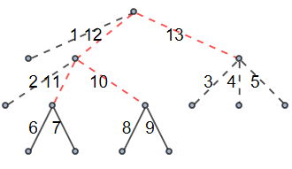
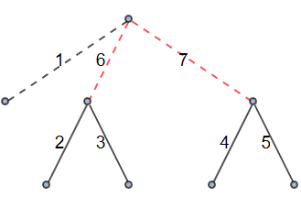
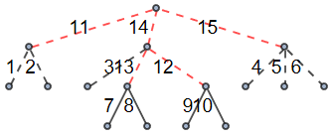
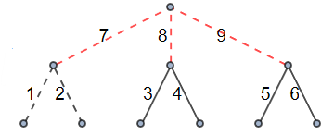
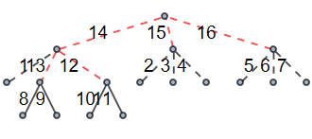
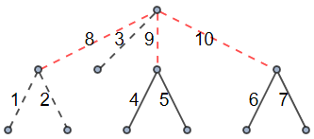
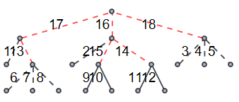
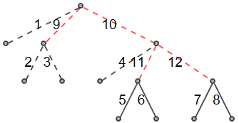
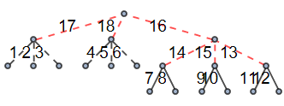
Topologies
SM Boson
New Boson
SM Fermion
New Fermion
Dim 6
Dim 11
+ 298 more
Dim 7
+ 1 more
Dim 12
+ 1059 more
Dim 8
+ 7 more
Dim 13
+ 3688 more
Dim 9
Dim 14
+ 13028 more
+ 24 more
Dim 10
+ 88 more
Dim 15
+ 45906 more

Slide 9
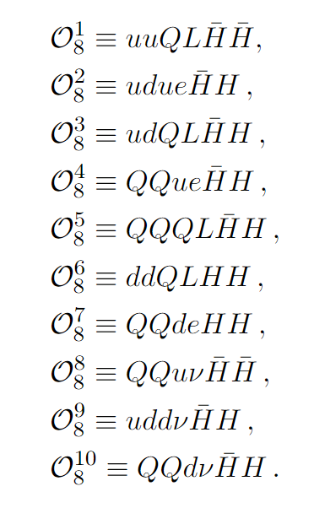
Example (Dimension 8)

Slide 10
Example (Dimension 8)

Slide 11
Possible permutations
Operator: ddLQHH
{{H H d d L Q}, {H H d d Q L} ,{H H d L d Q}, {H H d L Q d}, {H H d Q d L}, {H H d Q L d}, {H H L d d Q} ,{H H L d Q d} ,{H H L Q d d} ,{H H Q d d L}, {H H Qd L d}, {H H Q L d d}}
$$P_{3}$$
$$P_{2}$$
$$P_{1}$$
$$P_{6}$$
$$P_{4}$$
$$P_{5}$$

Slide 12
Internal particles
d $\{3,1,−\frac{1}{3}\}$
d $\{3,1,−\frac{1}{3}\}$
H $\{1,2,\frac{1}{2}\}$
H $\{1,2,\frac{1}{2}\}$
Q $\{3,2,\frac{1}{6}\}$
L $\{1,2,−\frac{1}{2}\}$

Slide 13
Internal particles
d $\{3,1,−\frac{1}{3}\}$
d $\{3,1,−\frac{1}{3}\}$
H $\{1,2,\frac{1}{2}\}$
H $\{1,2,\frac{1}{2}\}$
$$\{3,2,\frac{1}{6}\}$$
$$\{\overline{3},1,\frac{1}{3}\}$$
$$\{\overline{3},2,\frac{5}{6}\}$$
$$\{\overline{3},2,\frac{5}{6}\}$$
$$\{\overline{3},3,\frac{1}{3}\}$$
Q $\{3,2,\frac{1}{6}\}$
$$\{\overline{3},4,\frac{5}{6}\}$$
L $\{1,2,−\frac{1}{2}\}$
$$\{6,1,\frac{1}{3}\}$$
$$\{6,2,\frac{5}{6}\}$$
$$\{6,2,\frac{5}{6}\}$$
$$\{6,3,\frac{1}{3}\}$$
$$\{6,4,\frac{5}{6}\}$$

Slide 14
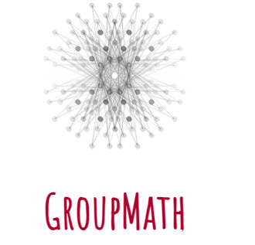
Internal particles
d $\{3,1,−\frac{1}{3}\}$
d $\{3,1,−\frac{1}{3}\}$
H $\{1,2,\frac{1}{2}\}$
H $\{1,2,\frac{1}{2}\}$
$$\{3,2,\frac{1}{6}\}$$
$\{3,2,\frac{1}{6}\}$, $\{\overline{3},1,\frac{1}{3}\}$, $\{\overline{3},2,\frac{5}{6}\}$
$\{3,2,\frac{1}{6}\}$, $\{\overline{3},3,\frac{1}{3}\}$, $\{\overline{3},2,\frac{5}{6}\}$
$$\{\overline{3},1,\frac{1}{3}\}$$
$$\{\overline{3},2,\frac{5}{6}\}$$
$$\{\overline{3},2,\frac{5}{6}\}$$
$$\{\overline{3},3,\frac{1}{3}\}$$
Q $\{3,2,\frac{1}{6}\}$
$$\{\overline{3},4,\frac{5}{6}\}$$
L $\{1,2,−\frac{1}{2}\}$
$$\{6,1,\frac{1}{3}\}$$
$$\{6,2,\frac{5}{6}\}$$
$$\{6,2,\frac{5}{6}\}$$
$$\{6,3,\frac{1}{3}\}$$
https://renatofonseca.net/groupmath
$$\{6,4,\frac{5}{6}\}$$

Slide 15
Internal particles
d
H
H
d
$$\{3,2,\frac{1}{6}\}$$
$$\{\overline{3},1,\frac{1}{3}\}$$
$$\{\overline{3},2,\frac{5}{6}\}$$
Q
L
$\{3,2,\frac{1}{6}\}$, $\{\overline{3},1,\frac{1}{3}\}$, $\{\overline{3},2,\frac{5}{6}\}$

Slide 16
Lorentz group (SU2×SU2)
For internal fermions we need to make sure that chirality is flipped to ensure that this fermions are massive.
SM Scalars
SM Fermion
$$F_{R}$$
$$F_{L}$$
$$F_{L}$$
$$F_{R}$$
For internal bosons we determine whether they are vector or scalar.
New Scalars
New Vector
$$B_{V}$$
$$B_{S}$$

Slide 17
Internal particles
d
H
H
d
d
H
H
d
$$\{3,2,\frac{1}{6}\}$$
$$\{3,2,\frac{1}{6}\}$$
$$F_{L}$$
$$F_{R}$$
$$\{\overline{3},1,\frac{1}{3}\}$$
$$\{\overline{3},2,\frac{5}{6}\}$$
$$\{\overline{3},1,\frac{1}{3}\}$$
$$\{\overline{3},2,\frac{5}{6}\}$$
Q
L
Q
L
$\{3,2,\frac{1}{6}\}$, $\{\overline{3},1,\frac{1}{3}\}$, $\{\overline{3},2,\frac{5}{6}\}$
${\left\{3,2,\frac{1}{6}\right\}}_{F}$, ${\left\{\overline{3},1,\frac{1}{3}\right\}}_{V}$, ${\left\{\overline{3},2,\frac{5}{6}\right\}}_{V}$
https://renatofonseca.net/sym2int

Slide 18
Permuting fields around topology
Topology:
Operator: ddLQHH

Slide 19
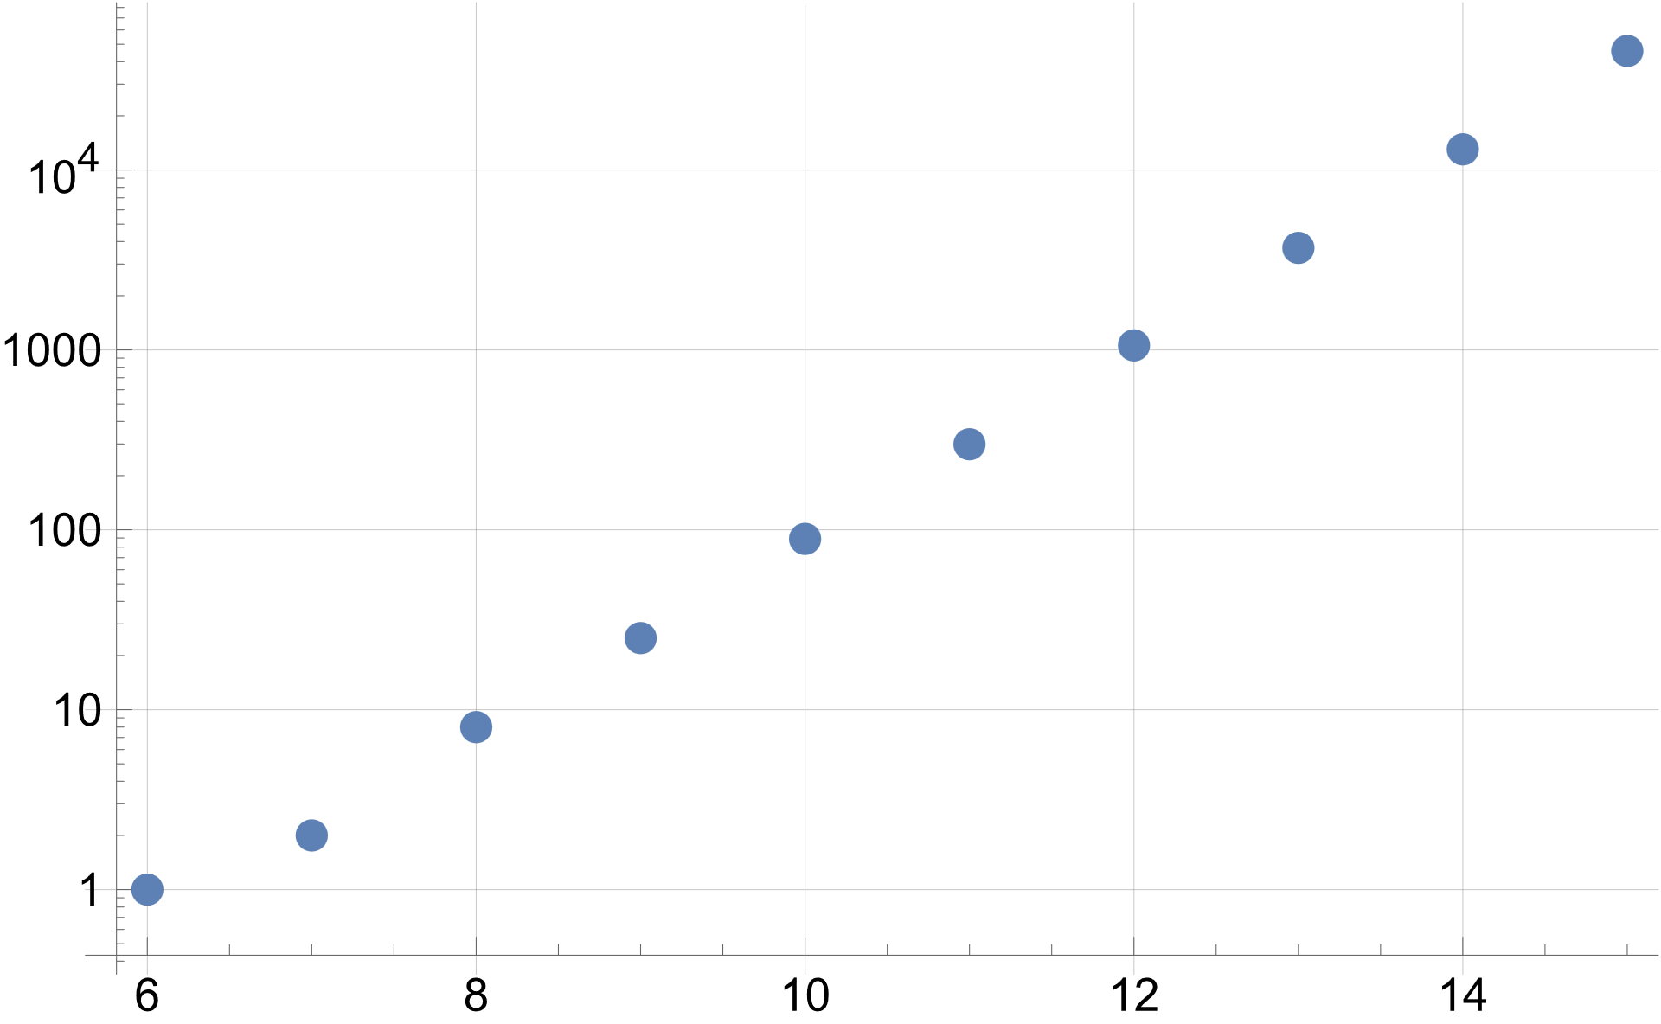
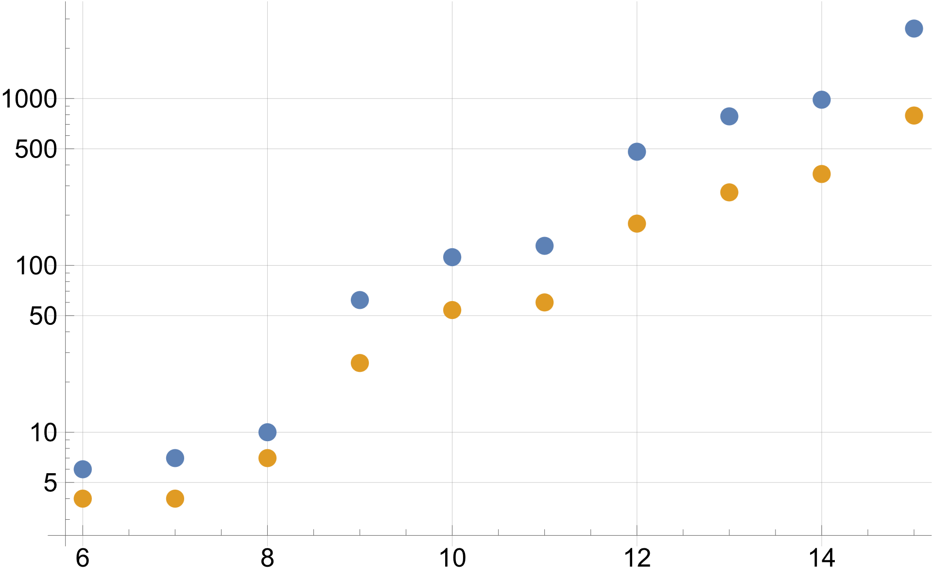
Number of operators and topologies
Number of topologies VS Mass dim
Number of operators VS Mass dim
Number of topologies
Number of operators
Mass dimension (d)
Mass dimension (d)

Slide 20
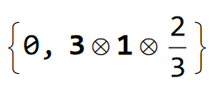
New particles
Dimension 6
Dimension 7
Spin
SU3×SU2×U1
Dimension 8
Dimension 9
Dimension 10
.
.
.
.
.
.

Slide 21
Conclusion:
Baryon number violation is uniquely sensitive to heavy new physics, probing mass dimensions $≫6.$
We found all UV completions for operators up to d=15 in terms of scalars, fermions and vectors including right-handed neutrinos.
Previously, only incomplete results up to dimension 9.
Useful for model building and in the event of a discovery in Super-Kamiokande, Hyper-Kamiokande, JUNO or DUNE.
Our method can be easily applied to other operators, for example violating lepton number, only limiting factor is presentation of actual results due to a number of solutions.
Thank You For Your Attention!

Slide 22
Thank You For Your Attention!

