Slide 1
Coupling and mutual transformation of acoustic and gravitational modes in kinematically complex flows.
Author: Ia Saralidze Advisor: Andria Rogava Free Univeristy of Tbilisi
Reference: Rogava et al. - ACOUSTICS OF KINEMATICALLY COMPLEX SHEAR FLOWS

Slide 2
Presentation Plan
01
02
03
04
Phenomenon Explanation
Main Formalism
Stratified fluid and internal gravity waves
Description of background flow
Compressible Case
Future Perspectives
After fluctuation fluid is compressible
Astrophysics and helioseismology

Slide 3
01
Phenomenon Explanation
Stratified fluid and internal gravity waves

Slide 4
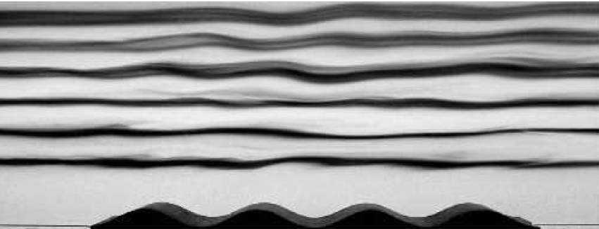
Phenomenon Explanation
Stratified fluid – density difference between thin layers.
Internal gravity waves – is created when we have stratified fluid.
Internal waves in uniformly stratified fluid visualized by the displacement of dye lines spaced apart by 5 cm. .

Slide 5
02
Main Formalism
Description of background flow

Slide 6
Main Formalism
Velocity gradient matrix (shear flow matrix)
In the close neighborhood of a point, the spatial variation of the mean velocity can be approximated by a the linear terms in its Taylor expansion. Then a set of nine constants forming the Shear Matrix S:
Approximate velocity
$$U_{i}\left(x,y,z\right)≅U_{0i}+a_{ik}x_{k}$$
$$S≡\left(\begin{matrix}U_{x,x} & U_{x,y} & U_{x,z} \\ U_{y,x} & U_{y,y} & U_{y,z} \\ U_{z,x} & U_{z,y} & U_{z,z}\end{matrix}\right)≡\left(\begin{matrix}a_{11} & a_{12} & a_{13} \\ a_{21} & a_{22} & a_{23} \\ a_{31} & a_{32} & a_{33}\end{matrix}\right)$$
Gradient components

Slide 7
Main Formalism
Spatially inhomogeneous operator
Velocity gradient
$$𝒟≡∂_{t}+U_{i}(x, y, z)∂_{i}$$
$$Du_{i}+a_{ik}u_{k}$$
Fluctuation function
Wave number vector
$$F(x, y, z;t)≡\hat{F}[k\left(t\right), t]e^{iφ}$$
$$φ≡k_{i}\left(t\right)x_{i}−U_{0_{i}}\int{k_{i}\left(t\right)dt}$$
Main equation for wave vector K
$$∂_{t}k + S^{T}∙k=0$$
$$𝒟F= e^{iφ}∂_{t}\hat{F}$$

Slide 8
Main Formalism
$$U_{y,x} component$$
$$of shear matrix$$
Equations for derivatives of wave vector components
$$k_{x}^{(1)}=−σk_{x}−R_{2}k_{y}$$
$$U_{x,x} component$$
$$of shear matrix$$
$$k_{y}^{(1)}=−{R_{1}k}_{x}+σk_{y}$$
$$U_{x,y} component$$
$$of shear matrix$$
$$k_{z}^{(1)}=0$$
Equations for derivatives of velocity components
$$v_{x}^{(1)}+σv_{x}+R_{1}v_{y}=−k_{x}P$$
$$v_{y}^{(1)}−σv_{y}+R_{2}v_{x}=−k_{y}P$$
$$v_{z}^{(1)}+{C_{1}v}_{x}+C_{2}v_{y}=−k_{z}P$$

Slide 9
Main Formalism
Equation for derivative of operator D
$$D^{(1)}= k_{x}\left(t\right)v_{x}+k_{y}\left(t\right)v_{y}+k_{z}\left(t\right)v_{z}$$
Time dependent operator
Conserved quantity
$$∆ =k_{x}^{(1)}k_{y}−k_{x}k_{y}^{\left(1\right)}=const$$

Slide 10
03
Compressible Case
Case where after fluctuation fluid is compressible

Slide 11
Compressible Case
Main equations for compressible fluid 2D case
$$D^{(1)}=iεv_{z}+k_{x}v_{x}+k_{y}v_{y}+k_{z}v_{z}$$
$$v_{y}^{(1)}−σv_{y}+R_{2}v_{x}=−k_{y}P$$
Pressure perturbation
$$v_{x}^{(1)}+σv_{x}+R_{1}v_{y}=−k_{x}P$$
$$v_{z}^{(1)}=−k_{z}P+iαd$$
Density perturbation
Brunt Vaisala’s frequency
$$N^{2}=αε$$
$$d=i\frac{N^{2}}{α}e+P$$
$$e^{(1)}=v_{z}$$
Derivative of entropy perturbantion

Slide 12
Compressible Case
Deriving main differential equation
$$\left\{\begin{aligned}Ψ≡k_{x}v_{y}−k_{y}v_{x} \\ \text{Φ} \text{≡} k_{x}v_{x}+k_{y}v_{y}\end{aligned}<=>\left\{\begin{aligned}v_{x}={\left({k_{x}}^{2}+{k_{y}}^{2}\right)}^{−1}(k_{x}\text{Φ}−k_{y}Ψ) \\ v_{y}={\left({k_{x}}^{2}+{k_{y}}^{2}\right)}^{−1}(k_{y}\text{Φ}+k_{x}Ψ)\end{aligned}\right.\right.$$
$$Ψ^{(1)}=(R_{1}−R_{2})\text{Φ}$$
Quantities we need to find
$$Ψ −\left(R_{1}−R_{2}\right)\left[P − k_{z}e\right]=const$$
$${v_{z}}^{(1)}=−k_{z}P−N^{2}e$$
$$P^{(1)}=\text{Φ}\text{ + }k_{z}v_{z}$$
$$φ^{(1)}=F(\text{Φ},Ψ,P)$$
$$e^{(1)}=v_{z}$$

Slide 13
Compressible Case
Deriving main differential equation
$${\text{Φ}}^{(1)}=−\left({k_{x}}^{2}+{k_{y}}^{2}\right)P+\frac{{{(k}_{x}^{2}+k_{y}^{2})}^{(1)}}{{(k}_{x}^{2}+k_{y}^{2})}\text{Φ}\text{ − }\frac{2∆}{{(k}_{x}^{2}+k_{y}^{2})}Ψ$$
$$E≡k_{z}e$$
$$Q≡P−E$$
$$Q^{(1)}=\text{Φ}$$
Main differential equation for coupled system
$$E^{(2)}+{(k}_{z}^{2}+N^{2})E=−k_{z}^{2}Q$$
$$Q^{(2)}−\frac{{{(k}_{x}^{2}+k_{y}^{2})}^{\left(1\right)}}{{(k}_{x}^{2}+k_{y}^{2})}Q^{\left(1\right)}+\left[k_{x}^{2}+k_{y}^{2}+\frac{2∆\left(R_{1}−R_{2}\right)}{{(k}_{x}^{2}+k_{y}^{2})}\right]Q=−{(k}_{x}^{2}+k_{y}^{2})E−\frac{2∆const}{{(k}_{x}^{2}+k_{y}^{2})}$$

Slide 14
Compressible Case
Removing first order derivative from differential equation
$$2\frac{φ^{(1)}}{φ}=−a=\frac{{{(k}_{x}^{2}+k_{y}^{2})}^{\left(1\right)}}{{(k}_{x}^{2}+k_{y}^{2})}=>2\frac{φ^{\left(1\right)}}{φ}=2{\left(\ln{φ}\right)}^{\left(1\right)}={\left(\ln{{(k}_{x}^{2}+k_{y}^{2})}\right)}^{\left(1\right)}=>φ=\sqrt{k_{x}^{2}+k_{y}^{2}}$$
$Q≡φ∙V =>$
$$Λ^{2}=σ^{2}+R_{1}R_{2}$$
$$k_{x}^{2}+k_{y}^{2}=k_{⊥}^{2}$$
Final differential equations for coupled system
$$E^{(2)}+{(k}_{z}^{2}+N^{2})E=−k_{z}^{2}k_{⊥}φ$$
$$φ^{(2)}−\left[2Λ^{2}+k_{⊥}^{2}+\frac{3}{k_{⊥}^{4}}\left\{k_{⊥}^{2}\left(R_{1}−R_{2}\right)Δ−{\left(σ\left(k_{y}^{2}−k_{x}^{2}\right)−k_{x}k_{y}\left(R_{1}−R_{2}\right)\right)}^{2}\right\}\right]φ=−k_{⊥}^{2}E−\frac{2∆const}{k_{⊥}^{3}}$$

Slide 15
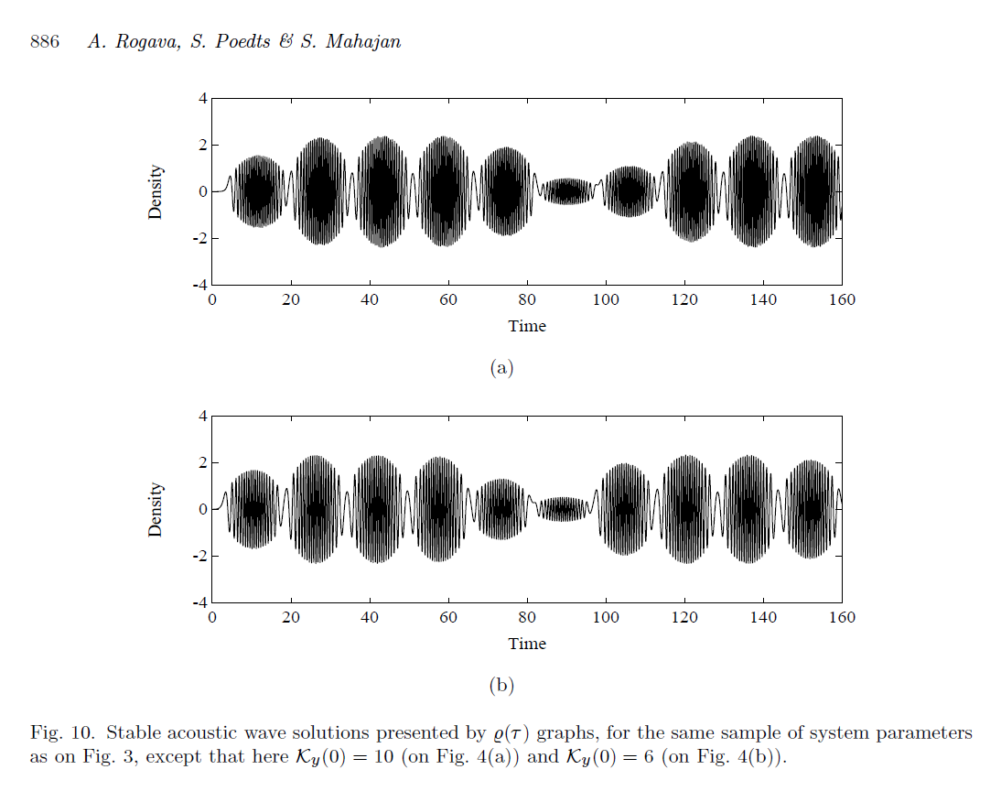
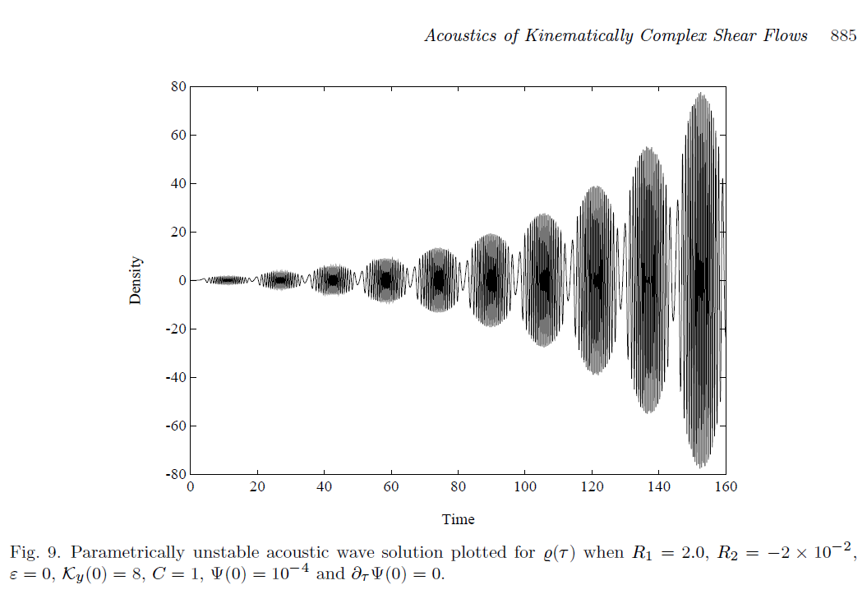
Compressible Case
Graphical Representation based
on referenced paper

Slide 16
04
Future Perspectives
Astrophysics and helioseismology

Slide 17
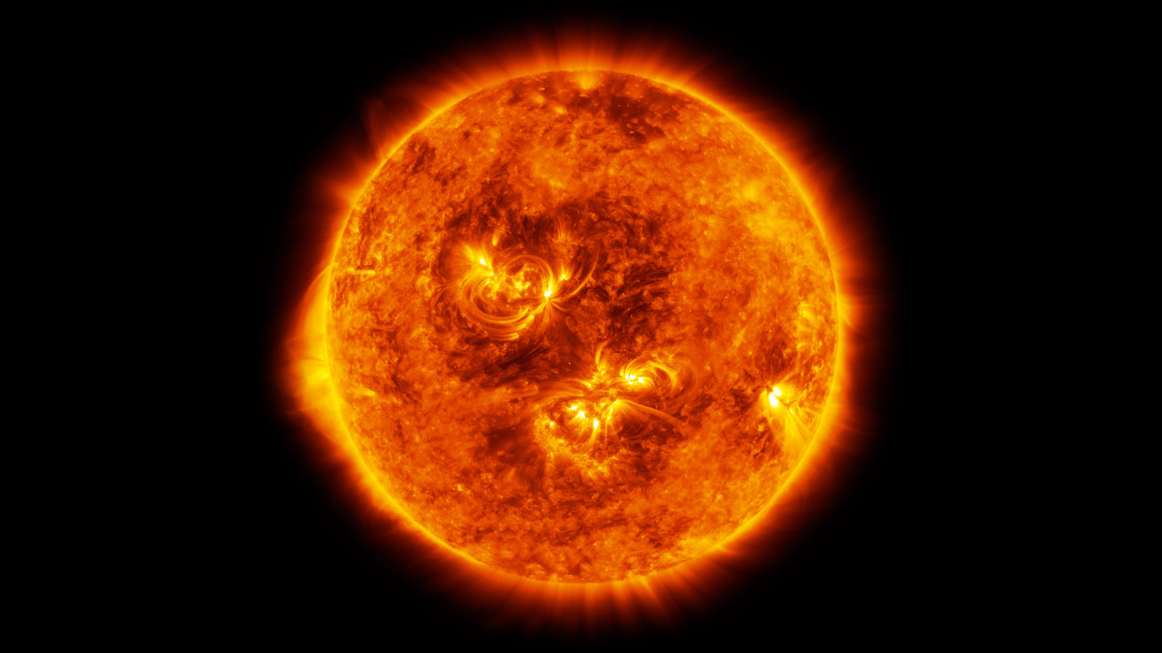
Helioseismology

Slide 18
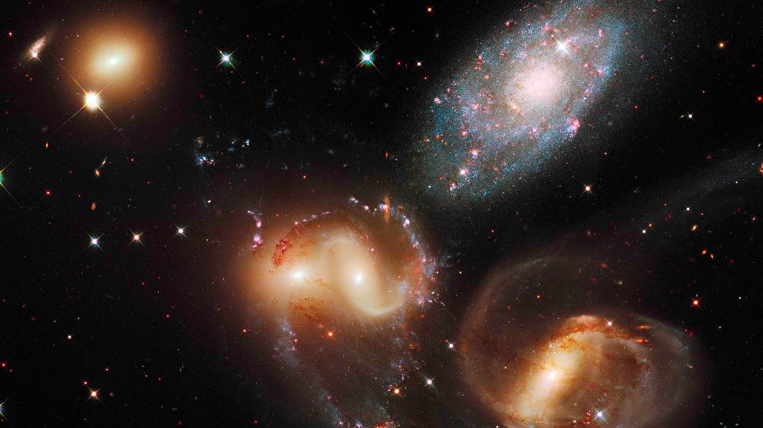
Astrophysics

Slide 19
Thank You
Reference: Rogava et al. - ACOUSTICS OF KINEMATICALLY COMPLEX SHEAR FLOWS
Author: Ia Saralidze Advisor: Andria Rogava Free Univeristy of Tbilisi

Slide 20
Compressible Case
Equation for wave number vector
$$K^{2}≡k_{x}^{2}+k_{y}^{2}$$
$${{(K}^{2})}^{(2)}=4Λ^{2}K^{2}−2Δ\left(R_{1}−R_{2}\right)$$
$$\frac{K^{(2)}}{K}=Λ^{2}+\frac{Δ^{2}}{K^{4}}$$
$$K^{(1)}=\sqrt{Λ^{2}K^{2}−Δ\left(R_{2}−R_{1}\right)−\frac{Δ^{2}}{K^{2}}}$$

