Slide 1
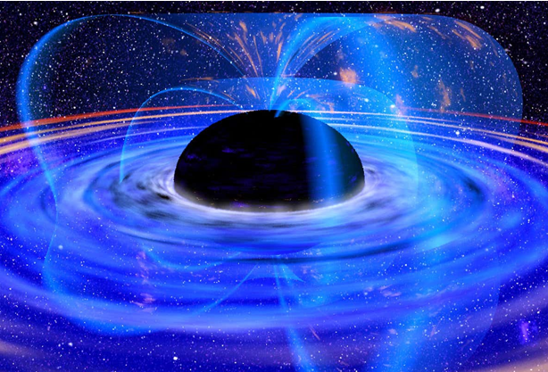
Acoustics of relativistic Hagen-Poiseuille flow
Hagen-Poiseullie flow is a very widespread type of flow in nature. However, in astronomy and astrophysics.we often encounter with relativistic Hagen - Poiseullie flows. Our goal is to study this flow and its acoustic effects in the relativistic limits and compare it to the nonrelativistic flows

Slide 2
Hagen-Poiseuille flow
$$R$$
$v_{z}\left(r\right)= v_{m }(1−\frac{r^{2}}{R^{2}}$)
$$z$$
$$v_{z}\left(r\right)$$

Slide 3
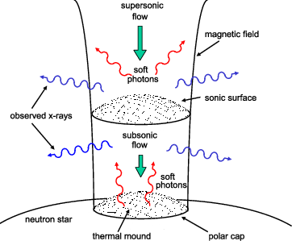
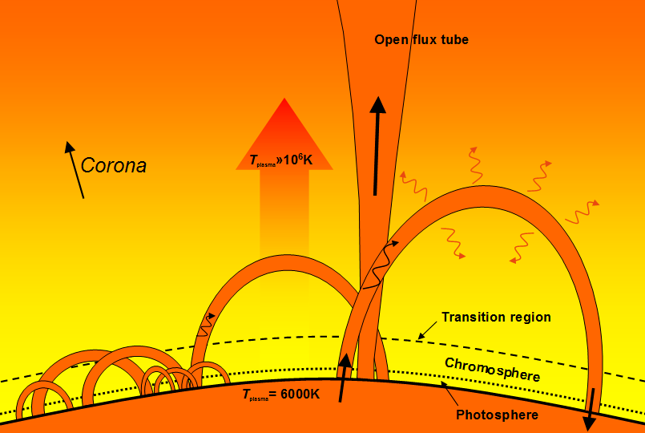
$$accreation columns$$
$$solar flux tubes$$

Slide 4
Non-relativistic case:

Slide 5
$$The Shear Matrix for our flow$$
$$\begin{matrix}\frac{∂U_{x}}{∂x} & \frac{∂U_{x}}{∂y} & \frac{∂U_{x}}{∂z} \\ \frac{∂U_{y}}{∂x} & \frac{∂U_{y}}{∂y} & \frac{∂U_{y}}{∂z} \\ \frac{∂U_{z}}{∂x} & \frac{∂U_{z}}{∂y} & \frac{∂U_{z}}{∂z}\end{matrix}$$
$$\begin{matrix}\begin{aligned}0 \\ \end{aligned} & \begin{aligned}0 \\ \end{aligned} & \begin{aligned}0 \\ \end{aligned} \\ \begin{aligned}0 \\ \end{aligned} & 0 & 0 \\ \frac{∂U_{z}}{∂x} & \frac{∂U_{z}}{∂y} & 0\end{matrix}$$
$$S=$$
$$=$$

Slide 6
The linear approximation for the velocity
${ U}_{i}(x\text{,}\text{y}\text{,}z\text{)} =U_{i}(x_{0}$,$y_{0}$,$z_{0}$) + $\frac{∂U_{i}}{∂x^{k}}(x_{k}−x_{0k})$

Slide 7
$$annihilating the spatial dependance of the derivative:$$
$$S. M . Mahajan and A.D. Rogava 1999$$
$$\frac{du_{j}}{dt}= \frac{∂u_{j}}{∂t}+ U_{i}\frac{∂u_{j}}{∂x_{i}}+\frac{∂U_{j}}{∂x^{k}}u_{k}$$
$$condition on wave vector$$
$$∂_{t}k+ S^{T} ∙k=0$$

Slide 8
$$The equations for the wave vector:$$
$$k_{x}\left(t\right)= k_{x}\left(0\right)− C_{1}k_{z}t$$
$C_{1}={\frac{∂U_{z}}{∂x}}_{x=x_{0}}$= $\frac{−2U_{m}}{R^{2}}x_{0}$
$$k_{y}\left(t\right)= k_{y}\left(0\right)− C_{2}k_{z}t$$
$C_{2}={\frac{∂U_{z}}{∂y}}_{y=y_{0}}$= $\frac{−2U_{m}}{R^{2}}y_{0}$
$$k_{z}=const$$

Slide 9
$$continuity equation for the disturbed media$$
$\frac{∂ρ′}{∂t}+ U_{i}\frac{∂ρ′}{∂x_{i}} + ρ_{0}(\frac{∂u_{x}}{∂x}+\frac{∂u_{x}}{∂x}$ + $\frac{∂u_{x}}{∂x}$ ) = 0

Slide 10
$$the equations of motion$$
$$\frac{∂u_{x}}{∂t}+ U_{i}\frac{∂u_{x}}{∂x_{i}}=−\frac{1}{ρ_{0}}\frac{∂p}{∂x}$$
$$\frac{∂u_{y}}{∂t}+ U_{i}\frac{∂u_{y}}{∂x_{i}}=−\frac{1}{ρ_{0}}\frac{∂p}{∂y}$$
$$\frac{∂u_{z}}{∂t}+ U_{i}\frac{∂u_{z}}{∂x_{i}}+ C_{1}u_{x}+C_{2}u_{y}=−\frac{1}{ρ_{0}}\frac{∂p}{∂z}$$

Slide 11
Final differential equations for the perturbation:
$$\frac{∂}{∂t}$$
$$\frac{∂u_{z}}{∂t}+C_{1}u_{x}+C_{2}u_{y}=−k_{z}\frac{p′}{ρ_{0}}$$
$\text{(}\frac{ρ′}{ρ_{0}}$)=$k_{x}u_{x}+k_{y}u_{y}+k_{z}u_{z}$
$$\frac{∂u_{x}}{∂t}=−k_{x}\frac{p′}{ρ_{0}}$$
$$\frac{∂u_{y}}{∂t}=−k_{y}\frac{p′}{ρ_{0}}$$

Slide 12
$$The relation between the parameters:$$
$$The notations of the new quantities:$$
$$\frac{∂}{∂t}$$
$\text{(}\frac{ρ′}{ρ_{0}}$) = ($k∙u)$
$$C= C_{1}\vec{i}+C_{2}\vec{j}+0$$
$$\frac{∂}{∂t}$$
(C$∙u)$
$$P=\frac{p′}{ρ_{0}}$$
$=−\text{(}C∙k)$P
$$\frac{∂}{∂t}$$
(k$∙u)$
$=−k^{2}$P -2$k_{z}$(C$∙u)$
$Ω$ = k x u
$$\frac{∂}{∂t}$$
(C$∙Ω)$
$$=−∆\text{(}C∙u)$$
$∆$ = $C_{2}k_{x}−C_{1}k_{y}$

Slide 13
$The velocity profile of the pertubation$:
$$where$$

Slide 14
Relativistic case:

Slide 15
$$The linear approximation:$$
$${\text{U}}_{m }\left(1−\frac{{\left(r_{0}+ ∆r\right)}^{2}}{R^{2}}\right)≈\text{U}\left(r_{0}\right) − \frac{2r_{0}{\text{U}}_{m}∆r}{R^{2}}$$
U$\left( r_{0}+ ∆r\right)=$
${U(r}_{0}) ≡ U_{0 }, −\frac{2r_{0}U_{m}}{R^{2}}$ $≡a$
U $\left(r_{0}+ ∆r\right)= U_{0 }$ + a$∆r$

Slide 16
$$\frac{1}{\sqrt{1−\frac{{(V_{m }(1−\frac{(r_{0}^{2})}{R^{2}}))}^{2}}{c^{2}}}}$$
$$γ_{0}=$$
$$γ_{0}(1−\frac{{V_{m}}^{2}{γ_{0}}^{2}∆r{ r}_{0}}{{Rc}^{2}})$$
$$γ\left( r_{0}+ ∆r\right)=$$

Slide 17
$$connecting velocity of the \\ fluid with its four velocity:$$
$$\frac{U_{0 }\text{ + }\text{a}∆r}{\sqrt{1+\frac{{(U_{0 }\text{ + }\text{a}∆r)}^{2}}{c^{2}}}}$$
$$V_{z}\left( r_{0}+ ∆r\right)=$$
$$U_{z}= γV_{z}$$
$U_{z}= U_{0 }$ + a$∆r$
$$V_{z}\left( r_{0}+ ∆r\right)=V_{0}+ (aγ_{0} − \frac{a{γ_{0}}^{2}{U_{0}}^{2}}{c^{2}})∆r$$

Slide 18
$$continuity equation for the fluid$$
ϱ
$\frac{∂}{∂t} +\text{ϱ}$($∇∙V$)= 0

Slide 19
$$y$$
$$x$$
$$no change$$
$$z$$
$$no change$$

Slide 20
$$ργ=ρ_{avg}γ_{0}(1−\frac{{v_{m}}^{2}{γ_{0}}^{2}∆r{ r}_{0}}{{Rc}^{2}})$$
$$\text{ϱ}$$
$$=$$
$$density in the lab frame$$
$$specific mean density$$

Slide 21
$$decomposition of the instantaneous values:$$
$$\frac{{v_{m}}^{2}{γ_{0}}^{2}∆r{ r}_{0}}{{Rc}^{2}}$$
$$α= \frac{V_{m}{γ_{0}}^{2}∆r{ r}_{0}}{{Rc}^{2}}$$
$\text{ϱ}$= ${\text{ϱ} }_{avg}\text{ + }\text{ϱ}\text{′ }$
$$V= V_{avg}+v$$
$$γ= γ_{avg}+ γ^{′}=γ_{0}(1−\frac{{V_{m}}^{2}{γ_{0}}^{2}∆r{ r}_{0}}{{Rc}^{2}}+ αv_{z})$$

Slide 22
$$equations for the pertrubed system:$$
$$\frac{∂\text{ϱ}\text{′}}{∂t}+\left(V_{0}+b∆r\right)\frac{∂\text{ϱ}\text{′}}{∂z}+ ρ_{avg}γ_{0}\left(∇∙v\right)+ b{γ_{0}}^{3}ρ_{avg}v_{y}∆r=0$$
$$b=aγ_{0} − \frac{a{γ_{0}}^{2}{U_{0}}^{2}}{c^{2}}$$
$\frac{∂v_{z}}{∂t}+\left(V_{0}+b∆r\right)\frac{∂v_{z}}{∂z}+bv_{y}+ \frac{V_{0}}{{γ_{0}}^{2}(e+P)}[\frac{∂P^{′}}{∂t}+\left(V_{0}+b∆r\right)\frac{∂P^{′}}{∂z}]+\frac{1}{{γ_{0}}^{4}(e+P)}\frac{∂P′}{∂x}$ = 0
$$avarage proper energy density specific pressure pertrubation (in the fluid rest frame)$$
$\frac{∂v_{y}}{∂t}+\left(V_{0}+b∆r\right)\frac{∂v_{y}}{∂z}+\frac{V_{0}}{{γ_{0}}^{2}(e+P)}\frac{∂P′}{∂y}$ = 0

Slide 23
$$b →0 limit$$

Slide 24
Using methodology from: Andria D. Rogava, Vazha I. Berezhiani and Swadesh M. Mahajan 1998 :
$$d= \frac{ρ′}{ρ_{avg}}$$
$$\frac{∂(d+αv_{z})}{∂τ}=−i (v_{z}+ {\frac{k_{y}}{k_{x}}v}_{y})$$
$$\frac{∂(v_{y} −\left(1−(C_{s }{V_{0})}^{2}\right){γ_{0}}^{2}{\frac{k_{y}}{k_{x}}v}_{z})}{∂τ}=−i(C_{s })^{2}{\frac{k_{y}}{k_{x}}V}_{0}(v_{z}+ {\frac{k_{y}}{k_{x}}v}_{y})$$
$$c=1$$
$$C_{s } =\frac{1}{√3}$$

Slide 25
$$The final result:$$
$(C_{s }{V_{0})}^{2}d\frac{k_{y}}{k_{x}}+αv_{z}(C_{s })^{2}{\frac{k_{y}}{k_{x}}V}_{0}$ = $v_{y} −\left(1−(C_{s }{V_{0})}^{2}\right){γ_{0}}^{2}{\frac{k_{y}}{k_{x}}v}_{z}$ + const

Slide 26
$Energy of the petrubation$:
Rogava, Berezhiani and Swadesh Mahajan 1998
$$E\left(τ\right)= \frac{1}{2} ( {v_{z}}^{2}+\frac{{v_{y}}^{2}}{{γ_{0}}^{2}}+\frac{{{(C}_{s}d)}^{2}}{{γ_{0}}^{4}})$$
$$E\left(τ\right) always increases$$

Slide 27
$$relativistic vs non−relativistic$$

Slide 28
$$conserved quantites:$$
$(C_{s }{V_{0})}^{2}d\frac{k_{y}}{k_{x}}+αv_{z}(C_{s })^{2}{\frac{k_{y}}{k_{x}}V}_{0}$ ${− v}_{y}$ $$+ \left(1−(C_{s }{V_{0})}^{2}\right){γ_{0}}^{2}{\frac{k_{y}}{k_{x}}v}_{z}$$
$$relativistic$$
$$non−relativistic$$

Slide 29
$$different energetic behaivour$$

Slide 30
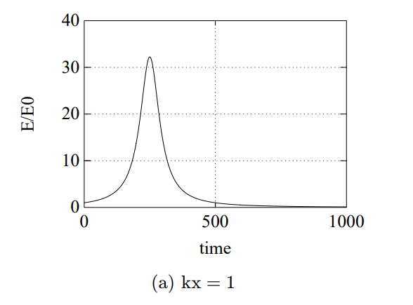
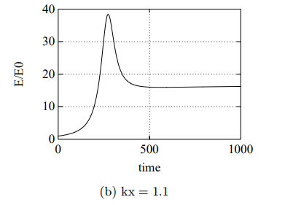
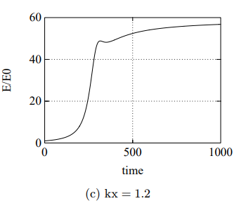
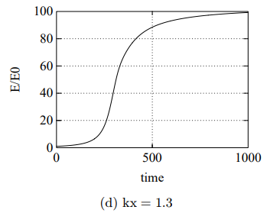
$$Andria Rogava 2000$$
$$different \\ behaivour$$

Slide 31
$$references:$$
S. M. Mahajan and A. D. Rogava, “What can kinematic complexity of astrophysical shear flows lead to?” Astrophys. J. 518, 814 (1999).
https://www.newscientist.com/article/2264389-black-holes-leak-energy-when-they-eat-plasma-near-the-event-horizon/
https://www.researchgate.net/figure/Schematic-view-of-the-accretion-column-Seed-photons-are-created-along-the-column-via_fig1_225307767
https://www.researchgate.net/figure/The-atmosphere-of-the-Sun_fig1_233866254
ACOUSTICS OF KINEMATICALLY COMPLEX SHEAR FLOWS∗ ANDRIA ROGAVA
Acoustic Phenomena in Relativistic Shear Flows Andria D. Rogava,1 Vazha I. Berezhiani2 and Swadesh M. Mahajan3

Slide 32
$$Thank you for your attention!$$

