Slide 1
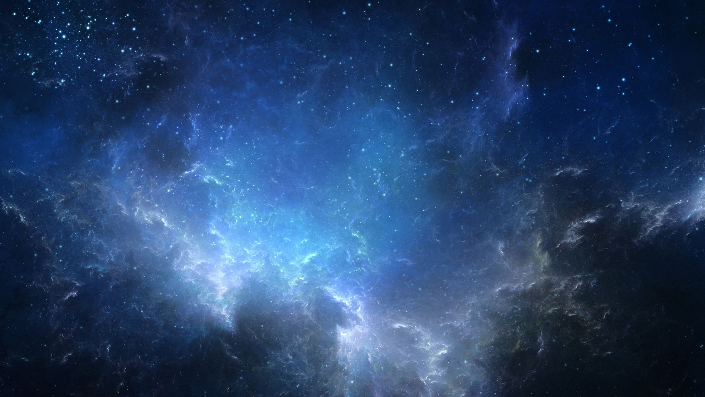
The effect of time density of data on the probability of detecting nearby planets in gravitational microlensing events
The effect of time density of data on the probability of detecting nearby planets in gravitational microlensing events
Nazanin Madakhel
Sedigheh Sajadian
Nazanin Madakhel
Sedigheh Sajadian

Slide 2
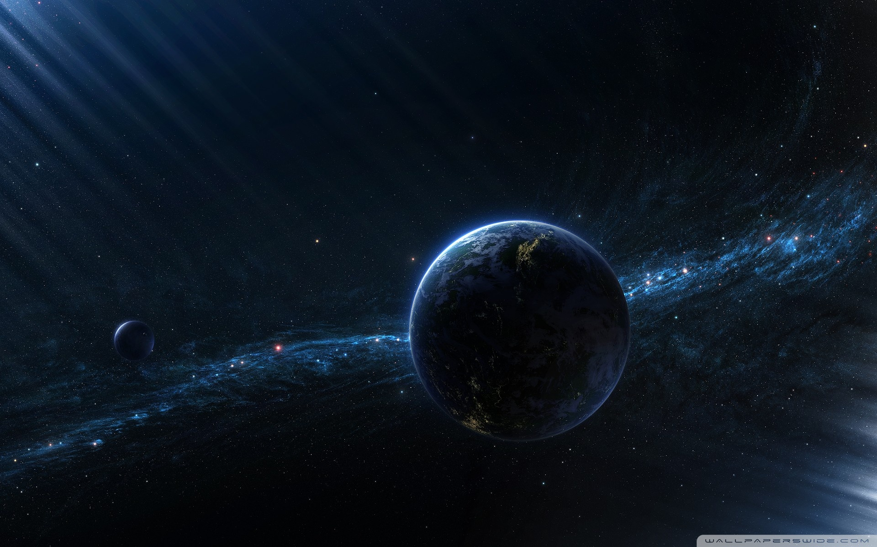
Have you ever thought about how planets are detected by telescopes despite their very low light?

Slide 3
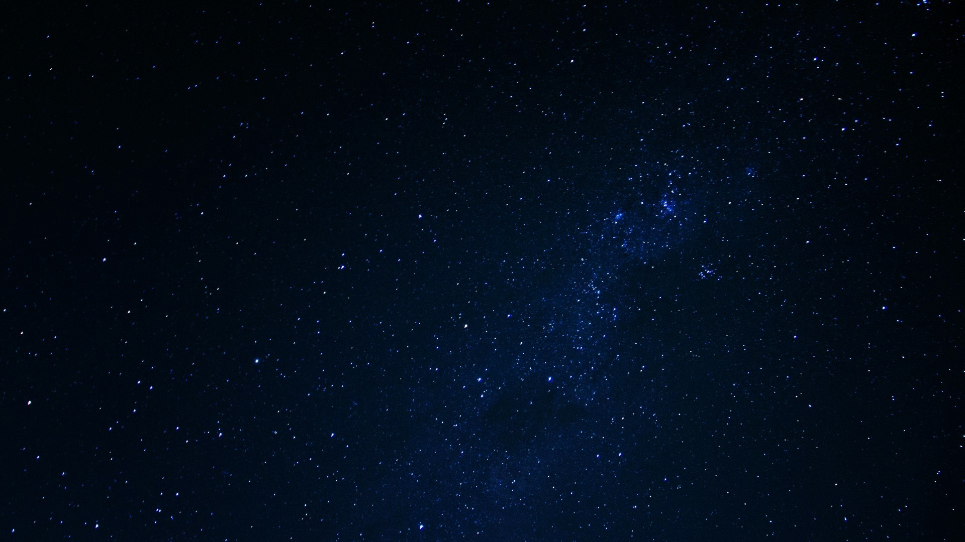
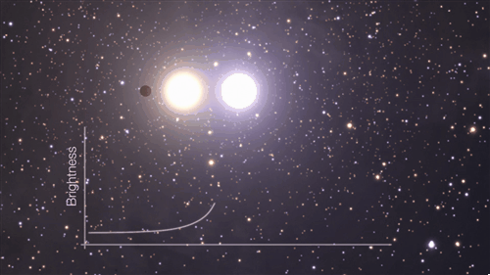
An introduction to gravitational microlensing
Gravitational microlensing is one of the interesting astrophysical phenomena that allows us to identify celestial objects that are not precisely visible.
This phenomenon is based on Einstein's general relativity. (In 1915, Einstein presented his theory of general relativity, showing that space and time are distorted by mass and energy)
When a large object (lens) is in our line of sight and a distant object (source), the light from the source is refracted by the lens and we can see an amplified and sometimes multiple image of the source.

Slide 4
What happens in gravitational microlensing according to general relativity?

Slide 5
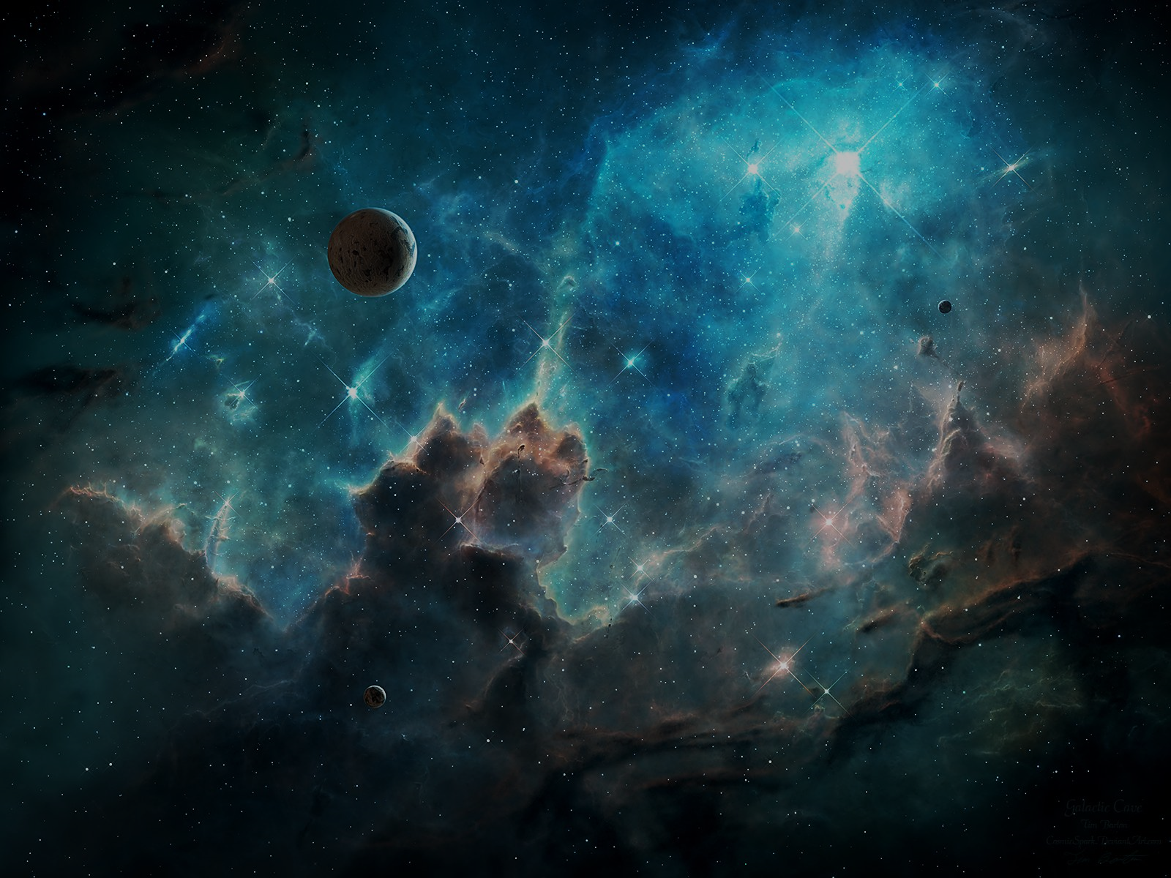
Types of gravitational lensing
Strong lensing occurs when the gravitational field of a massive object, such as a galaxy, produces multiple distinct images of a single background object.
strong lensing
Weak lensing does not produce multiple images but instead results in a highly deformed or stretched image of a background object. This effect allows for the observation of very distant galaxies that would otherwise be too faint to detect.
Types of gravitational lensing
weak lensing
In microlensing, the gravitational field of a foreground object, such as a star, temporarily increases the brightness of a background object without distorting its shape. The light amplification varies periodically due to the presence of planets around the lensing star.
microlensing

Slide 6
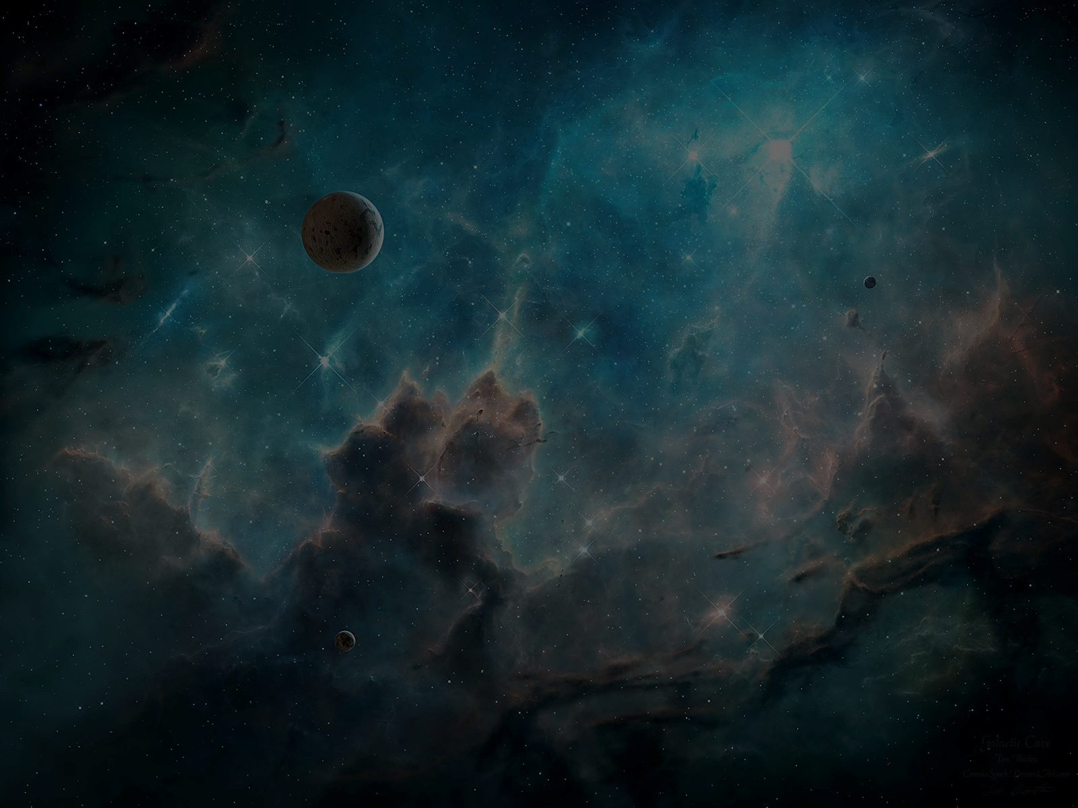
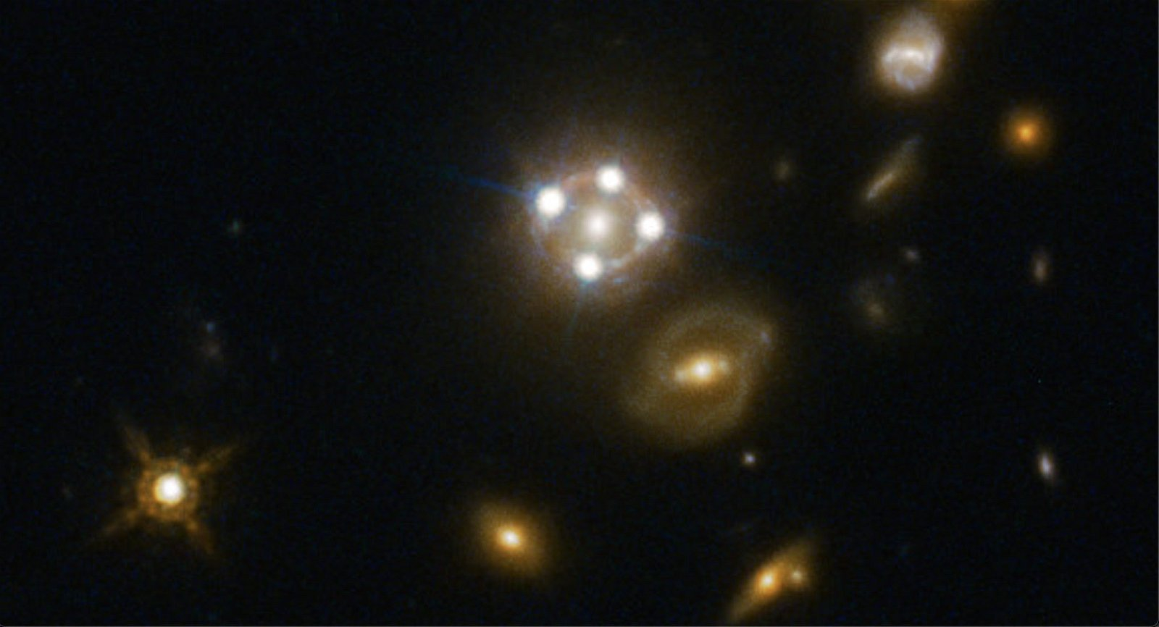
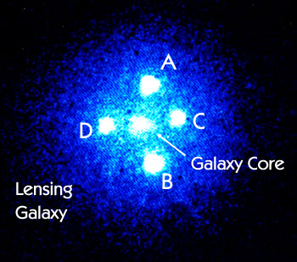
Example of strong lensing (Einstein's cross)
A well-known example is Einstein's Cross (Q2237+0305), where the gravitational lensing of a galaxy 400 million light-years away creates four separate images of a single quasar 8 billion light-years away.

Slide 7
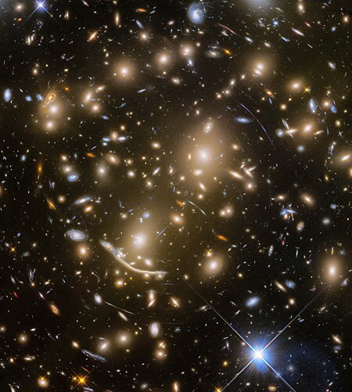
Example of Weak Lensing (cluster Abell 370)
The phenomenon was first observed in 1986 in cluster Abell 370, revealing a greatly deformed image of a distant galaxy.

Slide 8
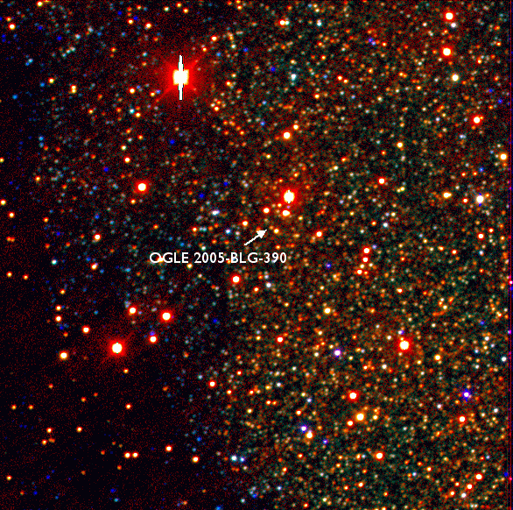
Example of Microlensing(OGLE-2005-BLG-390-Lb)
The first exoplanet discovered using microlensing was OGLE-2005-BLG-390-Lb on January 25, 2006. The planet was detected by observing periodic changes in the light from a more distant star caused by the gravitational field of the closer star and its planet.
Point: Microlensing is particularly useful for detecting exoplanets by observing the light from distant stars as it is bent and amplified by the gravitational fields of closer stars and their planets.

Slide 9
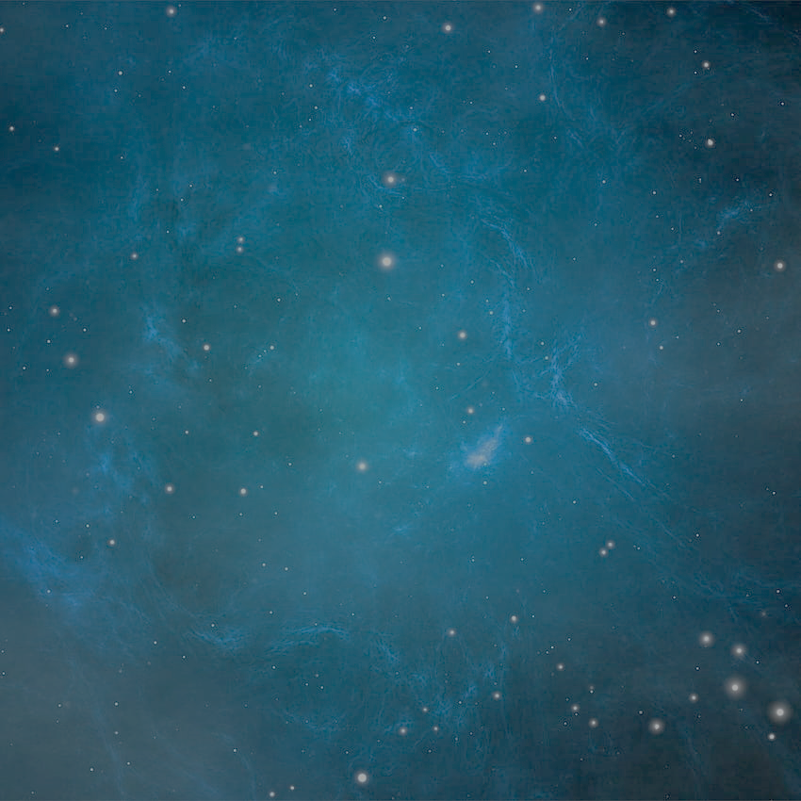
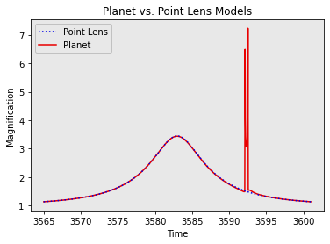
Changes in light amplification in gravitational microlensing
Disruption in the light curve of a gravitational microlensing event caused by the presence of a planet.

Slide 10
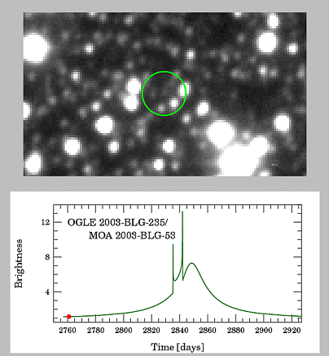
Light variations during the detection of a planet in gravitational microlensing

Slide 11
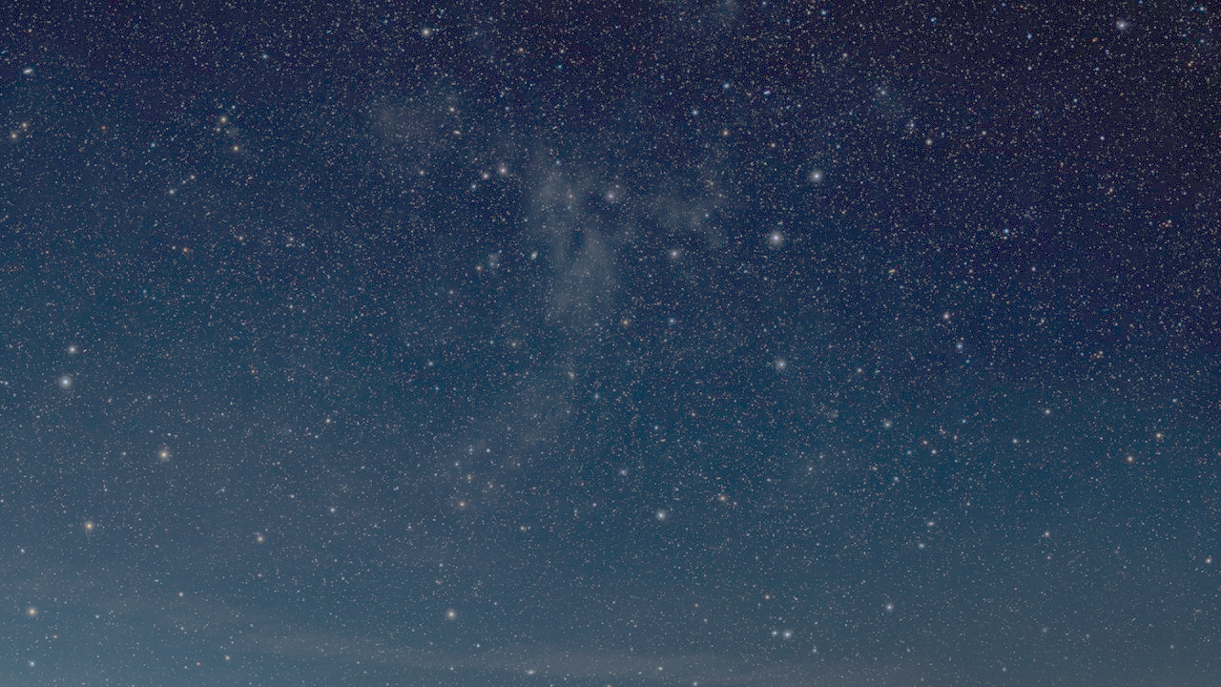
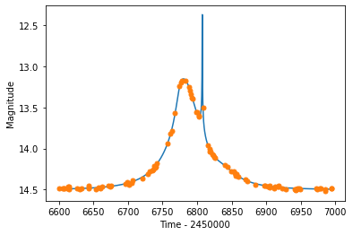
Data simulation in a gravitational microlensing event

Slide 12
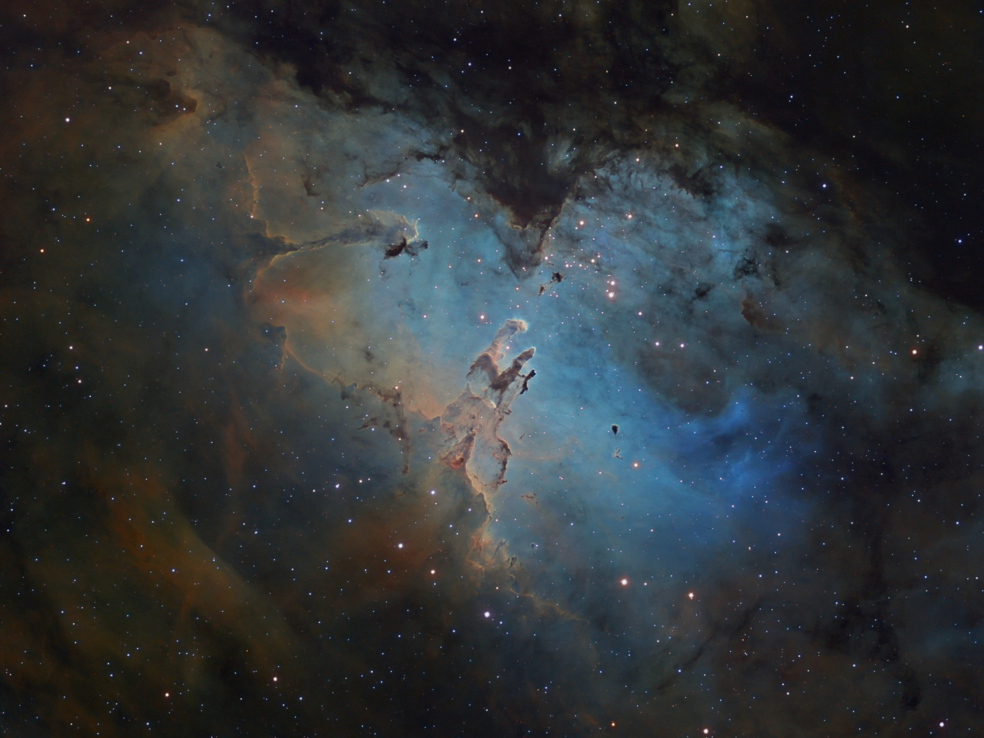
The sequence of steps in the simulation process
Data Generation:
I simulated 100 data points over a specific time range to generate light curves. Various parameters, including mass ratio (q), impact parameter ($u_{0}$), and separation between the two objects (S), were adjusted to analyze their effects on the likelihood of detecting gravitational microlensing events. Parameters such as the angle of impact and Einstein radius ($t_{E}$) were kept constant.
S: فاصله بین دو جسم (لنز اولیه و همدم آن)
q: نسبت جرم
u0: پارامتر برخورد یا حداقل فاصله زاویه‌ای (به واحد شعاع اینشتین) بین مسیر نوری منبع و عدسی گرانشی
Light Curve Simulation:
Initially, I simulated 450 light curves with a logarithm of q set to -1, using different values for S and $u_{0}$. Then, an additional 450 light curves were simulated for logarithms of q equal to -2 and -3, resulting in a total of 2700 light curves. The detection probability of events was compared across these simulations.
Increasing Data Points:
The number of data points was increased to 120, and the same parameters were applied to observe potential changes in the detection probability of double lensing events in gravitational microlensing.

Slide 13
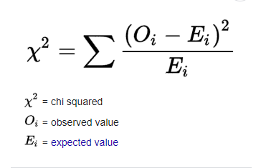
The sequence of steps in the simulation process
Detection Criteria:
To determine if a gravitational microlensing event with specific parameters is detectable, the chi squared parameter was used. The difference between the chi squared values of a fitted light curve under normal conditions and one in the presence of a double lensing event was used to identify anomalies. If the difference exceeded 50, the double lensing event was considered detectable; otherwise, the data would show a normal light curve.
S: فاصله بین دو جسم (لنز اولیه و همدم آن)
q: نسبت جرم
u0: پارامتر برخورد یا حداقل فاصله زاویه‌ای (به واحد شعاع اینشتین) بین مسیر نوری منبع و عدسی گرانشی
Analysis and Interpretation:
I analyzed how variations in parameters such as mass ratio (q) and impact parameter ($u_{0}$) affected the shape and characteristics of the light curves. Increasing the number of data points and examining their effects on the light curves showed that changes in observation timing could significantly impact the detection and analysis of gravitational microlensing events.

Slide 14
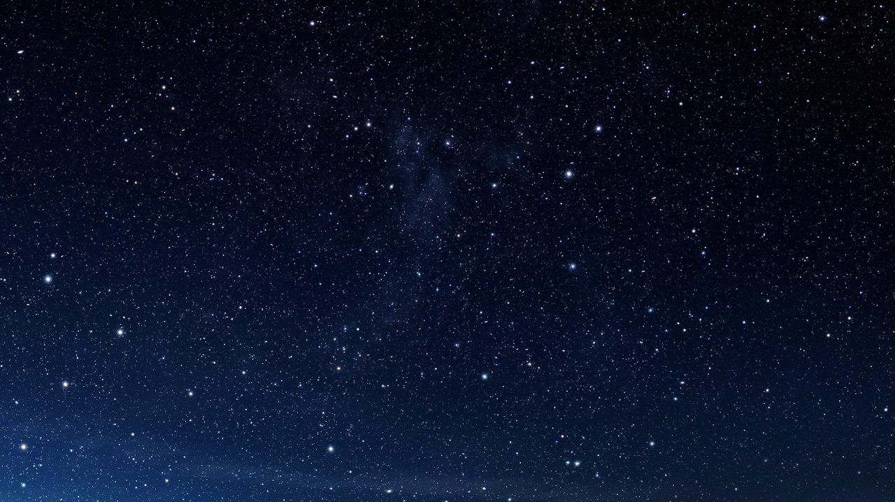
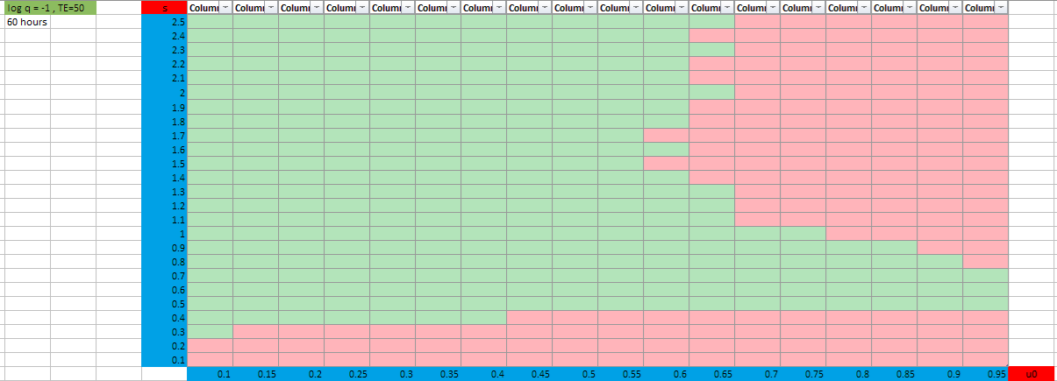
Comparison of the tables derived from the plotted charts with
log q = -1
The detection probability for the upper table is 56.8% and for the lower table is 60%.
Cadence= $72 h$
Cadence= $60 h$

Slide 15
Results Table
As you can see, the likelihood of detection increases with a greater number of data points (shorter cadence).
Probability of detection | Cadence | Number of data | Log(q)
%56.889 | 72 hours | 100 | $$−1$$
%60 | 60 hours | 120 | $$−1$$
%10.444 | 72 hours | 100 | $$−2$$
%11.778 | 60 hours | 120 | $$−2$$
%0.2222 | 72 hours | 100 | $$−3$$
%0.222 | 60 hours | 120 | $$−3$$

Slide 16
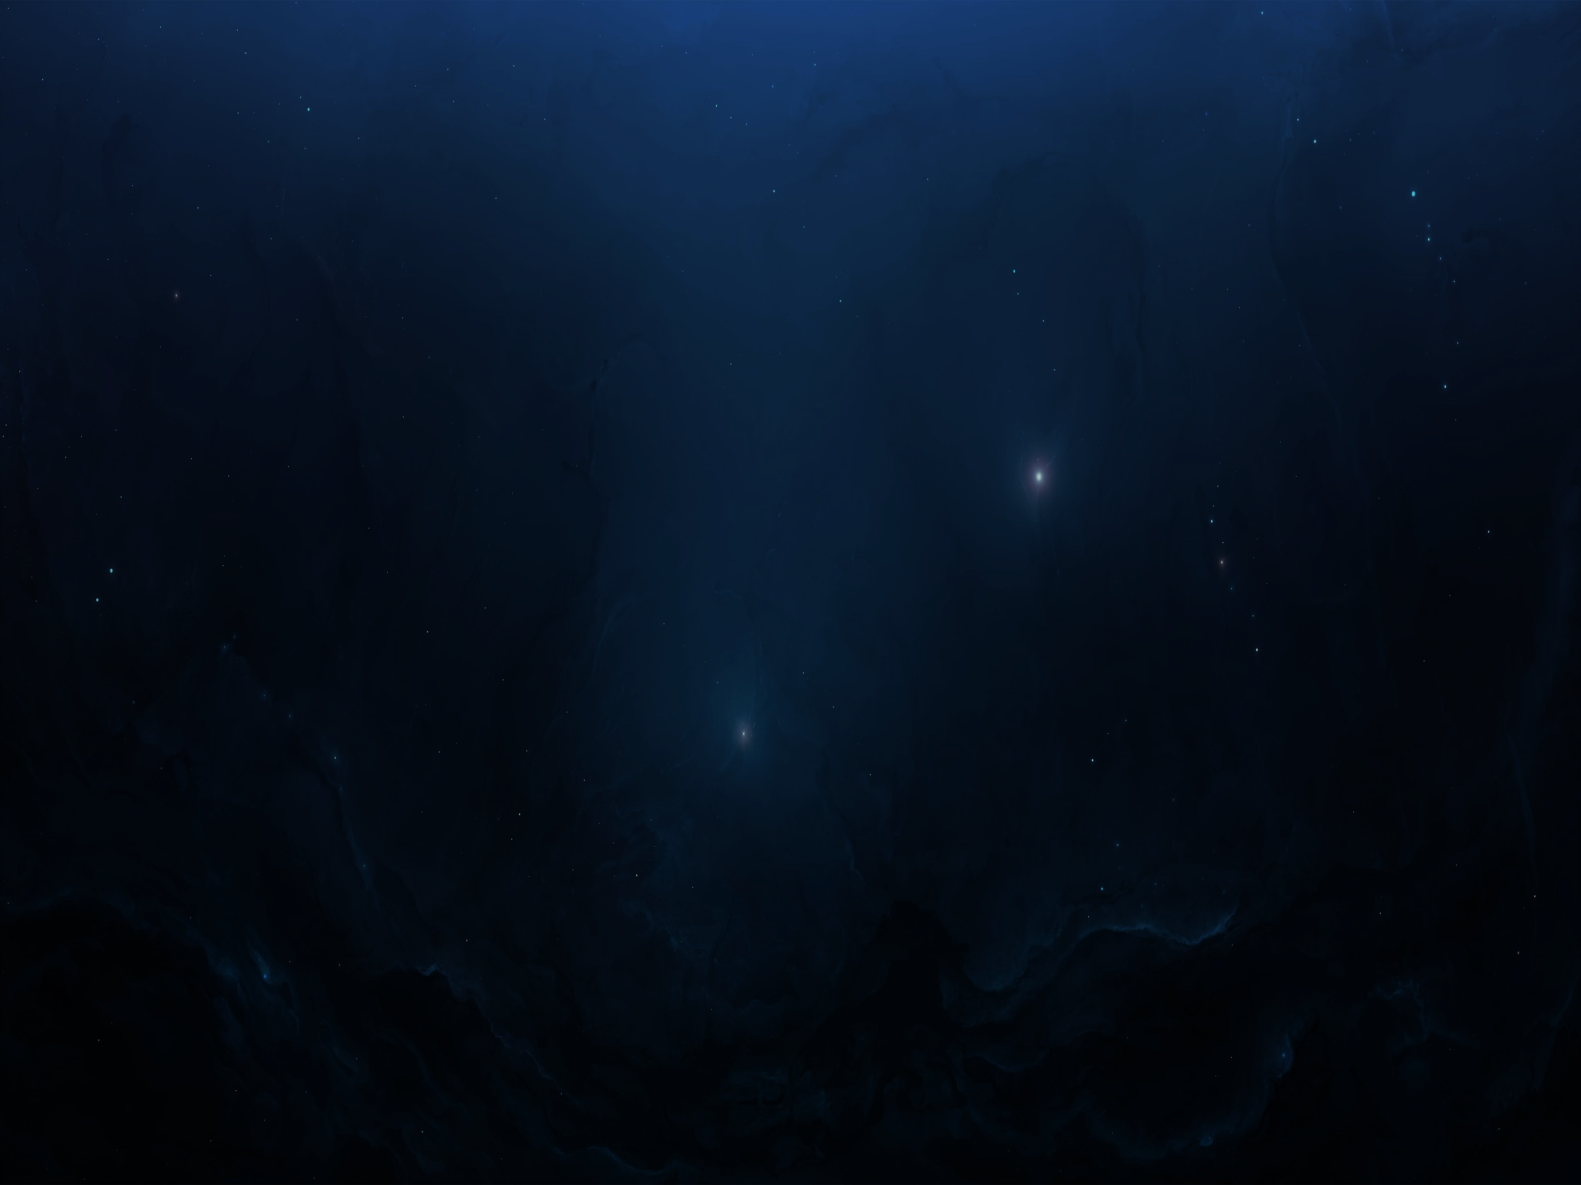
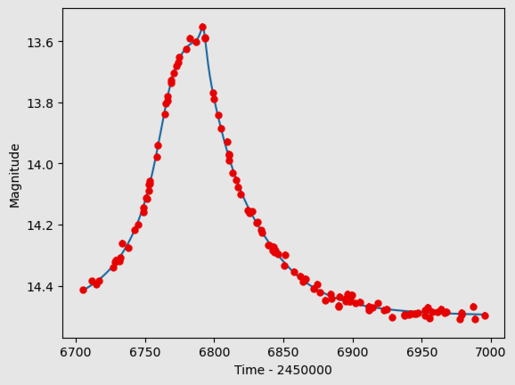
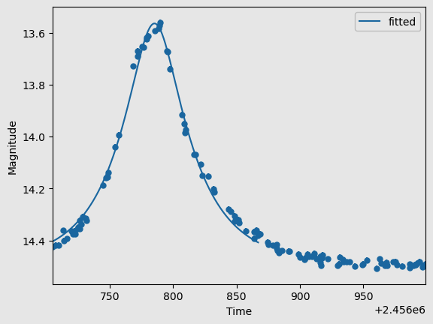
A sample of two simulated light curves using the data is shown: one fitted considering the presence of a double lens (left, chi-squared = 129) and the other without considering it (right, chi-squared = 416). Due to the Chi-squared difference exceeding 50, this double lensing event is detectable and thus is marked green in the table. Specifications:
$$u_{0}=0.5, s=1, \log\left(q\right)=−1$$

Slide 17
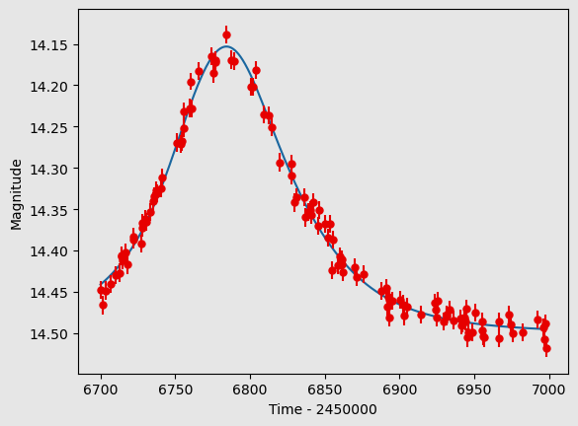
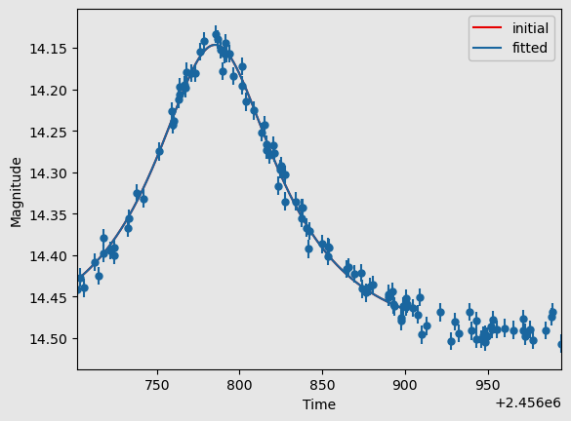
A sample of two simulated light curves using the data is shown: one fitted considering the presence of a double lens (left, chi-squared = 126) and the other without considering it (right, chi-squared = 126). Due to the Chi-squared difference being less than 50, this double lensing event is not detectable and is thus marked red in the table. Specifications:
$$u_{0}=0.95, s=1, \log\left(q\right)=−1$$

Slide 18
Rsult
The results of this project demonstrated that through data generation and simulation of light curves, we can achieve a deeper understanding of gravitational microlensing phenomena and the impact of various parameters. This knowledge can improve observational techniques and increase accuracy in identifying faint and distant objects, such as exoplanets and isolated dark bodies. Additionally, the project showed that by decreasing the interval between observation times and increasing the number of data points, the likelihood of detecting planets in microlensing events can be significantly enhanced. Overall, by precisely adjusting parameters and optimizing observation timings, we can significantly increase the likelihood of successfully detecting and analyzing gravitational microlensing events.
S: فاصله بین دو جسم (لنز اولیه و همدم آن)
q: نسبت جرم
u0: پارامتر برخورد یا حداقل فاصله زاویه‌ای (به واحد شعاع اینشتین) بین مسیر نوری منبع و عدسی گرانشی

Slide 19
Thank you for your attention!
If you have any questions or need further information, please feel free to contact me.
Email: nazaninmadakhel@gmail.com
S: فاصله بین دو جسم (لنز اولیه و همدم آن)
q: نسبت جرم
u0: پارامتر برخورد یا حداقل فاصله زاویه‌ای (به واحد شعاع اینشتین) بین مسیر نوری منبع و عدسی گرانشی

