Slide 1



Ultrafast pulses and time-resolved spectroscopy of molecular crystals
Robert Schwarzl
Graz University of Technology

Slide 2
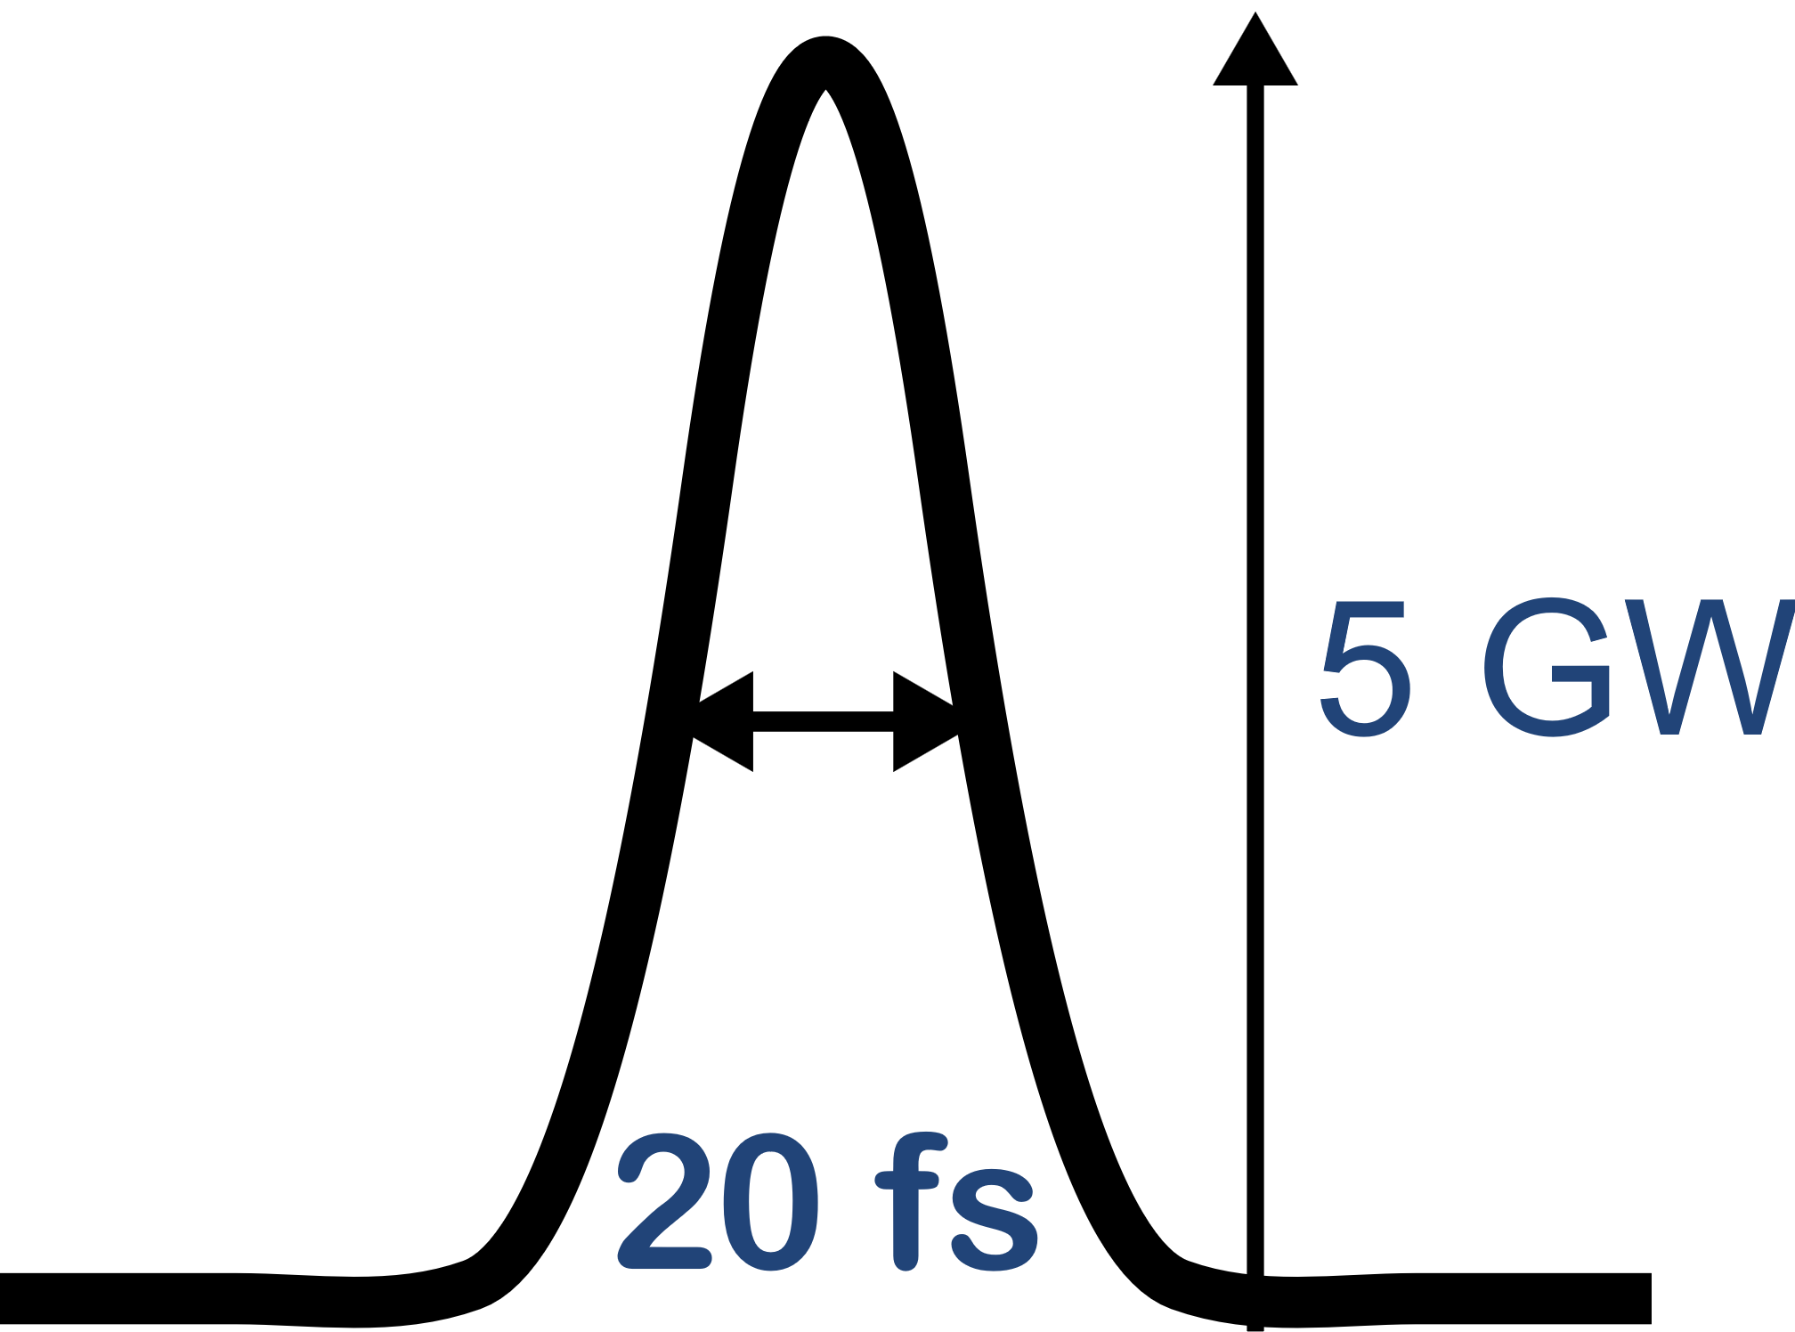
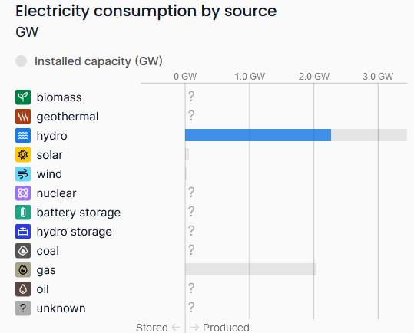
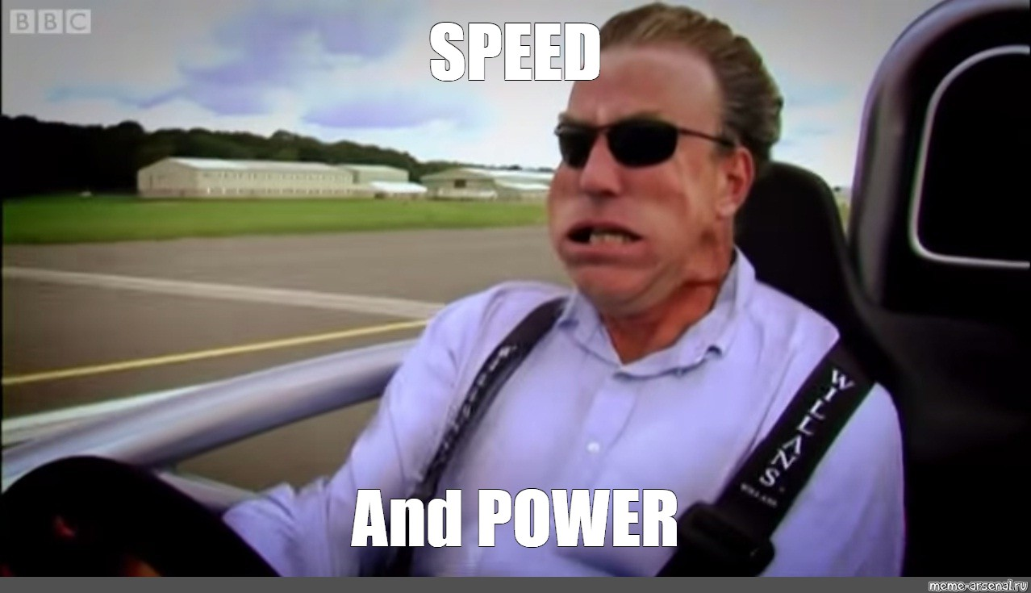
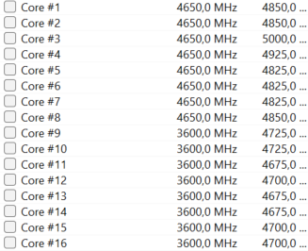
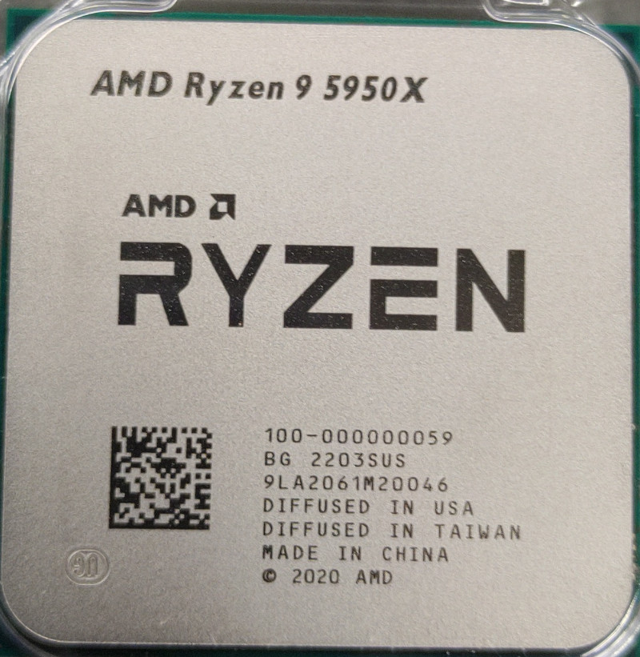
Motivation: Speed and power
2 times the power of our host country
10,000 times as fast as my desktop CPU
2.3 GW of electrical energy for the entirety of Georgia
(remarkable amount of renewables!)
5 GHz =
200 ps clock cycle

Slide 3
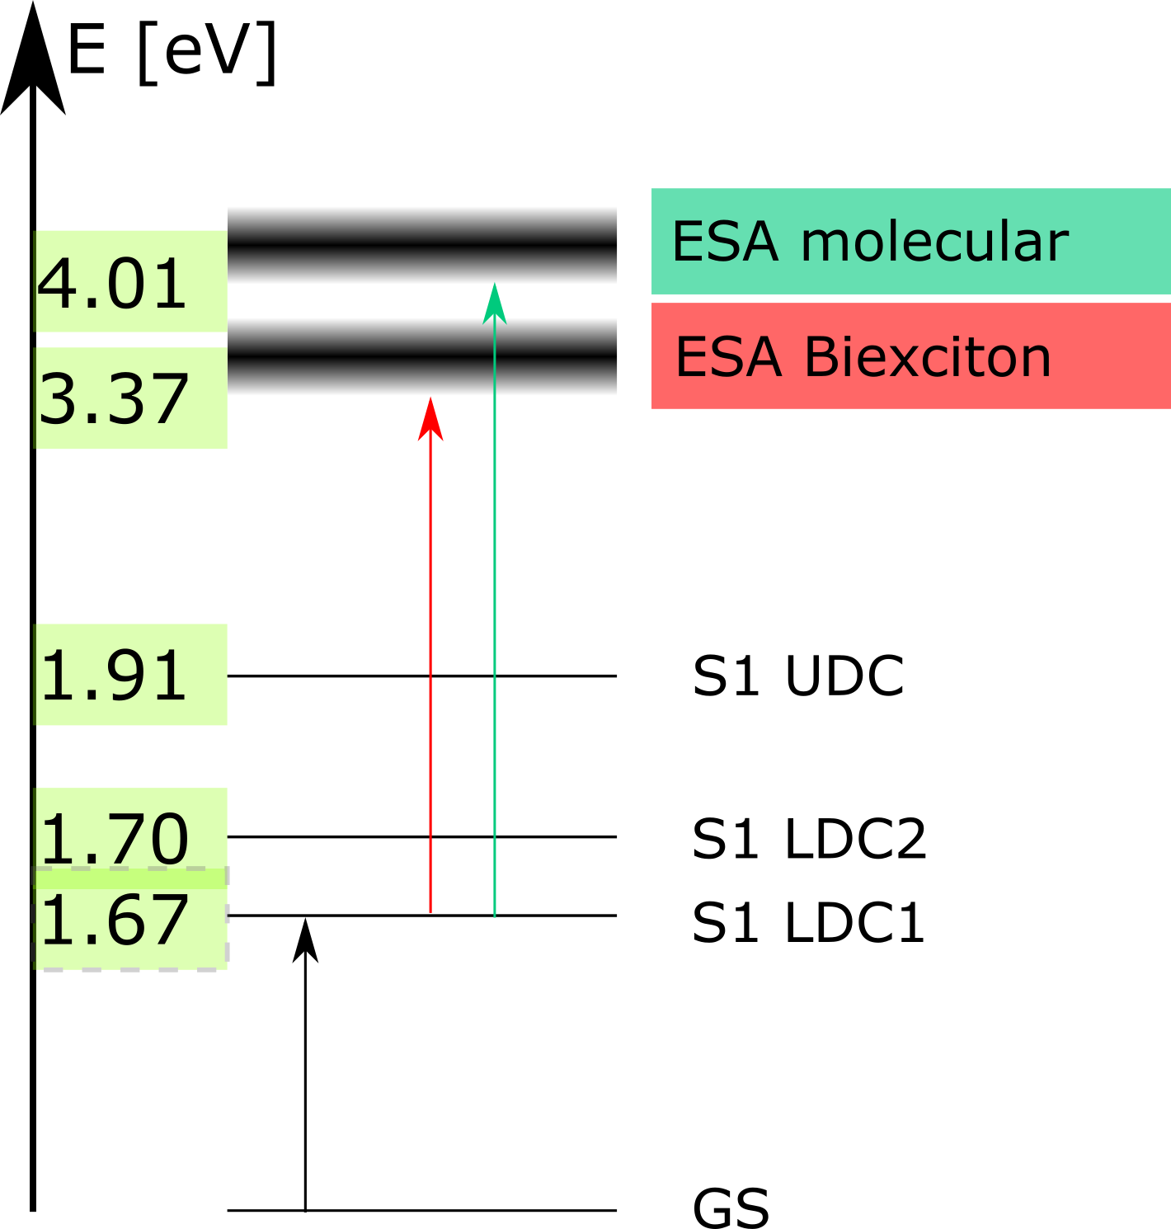
Motivation: Higher excited states
Higher excited states can‘t be excited directly from the ground state
  See what states can be reached from a previous excitation (Excited State Absorption)
Transient absorption
spectroscopy
Conventional (CW) spectroscopy

Slide 4
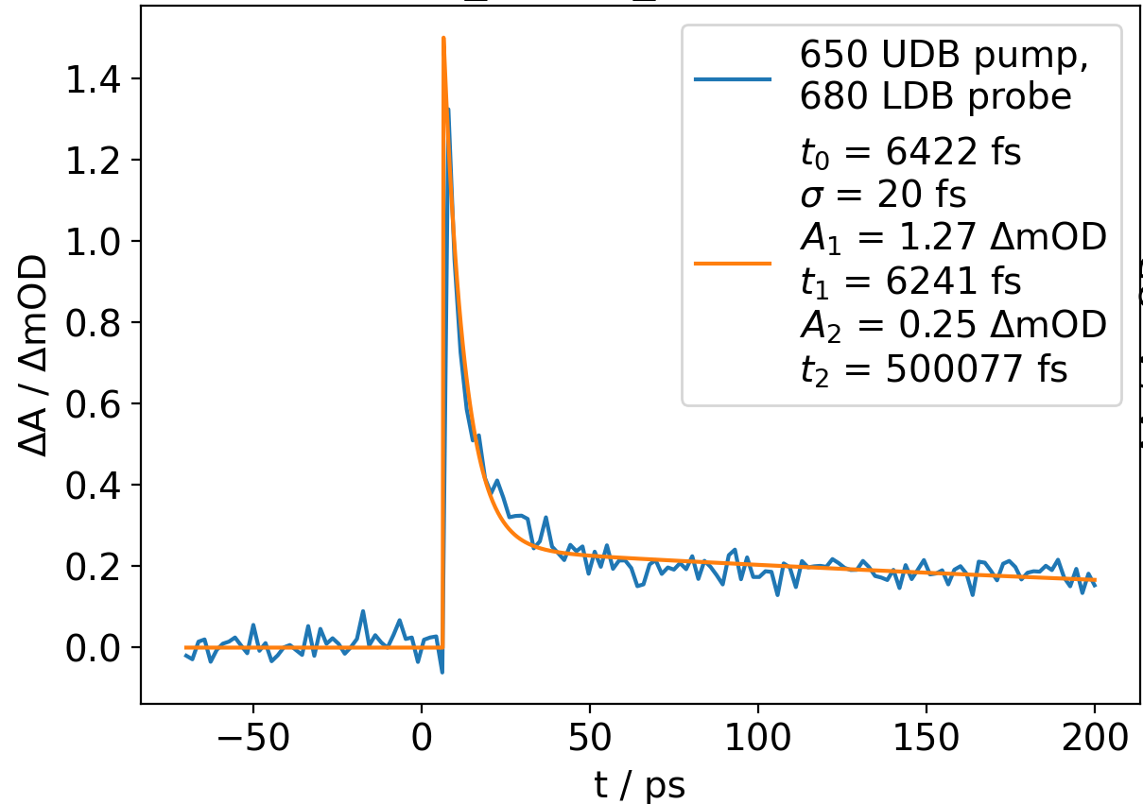
Motivation: Excitation dynamics at native time scales
Nuclear dynamics (vibration, excited state relaxation) happen within femto- to picoseconds
Combine spectral and temporal resolution in dense media

Slide 5
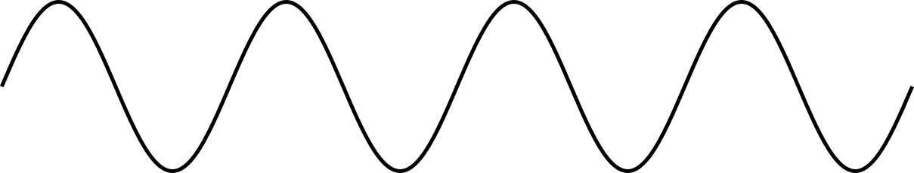
Let‘s build a simple laser…
Light
Amplification by
Stimulated
Emission of
Radiation
Energy into gain medium
Energy output
Mirror
Transp. Mirror

Slide 6
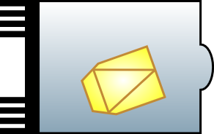
… pulse it…
Nanosecond laser (see laser ablation student lecture)
Possible with laser diodes
Energy into gain medium
Energy output
Mirror
Optical switch
Transp. Mirror
Fast electronics

Slide 7
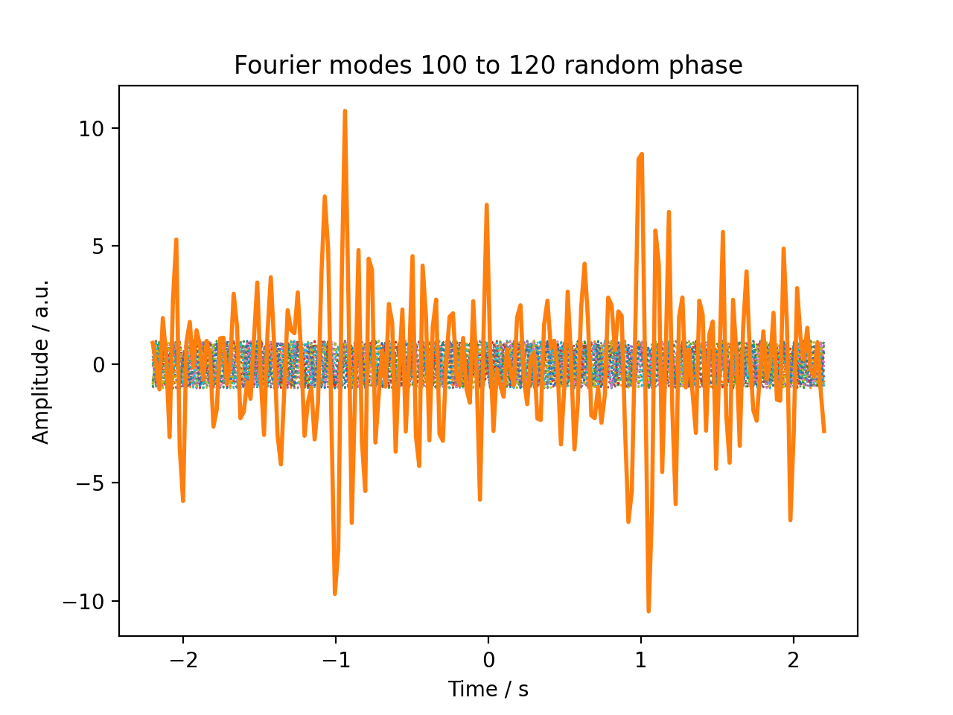
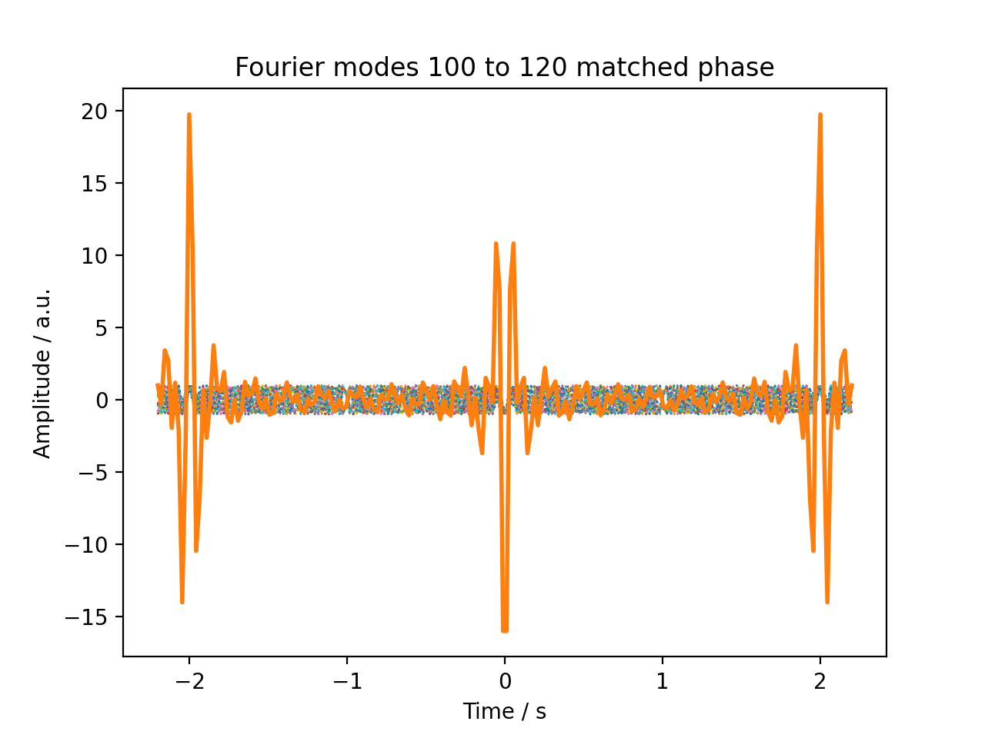


… make our laser faster…
$φ_{n} random$
$φ_{n}=0$
Ahmed Zewail, nobel laureate 1999
„For the invention of femtochemistry“
CC-BY-SA 3.0 Wikipedia/Science History Institute

Slide 8
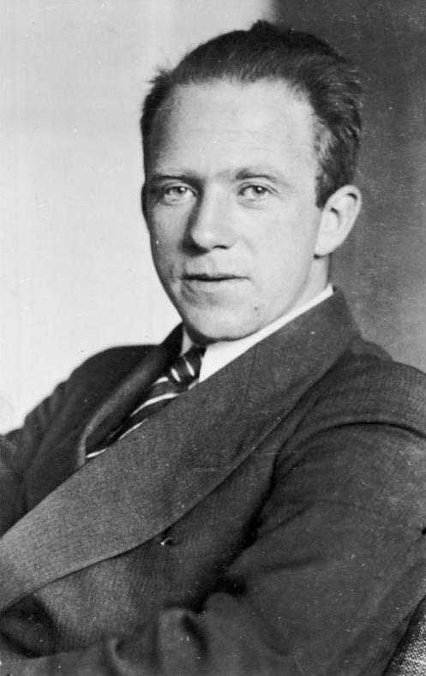
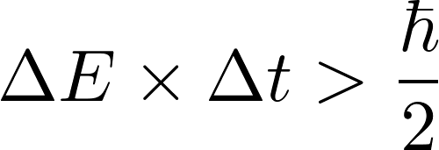
… hit physical limits…
(transform-limited pulses)
Werner Heisenberg
Nobel prize „for the creation of quantum mechanics”
Deutsches Bundesarchiv/Wikipedia
The shorter your pulses, the more colorful they have to be:

Slide 9
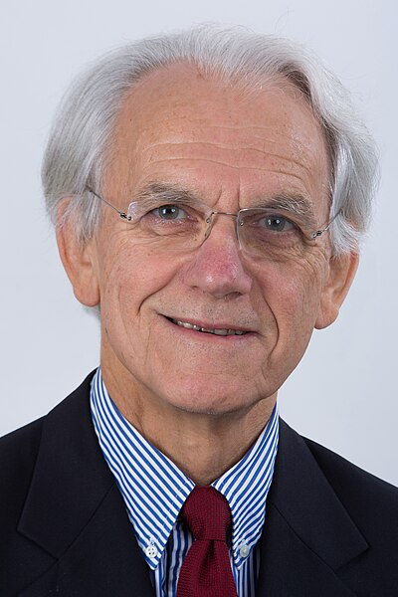
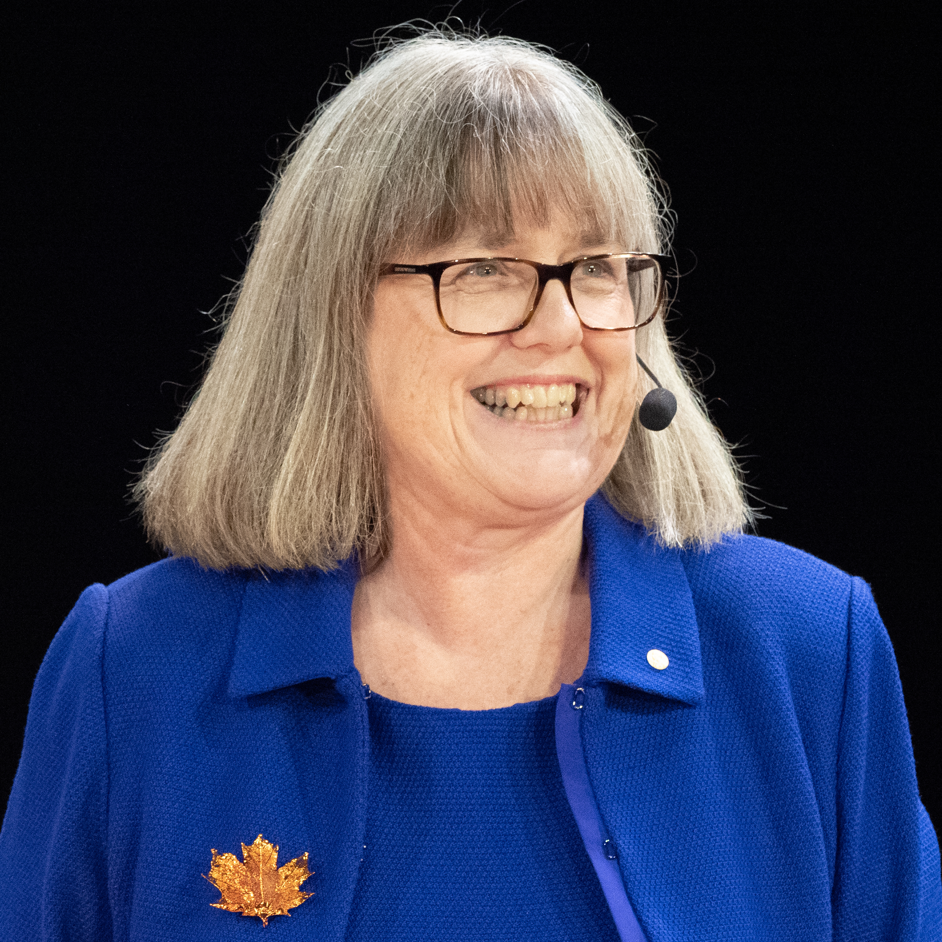
… amplify it…
Stretch pulses to ps or ns (less destructive)
Attenuate central wavelengths (would be amplified the most)
Amplify in a second laser medium
Compress to fs
Gérard Mourou, Donna Strickland
for their method of generating high-intensity, ultra-short optical pulses, 2018

Slide 10
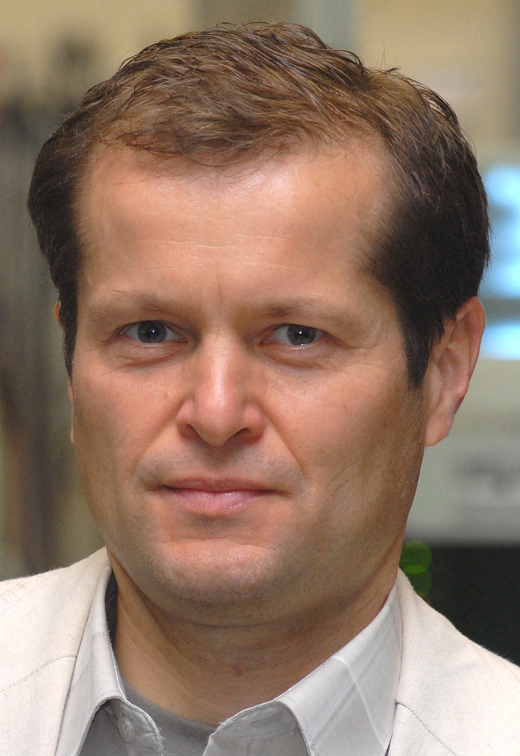
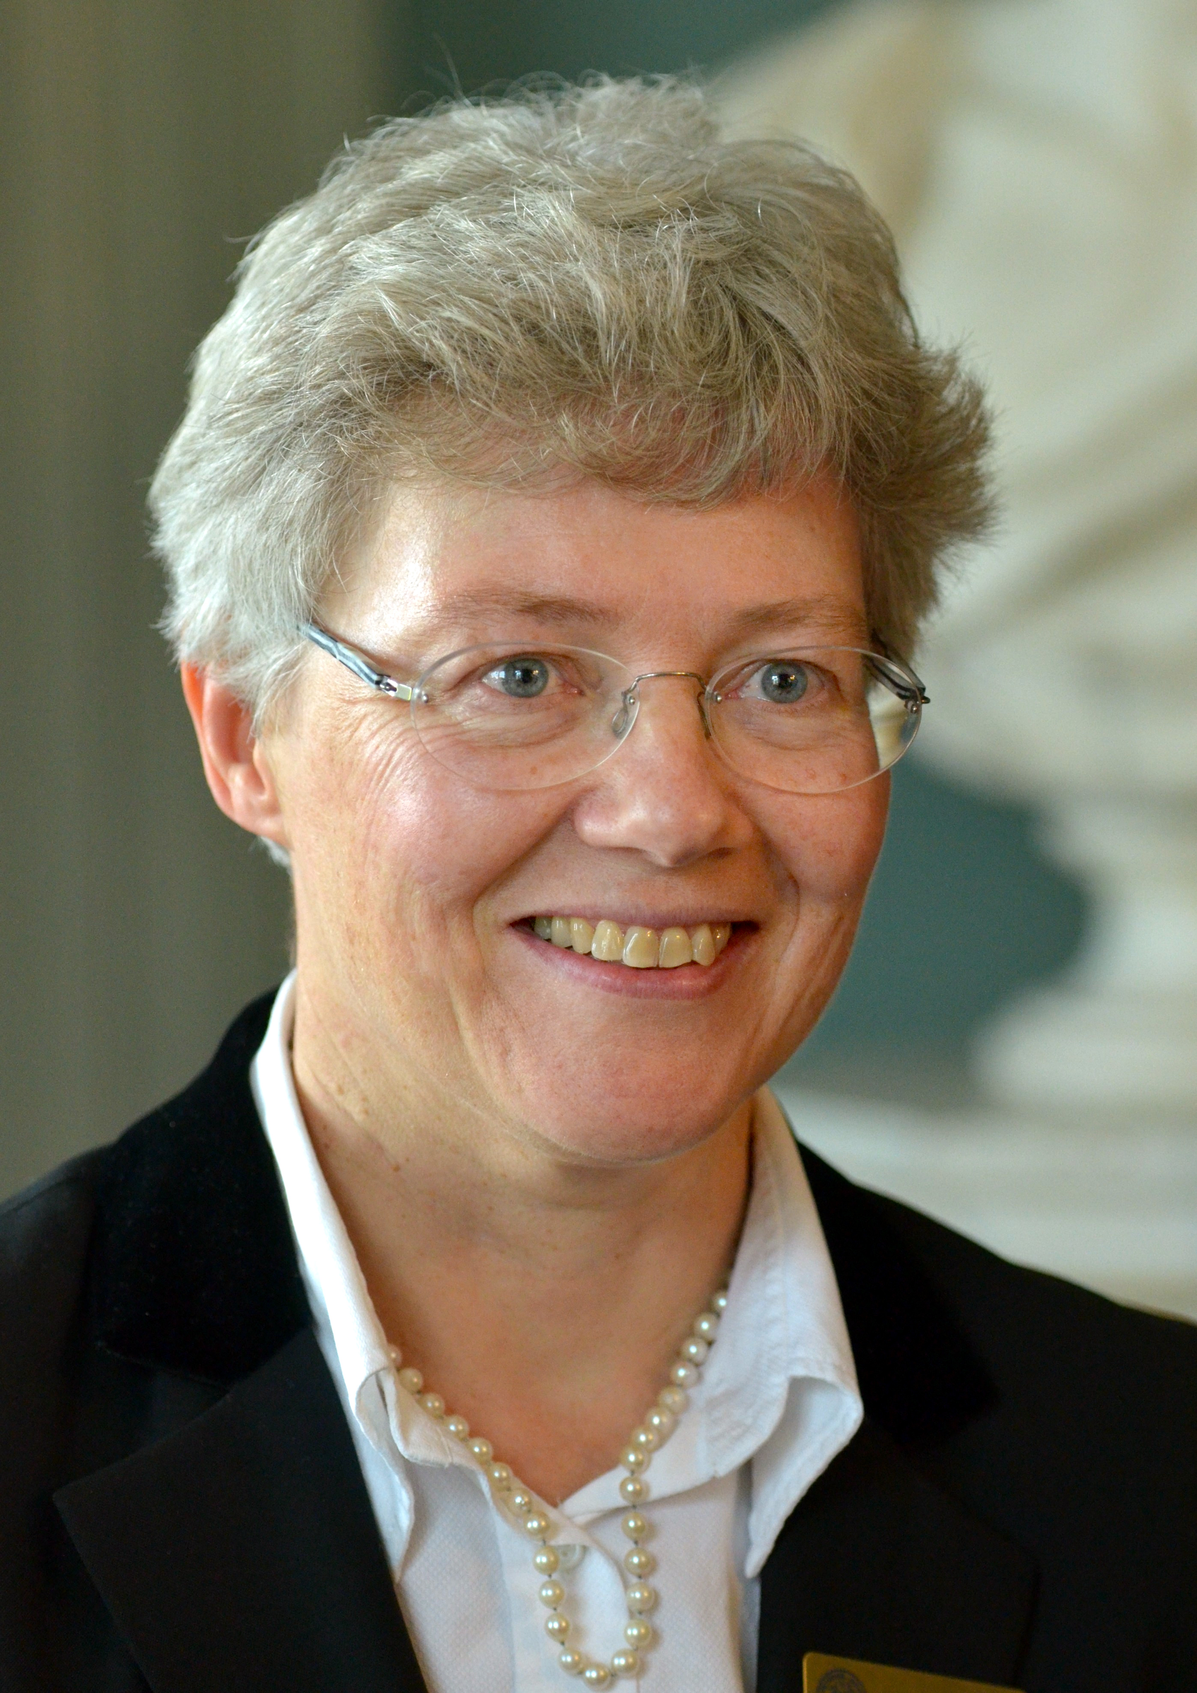
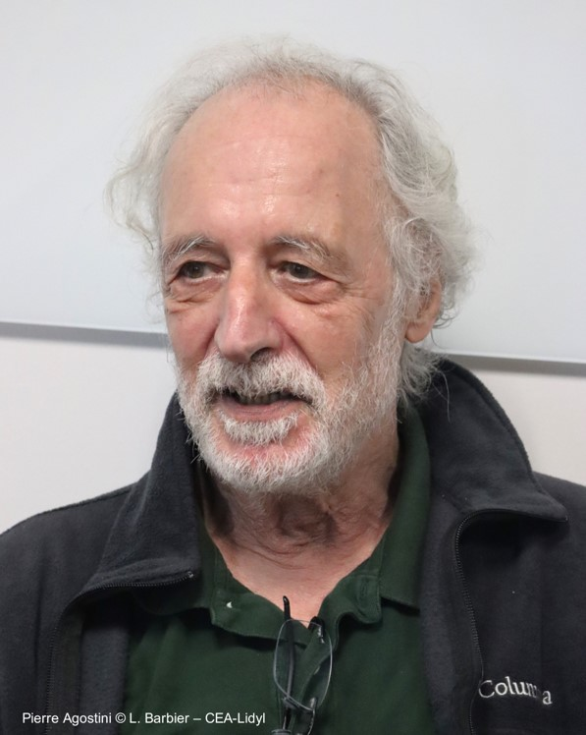
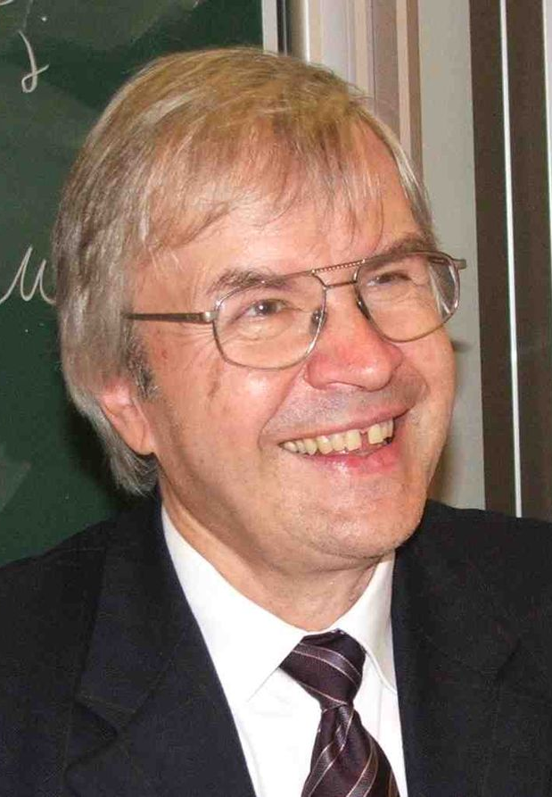
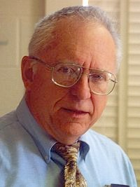
… and apply it.
Ferenc Krausz, Anne L’Huiller, Pierre Agostini
for experimental methods that generate attosecond pulses of light for the study of electron dynamics in matter, 2023
Theodor W. Hänsch, John L. Hall
for their contributions to the development of laser-based precision spectroscopy, including the optical frequency comb technique, 2005

Slide 11
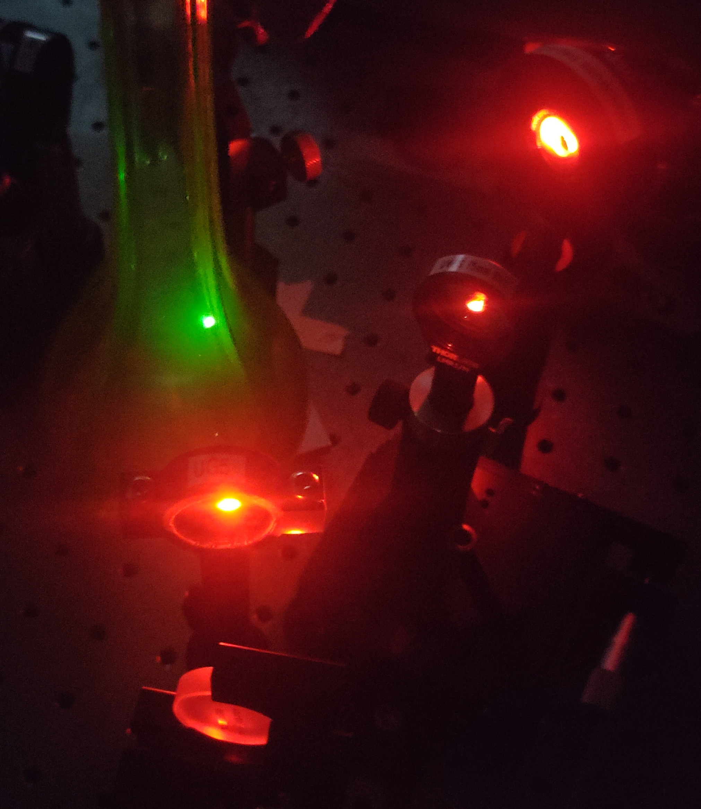
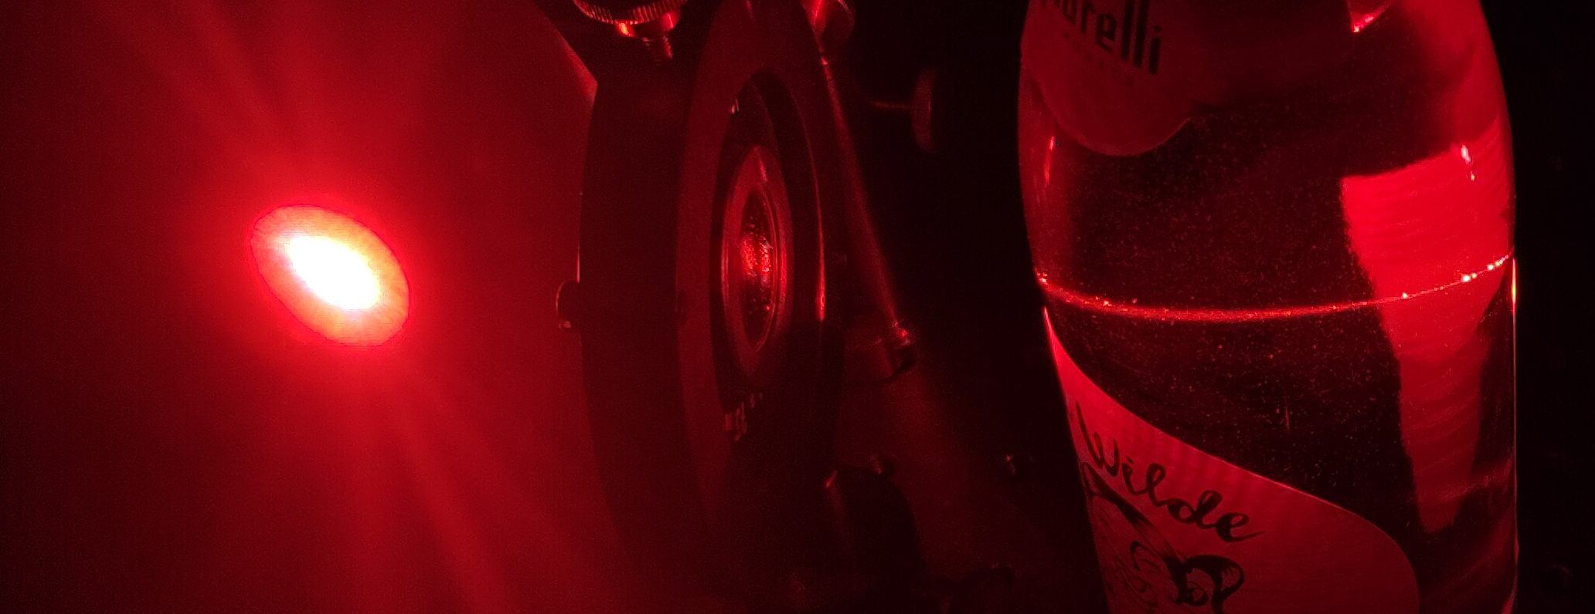
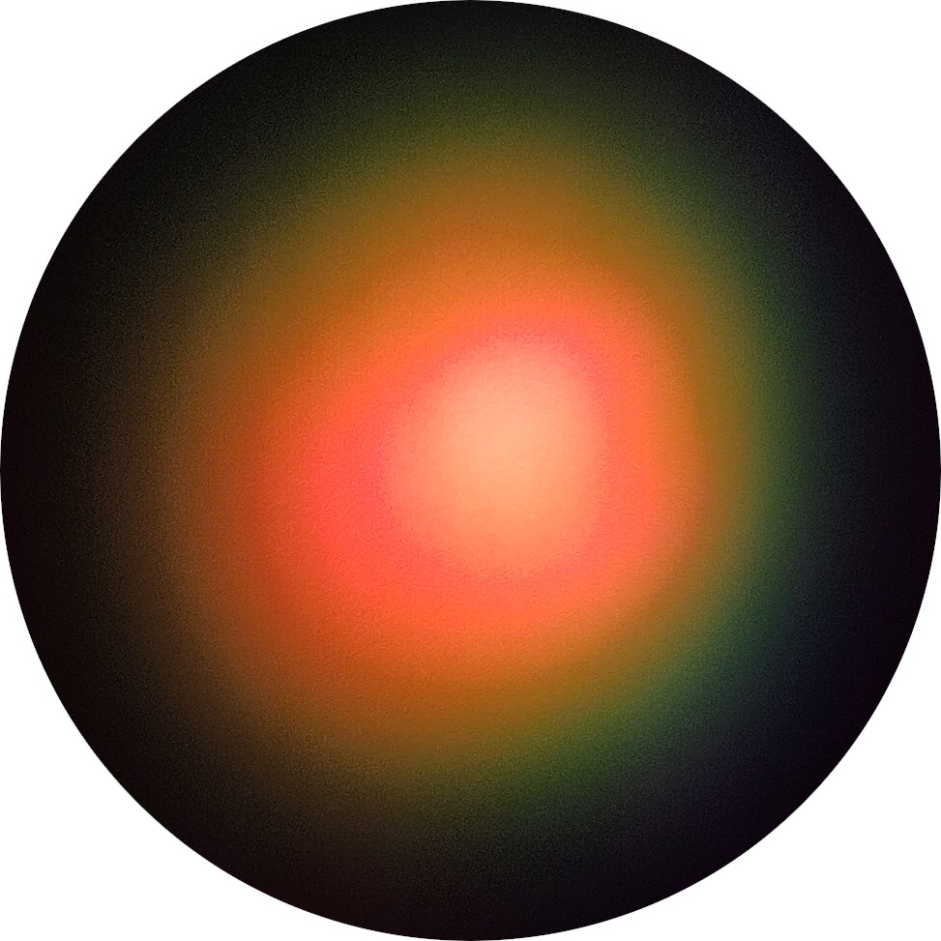
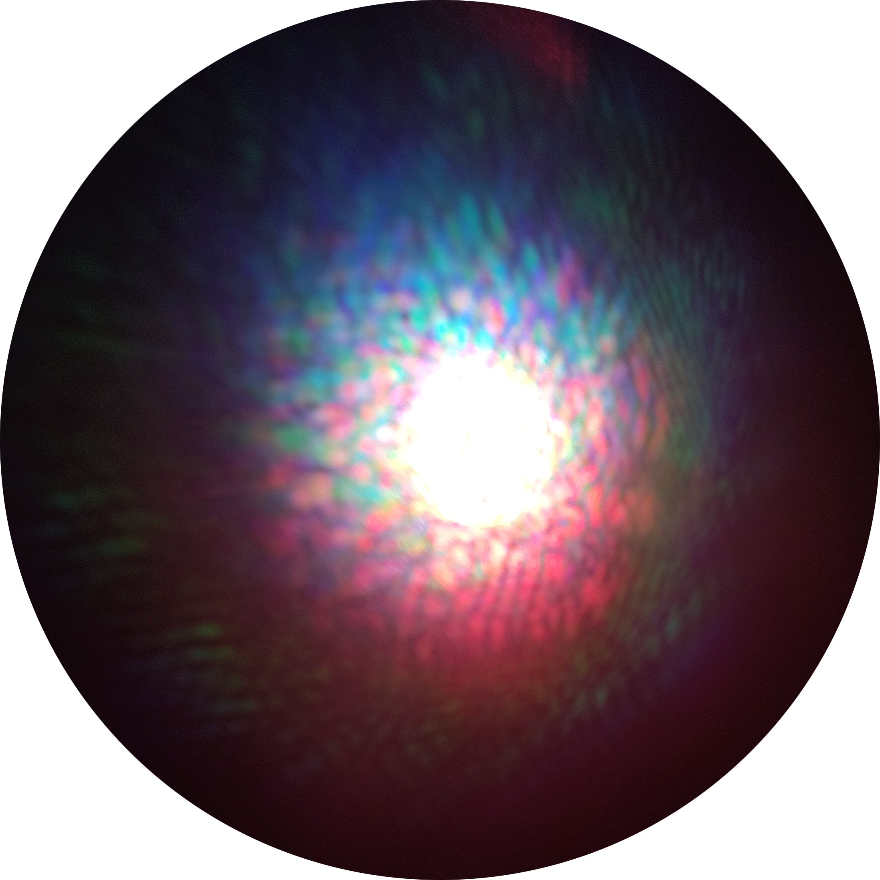
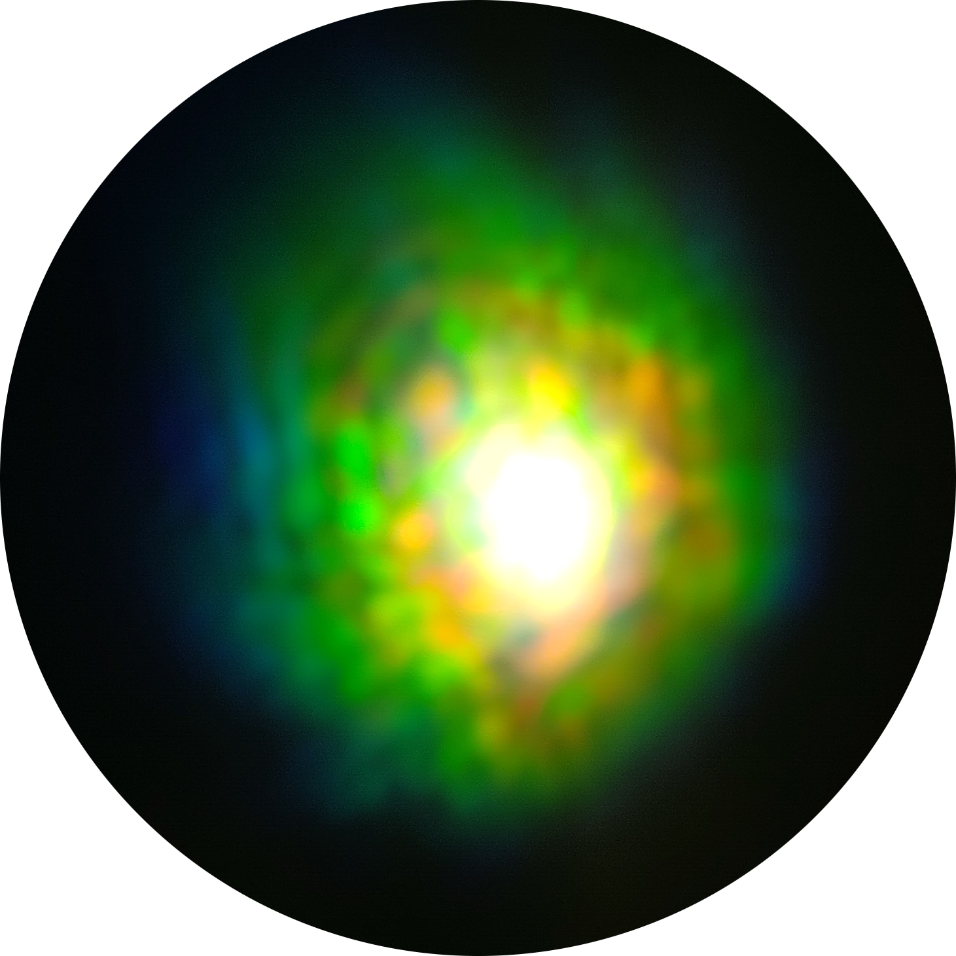
High electric field: Non-linear effects
620 nm red
310 nm UV
530 nm
Uranium glass fluorescence
Second Harmonics Generation
White Light Generation

Slide 12
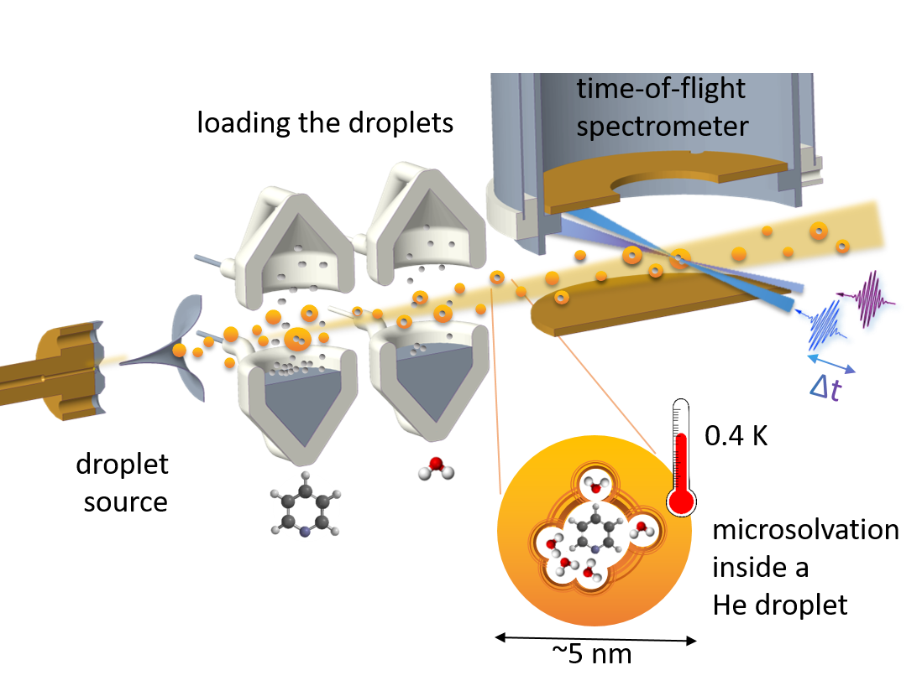
What we do? Time resolved photoelectron-photoion spectroscopy.

Slide 13
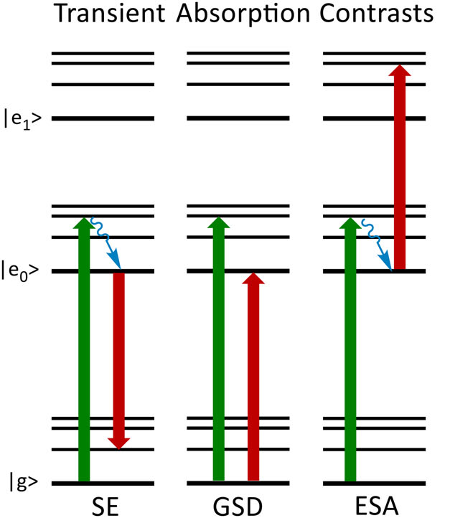
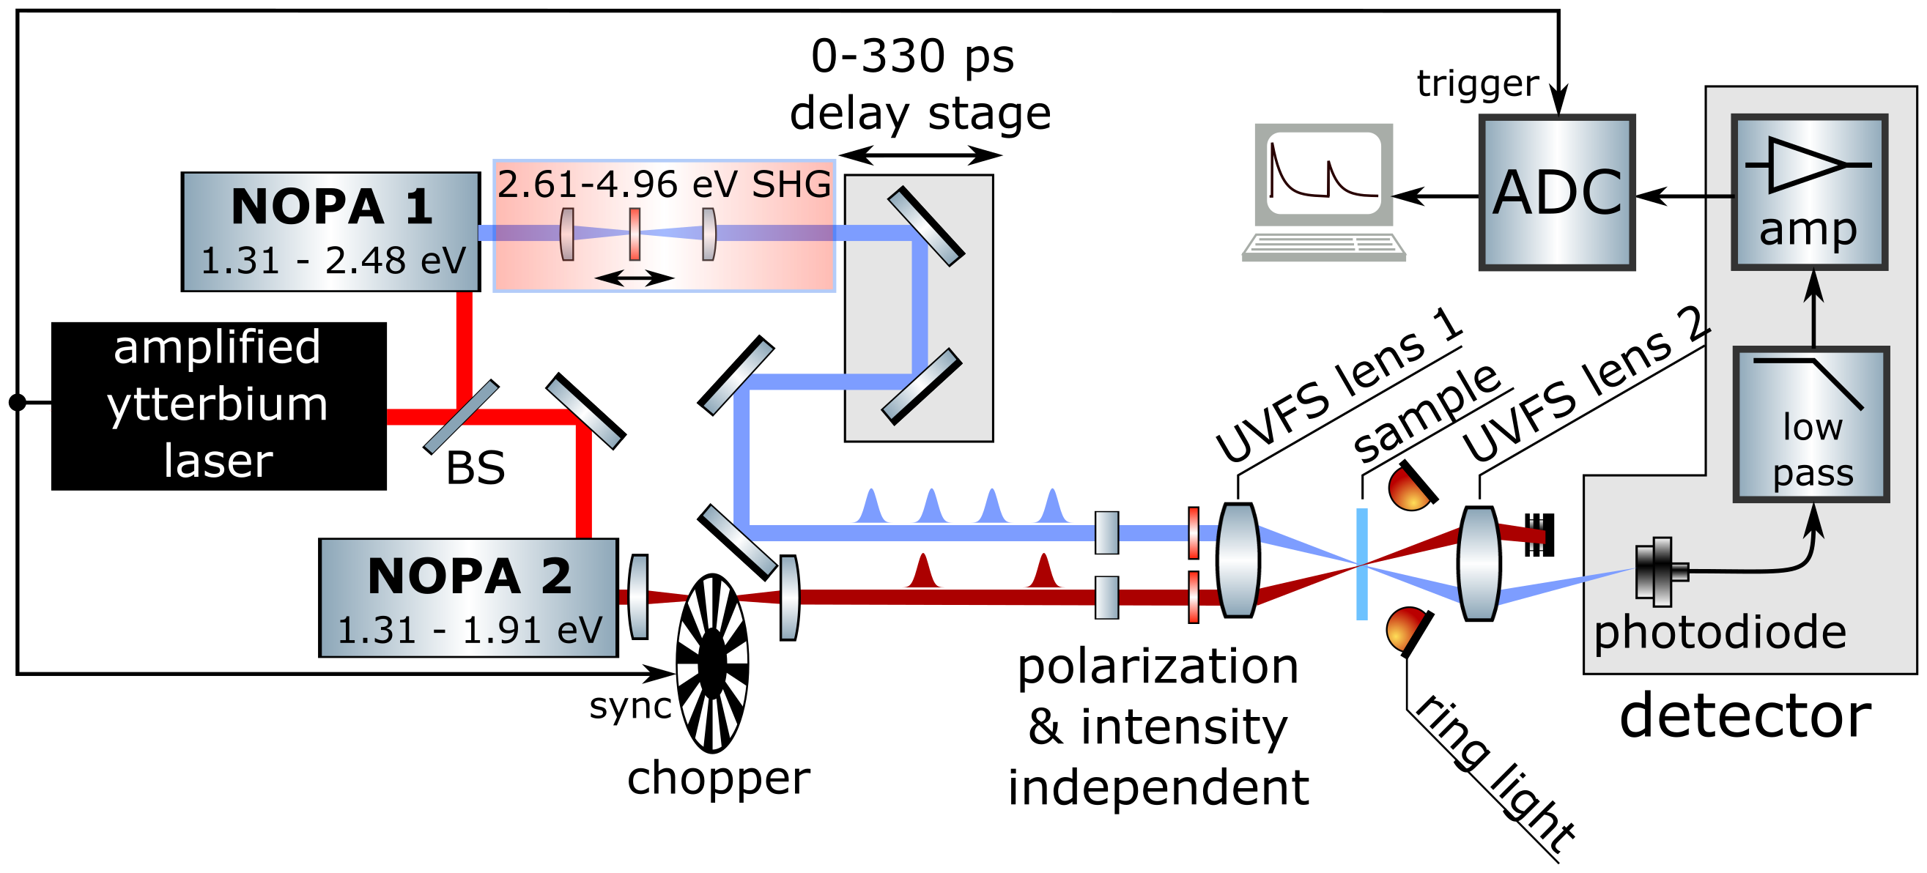
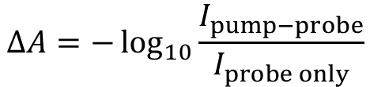
What we do? Transient Absorption.
Zhu et al., J. Chem. Phys. 152, 020901 (2020)
Pump: Visible to near-IR, 1.3 to 1.9 eV, 650-950 nm
Probe: UV-C to near-IR, 1.3 to 4.9 eV, 250-950 mm
Spatial resolution 3 µm
Temporal resolution 80 fs
Absorbance:
$$ΔA=−\log_{10}{\frac{I_{pump−probe}}{I_{probe only}}}$$

Slide 14
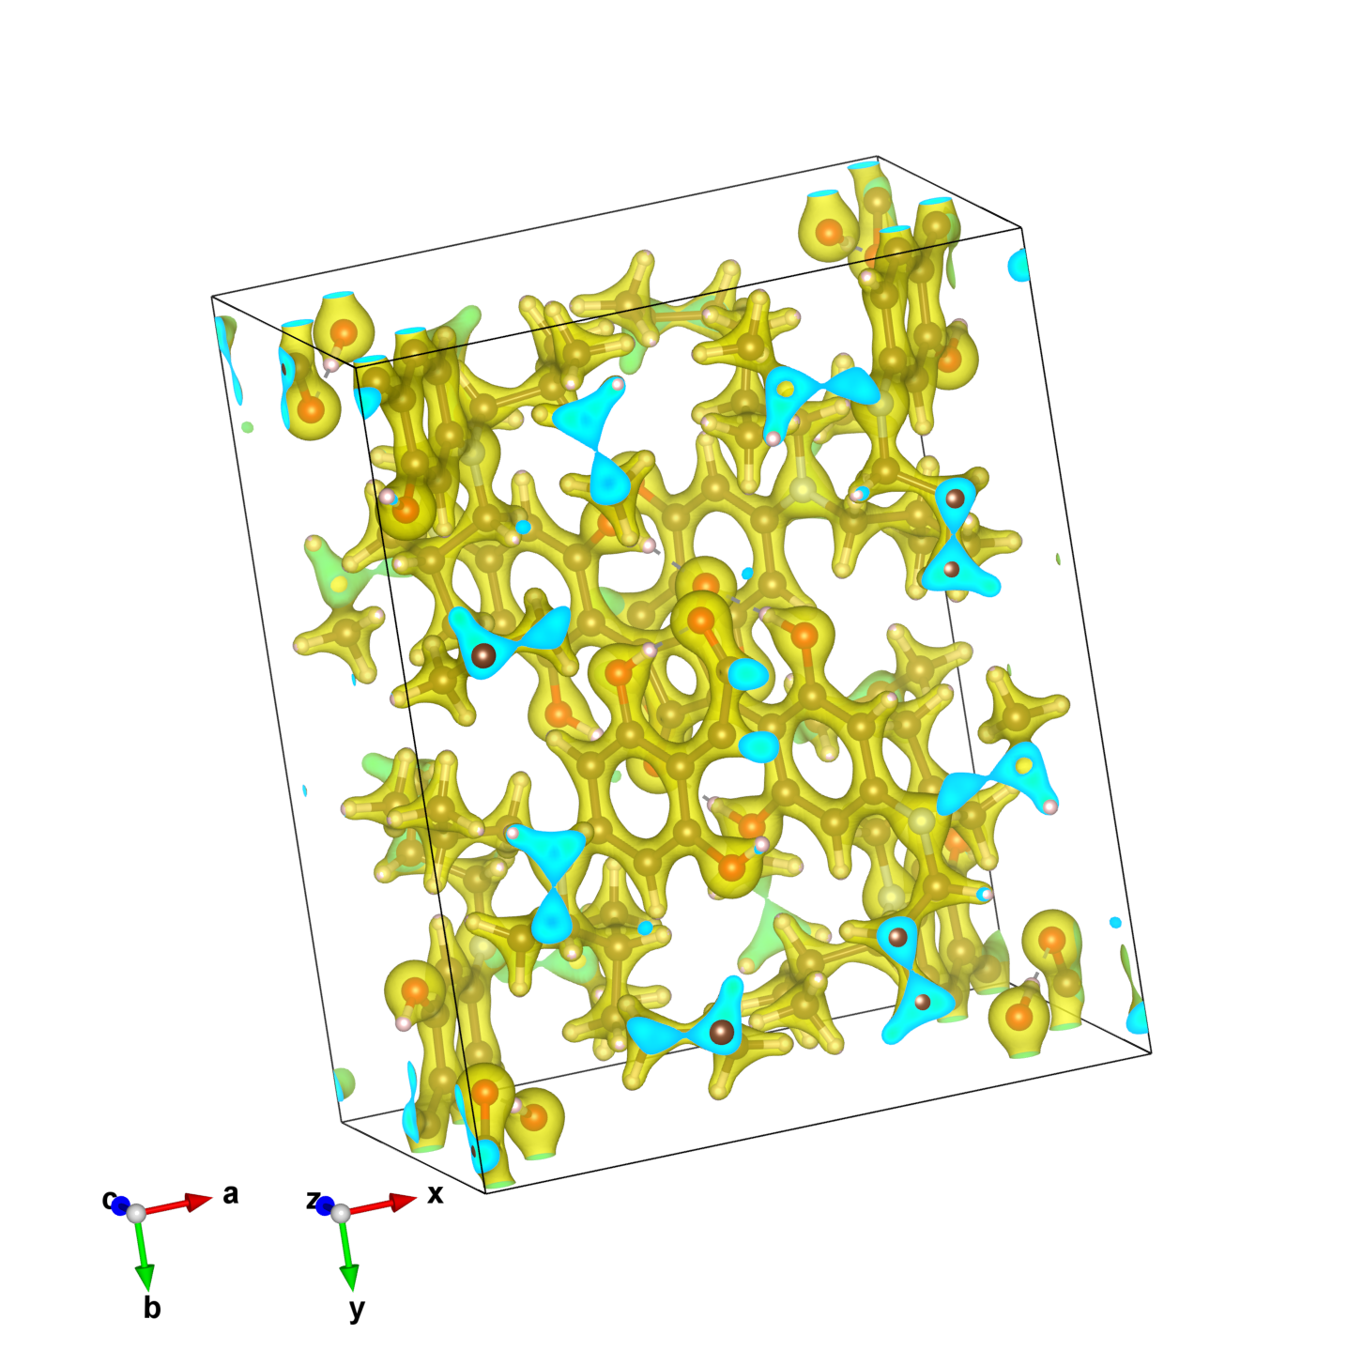
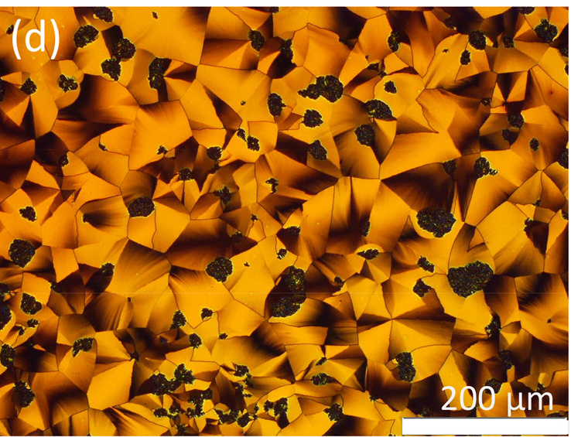
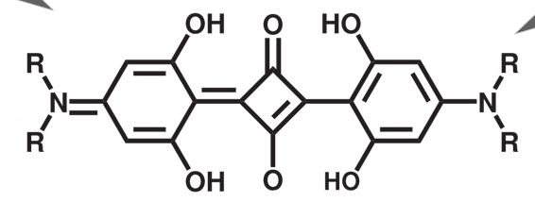
Squaraines: Organic donor-acceptor-donor chromophores
Square
(squaric acid)
Squaraine in polarization microscope.
Cryst. Growth Des. 2017, 17, 12, 6455–6466

Slide 15
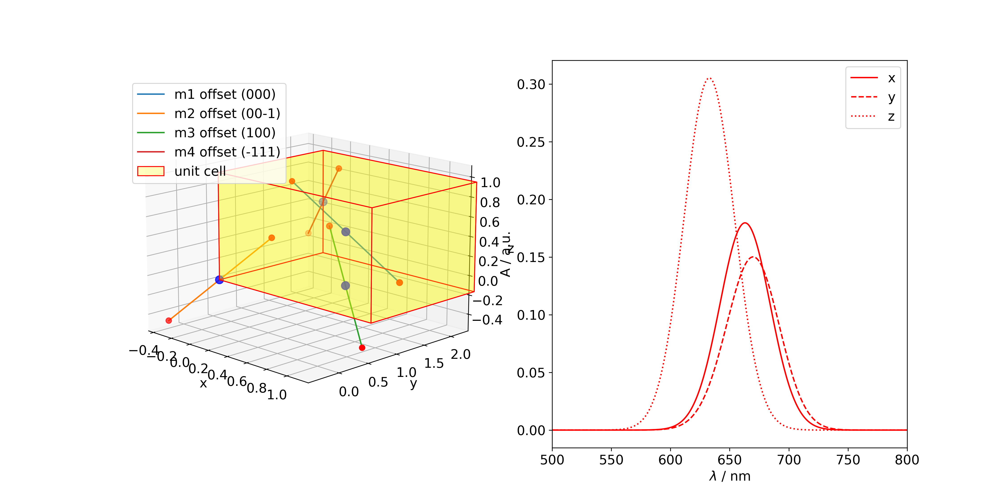

Squaraine: Simulation
Simplify
Calculate
A solution to limited progress? Find a research partner and do a stay abroad.
15

Slide 16
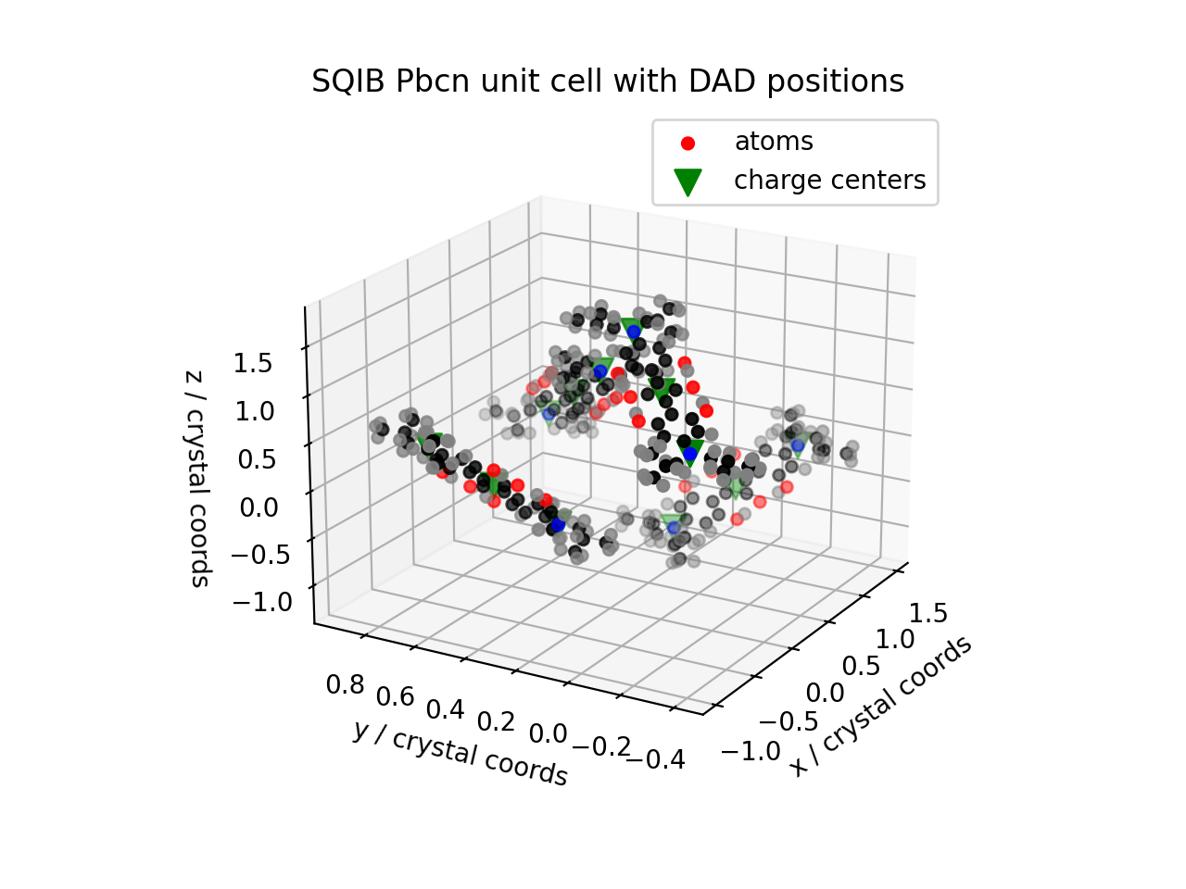
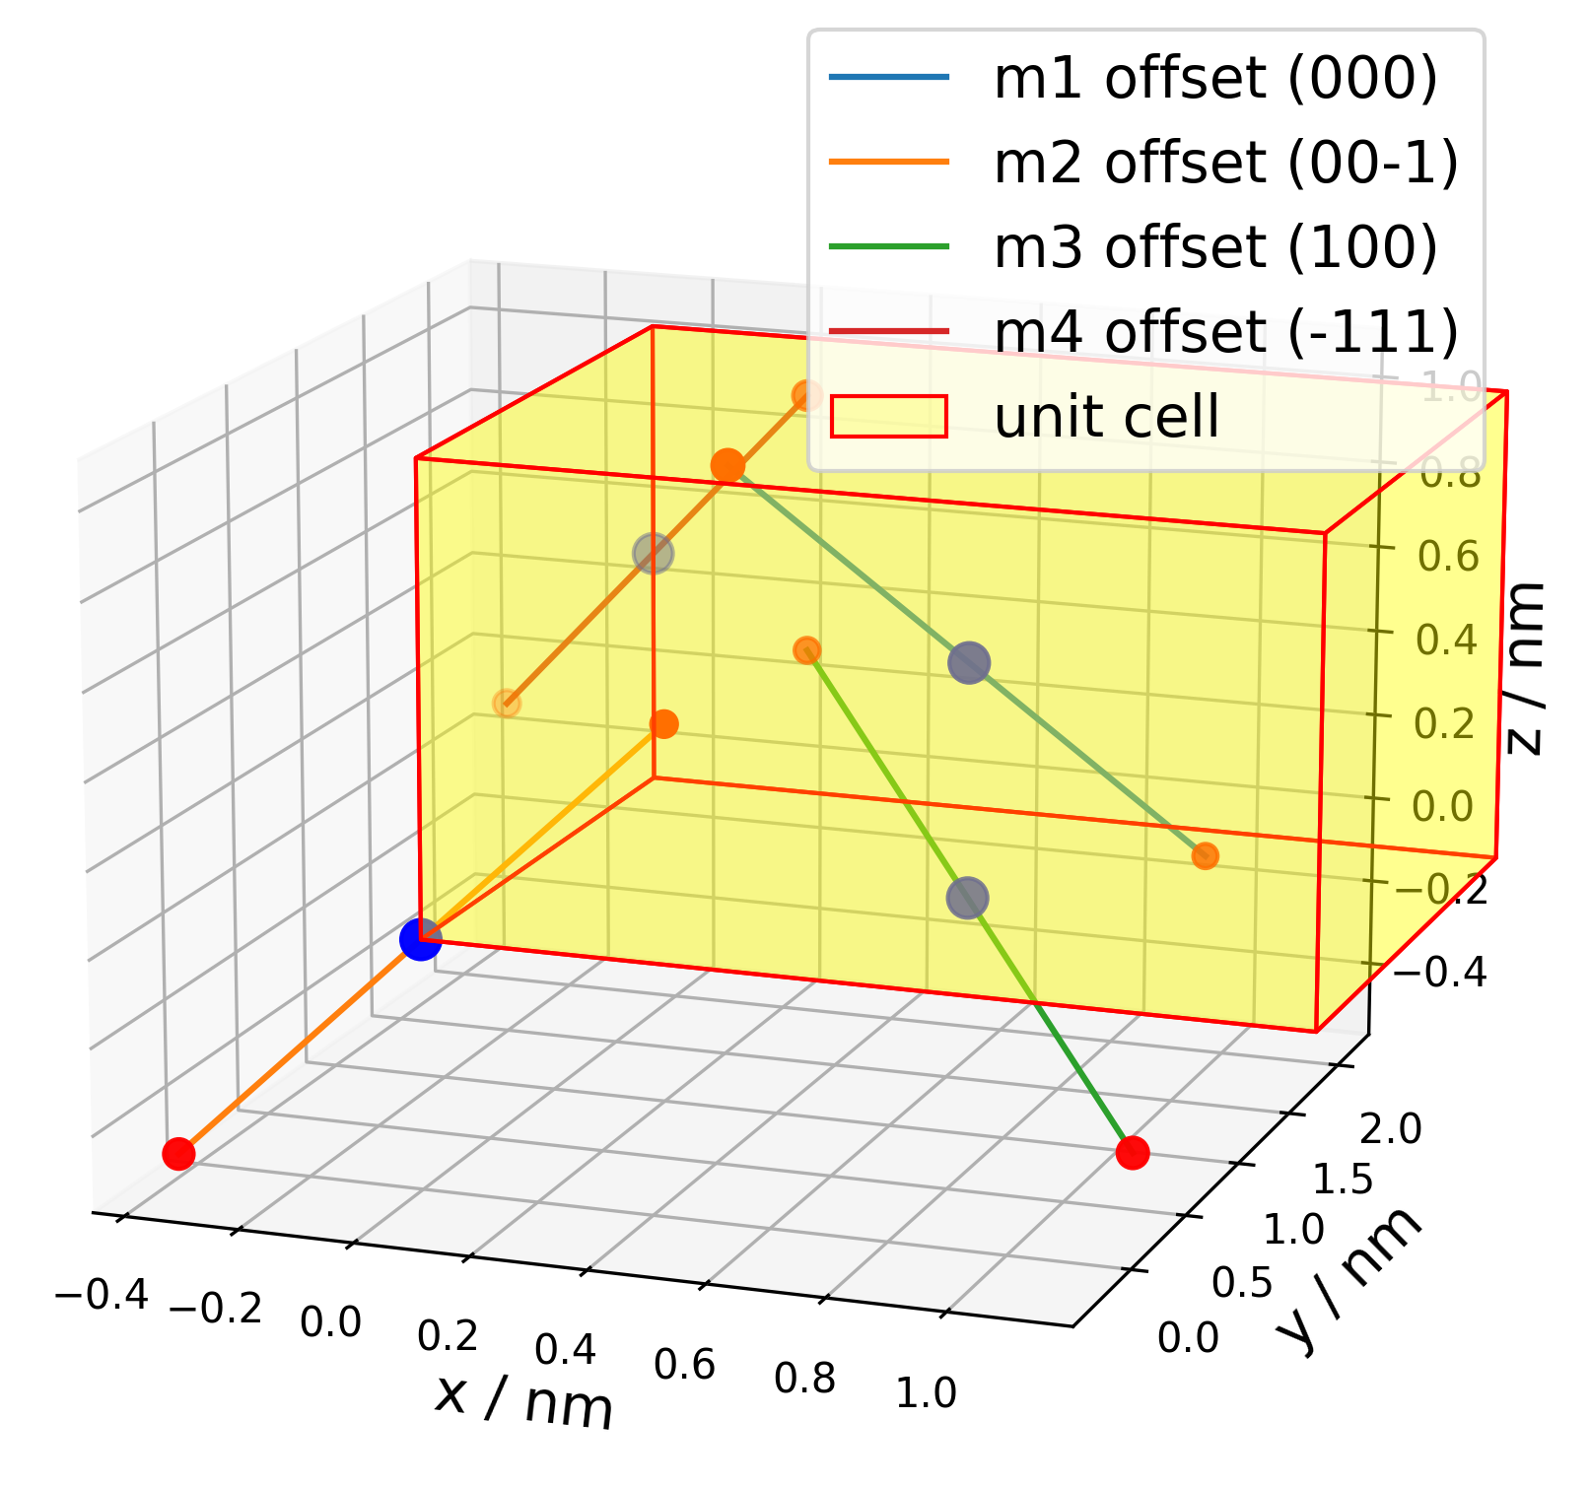
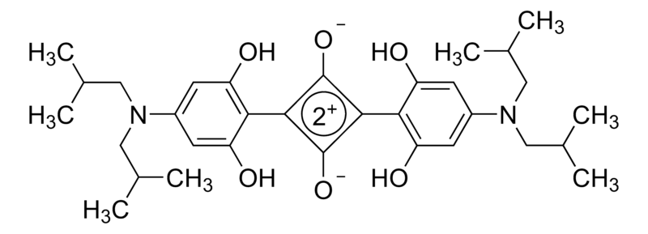
Essential states model of D-A-D chromophores: Interacting point charges
Z₁
D+
A-
D
D
A-
D+
Z₂
D
A
D
N
Sigma-Aldrich

Slide 17









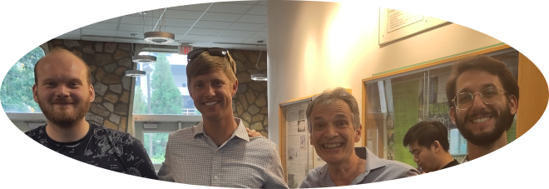
Acknowledgements
Maximilian Jeindl, Robert Schwarzl, Pascal Heim, Markus Koch
New: PAT 1379523
Manuela Schiek, Marvin Schumacher
Frank Spano
Davide Giavazzi, Anna Painelli, Brunella Bardi
Andreas Windischbacher, Narges Taghizade, Peter Puschnig

Slide 18
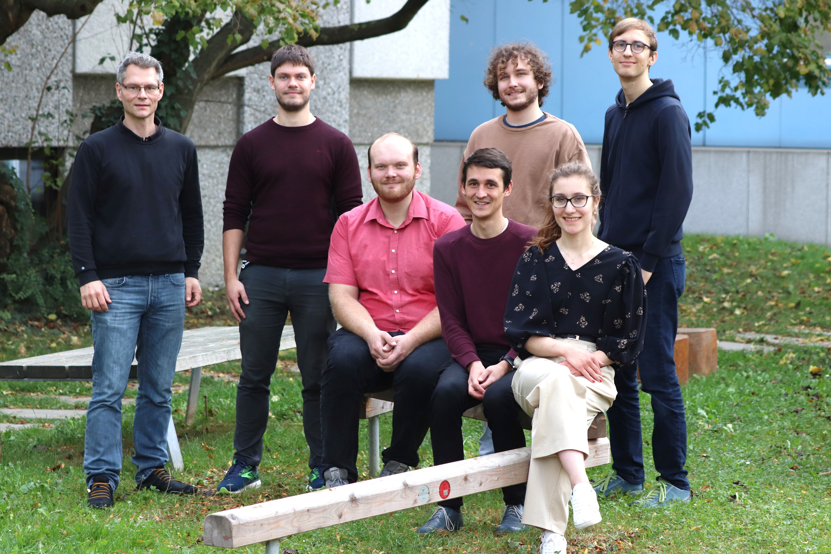
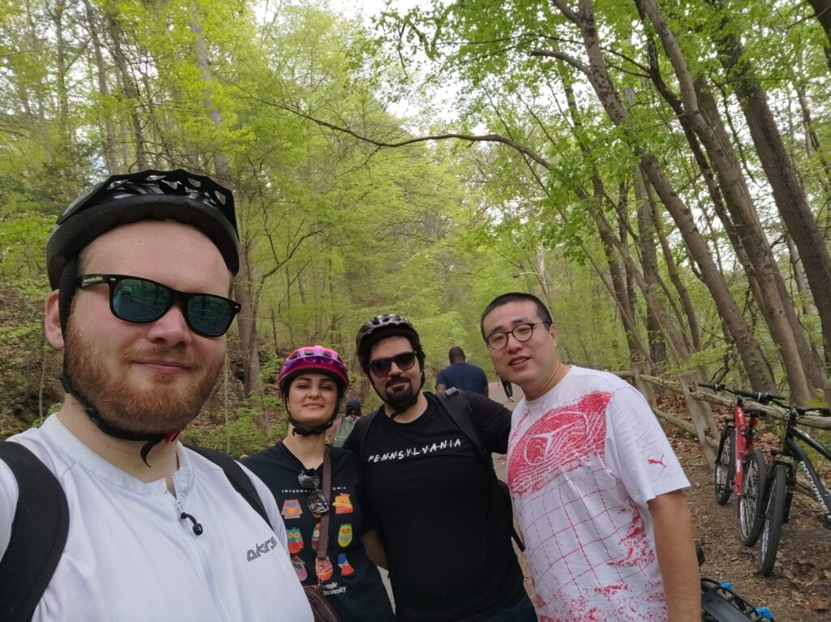
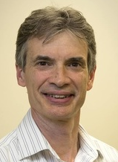
Markus Koch‘ femtosecond dynamics group, 2023, Graz
(A part of) Frank Spano‘s theoretical chemistry group, 2023, Philadelphia

