Slide 1
Preparation and Characterization of
Gold Nanoparticles Using Nanosecond Laser Ablation at Different Wavelengths
04.08.2024
Roza Mercan Eskin
Supervisor: Dr. Berna Morova

Slide 2
CONTENT
INTRODUCTION
THEORY
EXPERIMENTAL
3.1. Experimental Setup
3.2. Method: Nanoparticle Generation
3.3. Characterization
4. RESULTS AND DISCUSSIONS
5. CONCLUSION

Slide 3
INTRODUCTION
This study focused on the synthesis of gold nanoparticles by nanosecond laser ablation of a bulk gold. The objective was to assess two beams by using 0.5 gram of bulk gold at varying wavelengths, specifically utilizing Gaussian and Bessel beams for comparison. The produced nanoparticles were then characterized using scanning electron microscope and dynamic light scattering technique to evaluate their size, morphology and distribution.
Notes:
Dynamic light scattering

Slide 4
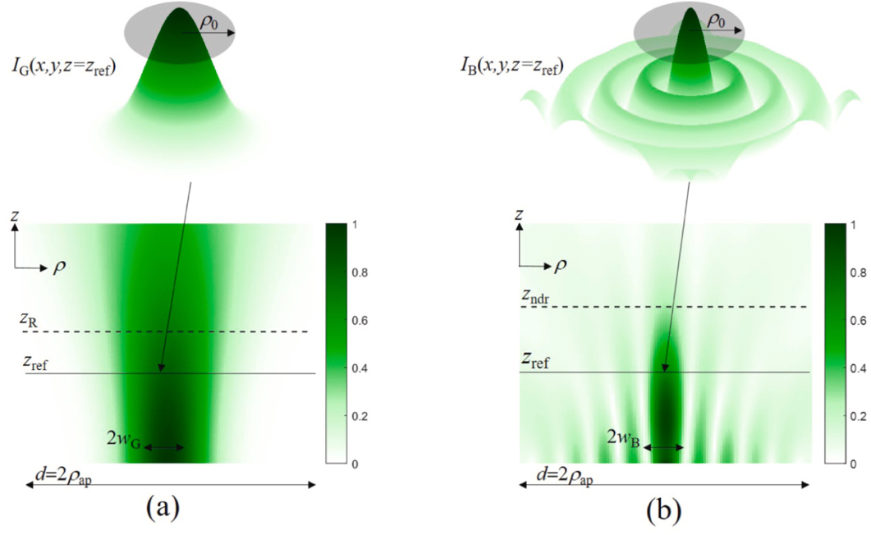
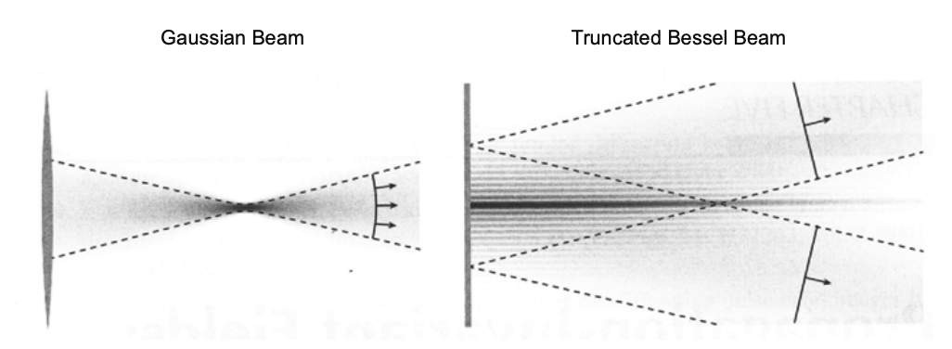
THEORY
Gaussian and Bessel Beams
Gaussian Beams | Bessel Beams
Non-localized | Localized
Diffracting | Non-diffracting
Efficient focusing nature | Small portion of the total power
Beam waist is larger | Beam waist is smaller
- | Self-healing character

Slide 5
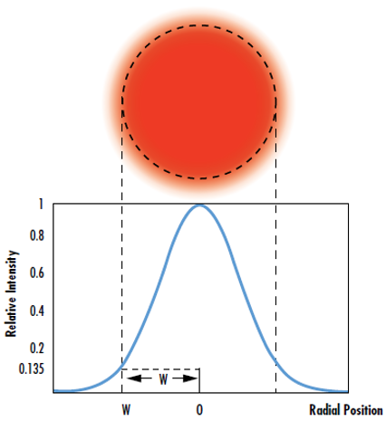
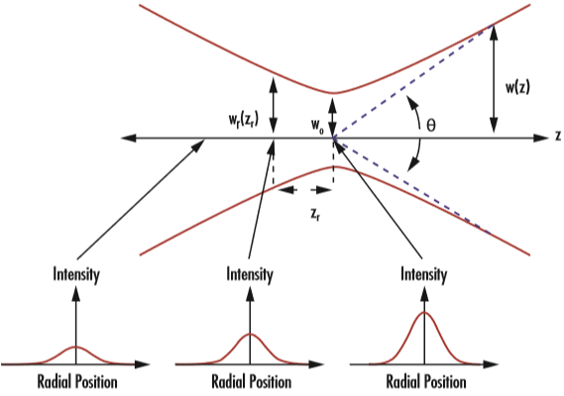
Gaussian Beams
$$z_{R}=\left(π/λ\right){ω_{0}}^{2}$$
Notes:
Gaussian beams (GBs) have garnered significant attention because the majority of the emitted power is contained within a confined beam. However, it’s important to note that Gaussian beams are inherently diffractive, and the beam’s width significantly expands beyond a certain distance from the emission aperture, a distance referred to as the Rayleigh range.
Gaussian beams are defined by their beam waist (w₀), Rayleigh range (z_{R}), and divergence angle (θ).
Rayleigh range is a result of Gaussian beams which is the solution of Maxwell wave equation. Further scientific works suggested that there was another solution to the Maxwell wave equation, a different wave type.
Energy???
tem00

Slide 6
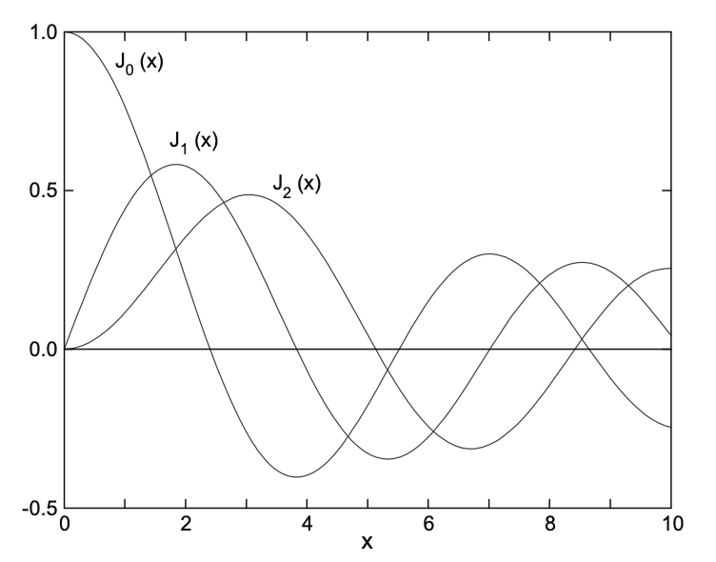
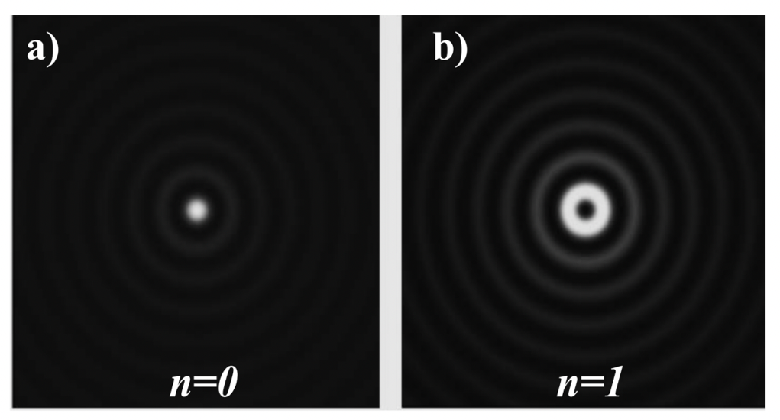
Bessel Beams
$$z_{ndr}=ρ_{ap}cot\left(θ_{0}\right)$$
Bessel beams maintain their non-diffracting nature only up to a certain distance z_{ndr}​ from the radiating aperture, known as the non-diffractive range. Here, ρ_{ap}​ is the radius of the aperture and θ₀​ is the axicon angle.

Slide 7
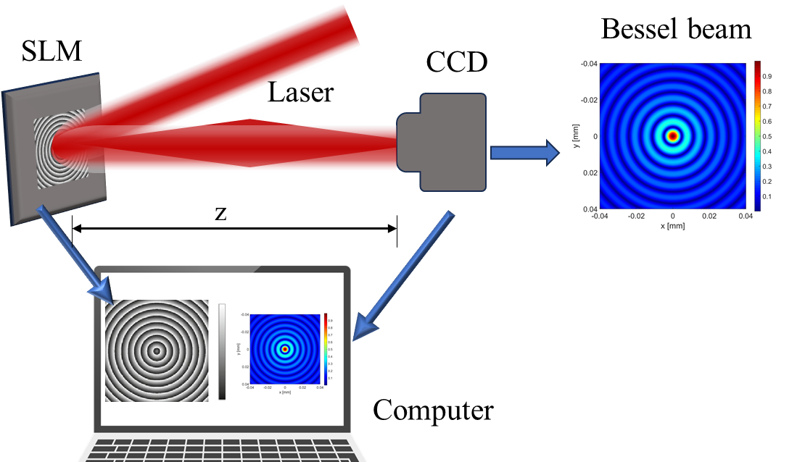
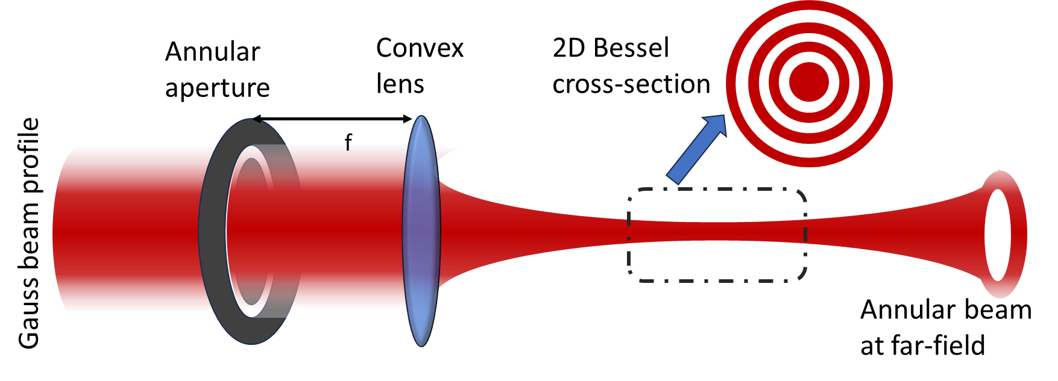
GENERATION OF DIFFRACTION-FREE BEAMS
Spatial Light Modulator
Annular aperture
Axicon
Very low mode conversion efficiency attributed to the blocking of the central part of the Gaussian beam.
This technique produces diffraction oscillations in the central lobe intensity along the propagation.
This technique cannot be used to generate higher order BBs.
This technique is not suitable for ultrashort laser sources.
SLM cannot be used to generate high-power BBs due to its low damage threshold.
SLM can be used for a certain range of wavelengths of the electromagnetic spectrum.
SLM based BB generation is expensive compared with most of the other techniques.
Axicon alone can produce only 0th order BB. For higher order BB generation, we need to pump the axicon with Gaussian vortex which is generally acquired by SPP/SLM.
Digital micro-mirror device (DMD)
Fiber-based BB generation
Metasurfaces
Notes:
The major issue with the BB is its experimental realization. As we discussed in the preceding section, to achieve the ideal BB, we need infinite optical energy which is practically not possible. However, we can generate quasi-BBs having a finite range of propagation and spatial extent in the laboratories through various experimental configurations.
Here we can see the several method of experimental configurations for achieving Bessel beams The first method is passing the Gaussian profile from an annular apperture and focusing it with a convex lens. But this method has some disadvantages like low mode conversion efficiency, due to the blocking of the central part of the Gaussian beam. And also this method produces diffraction oscillationsin central lobe intensity. In addition to those disadvantages, this method cannot be used for generating higher order BBs and it is not suitable for ultrashort pulses.
The other technique is that using a spatial light modulator. And this is the most common way to shape beams. But in this methodology there some limitations too such as SLM cannot be used to generate high-power BBs due to its low damage threshold. And its expensive and might be little bit complex.
Axicons are the other commonly used elements for Bessel beam formation. They can be used for wide range of wavelengths, and shaping high-power laser pulses. The only limitation for these elements is that only 0th order of Bessel beam can bea obtained. To get higher order of Bessel beams, phase plates shoul be added to the path of the Gaussian beams.

Slide 8
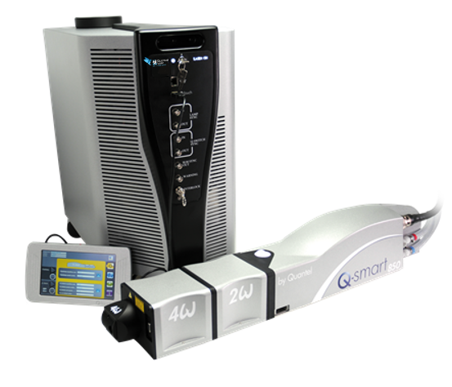
Laser
- Nanosecond
- Q-switching
- Pulsed
- High peak power in short durations
Notes:
Laser sürekli vs darbeli enerji, güç, pik gücü anlamında

Slide 9
EXPERIMENTAL
In this study, 0.5-gram bulk gold used to produce gold nanoparticles using deionized water. Before applying laser ablation, repeatedly washed the gold target and the petri dish filled with deionized water. The mirror, directly struck by the laser and featuring distinct tolerance ranges based on wavelength, was inclined at a 45-degree angle facing the optical table. The laser, reflected off the mirror, was meticulously aligned at the center of the lens. The stage was situated beneath the lens.

Slide 10
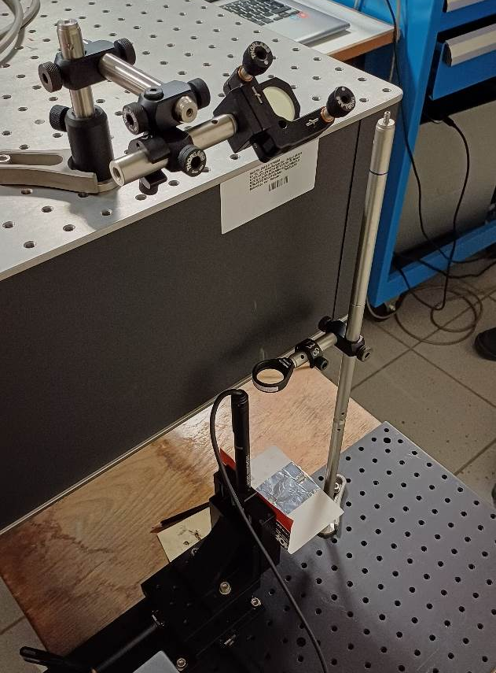
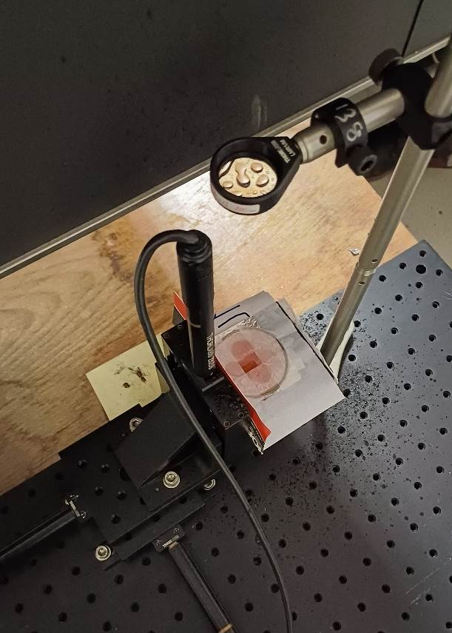
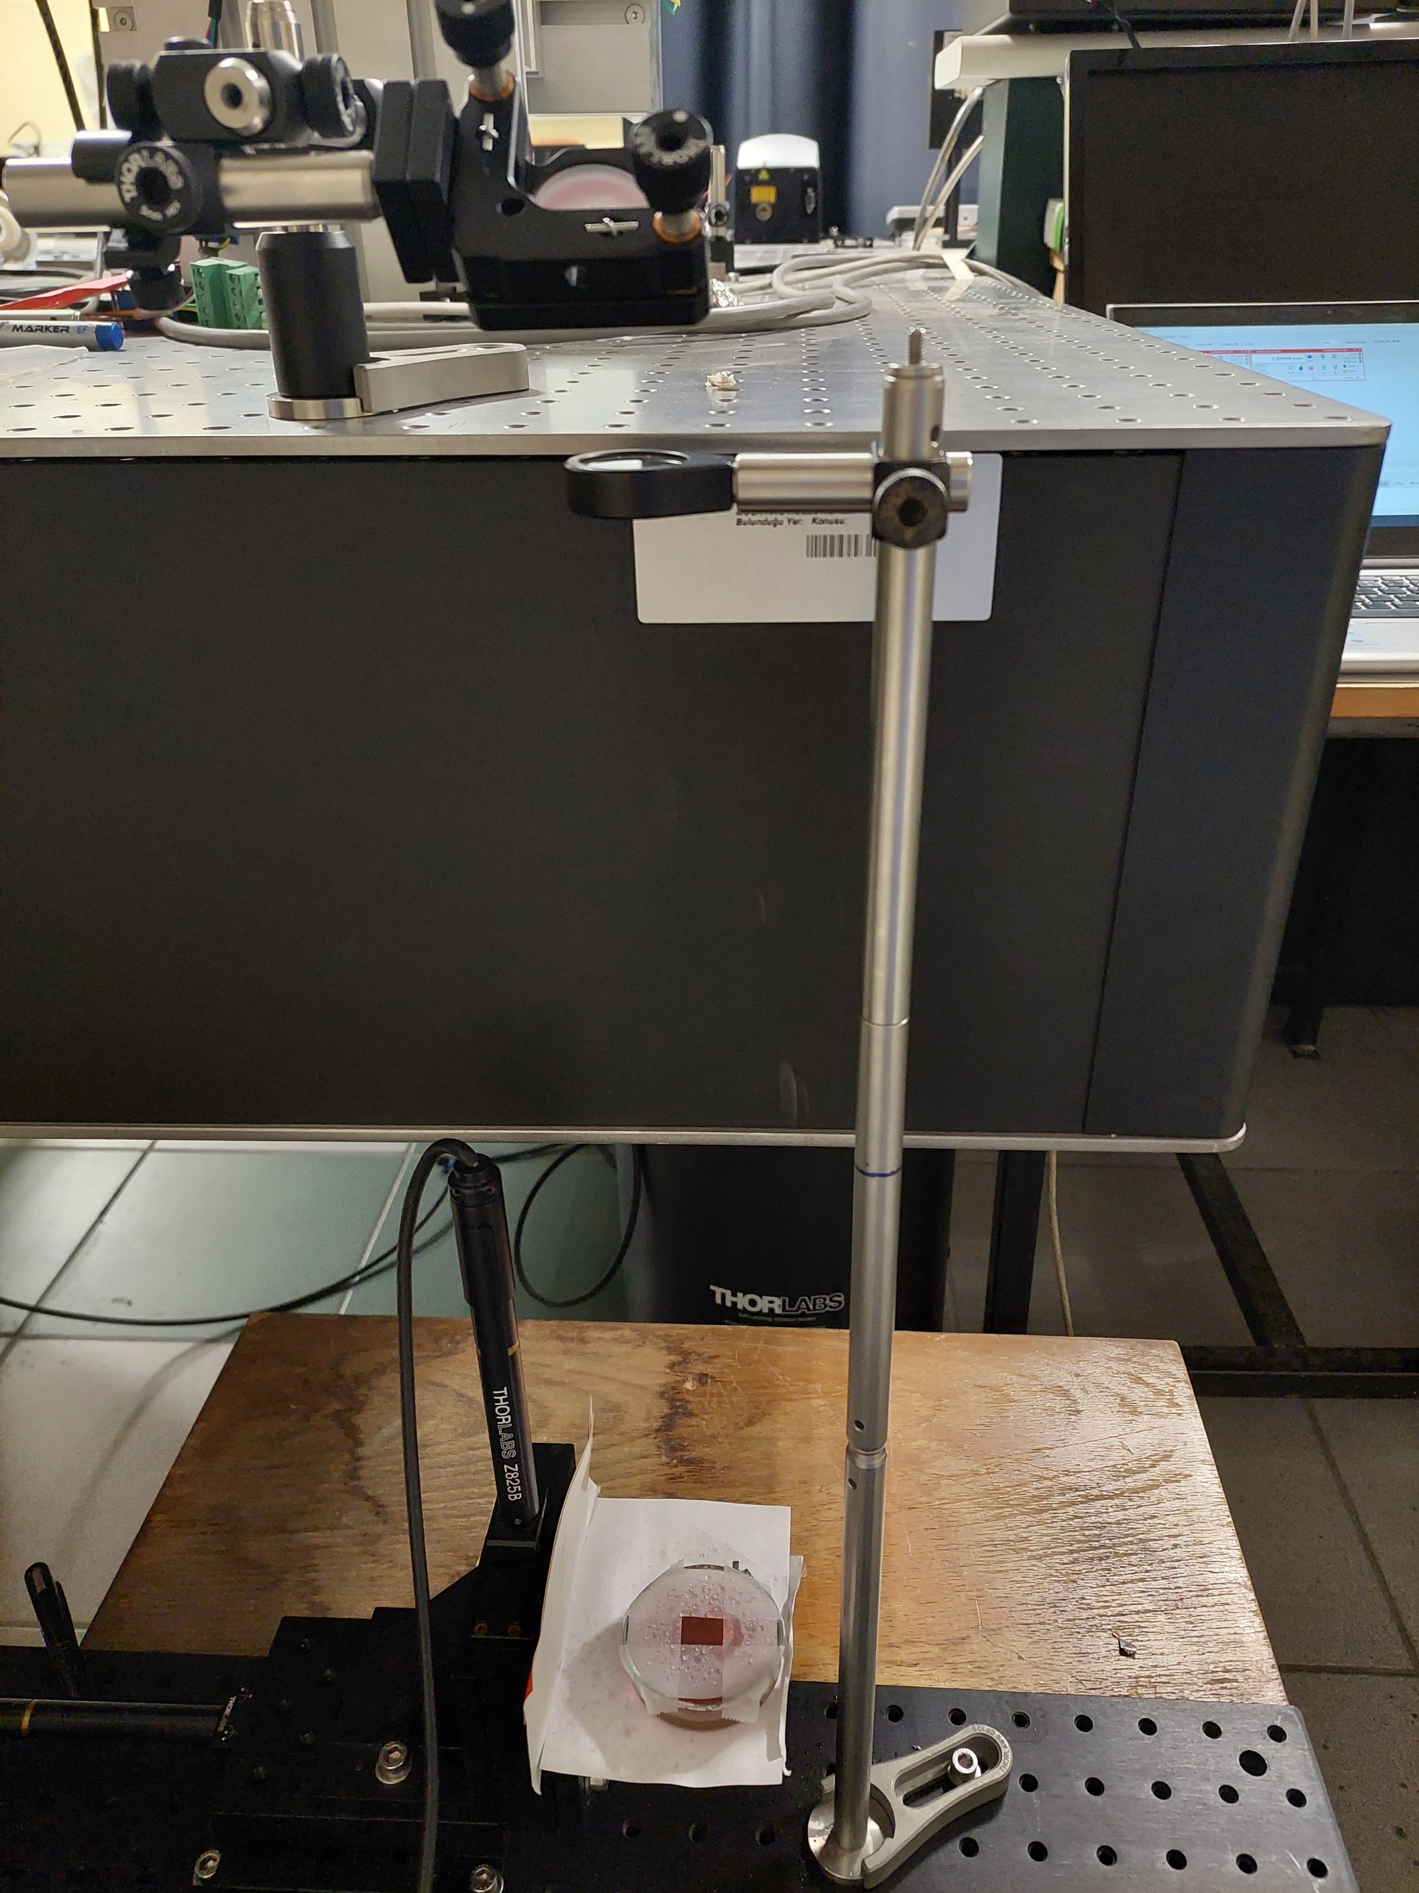
EXPERIMENTAL SETUP
(5)
(1)
(2)
(4)
(2)
(3)
(3)
Mirror (1) Lens (2) Stage (3) z-axis of the controller (4) Laser (5).
Notes:
Odak boyutlarını yaklaşık aynı olacak şekilde seçtik

Slide 11
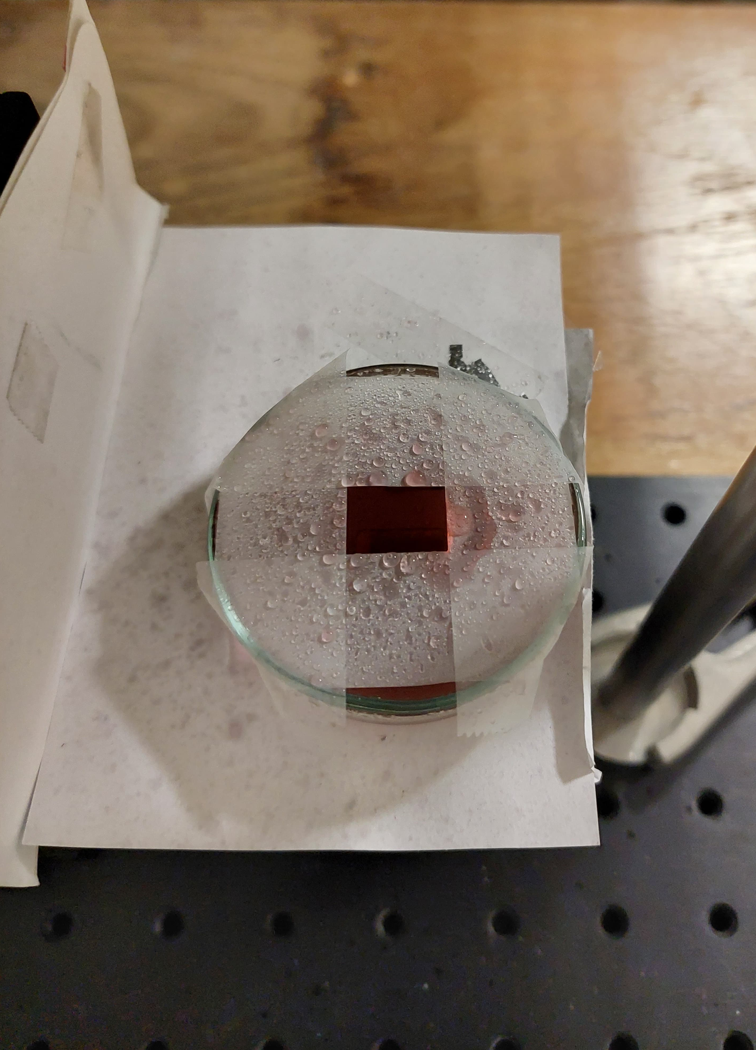
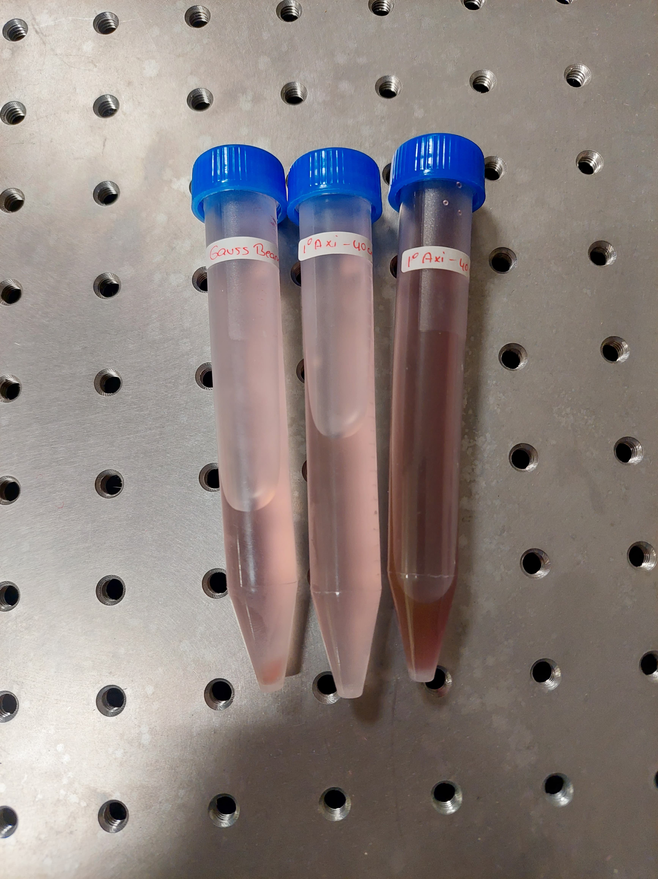
EXPERIMENTAL
Notes:
Aggregation (yapışma) sem’e bakmak gerekiyor
Literatürle karşılaştırılacak seviyede değiliz

Slide 12
METHOD
Gold nanoparticle generation using Gauss beams and Bessel beams at different wavelengths
Bulk gold underwent scanning at wavelengths of 1064 nm and 532 nm consistently maintaining the same speed for the stage's movement during each scan. Depending on the laser power, the petri dish was shielded with tape, revealing only the target bulk gold. This precautionary measure aimed to prevent water from splashing onto the lens, given that the petri dish was filled with distilled water, thus optimizing the laser's efficiency. As mentioned earlier, Gaussian beams were generated using a convex lens with a focal length of 200 mm and Bessel beams with an axicon with a base angle of 1°.
Notes:
Gold nanoparticle generation using Gauss beams and Bessel beams at different wavelengths
Bulk gold underwent scanning at wavelengths of 1064 nm, 532 nm, 355 nm, and 266 nm, consistently maintaining the same speed for the stage's movement during each scan. Depending on the laser power, the petri dish was shielded with tape, revealing only the target bulk gold. This precautionary measure aimed to prevent water from splashing onto the lens, given that the petri dish was filled with distilled water, thus optimizing the laser's efficiency. As mentioned earlier, Gaussian beams were generated using a convex lens with a focal length of 200 mm and Bessel beams with an axicon with a base angle of 1°.

Slide 13
CHARACTERIZATION
SEM Images
1064 nm Gauss Beam
1064 nm Bessel Beam
532 nm Gauss Beam
532 nm Bessel Beam

Slide 14
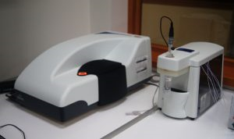
CHARACTERIZATION
Characterization of the Samples: Particle Size Analyser (Zetasizer)
Particle Size Analyzer (Zetasizer, Dynamic Light Scattering (DLS, 0.3 nm to 10 μm size range, 3.8 nm to 100 μm zeta potential size range) were used to characterize the produced gold nanoparticles.
MALVERN ZS – ZETASIZER
Ability to measure hydrodynamic particle size and distribution between 0.3 nm - 10 μm
For liquid dispersions or emulsions

Slide 15
RESULTS AND DISCUSSIONS
78,8
91,3
122
122
142
Notes:
Tek peak yakalanması iyi

Slide 16
RESULTS AND DISCUSSIONS
 | Average Size (d. nm)
1064 nm Bessel Beam | 65.4
1064 nm Gauss Beam | 110.6
532 nm Bessel Beam | 123.3
532 nm Gauss Beam | 257.6
Zetasizer PSD Measurement Results
Notes:
Particle size distribution

Slide 17
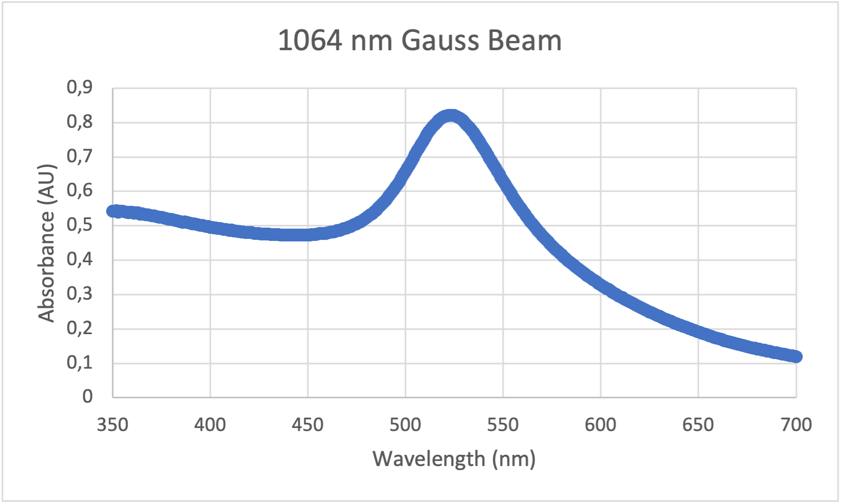
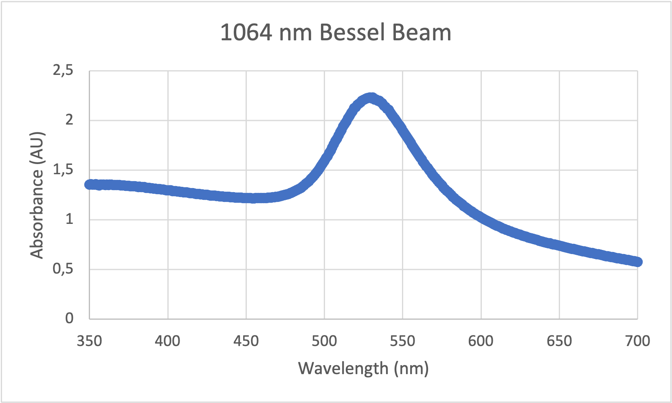
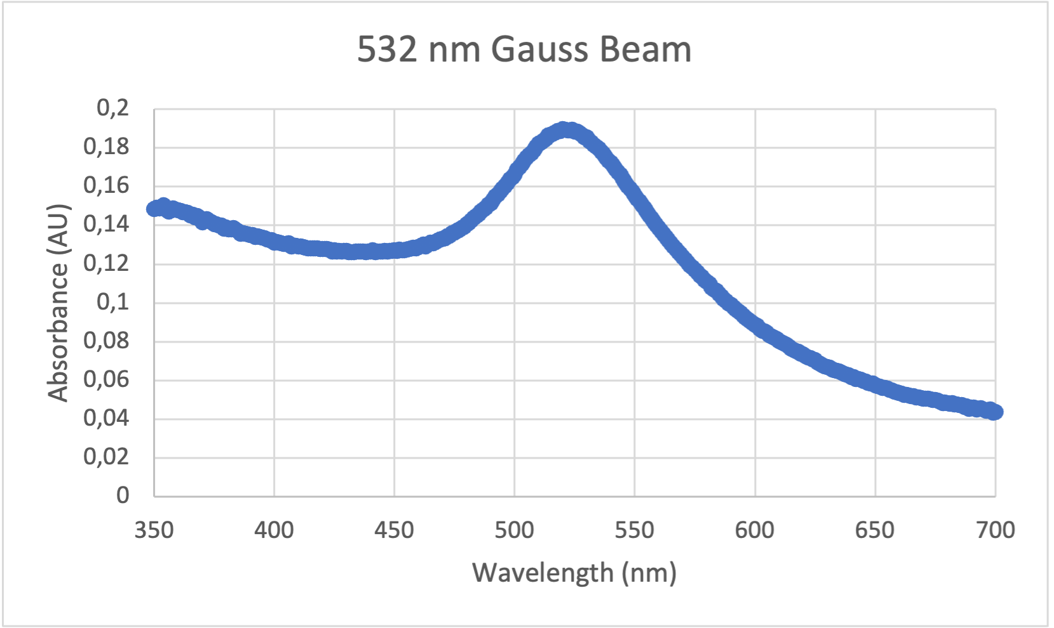
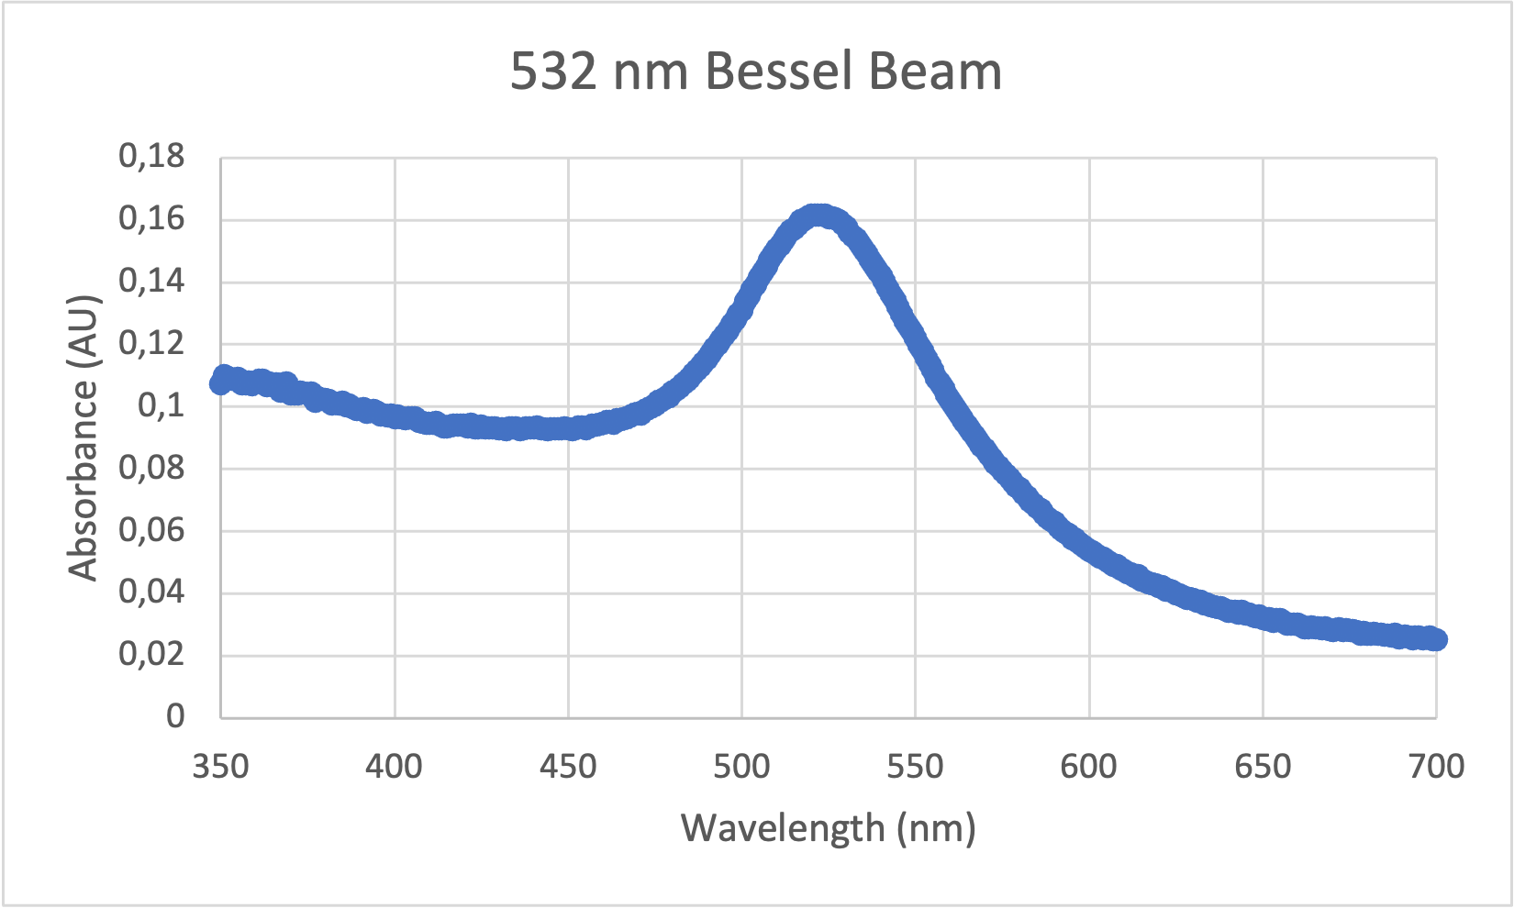
RESULTS AND DISCUSSIONS
UV-Vis Spectrometer
”Surface plasmon resonance" (SPR) peak. This peak results from the collective oscillation of conduction band electrons in metal nanoparticles in response to incoming light. The SPR peak for gold nanoparticles is typically seen in the visible area of the spectrum.
520 to 550 nanometers
Smaller nanoparticles produce SPR peaks at shorter wavelengths, whereas larger nanoparticles produce peaks at longer wavelengths.
According to the graphs, the peak varies between 515 nm and 542 nm, which is the expected result.
Bessel beams generally have higher concentration than the ones generated by Gauss beams.
Notes:
AuNP UV-Vis Spectrum Graphs
Gold nanoparticles usually have their absorbance peak at 520-550 nm wavelength
The SPR peak for gold nanoparticles is commonly seen at wavelengths ranging from 520 to 550 nanometers. The exact position of the peak varies depending on the gold nanoparticles' size, shape, and surrounding environment. In general, smaller nanoparticles produce SPR peaks at shorter wavelengths, whereas larger nanoparticles produce peaks at longer wavelengths.
According to the graphs, the peak varies between 515 nm and 542 nm, which is the expected result.
Arbitrary unit, absorbans tanımına bak
Absorbance is directly proportional to the concentration of the nanoparticles. The higher the concentration, the higher the absorbance. It can be deduced from the figures that particles generated by Bessel beams generally have higher concentration than the ones generated by Gauss beams. Then, it would not be wrong to say Bessel beams prove its efficiency once again.

Slide 18
Acknowledgement
We thank,
Scientific Research Projects Department of Istanbul Technical University for their support (ITU BAP, Project Number: 44400)
Scientific and Technological Research Council of Turkey (TUBITAK, Grant Number 110T330)

Slide 19
Preparation and Characterization of
Gold Nanoparticles Using Nanosecond Laser Ablation at Different Wavelengths
Thank You
04.08.2024
Roza Mercan Eskin

