Slide 1
Integrating Triboelectric Nanogenerators with TiO2-based UV Photodetectors for Self-Powered Sensor Systems

Slide 2
Maedeh Taherkhani
Dr. Raheleh Mohammadpour

Slide 3
Applications

Slide 4
Applications
Imaging systems
Cameras, Security, Medical imging
Optical Communications
Fiber optic cables, Optical switches
Industrial monitoring
Environmental sensors, Remote sensing
Electronic devices
Wearable devices, Smartphones, VR, AR
Scientific research
Spectroscopy, Astronomy, Particle physics

Slide 5
Introduction

Slide 6
Introduction
Triboelectric Nanogenerator
A contact induced electrification in which a material becomes electrically charged after it is contacted with a different material through friction.

Slide 7
Introduction
Working mechanism of TENGs
Two insulators contact each other

Slide 8
Introduction
Working mechanism of TENGs
According to the triboelectrification series, one of the surfaces becomes positively charged while the other becomes negatively charged upon contact.
The charged surfaces, causes charge induction in the electrodes and through the movement of the surfaces, a current will appear in the external circuit.
- - - - - - - -
+ + + + + + + +
- - - - - - - -
+ + + + + + + +

Slide 9
Introduction
Photodetector
Photodetection is a technology that converts incident light signal to electrical signal, which has been exploited widely for practical applications, such as light communication, medical, geological, industrial, photoimaging, civil, and so on.

Slide 10
Introduction
$${TiO}_{2}$$
Rutile
Anatase
Brookite

Slide 11
Introduction
$${TiO}_{2}$$
Rutile
Anatase
Brookite
3 eV
3.2 eV
Most stable at high Temp.
More stable in nano sized-particles
Instable

Slide 12
Introduction
Low temp. stable crystal
Suitable band gap
Excellent electron mobility
UV absorptivity
High visible light transmittance
$${TiO}_{2}$$
Anatase

Slide 13
Introduction
UV light
UV light comprises a segment of the electromagnetic spectrum between 400 and 100 nm, corresponding to photon energies from 3 to 124 eV.
UV-A (400 to 315 nm)
UV-B (315 to 280 nm)
UV-C (280 to 200 nm) → very high energy and destructive
Vacuum UV

Slide 14
Introduction
Working mechanism of semiconductor-based PDs
Resistor
Au
$${TiO}_{2}$$
Au
e-h
R
I

Slide 15
Introduction
Working mechanism of semiconductor-based PDs
UV
Au
$${TiO}_{2}$$
Au
e-h
R
I
h
e
h
e
h
e
e
e
h
h

Slide 16
Fabrication

Slide 17
Fabrication
Triboelectric Nanogenerator
Al
Kapton

Slide 18
Fabrication
Photodetector
Sputtering
Mask
Au
Au
Glass

Slide 19
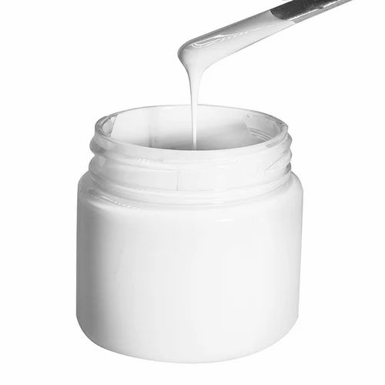
Fabrication
Photodetector
Sputtering
Doctor Blading
Mask
Au
$${TiO}_{2}$$
Au
${TiO}_{2}$ paste
Glass
Nanoparticle - Anatase
Size: Around 20 nm

Slide 20
Fabrication
Photodetector
FTO (Fluorine doped tin oxide)
Au
$${TiO}_{2}$$
Au
Glass

Slide 21
Fabrication
Final Device
Al
Kapton
FTO (Fluorine doped tin oxide)
Au
$${TiO}_{2}$$
Au
Glass

Slide 22
Fabrication
Final Device
Al
Kapton
FTO
Au
$${TiO}_{2}$$
Au
Glass

Slide 23
Fabrication
Final Device
+ + + + + + + + + + +
- - - - - - - - - - - -
Al
Kapton
+ + + + + + + + + + + +
FTO
Au
$${TiO}_{2}$$
Au
Glass

Slide 24
Characterization

Slide 25
Characterization
Triboelectric Nanogenerator

Slide 26
Characterization
Photodetector
EQE
Specific detectivity
Responsivity
External quantum efficiency reflects the energy conversion efficiency from light to electric
Represents the ability of a device for capturing weak signal
Represents the photocurrent per unit of incident power
$$EQE=R\frac{hν}{e}×100$$
$$D^{∗}=\frac{R\sqrt{S}}{\sqrt{2eI_{d}}}$$
$$R=\frac{I_{ph}}{P_{0}}$$
$e$= electron charge
$I_{d}=$Dark current
$S=$ Effective area
$I_{ph}$ = photocurrent
$P_{0}=$Incident light power

Slide 27
Characterization
Photodetector

Slide 28
Characterization
Photodetector

Slide 29
Conclusion

Slide 30
Conclusion
EQE
Detectivity
Responsivity

Slide 31
Maedeh.taherkhani@sharif.edu
Maedehtaherkhani@gmail.com
Maedeh-taherkhani
Thanks for your attention

