Slide 1
Unveiling Hidden Gamma-Ray Sources: Discoveries with SEMIFIC III on Fermi-LAT Data
Mehran Soor
Fatemeh Akhondi
Dr. Hadi Hedayadi
KNTU
KNTU
Prof at KNTU (Supervisor)

Slide 2
TABLE OF CONTENT
Enhanced the data by removing noise.
01
Introduction
02
Fermi-LAT Data Selection
Gamma-Ray Astronomy.
Select All-sky Data With Condition Now!
03
Data Denoising
04
Analysis New Sources
Enhanced The Data By Removing Noise.
Analyze The Findings To Discover Additional Resources.
05
Conclusion
Let’s Talk About New Findings!

Slide 3
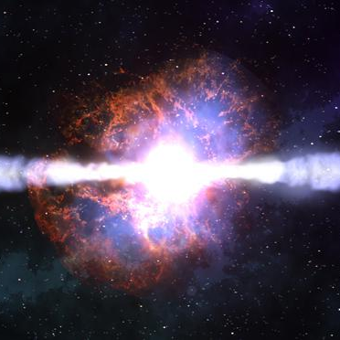
INTRODUCTION

Slide 4
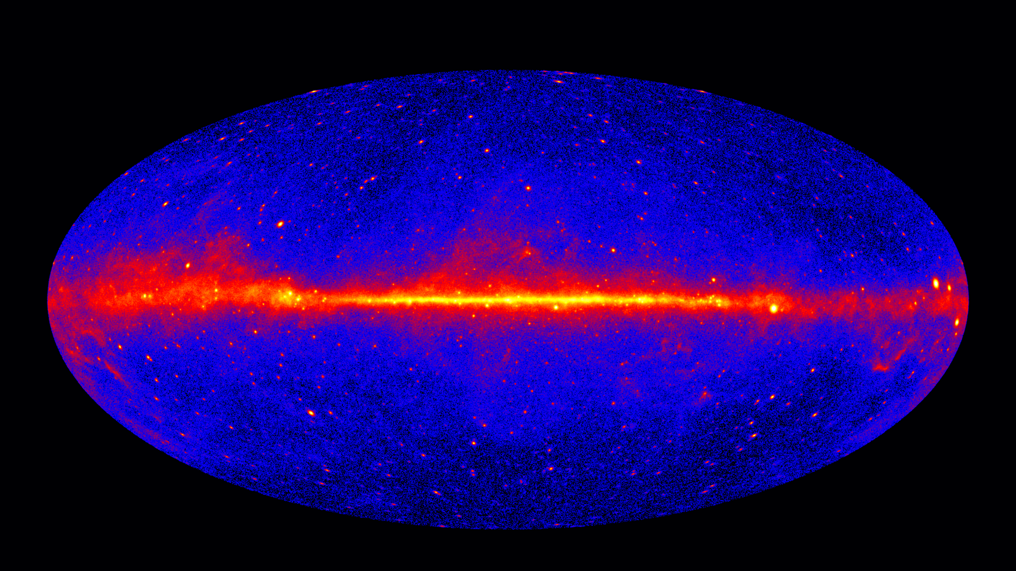
INTRODUCTION
What is Gamma-Ray Astronomy?
Gamma rays have energies exceeding 100 keV.
NASA/DOE/Fermi LAT Collaboration
Page 4/23

Slide 5
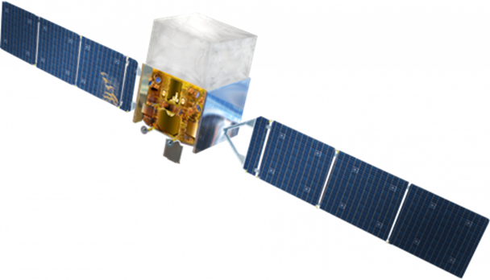
INTRODUCTION
Fermi-LAT
Onboard the Fermi satellite
Energy sensitivity → 20 MeV to over >300 GeV
Events record accuracy → < 1µs.
Entire sky covering → every 3 hours.
Field of view → 2.4 sr
Page 5/23

Slide 6
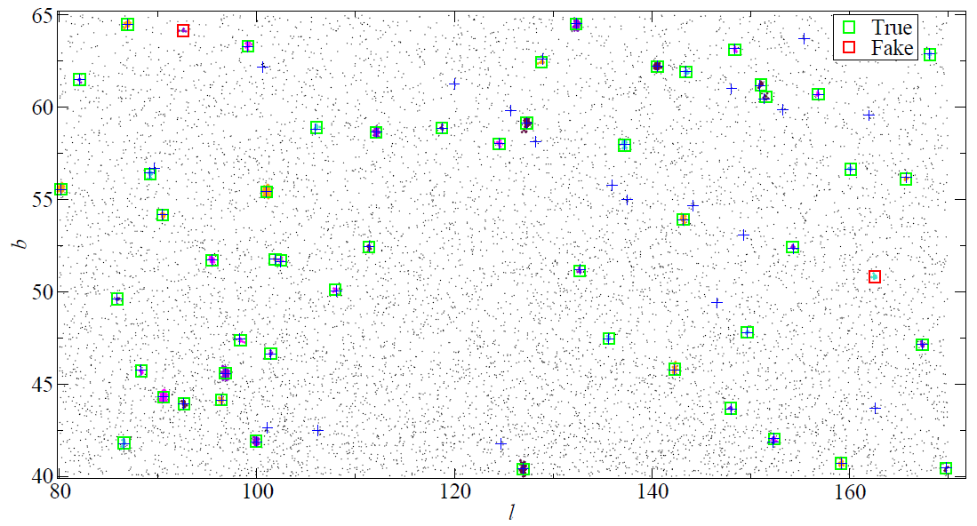
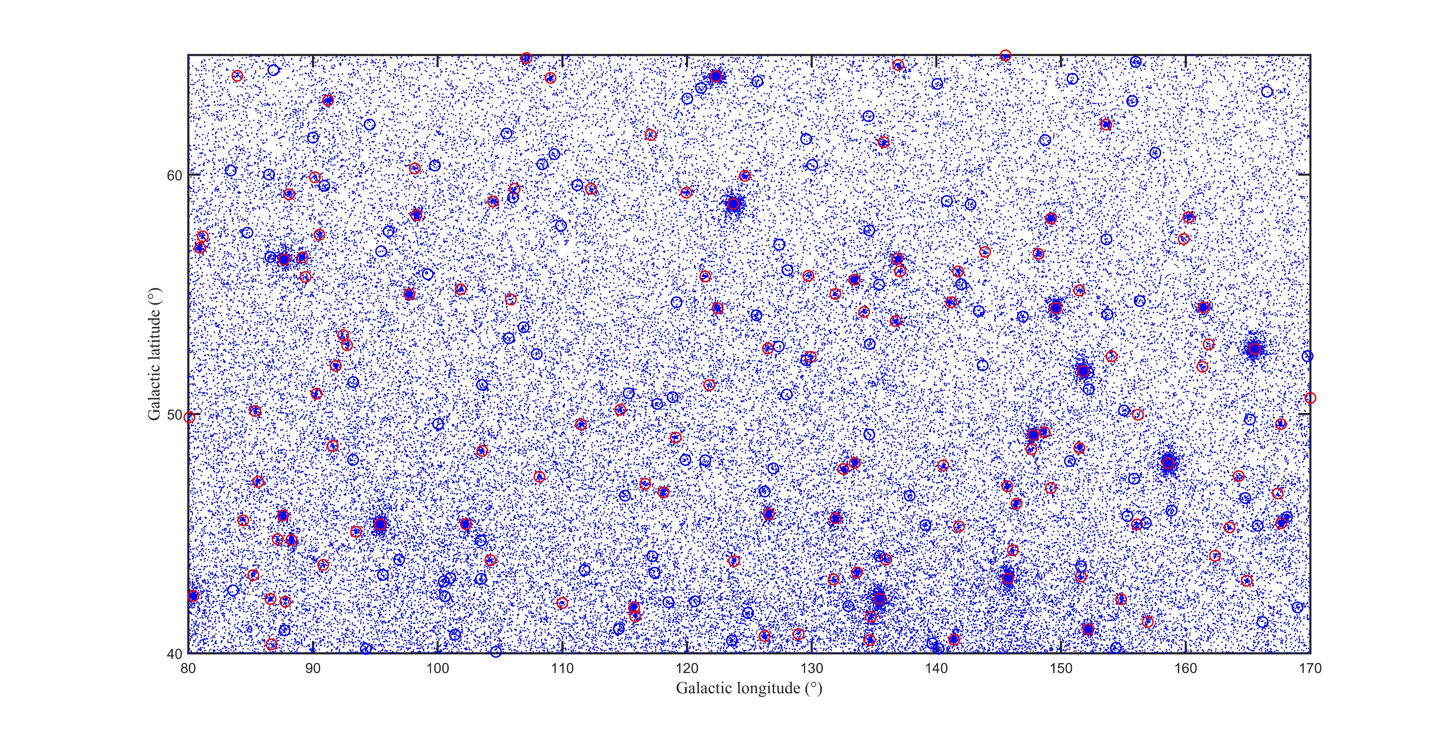
INTRODUCTION
What is the PROBLEM?
A. Tramacere et al (2013).
LAT Data Server (2023).
Page 6/23

Slide 7
2
Fermi-LAT Data Selection

Slide 8
Fermi-LAT dataset
Fermi-LAT dataset:
Downloaded from the FSSC archive
Events include:
Photons → $E_{γ}$> 3 GeV (why?) (Soor et al 2023)
15 years of data from 4 August 2008 to 4 August 2023
$$\text{0} \text{<} \text{l}\text{ < 360}$$
$$\left|\text{b}\right| \text{>} \text{20}$$
Analysis:
Fermitools & Fermipy
evclass=128
$\text{zenith} \text{angle}\text{ ≥90}$
"zenith angle ≥90"
evtype=3
Page 7/23

Slide 9
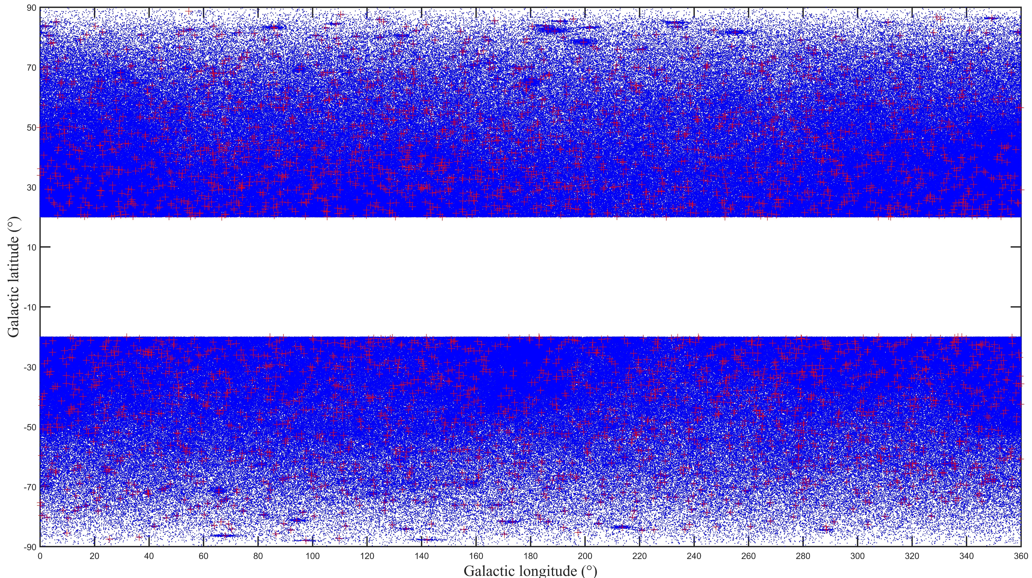
Fermi-LAT dataset
Scatter plot: 2M photons & 3936 sources
Page 8/23

Slide 10
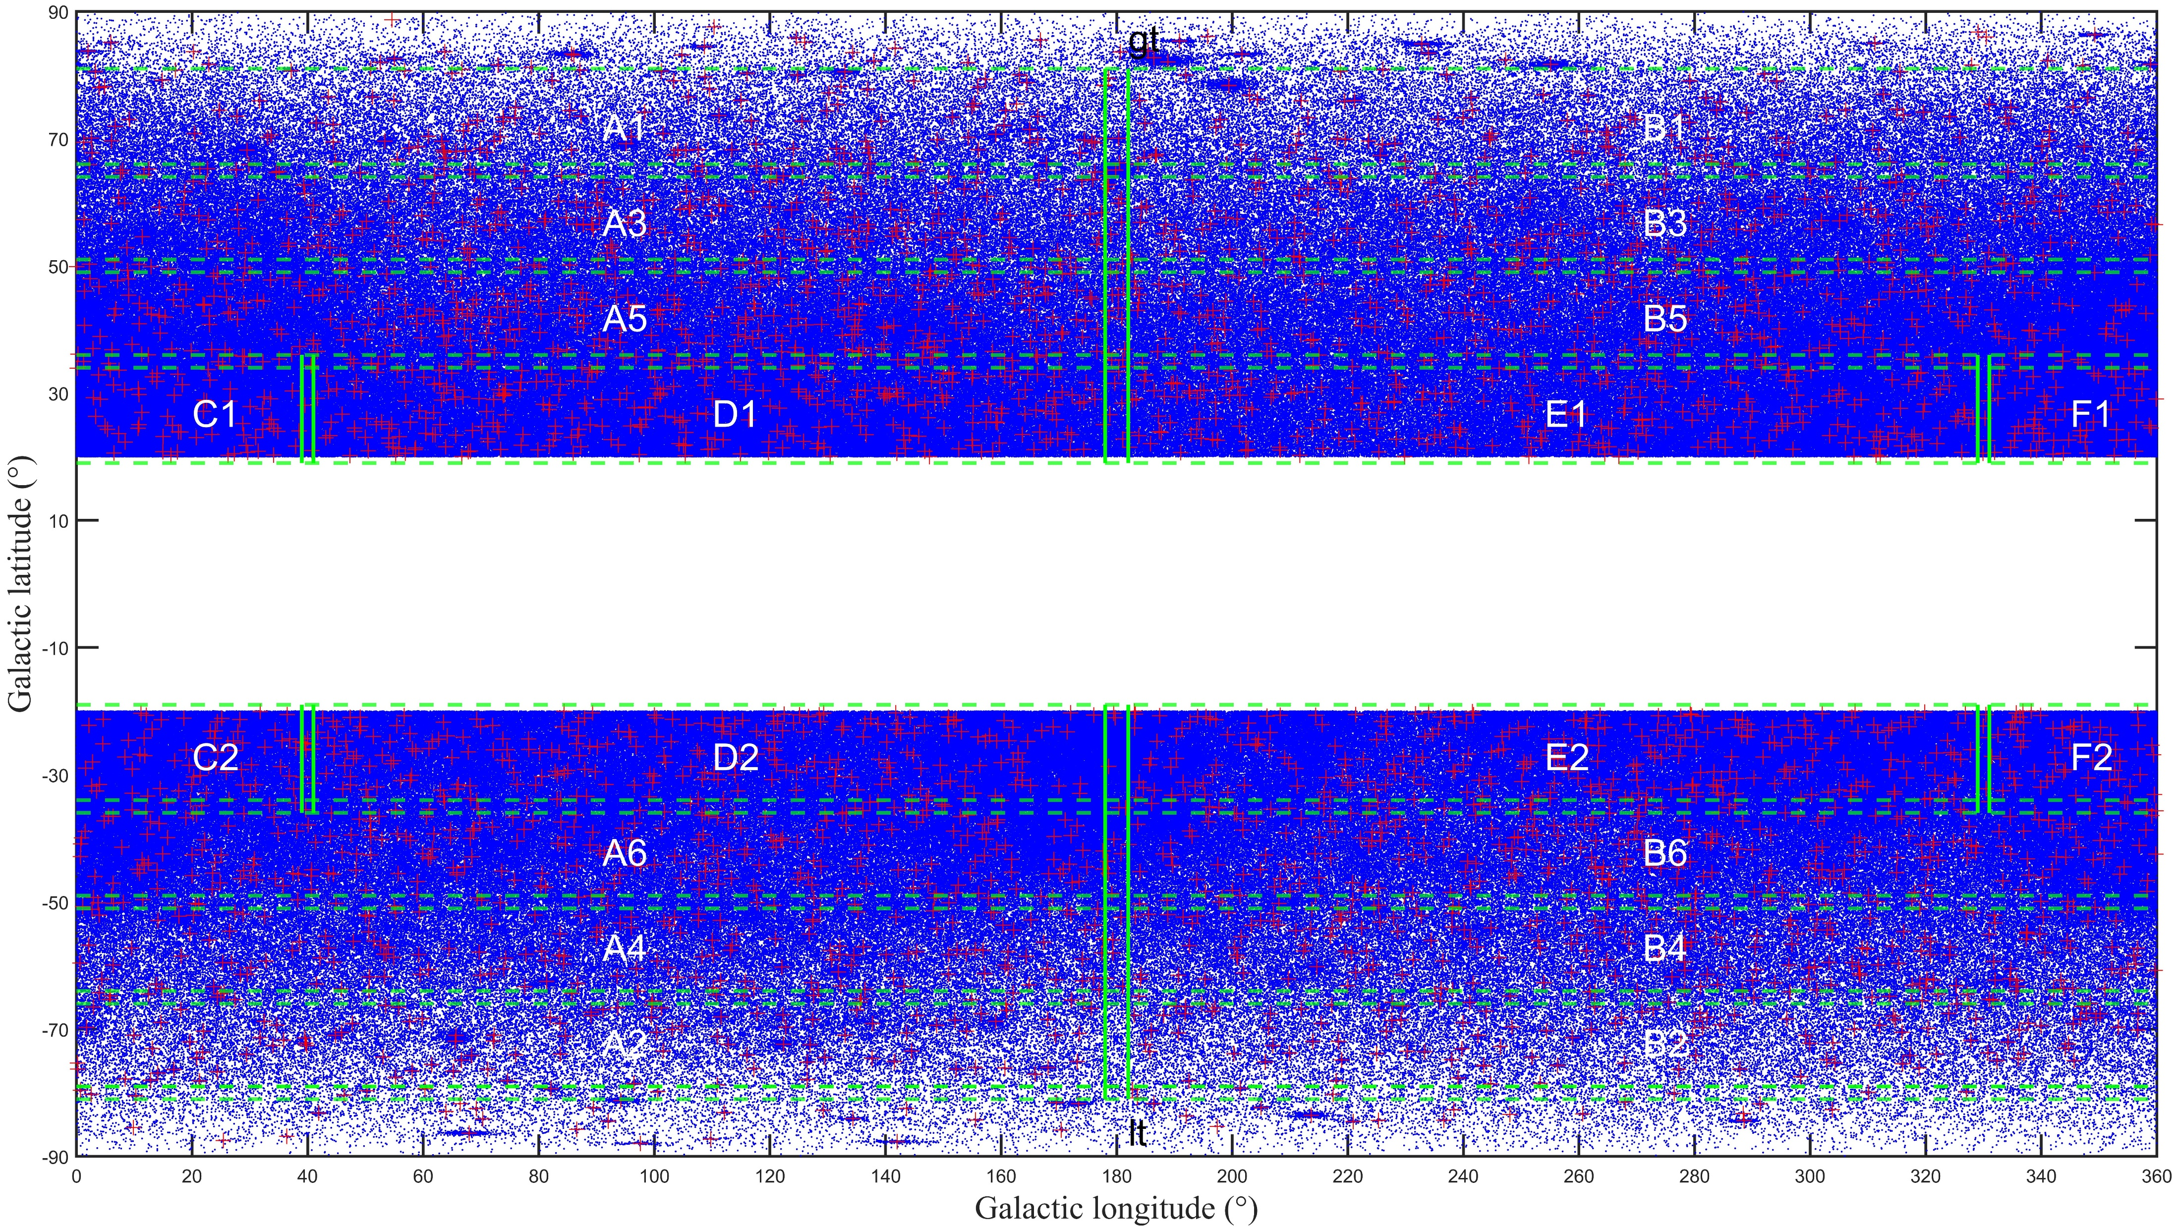
Fermi-LAT dataset
Let’s cut the field to explore!
Page 9/23

Slide 11
3
Data Denoising

Slide 12
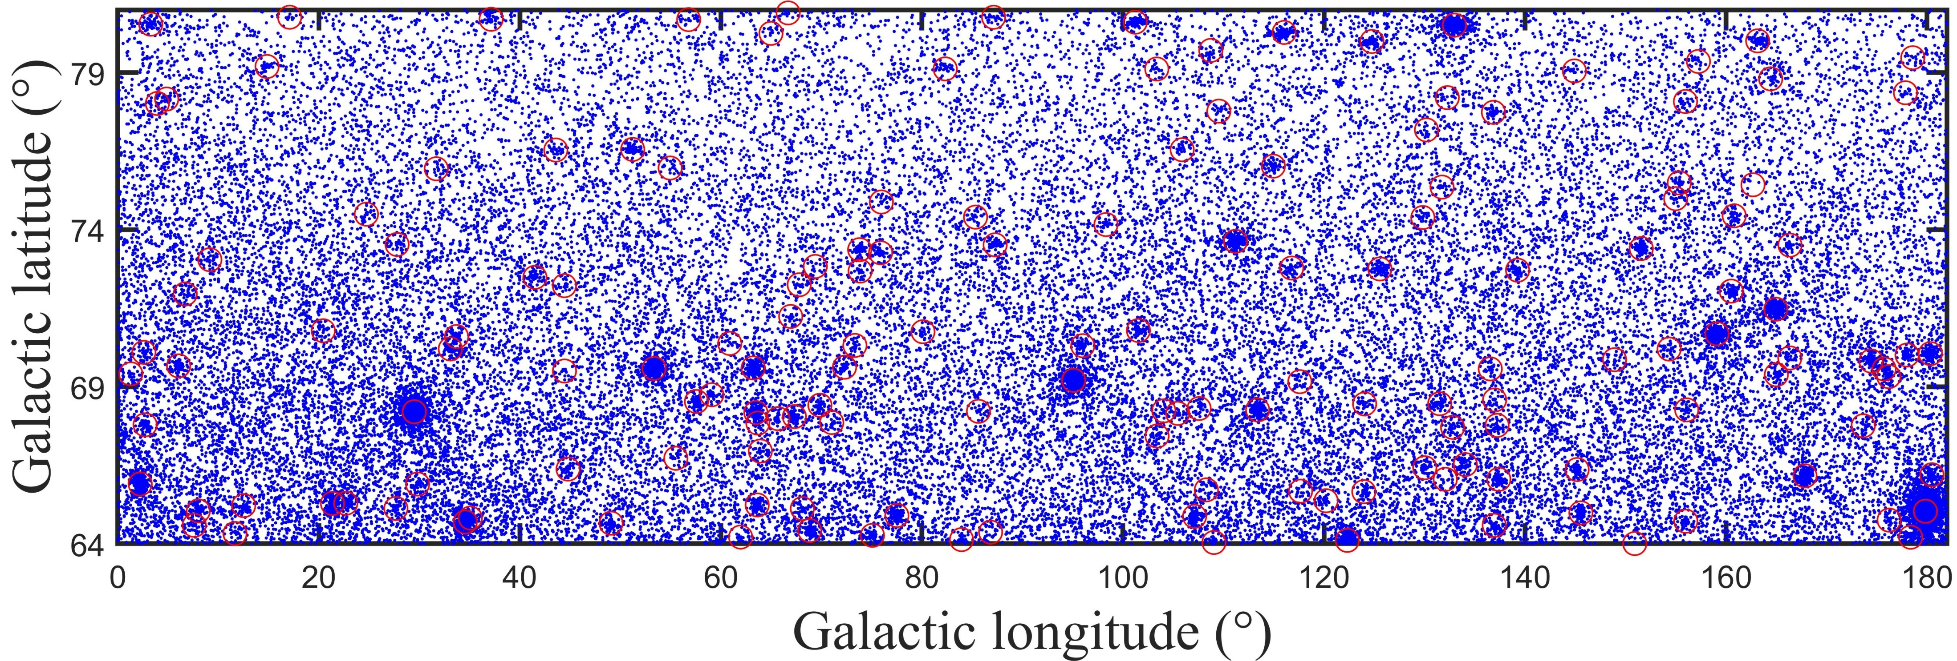
Data denoising
Let's consider a scenario where we choose from one of the 22 fields.
Page 12/23

Slide 13
Data denoising
DBSCAN before denoising
Page 13/23

Slide 14
Data denoising
DBSCAN after denoising
Apply DBSCAN on the Field With Cut 𝑎>𝑎 ̅
Apply DBSCAN on the Field With Cut 𝑎>𝑎 ̅/2
Page 14/23

Slide 15
4
Analysis New Sources

Slide 16
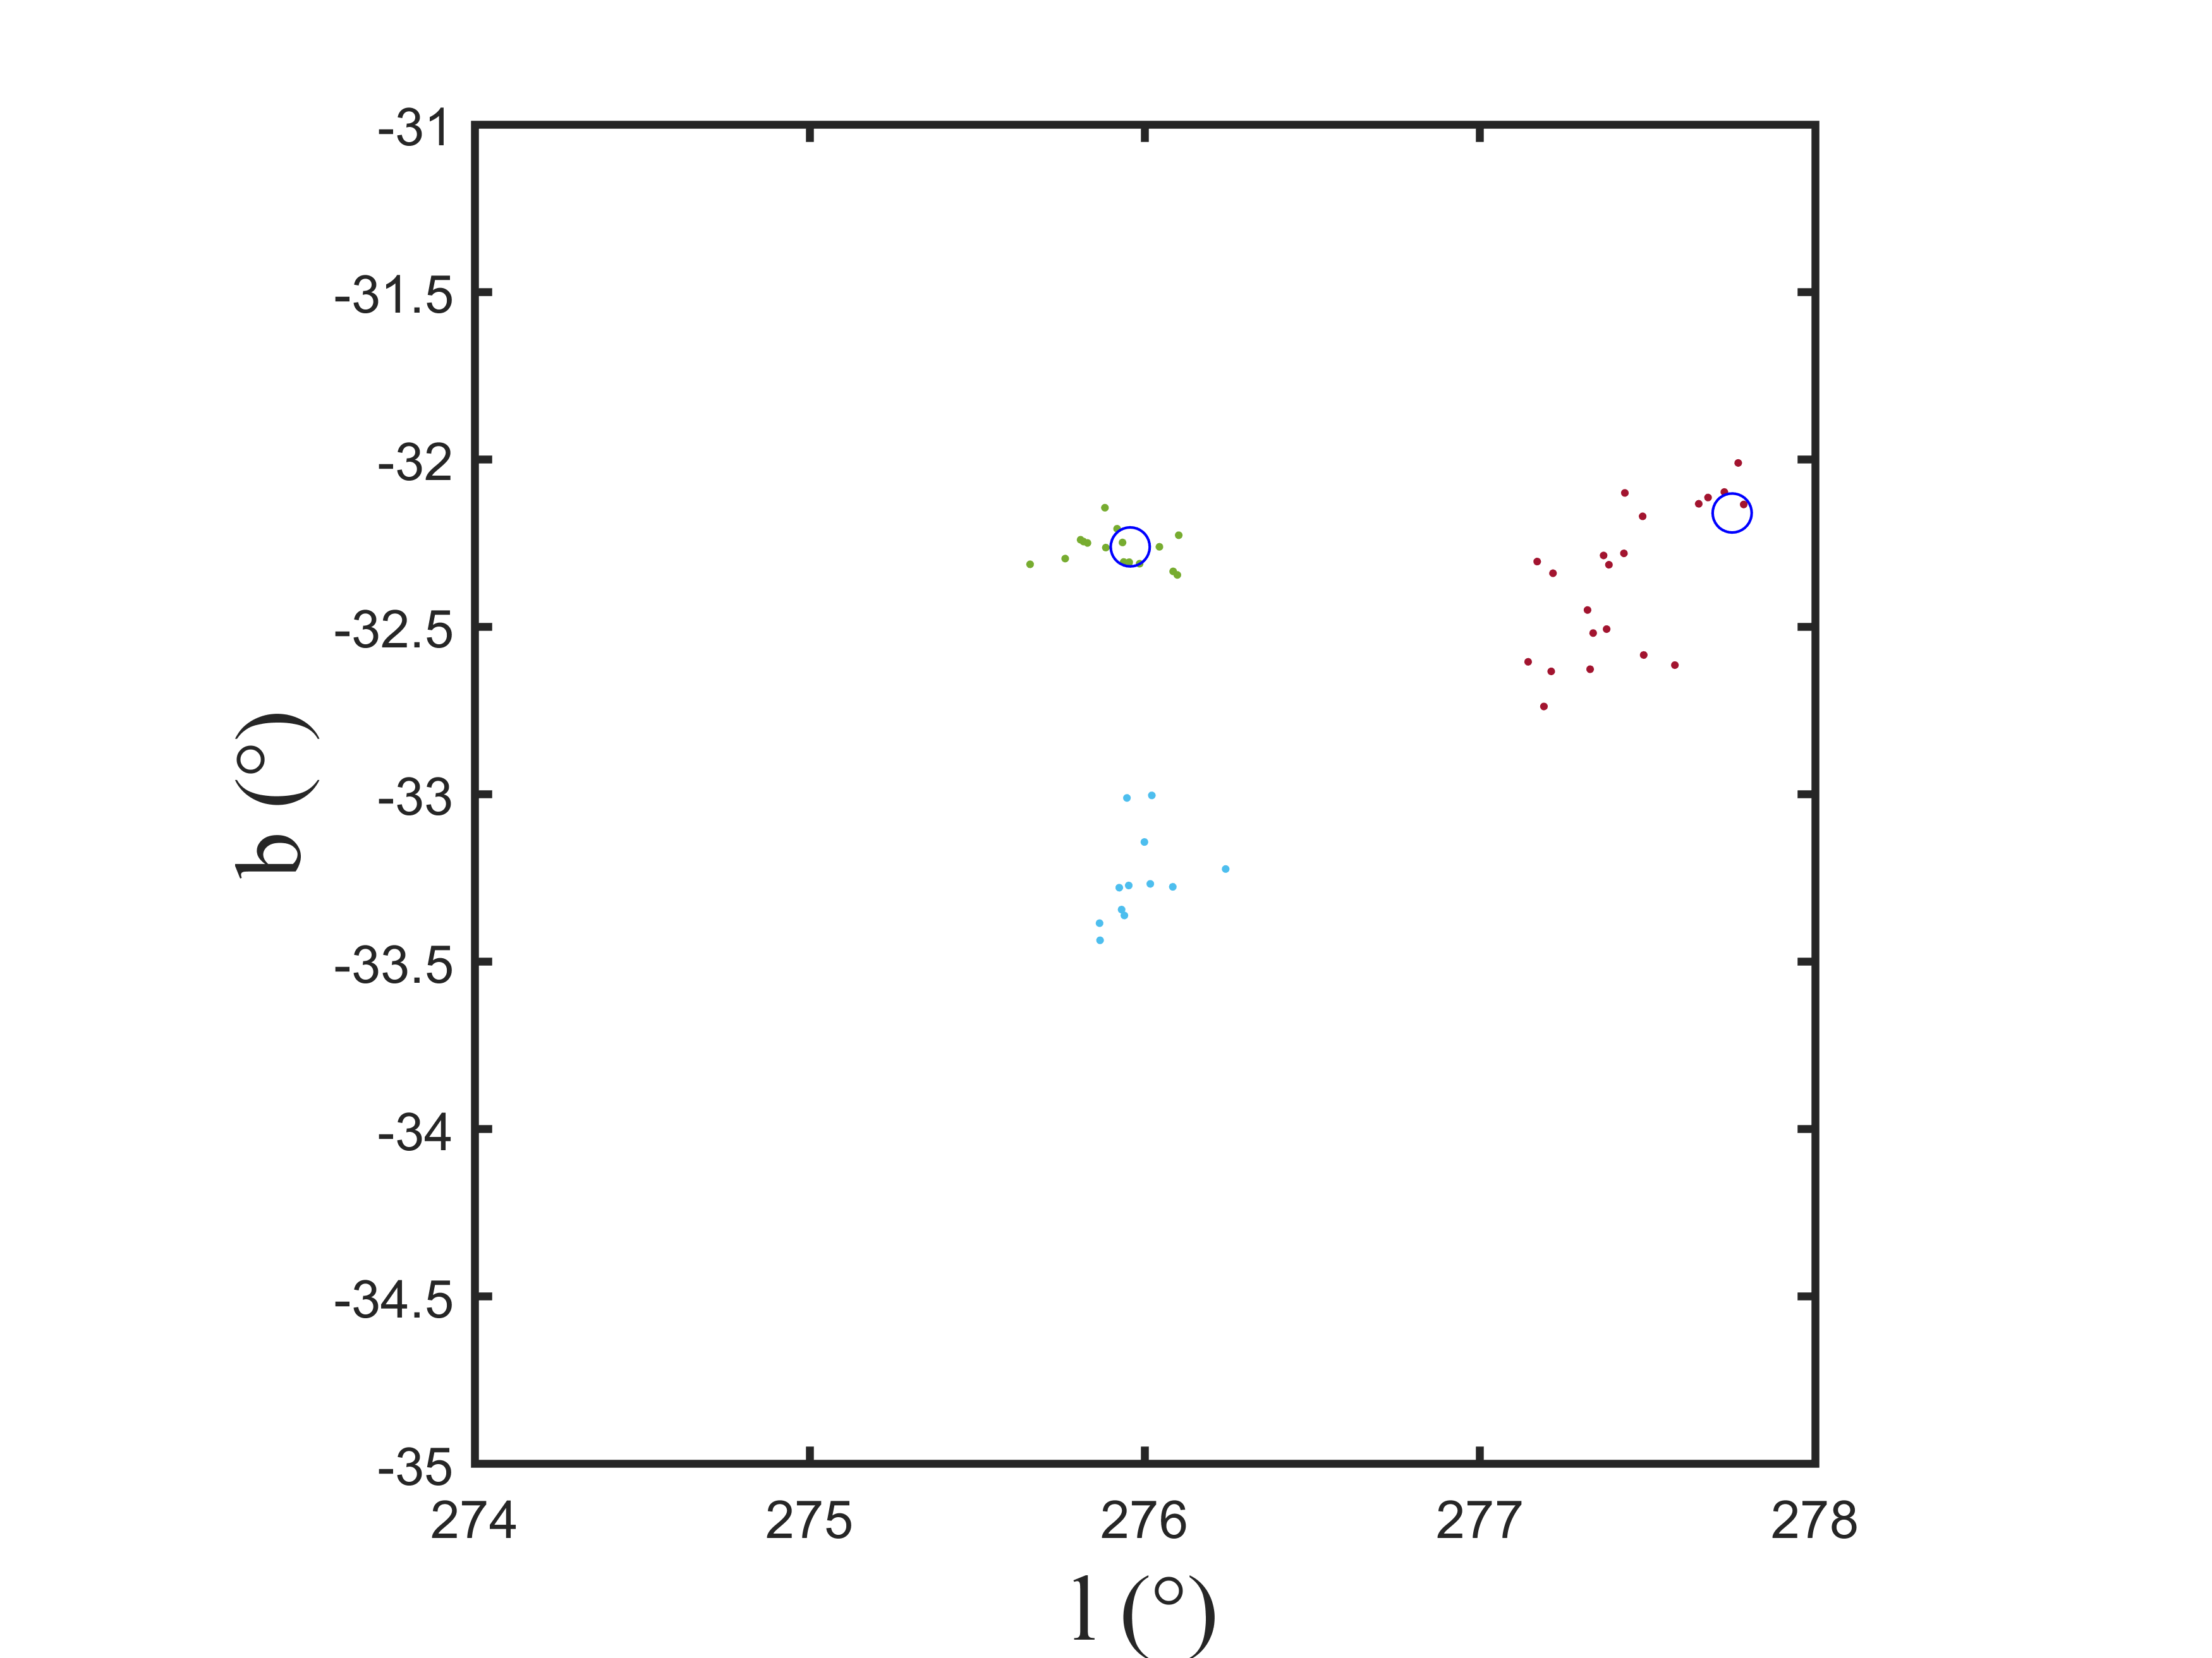
Analysis New Sources
We completed our analysis and removed noise from all 22 fields to discover new sources!
After that, we discovered a total of 16 potential sources!
Just like this one:
Source Candidate
Page 16/23

Slide 17
Analysis New Sources
Cluster Sig
Li & Ma (1983).
TS (Test Statistic)
M. Ackermann et al (2013).
&
$$S=\frac{1}{2}√TS$$
Campana & Massaro (2021).
Page 17/23

Slide 18
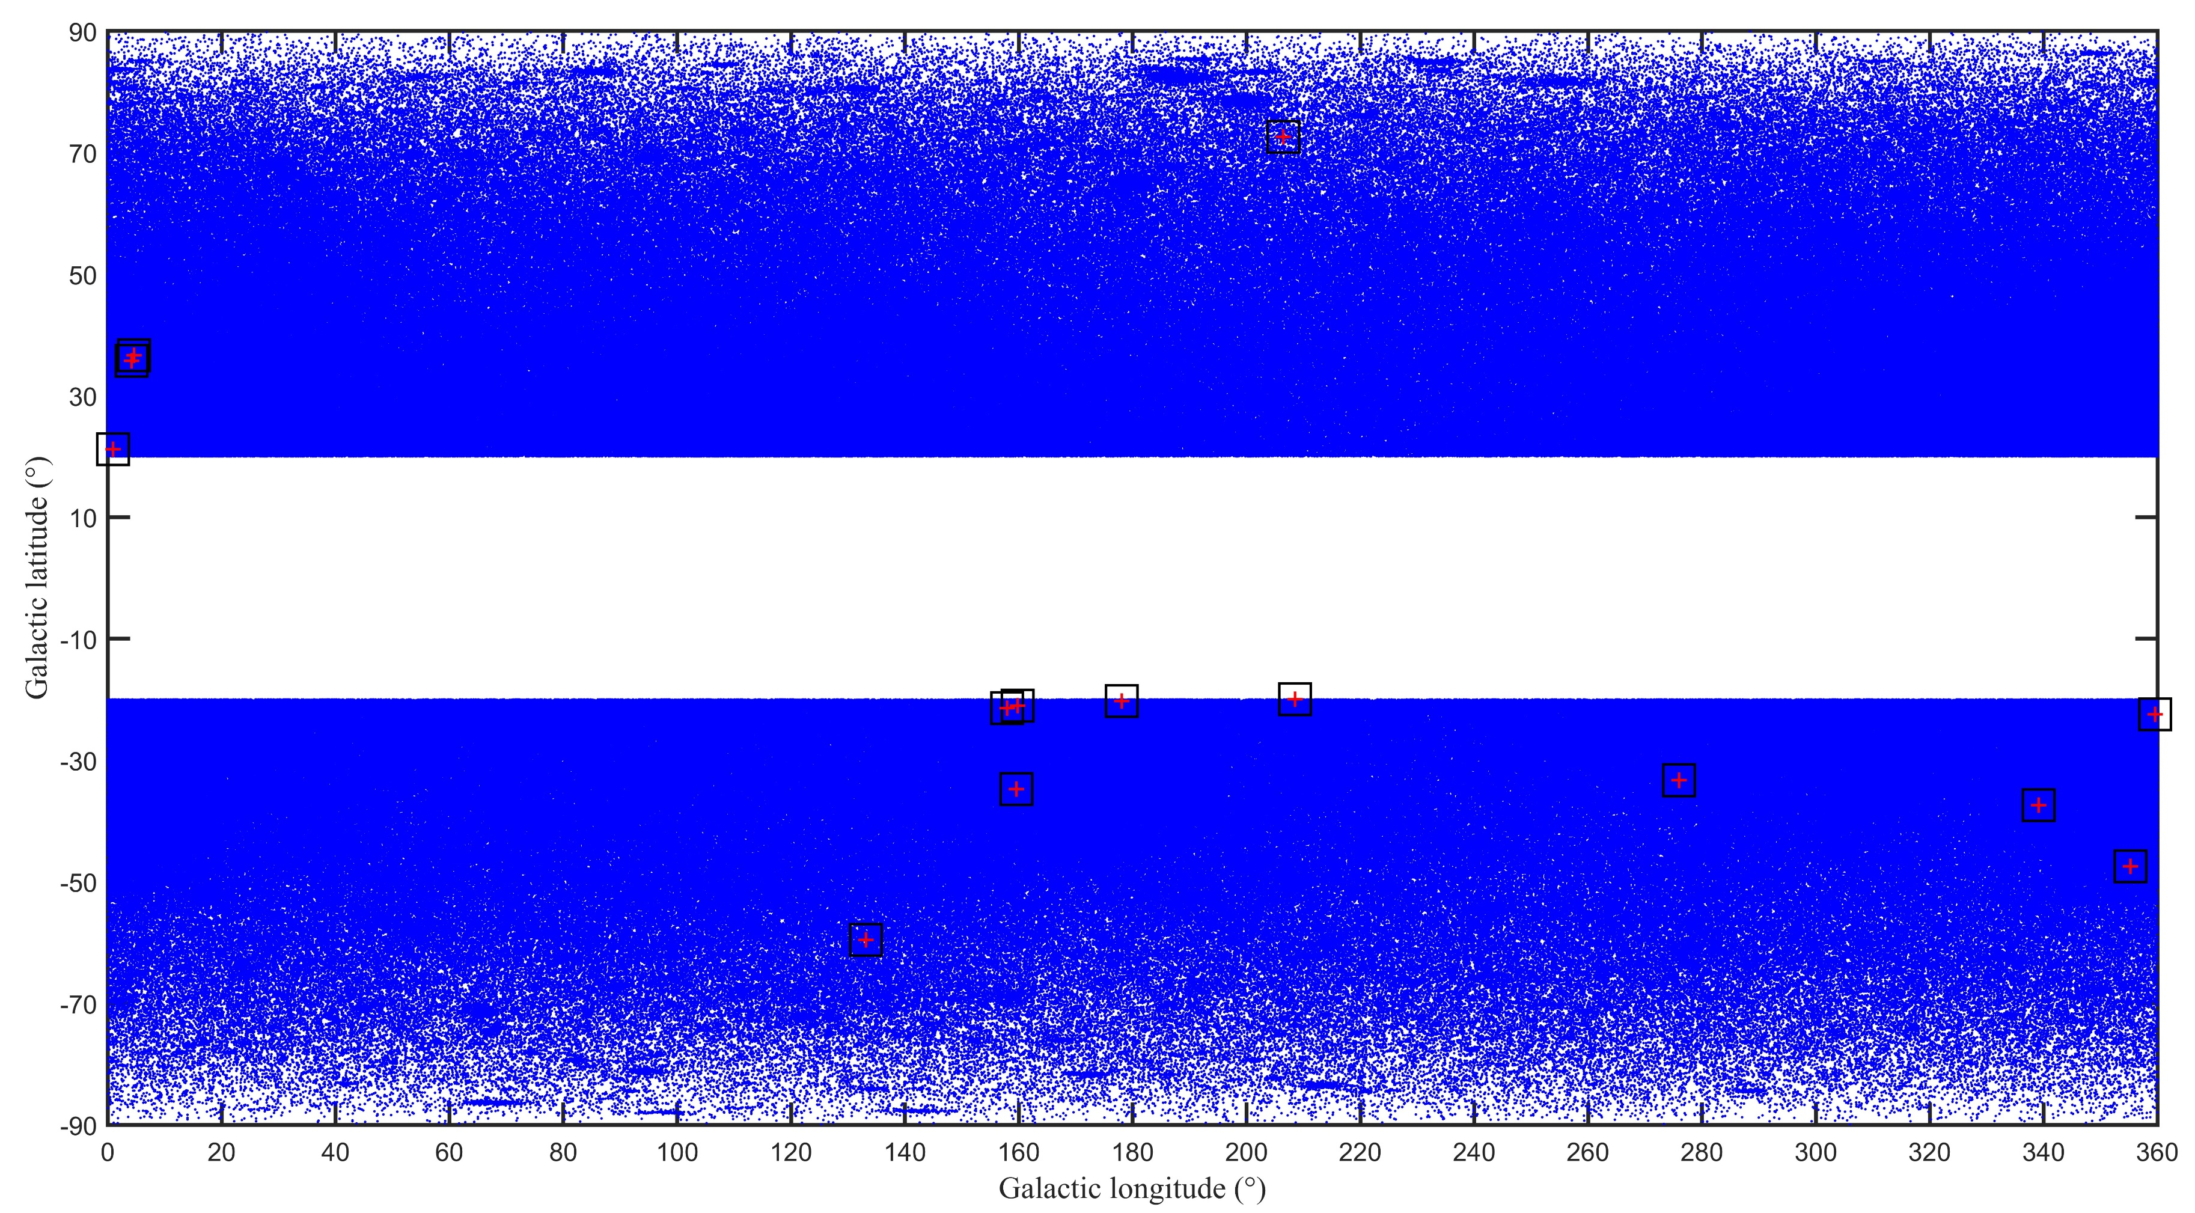
Analysis New Sources
Potential sources on scatter plot
Page 18/23

Slide 19
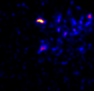
Analysis New Sources
TS Map
-31
4FGL J0535.2-6736
4FGL J0535.7-6604c
b
Source Candidate
-33
275 l 277
Page 19/23

Slide 20
Analysis New Sources
Table of results
Name | L | B | N | S | estimate TS
New Source 1 | 1.877 | -66.208 | 5 | 2.596 | 26.957
New Source 2 | 133.141 | -59.541 | 6 | 2.834 | 32.126
New Source 3 | 206.453 | 72.582 | 6 | 2.703 | 29.225
New Source 4 | 4.609 | 36.609 | 6 | 2.813 | 31.652
New Source 5 | 4.168 | 35.727 | 7 | 3.014 | 36.337
New Source 6 | 159.576 | -34.746 | 7 | 3.017 | 36.409
New Source 7 | 355.246 | -47.482 | 5 | 2.566 | 26.337
New Source 8 | 339.129 | -37.404 | 5 | 2.592 | 26.874
New Source 9 | 0.944 | 21.174 | 5 | 2.717 | 29.528
New Source 10 | 178.076 | -20.262 | 5 | 2.556 | 26.133
New Source 11 | 159.812 | -21.028 | 7 | 2.964 | 35.141
New Source 12 | 157.951 | -21.429 | 7 | 2.991 | 35.784
New Source 13 | 159.567 | -34.740 | 5 | 2.589 | 26.812
New Source 14 | 208.502 | -19.971 | 5 | 2.790 | 31.136
New Source 15 | 275.982 | -33.250 | 9 | 3.412 | 46.567
New Source 16 | 359.550 | -22.442 | 5 | 2.605 | 27.144
Page 20/23

Slide 21
5
Conclusion

Slide 22
Conclusion
Tested on random fields
We develop an algorithm Hedayati et al (2023)
tested on Fermi-Lat Data
Reach 16 Candidate Sources!
Analysis All sky
Page 22/23

Slide 23
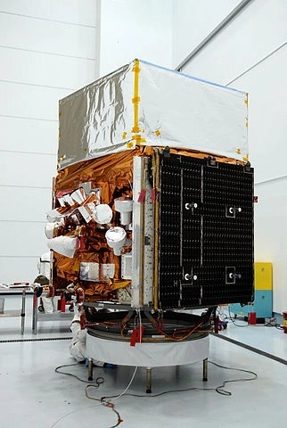
Thanks! Mehransoor96@gmail.com

