Slide 1
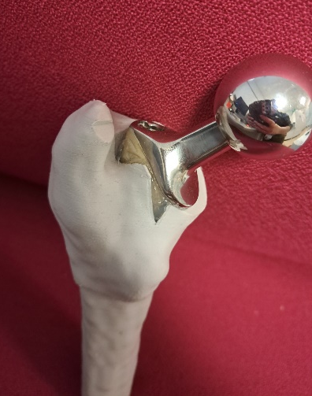
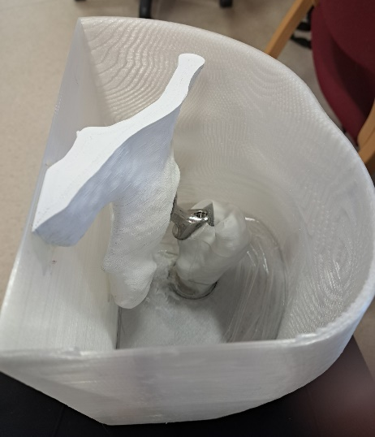
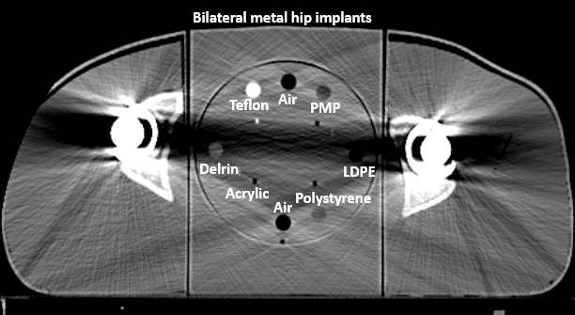
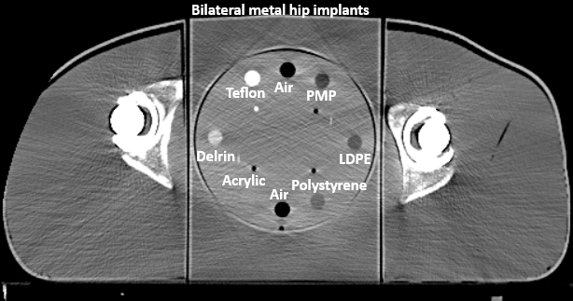
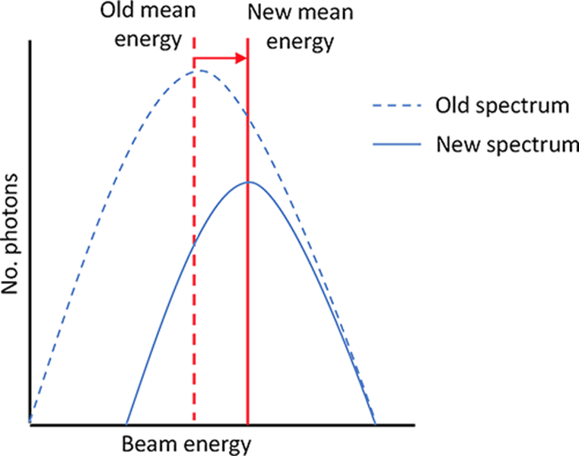
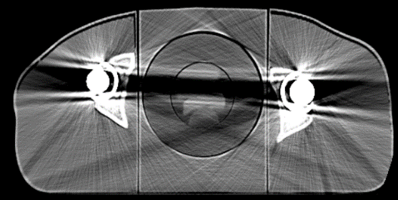
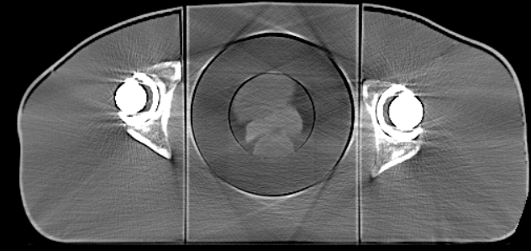
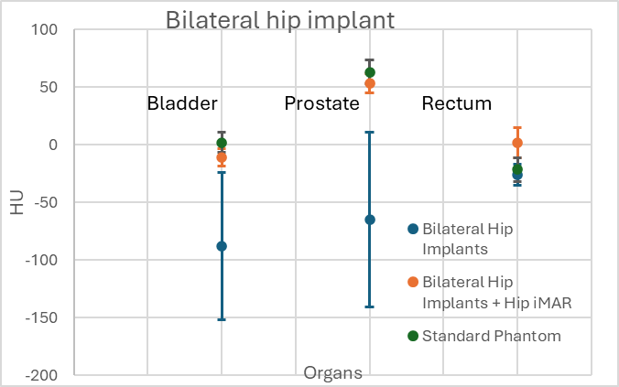
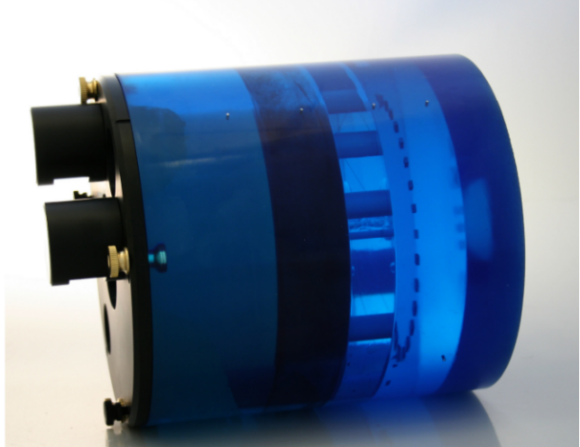
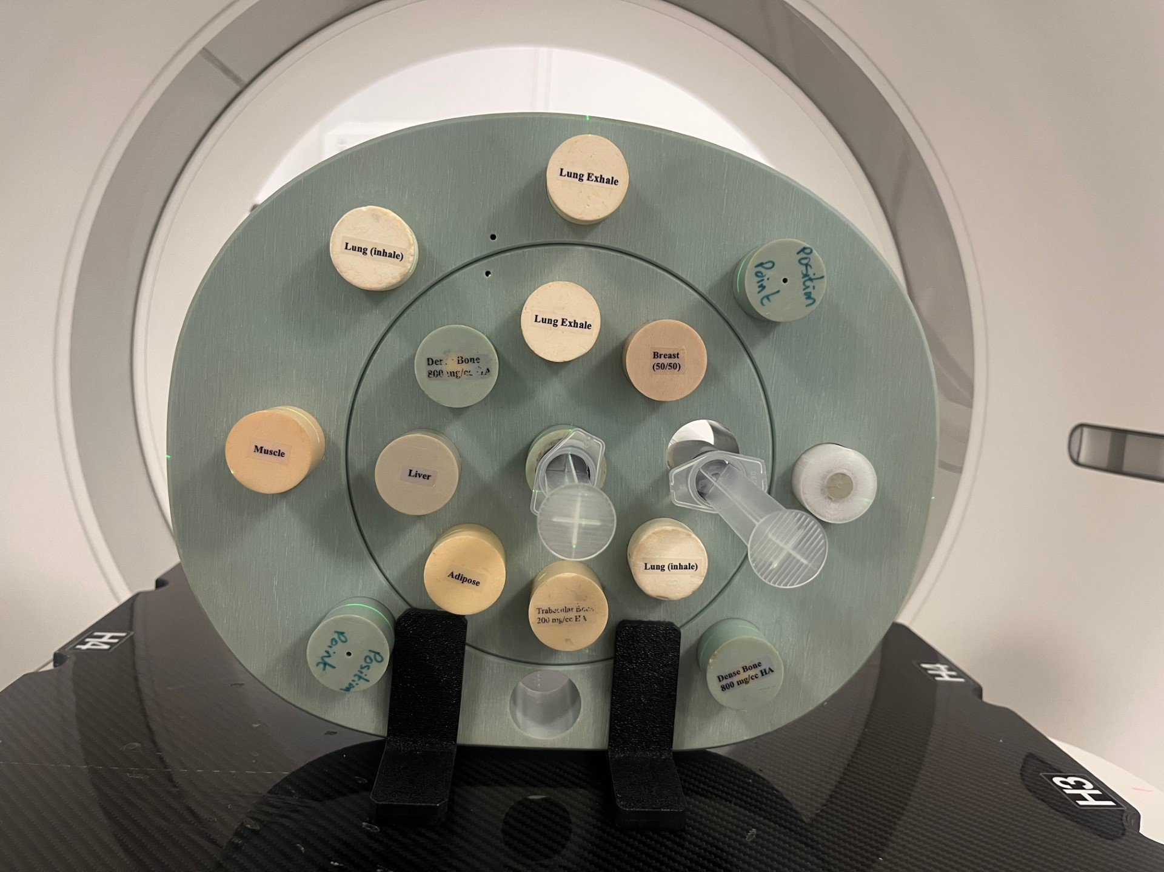
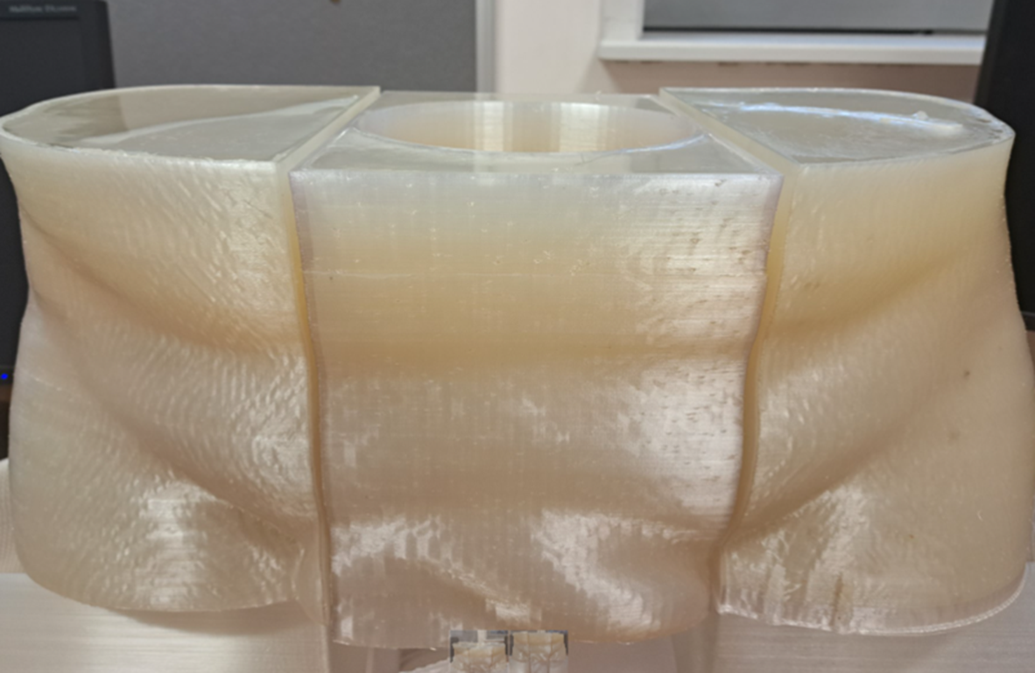
A Novel 3D Printed Anatomical Prostate Phantom for Investigating Advanced Imaging in Radiotherapy Ciara McHugh cmchugh29@qub.ac.uk Supervisors: Dr Conor McGarry and Dr Louise Belshaw Acknowledgements: Mr David Beverland, Musgrave Park Hospital, Belfast
Introduction
Methods
Across the UK, approximately 1 in 8 men will develop prostate cancer, with men over 50 being particularly at risk [1]. One of the ways to treat prostate cancer is external beam radiotherapy.
CT imaging is used to create a treatment plan for radiotherapy patients as the technique visualises the patients' internal anatomy and provide quantitative information, in the form of CT numbers which are expressed in Hounsfield Units (HU) and are used to calculate radiation dose.
With the aging population, the number of patients requiring radiotherapy that have prostatic hips present is rising [2].
Each of the phantoms were scanned using a Siemens CT scanner with the Pelvic Supine protocol. Each phantom was centred on the bed and in the bore of the CT scanner. The beam energy used was 120kV with a slice thickness of 2mm and 280mAs. The extended CT range was used, and the images were reconstructed with and without iterative metal artefact reduction (iMAR).
Results
Treating prostate cancer patients with metal hip implants is difficult as these metal implants cause streaking and distort CT images, reducing image quality and accuracy of CT numbers. This streaking and distortion caused by metal implants is known as metal artefacts and occur due to:
beam hardening (a shift in the mean beam energy due to attenuation of low energy photons) [3],
under-sampling (occurs due to large differences in the density of the implant compared to surrounding soft tissue [4]),
scattering (causes a deviation of photons from their original trajectory [5])
photon starvation (occurs due to attenuation of photons [5]).
If CT images become distorted, this can severely impact the accuracy of a radiotherapy treatment plan, potentially leading to unnecessary irradiation of healthy tissue or insufficient radiation dose to the tumour [2].
unnecessary
Figure 1: a) CT image of a phantom with two circles of dense material (white) without beam hardening. (b) The phantom with visible beam hardening artifacts [6]
Figure 7: 3D printed femur with metal hip implant:
Figure 8:3D printed femur within 3D printed side module
Figure 9: 3D printed femur and hip within 3D printed side module
Figure 10: 3D printed pelvic phantom set up in the CT scanner
Figure 11:Catphan 504 CTP404 module inside pelvic phantom . Image on the left shows the bilateral set up with no iMAR applied and the image on the right shows the bilateral set up with Hip iMAR applied
Figure 2: Shift in mean beam energy caused by beam hardening [3]
Figure 12: Image on the left shows the CT image of bilateral hip implant set up with the 3D printed organs and, on the right, shows the same CT image reconstructed using Hip iMAR
The purpose of this work was to investigate the impact of, and ways to improve, the effect of metal hip implants on radiotherapy treatment planning for treating prostate cancer.
Methods
To investigate the impact of and ways to improve the effects of metal artefacts, the following was carried out:
Analysis of standard image quality object (Catphan504) to investigate:
Geometric distortion
Uniformity
Spatial resolution
Contrast resolution
Investigated a second standard image quality object (CIRS phantom) with high density insert to investigate:
Impact at various distances from a metal insert
Effect on HU of known materials close to the metal insert
Designed and created a 3D printed anatomical pelvic phantom, both with and without metal artificial hips. This was designed to fit 3D printed organs and Catphan504 modules within the anatomical phantom for deeper investigations.
In this project, an iterative metal artefact reduction algorithm (iMAR) designed to improve the effects of metal artefacts at the projection stage of CT image reconstruction was investigated.
iMAR was developed by Siemens and is widely used to improve the effects of metal artefacts and its effectiveness has been explored in literature. However, there are only 8 different types of preset iMAR, with the focus of this project being mainly on Hip iMAR. However, the other iMAR presets were also explored during this project.
Figure 3: Catphan 504 phantom
Figure 13: Plot of the HU for each 3D printed organ, with the green representing the organs in the standard pelvic phantom set up (no metal present), the blue representing the organs HU values in the bilateral metal hip set up and the orange representing the organs when the bilateral hip set up was reconstructed using Hip iMAR
Figure 4: CIRS Electron Density phantom
The Hip iMAR protocol was effective in improving the accuracy of the HUs assigned to materials. As seen in Figure 13 illustrating the HU assigned to each of 3D printed replica organs, the streaking caused by bilateral metal hips caused the bladder and prostate to be assigned lower HUs than expected of -88±64HU and -65±76HU respectively. When the CT images were reconstructed using the Hip iMAR, the HUs assigned to the prostate and bladder were -10±7HU and 53±8HU which are similar to the expected values of 2±9HU and 63±10HU.
Figure 5: 3D printed pelvic phantom
Conclusion
iMAR is a useful and effective tool for reducing the negative effects of metal artefacts caused by metal hip implants, helping to improve the qualitative and quantitative information gained from a radiotherapy planning CT scan.
In this project it was observed that the preset ‘Hip iMAR’ was useful in both the case of unilateral and bilateral metal hip implants.
Figure 6: Catphan 504 modules
[1] Prostate Cancer UK, Web address: https://prostatecanceruk.org/prostate-information-and-support/risk-and-symptoms/about-prostate-cancer. Accessed on the 22/01/2024
[2] Zhao, J., Wang, W., Shahnaz, K., Wu, X., Mao, J., Li, P. and Zhang, Q., 2021. Dosimetric impact of using a commercial metal artifact reduction tool in carbon ion therapy in patients with hip prostheses. Journal of Applied Clinical Medical Physics, 22(7), pp.224-234
[3] CT artefacts, Web address: https://www.radiologycafe.com/frcr-physics-notes/ct-imaging/ct-artefacts/ Accessed on the 22/01/2024
[4] Kachelreiß, M. and Krauss, A., 2015. Iterative metal artifact reduction (imar): Technical principles and clinical results in radiation therapy (white paper). Heidelberg, Germany: Siemens Healthcare
[5] Sharma, S., Kaushal, A., Patel, S., Kumar, V., Prakash, M. and Mandeep, D., 2021. Methods to address metal artifacts in post-processed CT images–A do-it-yourself guide for orthopedic surgeons. Journal of Clinical Orthopaedics and Trauma, 20, p.101493
[6] Maier, A., Steidl, S., Christlein, V. and Hornegger, J. eds., 2018. Medical imaging systems: An introductory guide

