Slide 1

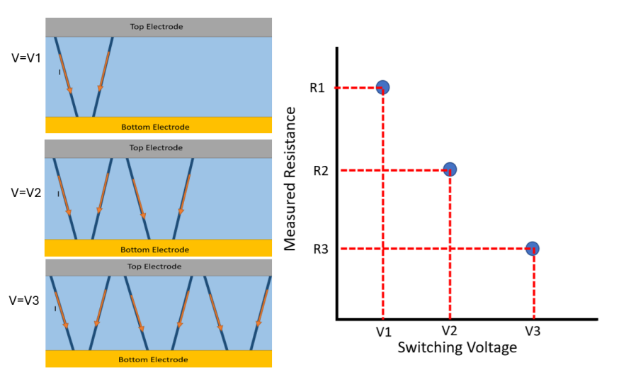
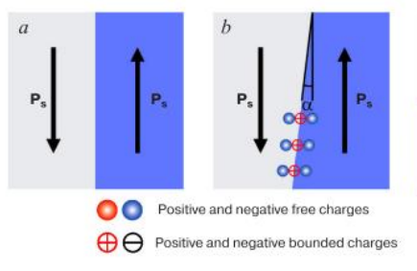
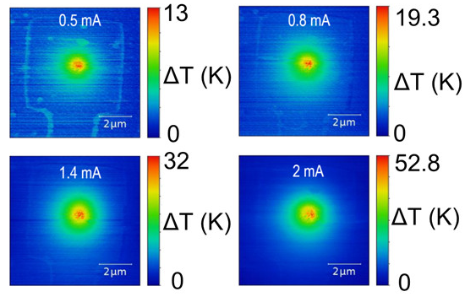
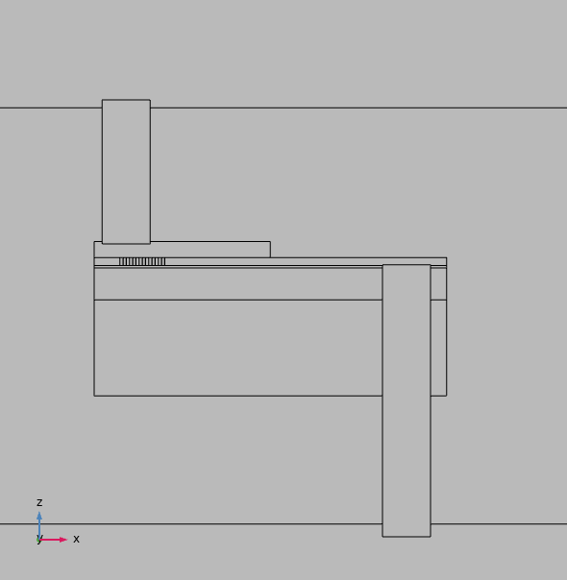
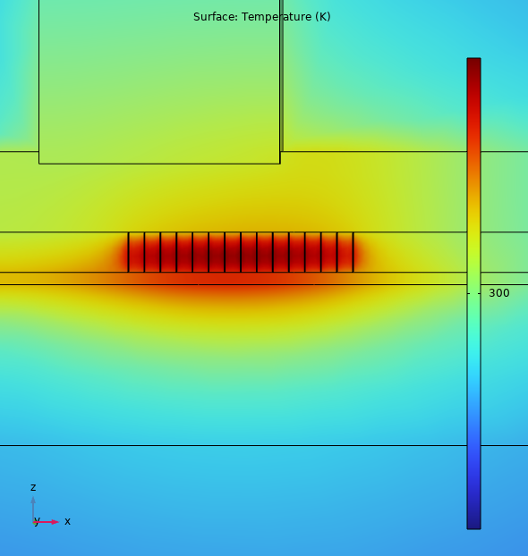
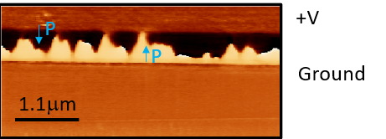
Investigating Nanoscale Joule Heating in Lithium Niobate Memristors
Ciara Ward*, Lindsey Lynch, Dr Raymond McQuaid
School of Mathematics and Physics, Queen’s University Belfast, U.K.
*e-mail: cward40@qub.ac.uk
CONCEPT & BACKGROUND
The number of domain walls connecting device electrodes determines the current, and hence device resistance (right). Multiple non-volatile resistance levels can be voltage programmed to create a multistate memory device i.e. a memristor. [2,3]
Domain walls in ferroelectrics are interfaces that separate polar domain variants. They can be created, erased or moved by applied voltages, and in this sense are reconfigurable. Certain domain wall types can also have higher electrical conductivity than the bulk material.
Schematic of varying number of conducting domain walls and associated device resistance.
These conductive domain walls experience localised Joule heating when biased. Unregulated self-heating in filament conductor based resistive memory devices (left) can affect performance and efficiency. Nanoscale temperature mapping is required for better understanding of these heating processes and to enable improved device efficiency.
Schematic of domains (regions of polarisation) and the boundary between them (domain walls) and how this leads to conductive domain walls. [1]
Thermal mapping of conductive filaments in memristor devices experience joule heating [4]
METHODS
The experiment was also simulated using COMSOL finite element modelling. The memristor device was recreated and the temperature of the current-carrying domain walls was calculated when the device was powered.
Domain walls were introduced to thin-film ferroelectric LiNbO₃ by voltage poling (below). The size of the domains increases with increased applied voltage; conductive paths are formed when the domain walls connect top and bottom electrodes.
Scanning probe
LiNbO₃ with domains
Raster path
The presence of domain walls within the real device was confirmed using Piezoresponse Force Microscopy (PFM) imaging of the device cross section (fabricated by Focused Ion Beam machining and schematised above). For thermal imaging, the active region can be contacted directly by the scanning probe while bias is supplied through planar surface electrodes.
Conducting Domain Walls
Pt Electrode
LiNbO₃
Platinum
Au Electrode
P
P
P
P
P
LiNbO₃
SiO₂
Gold
Bulk LiNbO₃
Bulk
RESULTS
Finite element modelling estimates temperature changes of ΔT~30mK for a 10µA current flowing through the device cross-section, when placed on SiO₂ substrate. An increased ΔT of ~70 mK is observed for 10 µA current in the absence of the substrate. Direct imaging of the heated filaments therefore comes at the cost of reduced temperatures compared to the buried devices (ΔT of ~10 K), due to the effects of small active volume in the cross section (~10 x 0.5 x 0.3 μm³) and substrate heat sinking.
Piezoresponse phase map
Top Pt Electrode
LiNbO₃ (with domains)
Bottom Au Electrode
Piezoresponse amplitude map
Bulk substrate
Domains and domain walls were preserved in the lamella (left). Electroded device cross sections were successfully fabricated to use in thermal imaging investigations.
1 µm
Domain walls (dark contours)
REFERENCES
[1] Kislyuk, Aleksandr M., et al. Modern Electronic Materials 9.4 (2023): 145-161.
[2] McConville, James PV, et al. Advanced Functional Materials 30.28 (2020): 2000109.
[3] Seidel, Jan, et al. Nature materials 8.3 (2009): 229-234.
[4] Nandi, Elliman et. al. ACS Applied Materials & Interfaces. 14,25 (2022)
Notes:
Up nano probe

