Slide 1
Centrifugally driven
relativistic particles
Speaker: Elene Gaprindashvili;
Free university of Tbilisi
Supervisor: Andria Rogava
gaprindashviliellene@gmail.com

Slide 2
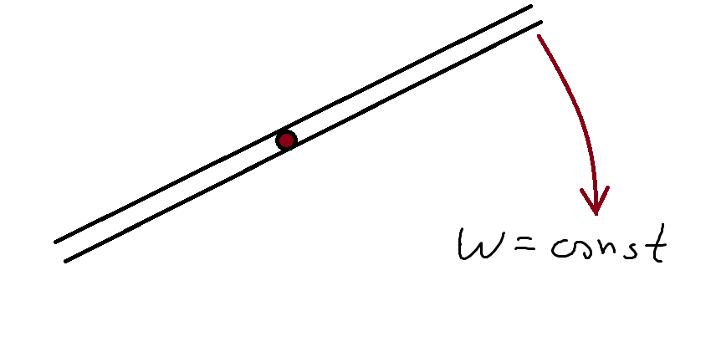
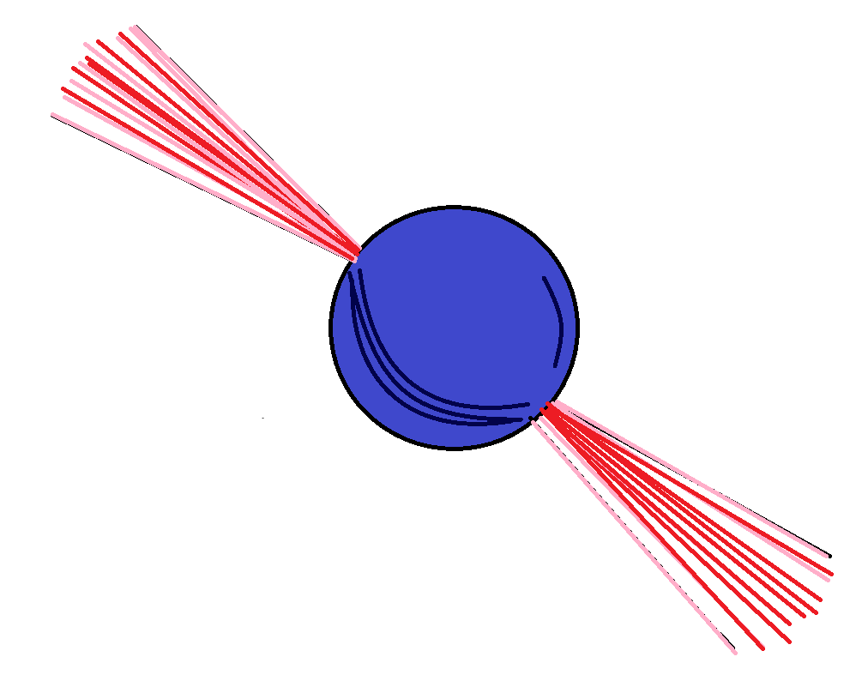
Introduction
Machabeli G.Z and Rogava A.D
Giorgi khomeriki and Andria Rogava study

Slide 3
Metric of a rotating massive object:
$${ds}^{2} = g_{tt}{dt}^{2} + 2g_{tφ}dtdφ + g_{φφ}{dφ}^{2} + g_{rr}{dr}^{2} + g_{θθ}{dθ}^{2};$$
Which might reduce to:
Rotating black hole metric
Non-rotating black hole metric
Minkowski metric
Let us consider following trajectories:
$Ω=Ω\left(θ,r\right);$
$$θ=θ\left(r\right);$$
$$φ = φ(r) + Ω(θ, r);$$

Slide 4
$Ω=Ω\left(θ,r\right);$
$$θ=θ\left(r\right);$$
$$φ = φ(r) + Ω(θ, r);$$
From which we get the following metric:
$${ds}^{2} = G_{tt}{dt}^{2} + 2G_{tr}drdt + G_{rr}{dr}^{2};$$
Where:
$$G_{tt} = g_{tt}+2Ωg_{tφ}+g_{φφ}Ω^{2};$$
$$G_{tr} = \left(g_{tφ}+g_{φφ}\right)\left(\acute{φ}+\acute{Ω}t+\frac{∂Ω}{∂θ}\acute{θ}t\right);$$
$G_{rr} = g_{φφ}{\left(\acute{φ}+\acute{Ω}t+\frac{∂Ω}{∂θ}\acute{θ}t\right)}^{2}+g_{rr}+g_{θθ}{\acute{θ}}^{2}$;

Slide 5
The particle’s energy is non-conserved!
But, if we consider that $Ω$ is not dependent on $θ$ and r:
$G_{tt}\frac{dt}{dτ} + G_{tr}\frac{dr}{dτ} = −E = const;$
$${\left(\frac{dt}{dτ}\right)}^{2}\left(G_{tt}+2G_{tr}\frac{dr}{dt}+{\left(\frac{dr}{dt}\right)}^{2}\right)=−1$$
From which we can get the quadratic equation for velocity:
$$\left(G_{rr}E^{2}+{G_{tr}}^{2}\right){\left(\frac{dr}{dt}\right)}^{2}+2G_{tr}\left(E^{2}+G_{tt}\right)\frac{dr}{dt}+G_{tt}\left(E^{2}+G_{tt}\right)=0$$

Slide 6
Special-relativistic case:
$${ds}^{2} = −{dτ}^{2} =−{dt}^{2} + {dr}^{2} + r^{2}{dφ}^{2} + {dz}^{2};$$
Where:
$$φ=ωt+φ\left(r\right);$$
$$z=z\left(r\right);$$
$${ds}^{2}=−{dτ}^{2}=(1+r^{2}{\acute{φ}}^{2}+{\acute{z}}^{2}){dr}^{2}+2r^{2}ω\acute{φ}drdt+(r^{2}ω^{2}−1){dt}^{2}$$

Slide 7
Radial velocity:
Lagrangian:
$$L=\frac{1}{2}\left(1+r^{2}{\acute{φ}}^{2}+{\acute{z}}^{2}\right){\left(\frac{dr}{dτ}\right)}^{2}+2r^{2}ω\acute{φ}\frac{dr}{dτ}\frac{dt}{dτ}+\left(r^{2}ω^{2}−1\right){\left(\frac{dt}{dτ}\right)}^{2}$$
we can calculate the energy and get the quadratic equation for velocity:
$$r^{2}ω\acute{φ}\frac{dr}{dτ}+\left(r^{2}ω^{2}−1\right)\frac{dt}{dτ}=const=−E$$
$$\left({\left(\frac{r^{2}ω\acute{φ}}{E}\right)}^{2}+\left(1+r^{2}{\acute{φ}}^{2}+{\acute{z}}^{2}\right)\right){\left(\frac{dr}{dt}\right)}^{2}+\left(\frac{2r^{2}ω\acute{φ}\left(r^{2}ω^{2}−1\right)}{E^{2}}+2r^{2}ω\acute{φ}\right)\frac{dr}{dt}+{\left(\frac{r^{2}ω\acute{φ}}{E}\right)}^{2}+\left(r^{2}ω^{2}−1\right)=0$$

Slide 8
Refereneces:
Machabeli, G.Z., Rogava, A.D.: Phys. Rev. A 50, 98 (1994)
Rogava, A.D., Dalakishvili, G., Osmanov, Z.N.: Gen. Relativ. Gravit 35, 1133 (2003)
Gudavadze, I., Osmanov, Z.N., Rogava, A.D.: Int. J. Mod. Phys. D 24, 1550042 (2015)
Andria Rogava - Centrifugal Acceleration in Relativistic Astrophysics (2023)
Giorgi Khomeriki, Andria Rogava: Centrifugally driven relativistic particles (2020)

Slide 9
Thank you!

