Slide 1
The effects of Solar Activity cycles on the asteroseismic parameters from 25 years of observations with GOLF and VIRGO on the ESA SOHO space telescope
Sabrina Michlmayer
Talk at ICPS 2024 in Tbilisi

Slide 2
How the Sun can serve as a blueprint for magnetic cycle observations in solar-like stars
Sabrina Michlmayer
Talk at ICPS 2024 in Tbilisi

Slide 3
The Sun
vs.
All other Stars
How can we observe both with similar methods?
▲[1] NASA SDO, ASA instrument at 304 Å
NASA, Hubble Space Telescope [2]▲

Slide 4
Helio- / Asteroseismology
◄ [3] García 2019, Living Reviews in Solar Physics

Slide 5
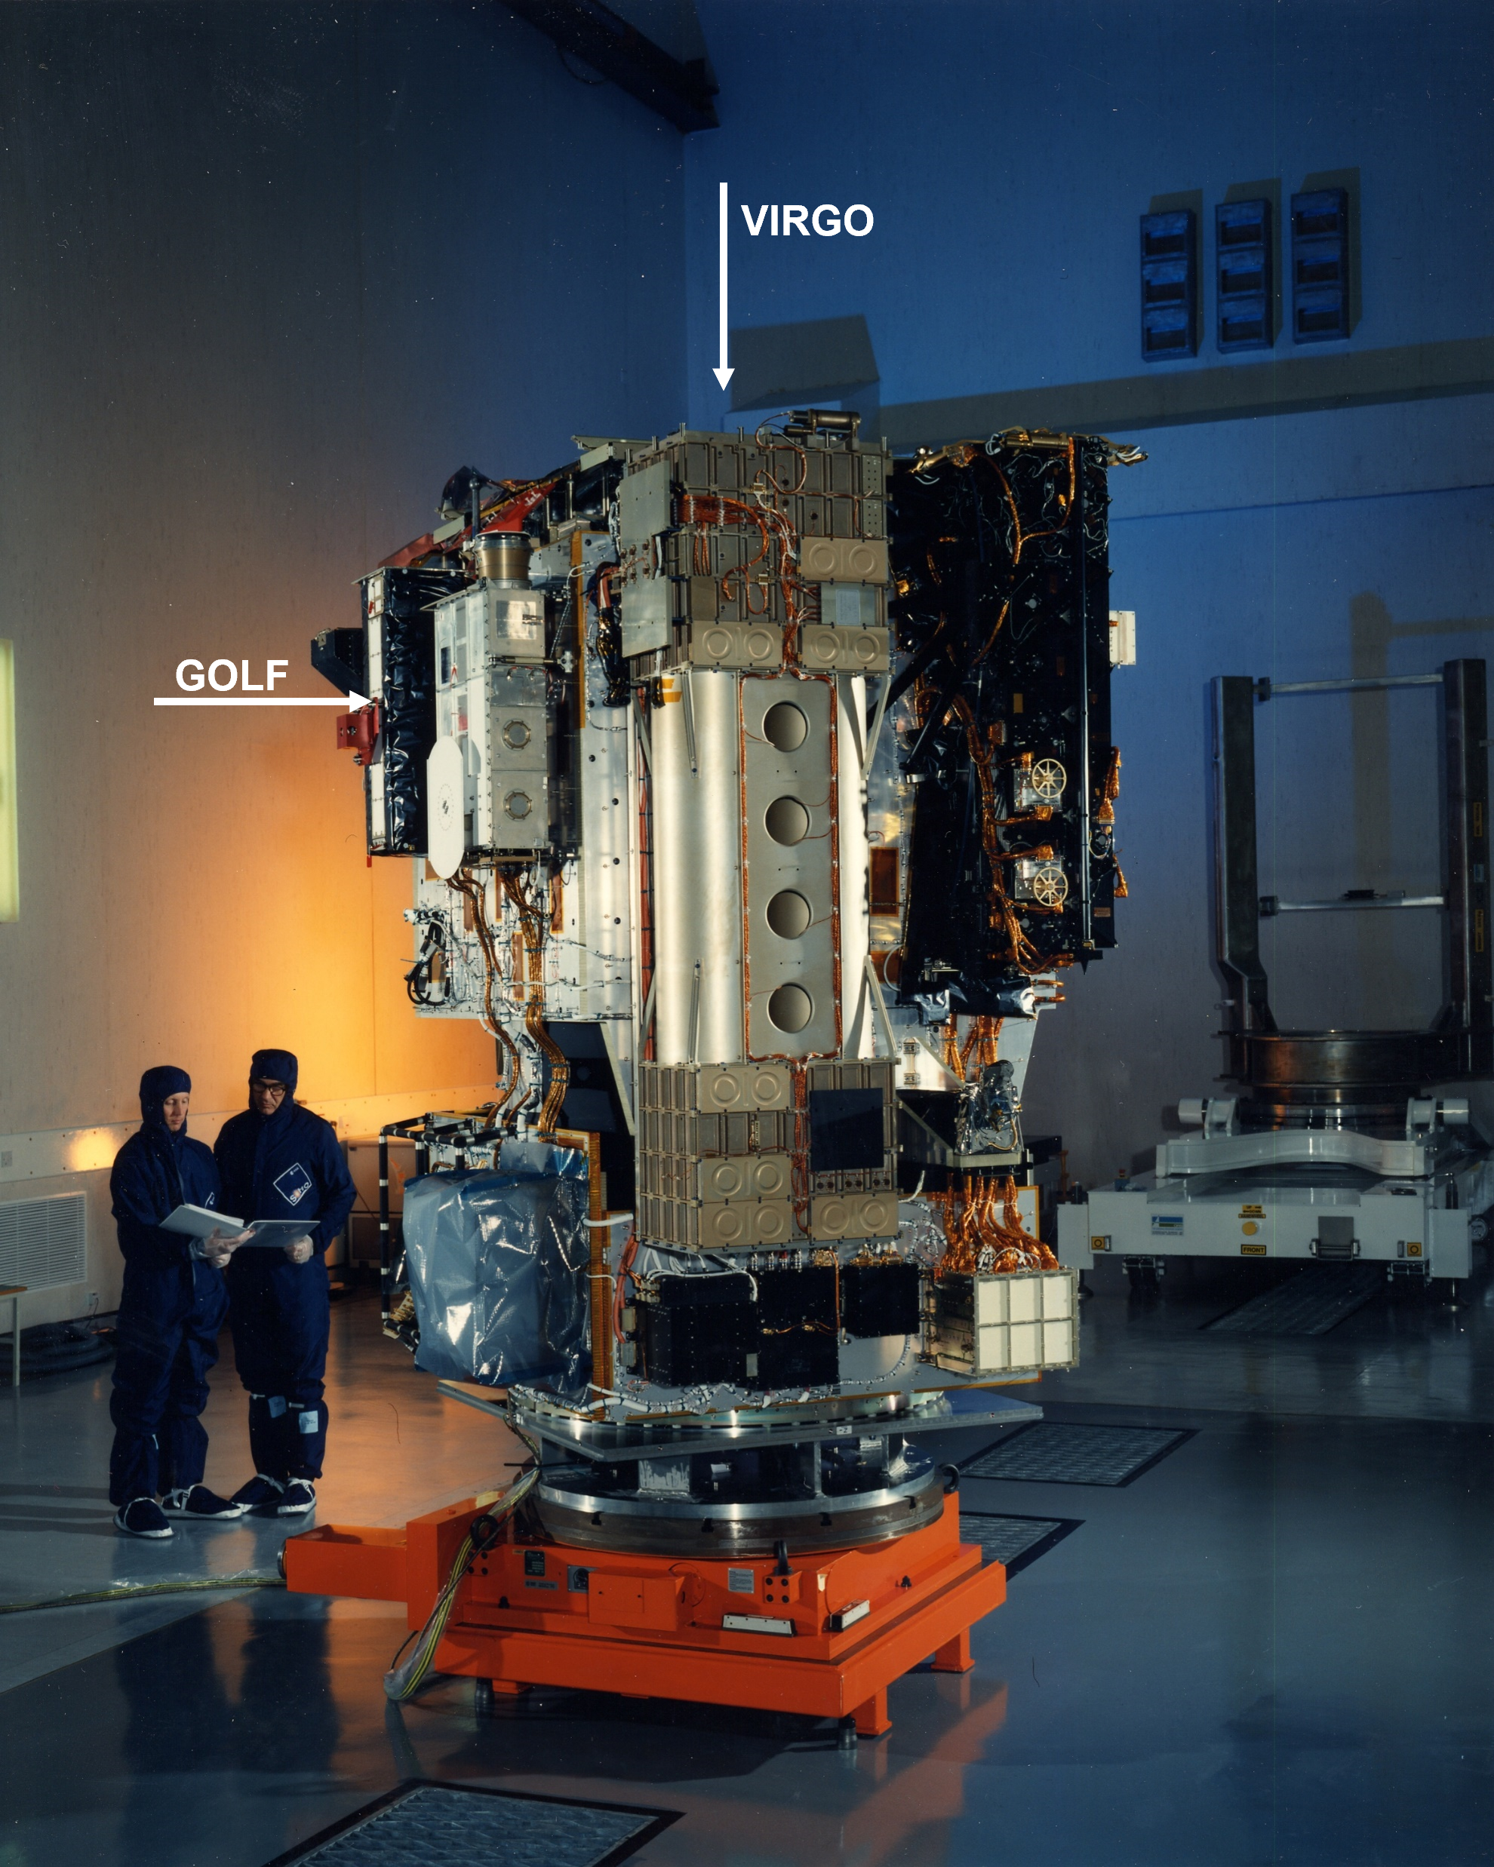
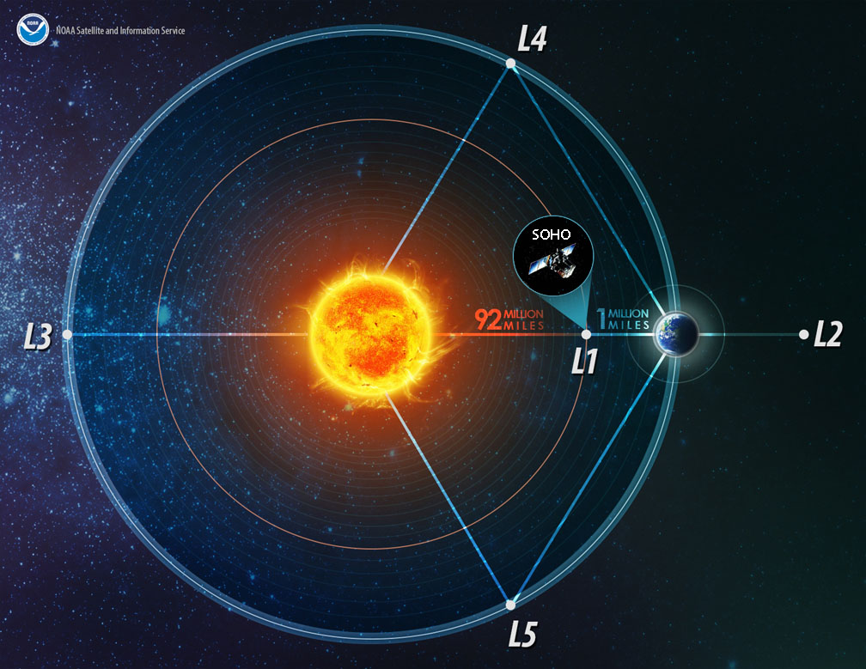
SOHO: VIRGO and GOLF
▲ [4] NOAA, Website position of SOHO in space
SOHO Webmaster [5]► spacecraft before launch

Slide 6
Time series

Slide 7
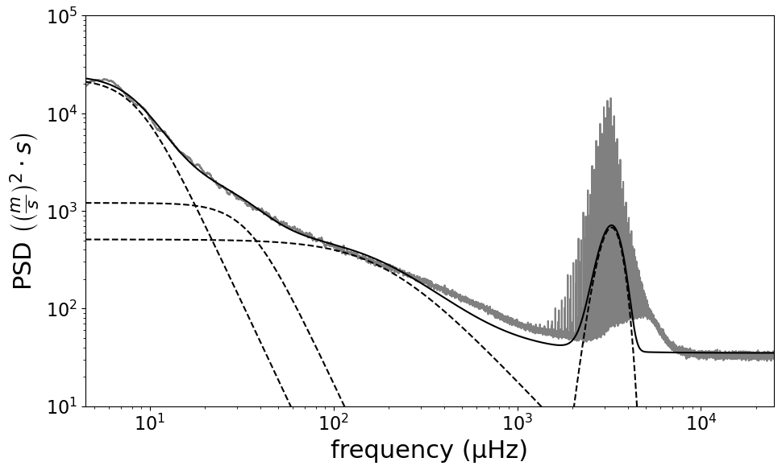
Time series
→ Frequency

Slide 8
Time series → Frequency

Slide 9
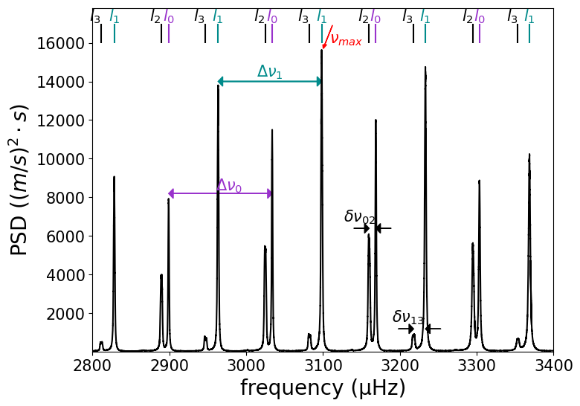
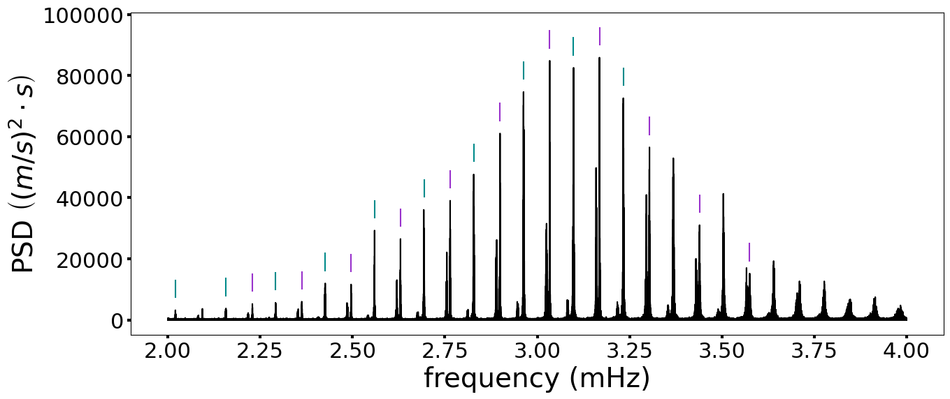
Frequency domain
$Δν$…large separation
$Δν$…small separation

Slide 10
Shift of lines during cycle

Slide 11
Splitting the time series
…
FFT
FFT
FFT
FFT

Slide 12
Shift of lines during cycle

Slide 13
Dependent shift
Different degrees:
• … l = 0
▲ … l = 1
$S_{vel}$ … activity proxy comparable to S index
Mean Frequency Shift (µHz)

Slide 14
Cycle observations on stars
Stars: KIC3241581 (a) and KIC10644253 (b)
Starspot activity proxy $S_{ph}$, comparable to solar S index
Activity cycle: a: $P=395$days, b: $P=582$ days
Observed with Kepler
▼ [6] Salabert 2016, A&A
García 2010, Science [7]▲
Star: HD49933
Amplitude, frequency shift and starspot proxy over one stellar activity cycle
Activity cycle: $P≈120$ days
Observed with CoRoT

Slide 15
Take Away Points
The Sun is the star we know best.
With Asteroseismology we can observe the Sun and stars in similar ways.
P-mode frequencies vary with the solar cycle.
During cycle ascent positive shift, during cycle descent opposite.
Extent of shift depends on frequency and degree l.
Higher frequencies shift more.
l=0 and l=1 modes shift slightly differently.
Other solar like stars show similar behavior as the Sun.
It’s possible to observe activity cycles with asteroseismic measurements.
Current and upcoming exoplanet surveys are perfect conditions for Asteroseismology of distant stars.

Slide 16
Thank you!
Sources:
NASA SDO: https://sdo.gsfc.nasa.gov/assets/img/browse/2010/08/19/20100819_003221_4096_0304.jpg
NASA, Hubble Space Telescope: https://science.nasa.gov/mission/hubble/multimedia/hubble-images/
García 2019: DOI: 10.1007/s41116-019-0020-1
NOAA Website: www.noaa.gov
SOHO Websmaster: soho.nascom.nasa.gov/gallery/Spacecraft
Salabert 2016: DOI: 10.1051/0004-6361/201628583
García 2010: DOI: 10.1126/science.1191064
michlmayer.studium@gmail.com
Sabrina Michlmayer
University of Graz

Slide 17
Addition: activity indices

