Slide 1
Trapping light at the nanoscale with 2D materials
Andrés Núñez Marcos
ICPS Georgia 2024

Slide 2
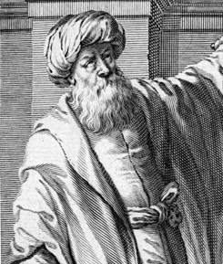
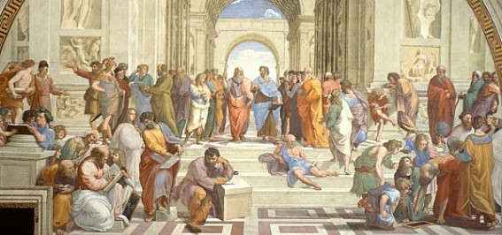
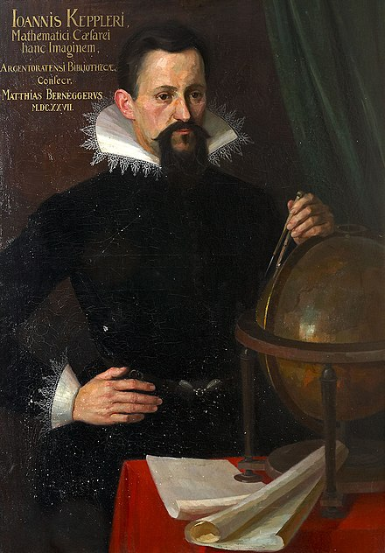
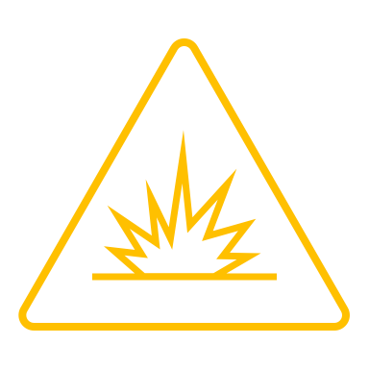
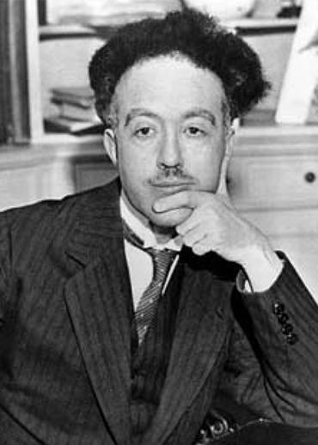
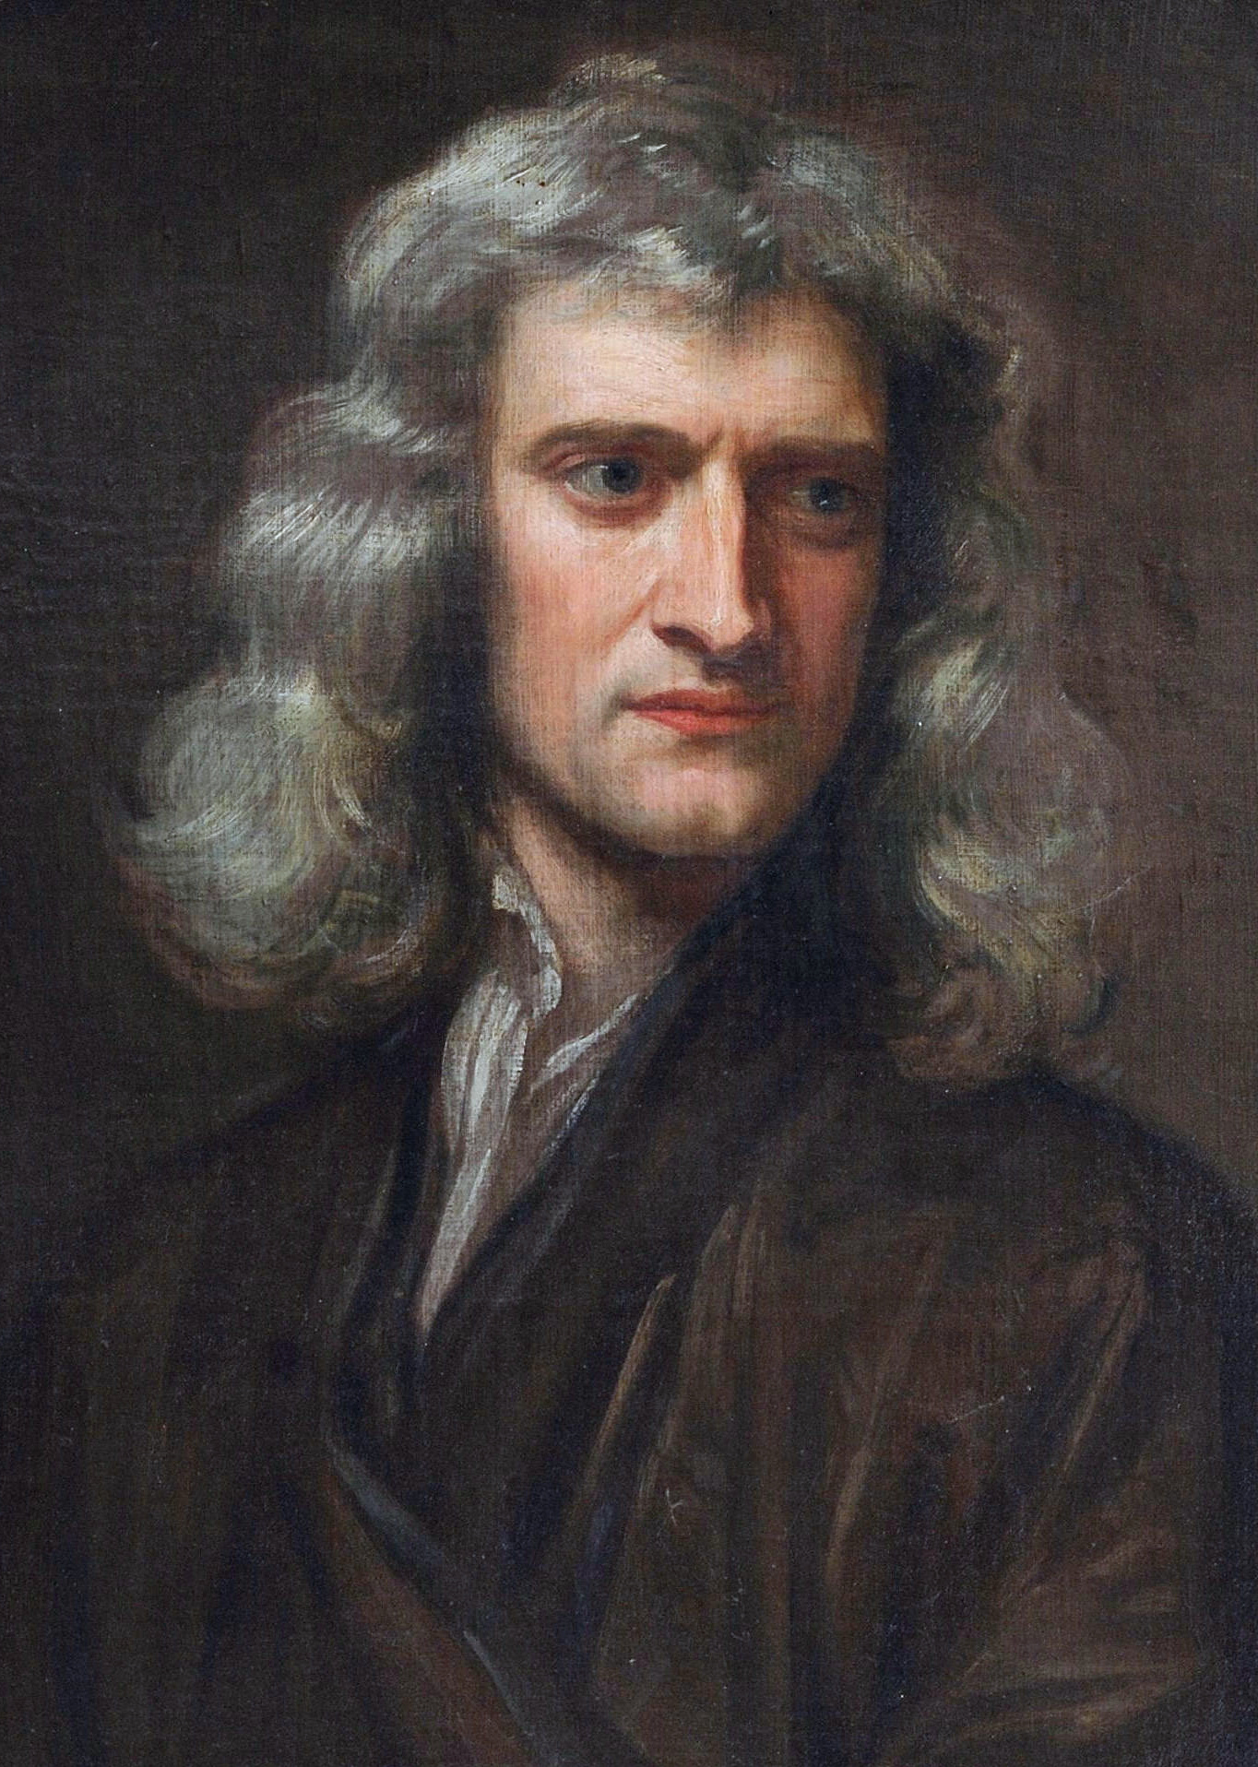
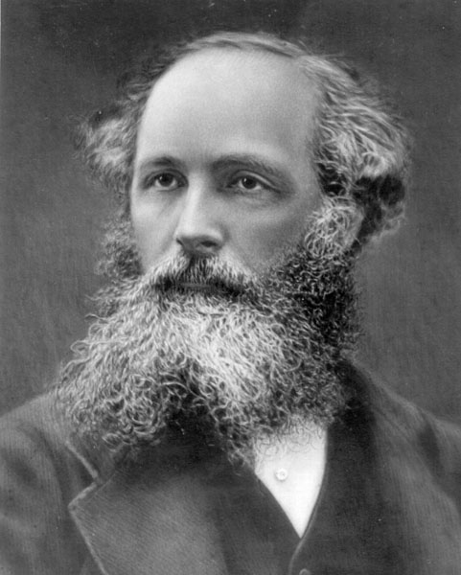
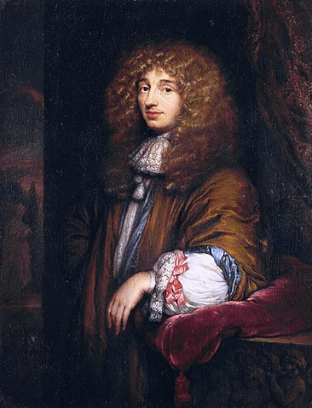
Light is complicated
I am the light
No, we have the light
No, light comes to us
Yes, and it travels through the ether
In fact, light is both wave and particle at the same time
My calculations say that they are waveform fields
Light is a wave
No, it is a particle

Slide 3
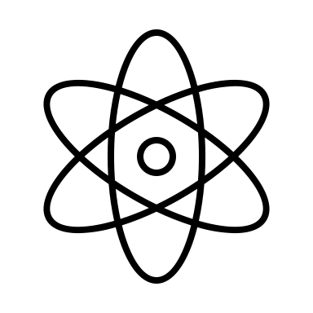
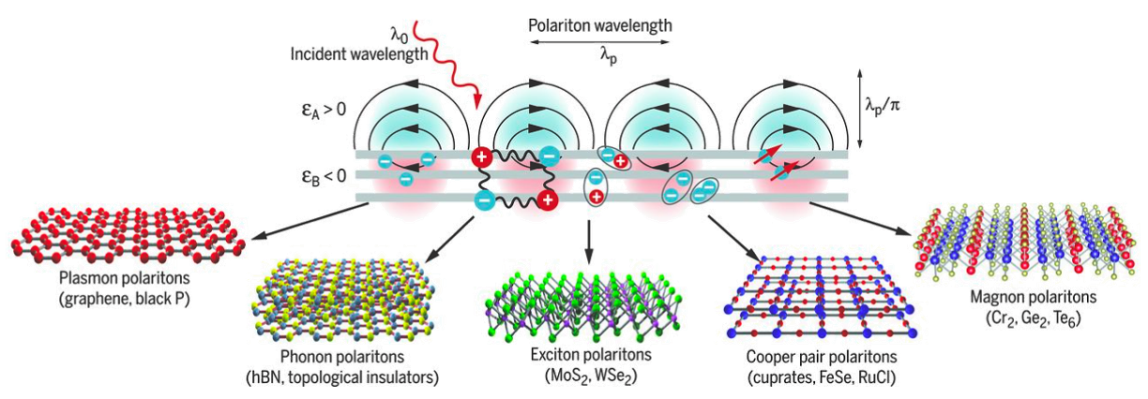
Light is brilliant
Diffraction limit $→d≥λ/2n$
Ionizing lights are dangerous
Light-matter interaction: Polaritons
Although quantum, it can be explained through its classical wave nature
$$λ∼1/2 μm$$
$$d∼Å$$
D N Basov et al., De Gruyter, Nanooptics 10, 2021 (10.1515/nanoph-2020-0449)

Slide 4
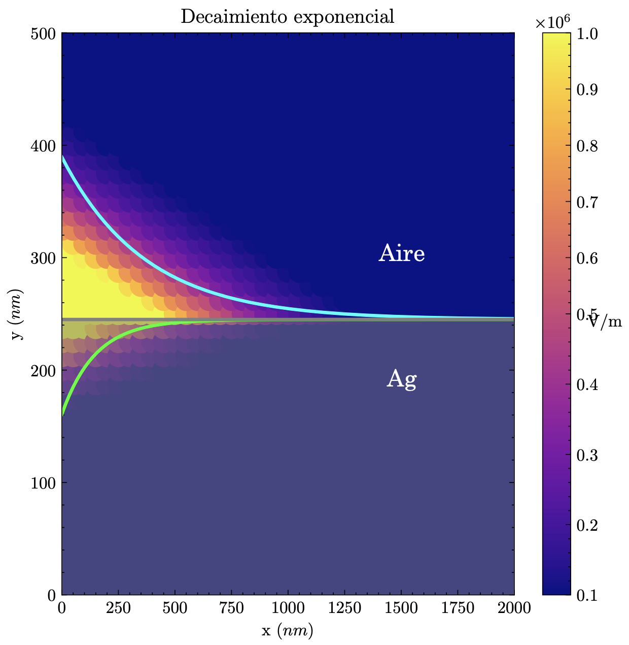
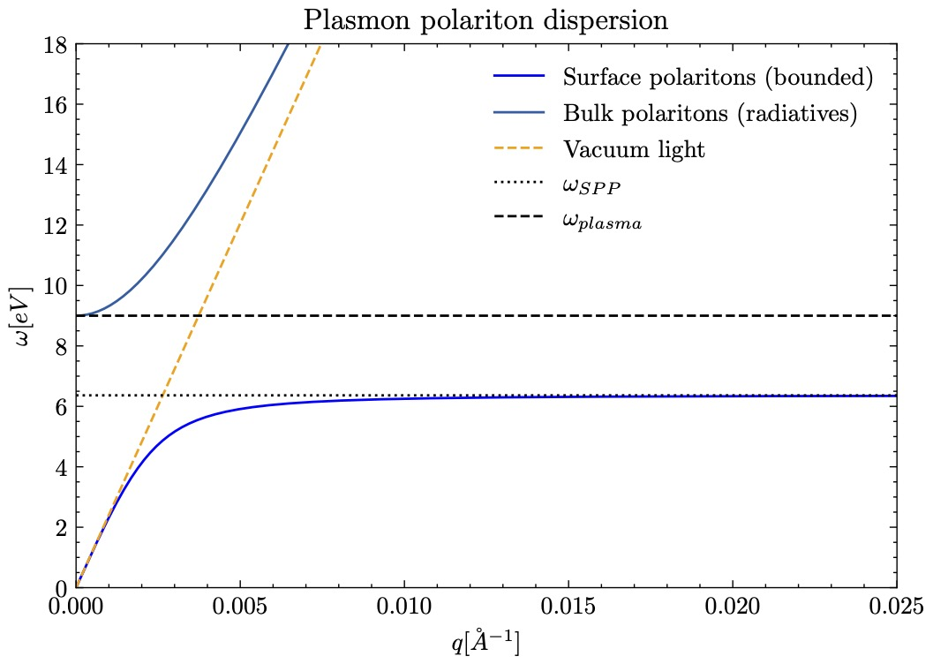
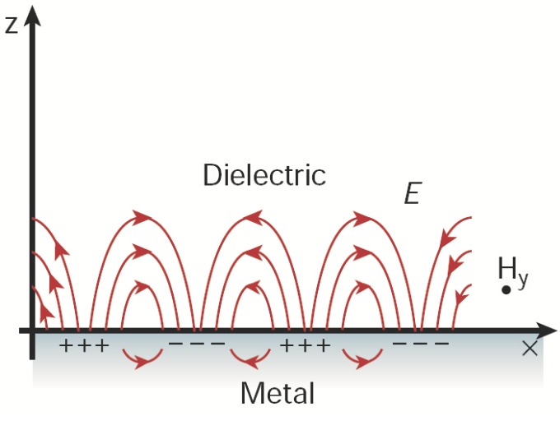
Main properties of polaritons
Two mediums with opposite sign in electric permittivity
Evanescent waves –
exponential decay in the perpendicular propagation direction
High confined waves that can not be excited only with natural light
Plasmon polaritons in Ag
$${\vec{E}}_{i}∝e^{±κ_{i}z}$$
Air
$$k_{0}$$
$$k_{p}$$
Barnes W et al., Nature, 2003 (10.1038/nature01937)
$$k∝\frac{2π}{λ} →λ_{p}≪λ_{0}$$

Slide 5
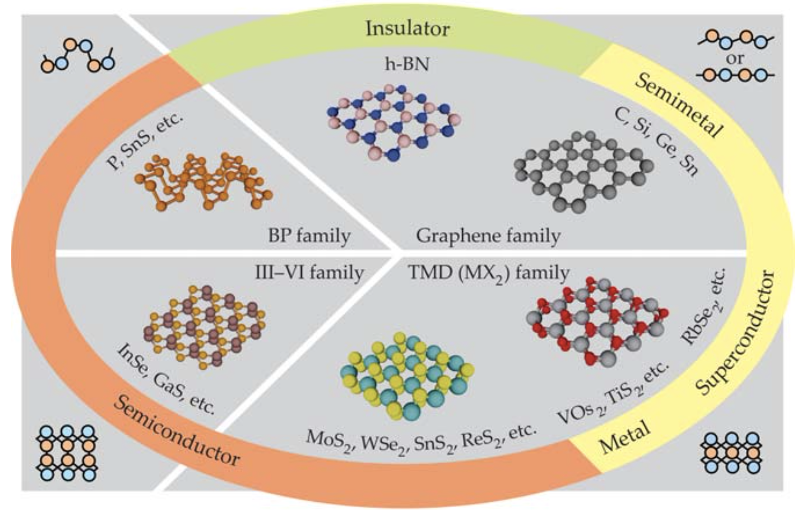
van der Waals (2D) materials
Strong (covalent) forces in atomic plane and weak (vdW) forces between planes
First kind discovered (unexpectedly) was graphene
All types of properties and structures
Polaritons have greater coupling in 2D materials thanks to reduced electrical screening
P. Ajayan y col., Physics Today 69, 38-44 (2016)

Slide 6
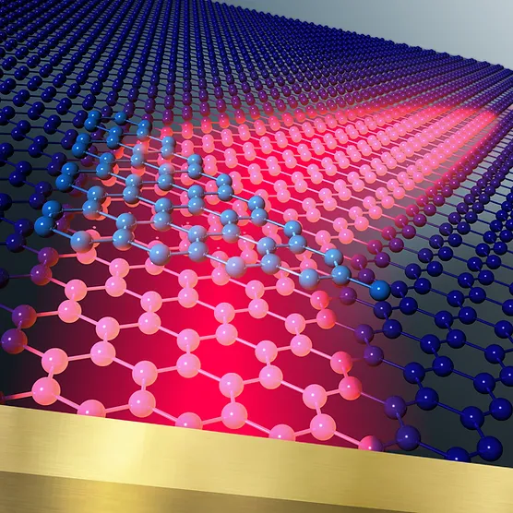
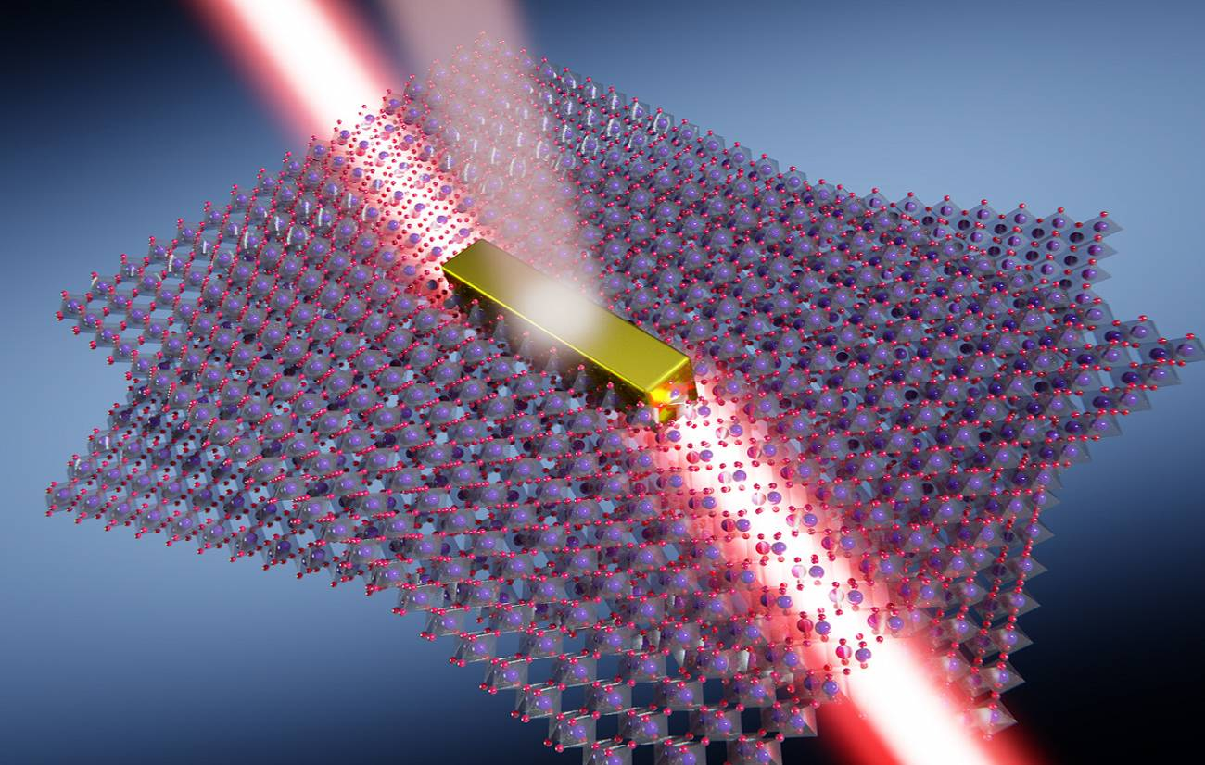
Counterintuitive phenomena

Slide 7
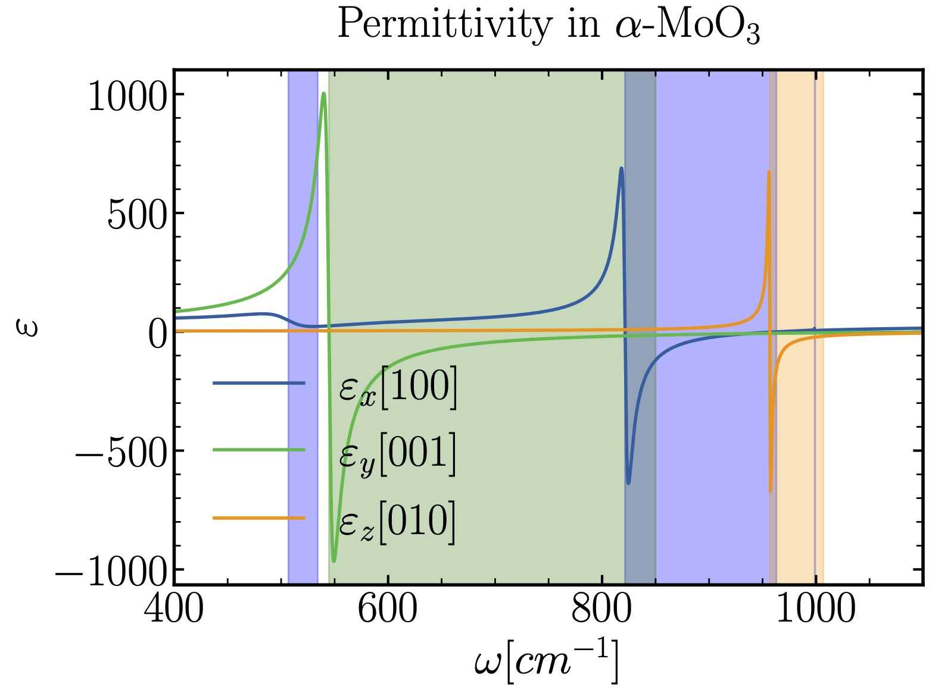
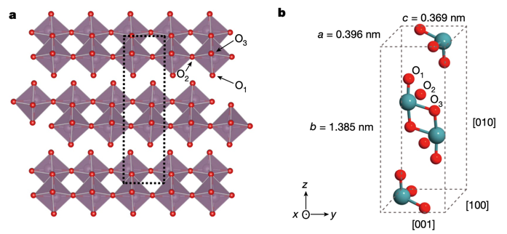
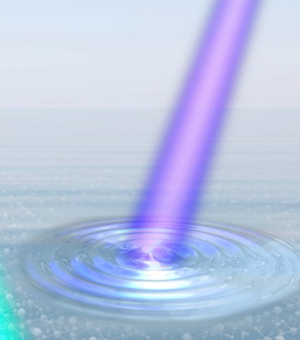
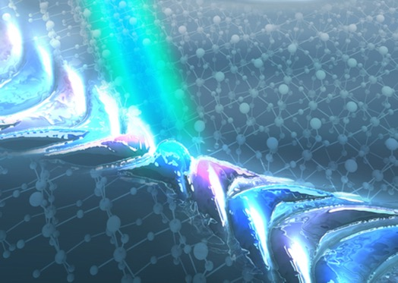
Hyperbolic light-matter propagation
Molybdenum trioxide in alpha phase $(α$-$MoO_{3})$
Multiple Reststrahlen bands
($ε_{i}<0$)
Weiliang Ma; P. Alonso-González et al., Springer Nature, 2018 (10.1038/s41586-018-0618-9)
Light-matter hyperbolic propagation in the plane
$$ε=ε_{0}$$
$$ε=\left(\begin{matrix}ε_{xx} & 0 & 0 \\ 0 & ε_{yy} & 0 \\ 0 & 0 & ε_{zz}\end{matrix}\right)$$
Scalar
Tensor
G. Álvarez Pérez, PhD Thesis, Universidad de Oviedo, 2023

Slide 8
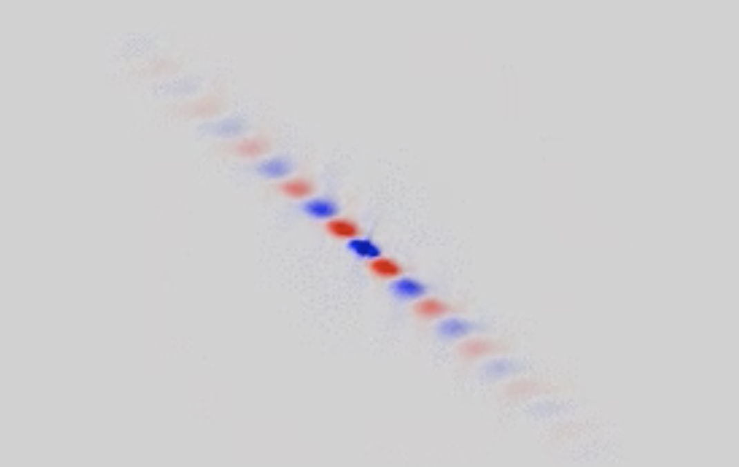
Light natural canalization
Twisting
Twistoptics $→$ Light-matter interaction in rotated 2D materials
Phonon polaritons’ (PhPs) propagation can be modified from open (hyperbolic) curve to close (circular) curve
Light natural canalization
“Diffraction-less” propagation
Dipole
$$d_{1}=d_{2}=200 nm →θ={63}^{∘}$$
Jiahua Duan et al., Nano Letters, 2020 (10.1021/acs. nanolett.0c01673)

Slide 9
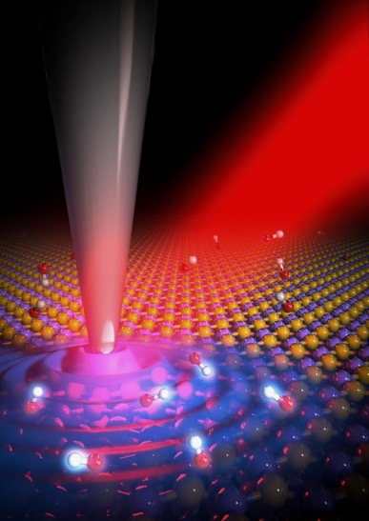
Negative and back reflection
Back reflection → Light reflects in same direction and opposite sign as incident light
$$Δ\vec{k}≡{\vec{k}}_{∥}^{r}−{\vec{k}}_{∥}^{i}=0 → \left|{\vec{k}}_{r}\right|\sin{θ_{r}}=\left|{\vec{k}}_{i}\right|\sin{θ_{i}}$$
Usually demonstrated in artificially engineered interfaces, such as metasurfaces
Recently visualized in high anisotropic materials in atomic plane
Reflection of phonon polaritons (by courtesy of Quantum Nano-optics Lab at the University of Oviedo)
G. Álvarez-Pérez et al., Science Advances 8, 2022 (10.1126/sciadv.abp8486)
Nature, Volume 15 Issue 3, March 2021

Slide 10
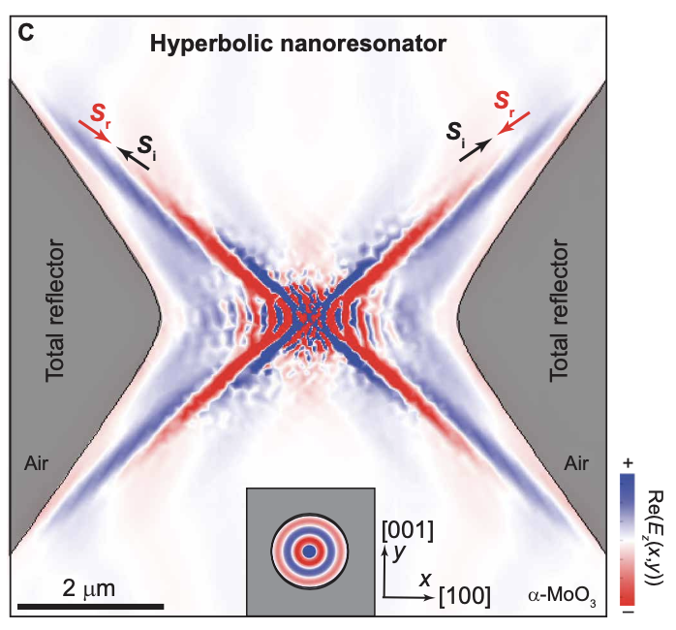
Applications
Nanochemistry $→$ Hyperbolic mirror
Quantum computing $→$ Light propagation direction
Reflecting all incident phonon polaritons back to their source
Intensity and, in principle, temperature increasement
Experimental research in progress
Programmed in-plane canalization direction
Demonstrated both analytically and experimentally with systems of three layers
Entanglement of quantum emitters
G. Álvarez-Pérez et al., Science Advances 8, 2022 (10.1126/sciadv.abp8486)
Light manipulation concept (by courtesy of Quantum Nano-optics Lab at the University of Oviedo)

Slide 11
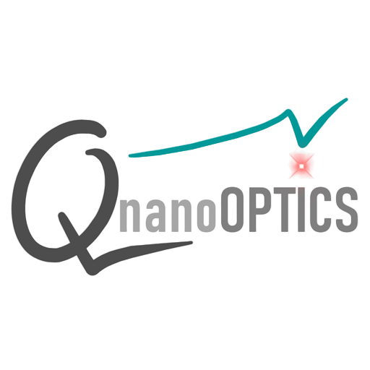
Conclusions
Polaritons
Nanoscale phenomena
Hyperbolic propagation
Light canalization
Back reflection
Applications
Phonon polaritons
2D materials
Nanochemistry
Quantum computing
Dr. Pablo Alonso González
Post-PhD Aitana Tarazaga Martín-Luengo

Slide 12
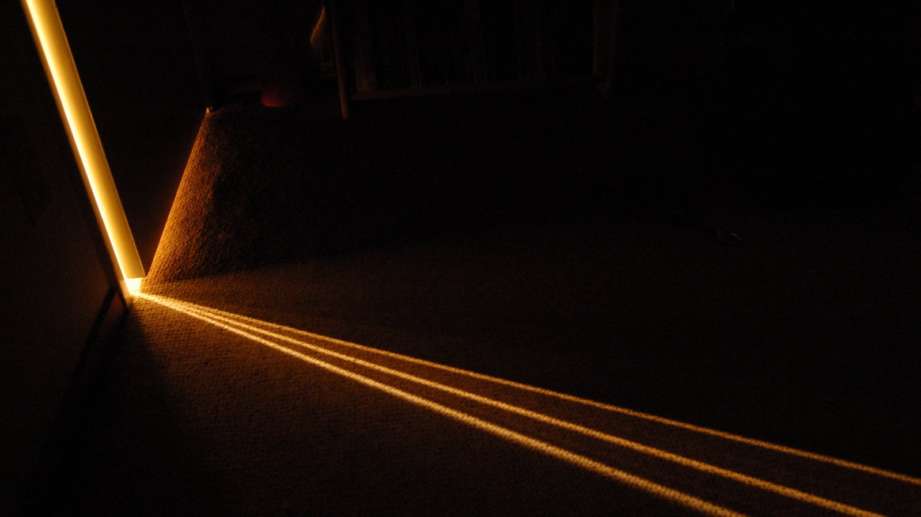
Thank you for your attention

Slide 13
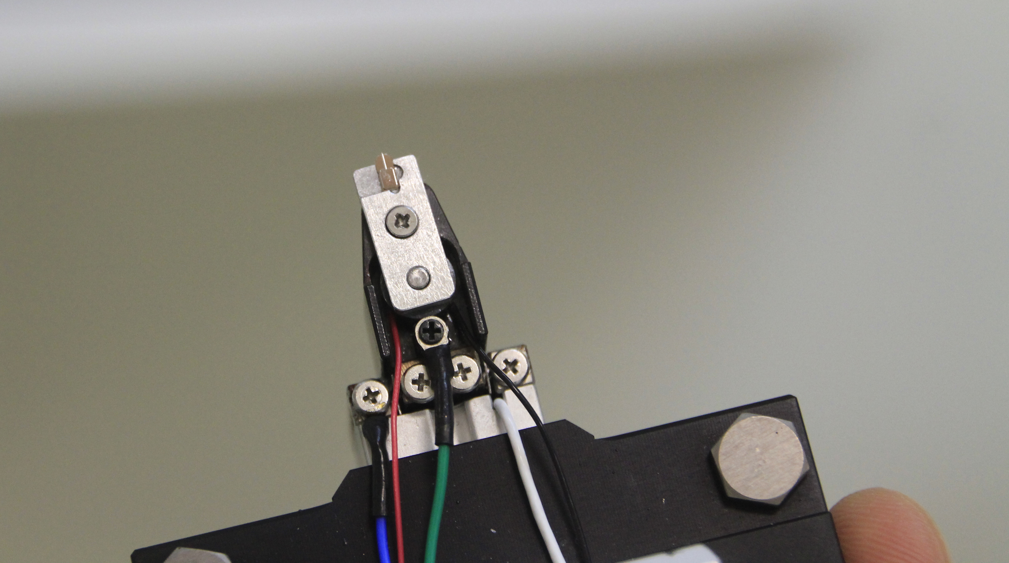
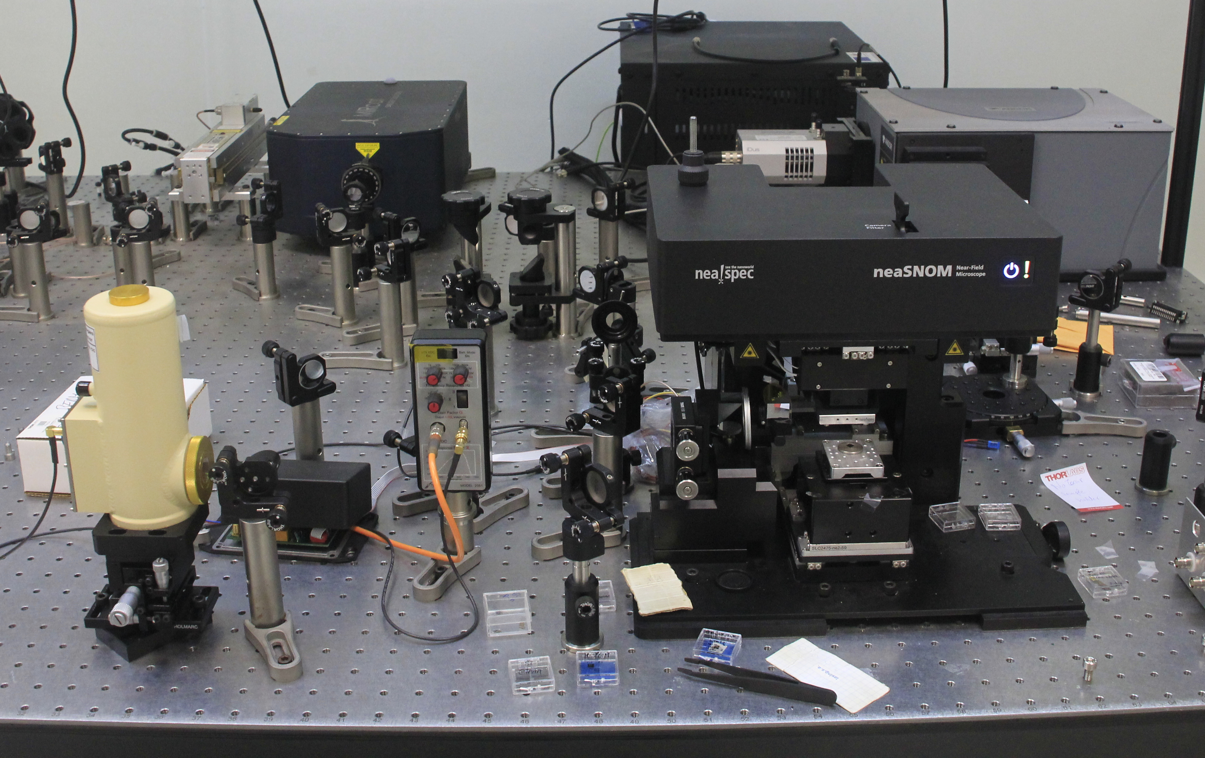
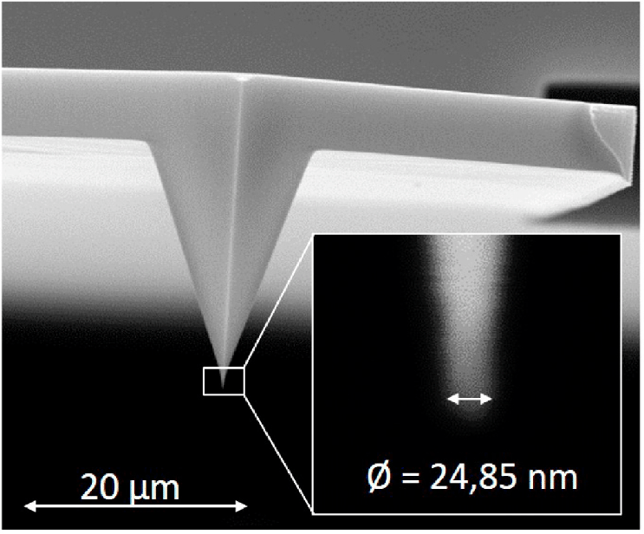
Appendix
sSNOM: the nanometer viewer
Michelson interferometer
Quantum cascade laser
Parabolic mirror
Sample holder
Photomultiplier
MCT controller

Slide 14
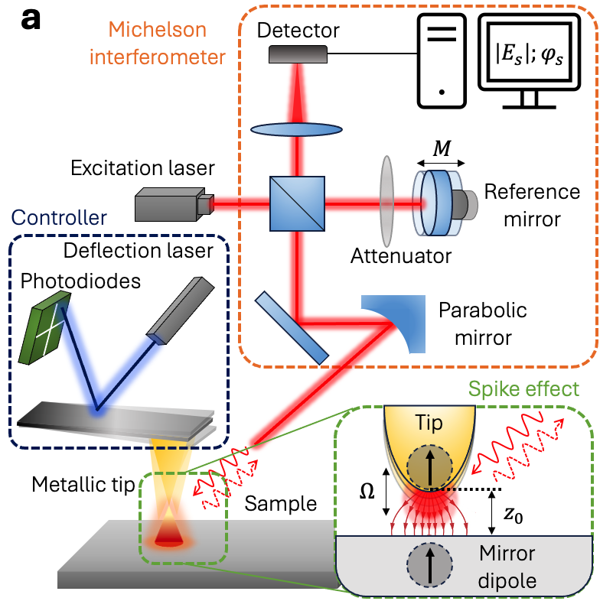
Appendix
sSNOM: the nanometer viewer
Spike effect $→$ Field enhancement
Controller $→$ Responsible for tip contact
Michelson (asymmetrical) interferometer $→$ Background field + Near-field signal + Reference beam + Noise (uncertainty)
$$I={\left|E_{nf}\right|}^{2}+2\left|E_{nf}\right|\left|E_{bg}\right|\cos\left(φ_{nf}−φ_{bg}\right)$$
$$+2\left|E_{nf}\right|\left|E_{ref}\right|cos⁡(φ_{nf}−φ_{ref})+E_{noise}^{2}$$
Tapping method oscillates the tip vertically
Reference field also oscillates harmonically to modulate signal phase
Signal demodulation gives us the harmonic orders of our desired contribution (preferably 3rd and 4th harmonic orders)

Slide 15
Appendix
Polariton’s derivation from Maxwell’s equations
Maxwell’s equations
Constitutional equations
Electric permittivity
$$∇⋅\vec{D}=4πρ$$
$$∇⋅\vec{B}=0$$
$$\vec{J}=σ\vec{E}$$
$$\vec{B}=\vec{H}$$
$$∇⋅\vec{E}=−\frac{1}{c}\frac{∂\vec{B}}{∂t}$$
$$∇⋅\vec{H}=−\frac{4π}{c}\vec{J}+\frac{1}{c}\frac{∂\vec{D}}{∂t}$$
$$\vec{D}=ε\vec{E}$$
$$D_{i}=ε_{ij}E_{j}$$
Homogeneous materials
Non-magnetic materials
$$ε=Re\left(ε\left(ω\right)\right)+iIm\left(ε\left(ω\right)\right)$$
$$\vec{B}=μ\vec{H}$$
Fresnel’s momentum equation
$$\vec{n}=c\vec{k}/ω$$
$${\vec{k}}^{2}\left(ε_{x}k_{x}^{2}+ε_{y}k_{y}^{2}+ε_{z}k_{z}^{2}\right)−\frac{ω^{2}}{c^{2}}\left[k_{x}^{2}ε_{x}\left(ε_{y}+ε_{z}\right)+k_{y}^{2}ε_{y}\left(ε_{x}+ε_{z}\right)+k_{z}^{2}ε_{z}\left(ε_{x}+ε_{y}\right)\right]+\frac{ω^{4}}{c^{4}}ε_{x}ε_{y}ε_{z}=0$$
TE propagation mode not possible!
$$\vec{E_{i}}=\left(E_{i;x};0; ±E_{i;z}\right)e^{i\left({\vec{k}}_{i}\vec{r}−iωt\right)}$$
$$\vec{H_{i}}=\left(0;H_{i;y};0\right)e^{i\left({\vec{k}}_{i}\vec{r}−iωt\right)}$$
$$ik_{i;z}H_{i;y}=\frac{ω}{c}ε_{i}E_{i;x}$$
Boundary conditions
$$D_{1;z}=D_{2;z} ; E_{1;xy}=E_{2;xy}$$
Light plane wave TM mode
$$\frac{k_{1;z}}{ε_{1}}=−\frac{k_{2;z}}{ε_{2}}$$
Drude-Lorentz’s model
Continuous wave condition
$$k_{SPhP}≡k_{x}=\frac{ω}{c}\sqrt{\frac{ε(ω) }{1+ε(ω)}}$$
$$ε\left(ω\right)=ε_{∞}\left(1+\frac{ω_{LO}^{2}−ω_{TO}^{2}}{{ω_{TO}^{2}−ω}^{2}−iγω}\right)$$
Dispersion relation

