Slide 1
Enhancing Fermi-LAT Source Detection Through a Novel Denoising Technique
F. Akhondi V.¹, M. Soor¹, H. Hedayati Kh.¹
¹Department of Physics, K.N. Toosi University of Technology, Tehran

Slide 2
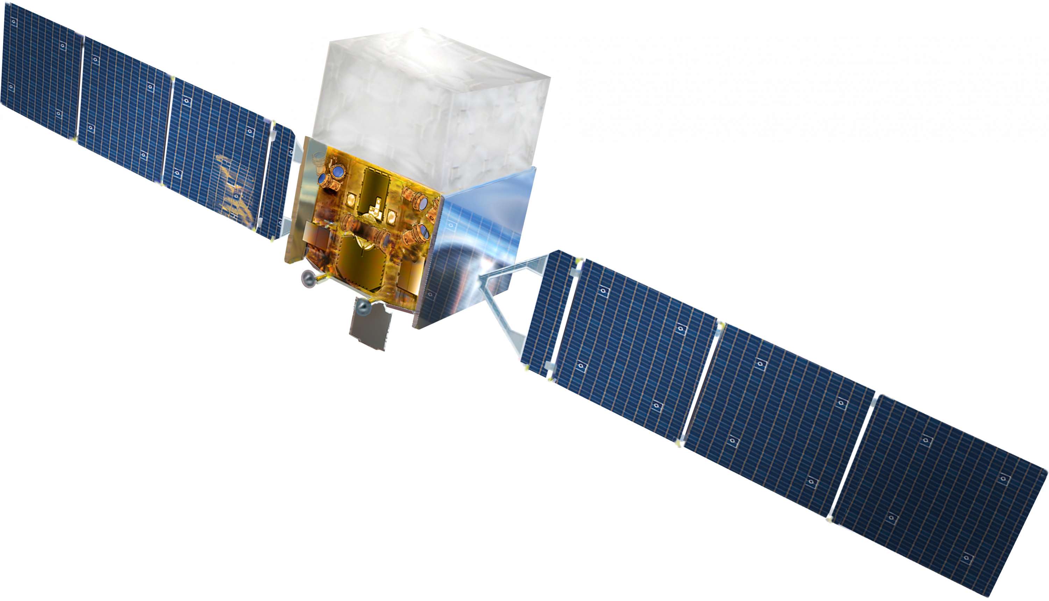
INTRODUCTION
What are gamma-rays?
How to detect gamma-rays?
Space
Ground
gamma-ray
$$e^{+}$$
$$e^{−}$$

Slide 3
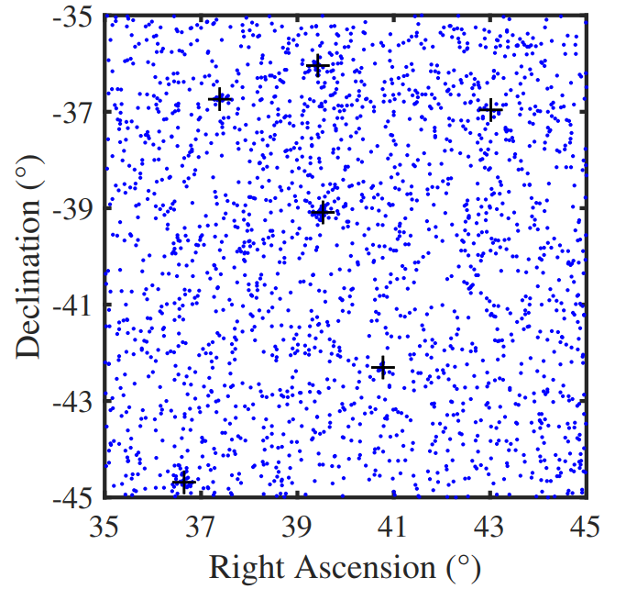
MOTIVATION
Fermi-LAT gamma-ray data
Source Detection
Parametric
Non-parametric
Clustering algorithms
DBSCAN
MST
Maximum Likelihood

Slide 4
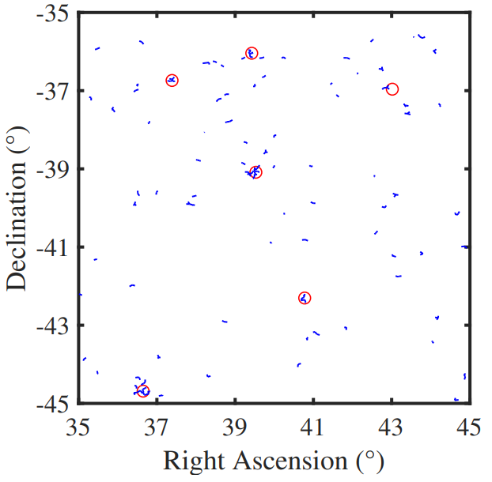
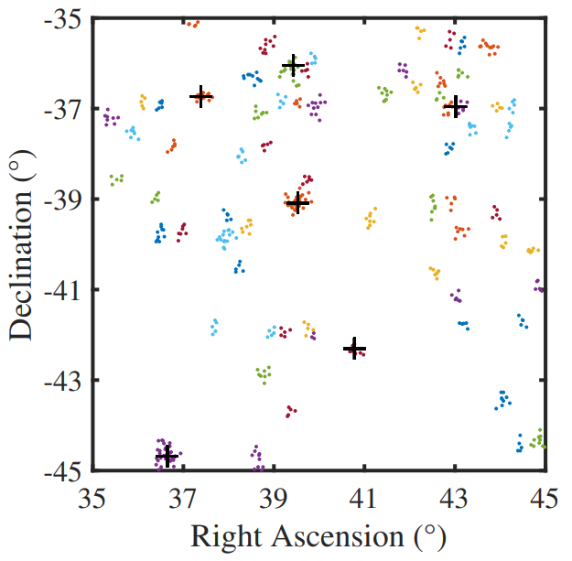
MOTIVATION
Source detection: MST
Source detection: DBSCAN

Slide 5
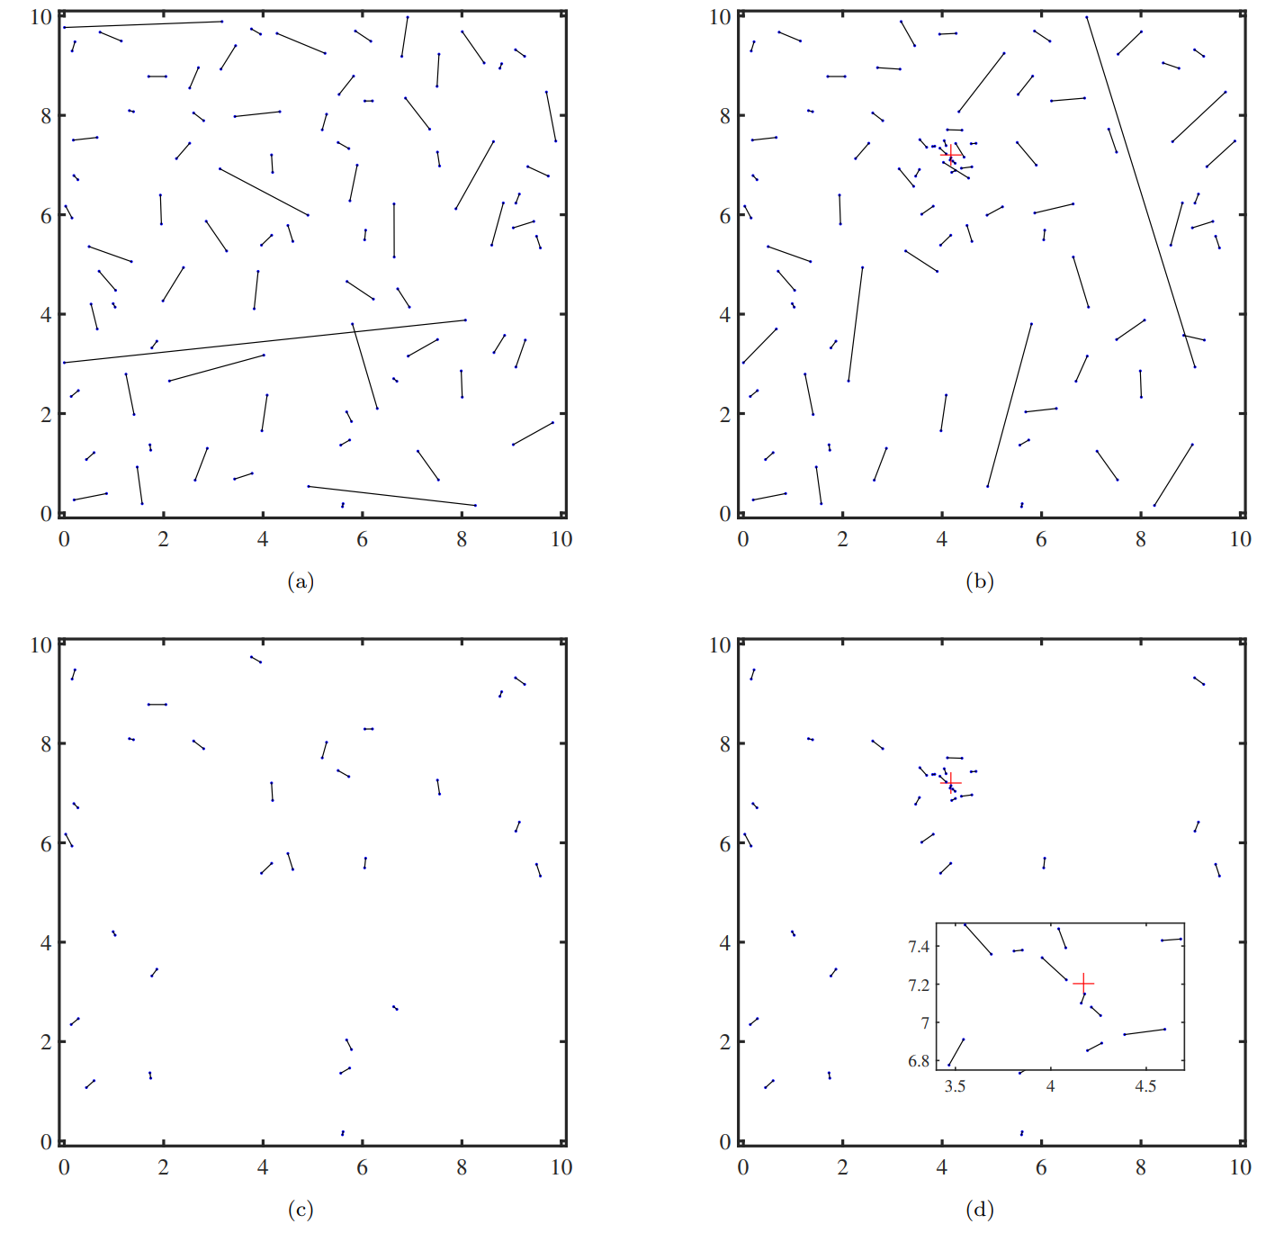
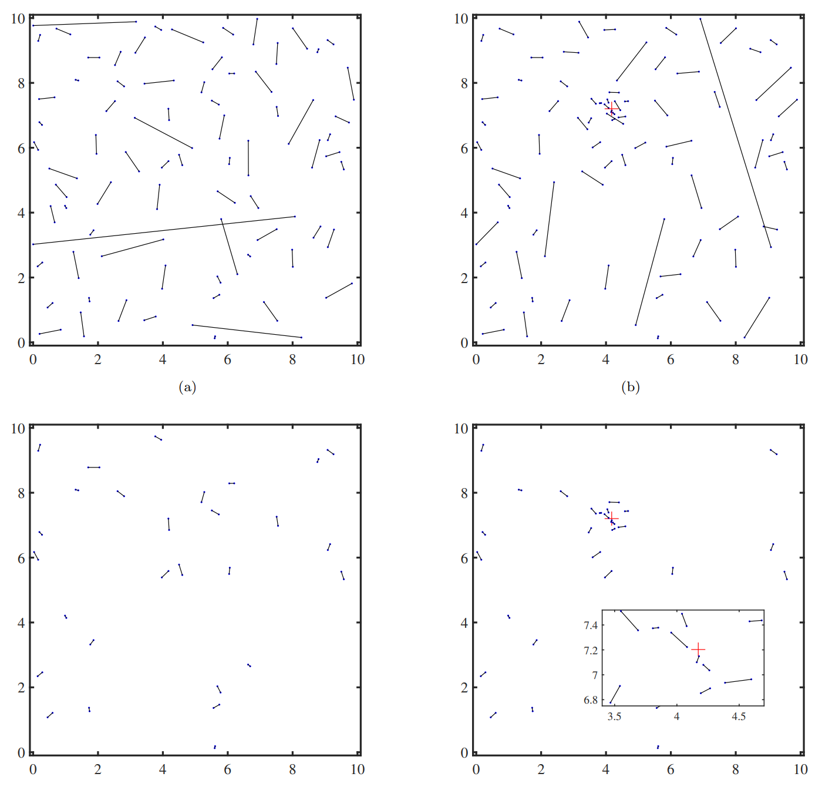
SIMEFIC III
Concentrations related to point sources (clusters)

Slide 7
SIMEFIC III
Distances matrix:
$$D= \left(\begin{matrix}\begin{matrix}× & d_{12} & d_{13} \\ d_{21} & × & d_{23} \\ d_{31} & d_{32} & ×\end{matrix} & ⋯ & \begin{matrix}d_{1N} \\ d_{2N} \\ d_{3N}\end{matrix} \\ ⋮ & ⋱ & ⋮ \\ \begin{matrix}d_{N1} & d_{N2} & d_{N3}\end{matrix} & ⋯ & ×\end{matrix}\right)$$
The smallest element:
$d_{ij}= d_{ji}$
Third point:
$$d_{min}^{(2)}= d_{ik}+ d_{jk}$$
comparing the two elements:
$$d_{ik}< d_{jk} or d_{ik}> d_{jk}$$
Repeat

Slide 8
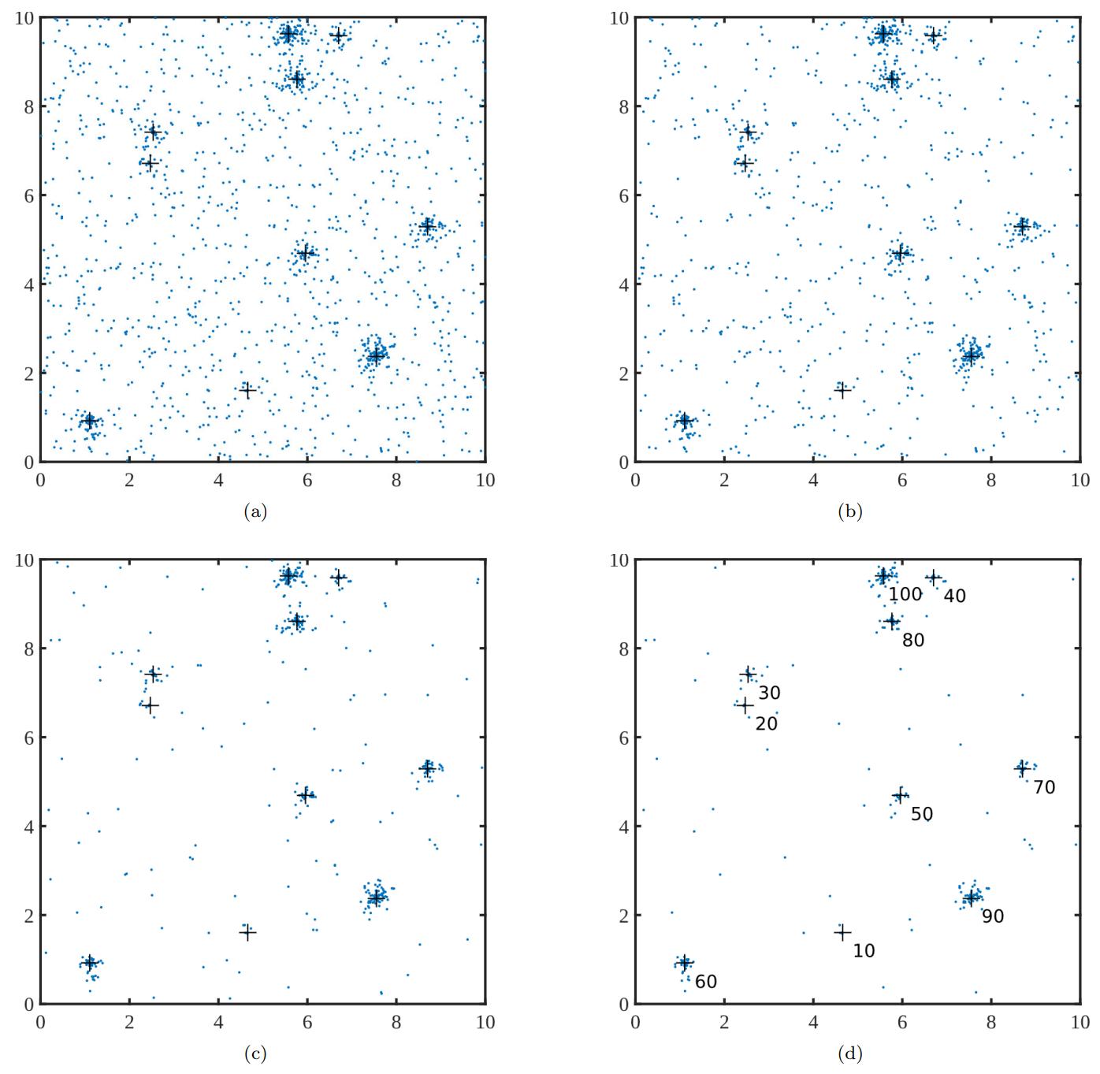
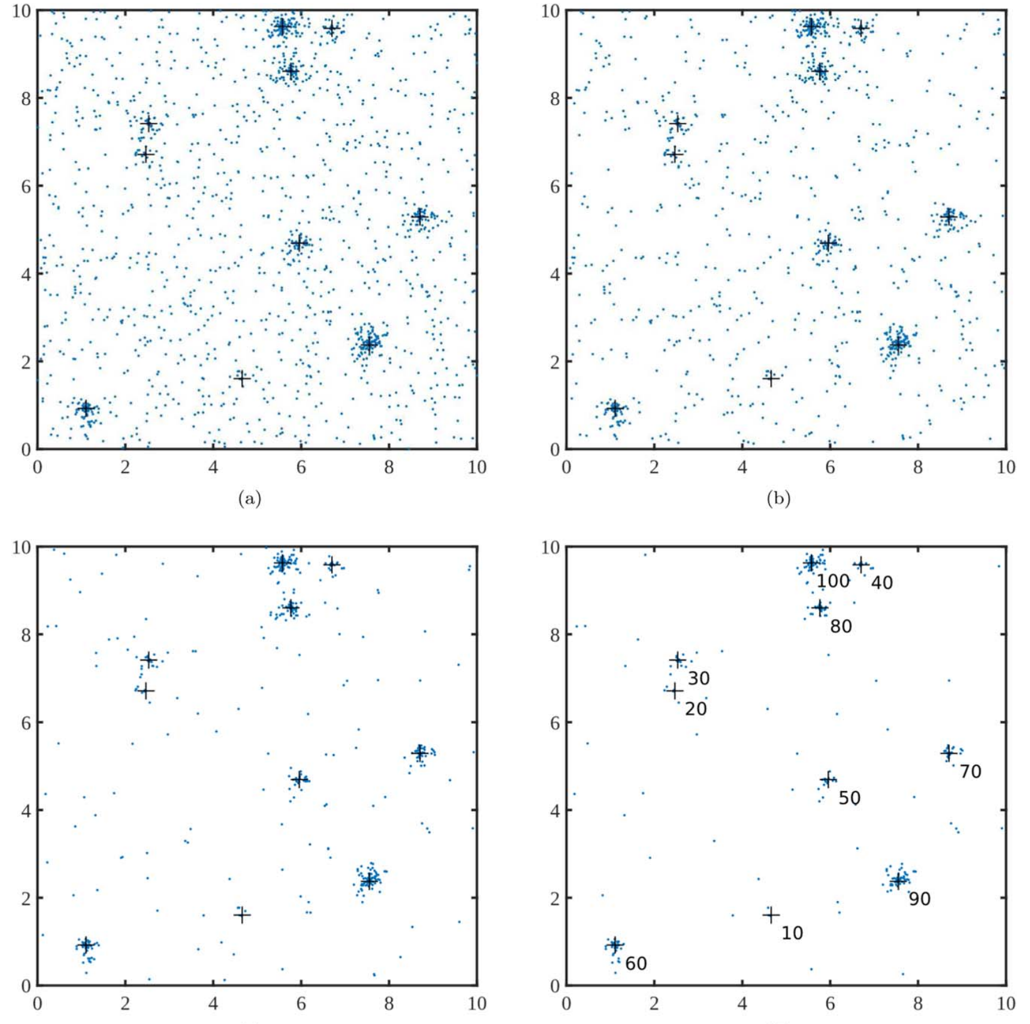
RESULTS
Noise reduction of a field of random points

Slide 10
RESULTS
MST on the field of random points
MST on the denoised field of random points

Slide 11
RESULTS
DBSCAN on the field of random points
DBSCAN on the denoised field of random points

Slide 12
RESULTS

Slide 13
The End
Thank you for your attention

