Slide 1
Anisotripic extended XY model with four spin interaction
Giorgi Gogaberishvili
Nika Kurdadze

Slide 2
Presentation plan:
Brief overview of ordinary XY model
Extended XY model
Anisotropic extended XY model with four spin interaction

Slide 3
Ordinary XY model
Hamiltonian:
$$H=−J\sum_{n}{\left(S_{n}^{x}S_{n+1}^{x}+S_{n}^{y}S_{n+1}^{y}\right) }$$
Jordan-Wigner transformation:
Hamiltonian by spinless fermions:
Algebra is satisfied:

Slide 4
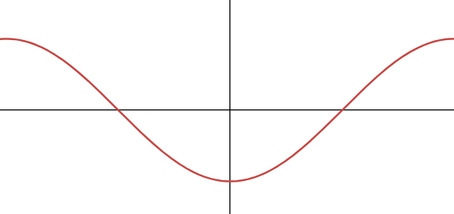
Ordinary XY model
After Fourier transform we have:
$$H=−J\cos\left(k\right)c_{k}^{+}c_{k}$$
Spectrum:

Slide 5
Extended XY model
Hamiltonian:
After Jordan-Wigner transformation:
After Fourier transform:
Where:

Slide 6
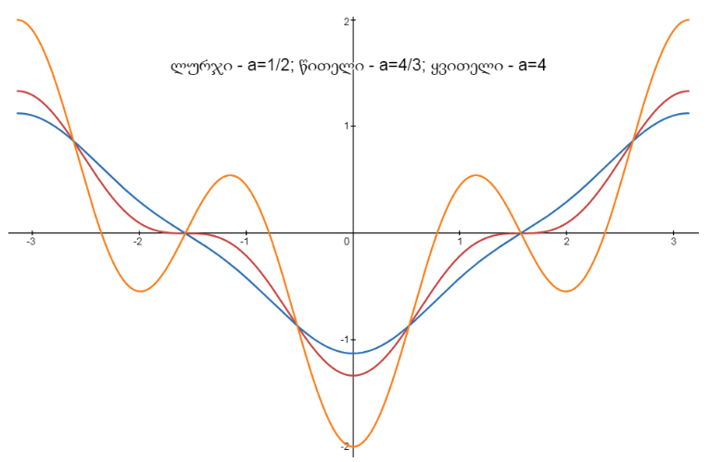
Extended XY model spectrum:

Slide 7
Anisotropic XY model
Hamiltonian:

Slide 8
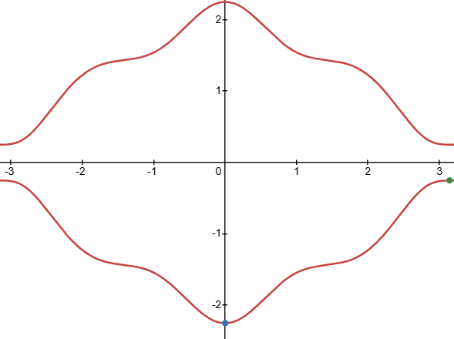
Anisotropic XY model. Diagonalisation of Hamiltonian
$$α=1$$
h=1
Effective magnetic field(sigma matrices combination):
So the spectrum is:
$$ε_{k}$$

Slide 9
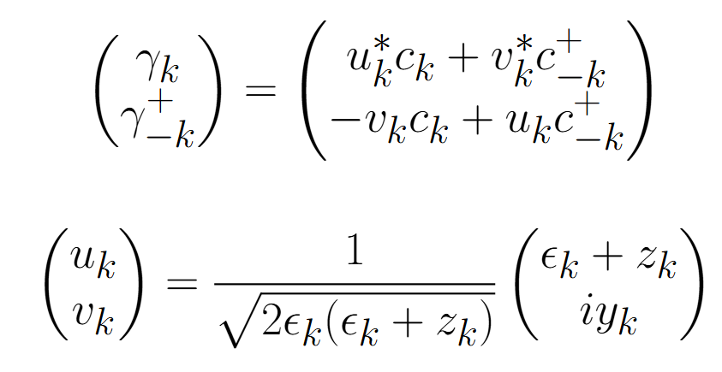
Anisotropic XY model. Diagonalisation of Hamiltonian
Hamiltonian can be rewritten: where:

Slide 10
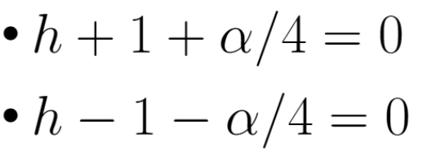
Anisotropic XY model. Topology of effective magnetic field $(γ=1)$
Let’s observe winding number.
Winding number is 1, if $\left|h\right|<|1+\frac{α}{4}|$. Thus we have two special line:

Slide 11
Anisotropic XY model. Topology of effective magnetic field $(γ=1)$.

Slide 12
Ordinary Anisotropic XY model. Periodic-Anti Periodic boundary conditions.
$$S_{L}^{+}S_{1}=\exp\left(iπ\sum_{n=1}^{L−1}{c_{n}^{+}c_{n}}\right)c_{L}^{+}c_{1}=−exp{(iπN)}c_{L}^{+}c_{1}$$
So:
$$c_{L+1}=−\exp\left(iπN\right)c_{1}$$
Thus we have periodic or antiperiodic conditions for spinless fermions, depending the number of quasiparticles. If they are odd, then condition is periodic, If it is even, then anti-periodic.

Slide 13
Extended Anisotropic XY model. Periodic-Anti Periodic boundary conditions.
$$S_{L−1}^{+}S_{2}S_{L}^{z}S_{1}^{Z}=\exp\left(iπ\sum_{n=1}^{L−2}{c_{n}^{+}c_{n}}\right)c_{L−1}^{+}c_{2}\exp\left(iπc_{1}^{+}c_{1}\right) \left(1−2c_{L}^{+}c_{L}\right)\left(1−2c_{1}^{+}c_{1}\right)=−\exp\left(iπN\right)c_{L−1}^{+}c_{2}$$
So:
$$c_{L+1}=−\exp\left(iπN\right)c_{1}$$
Thus we have same rule for periodic or antiperiodic conditions.

Slide 14
Anisotropic XY model. Periodic-Anti Periodic boundary conditions.
in a vacuum, pairs are formed with $(k,−k)$ pairing. The challenge arises because, under periodic boundary conditions, there must be an odd number of particles [6]. Consequently, there is one unpaired particle with momentum $k=0$ or $k=π$. thus, in PBC we have
$$PBC:k=\frac{2πn}{L}, where n=−\frac{L}{2}+1,…,\frac{L}{2}$$
$$ABC:k=±\frac{π\left(2n+1\right)}{L}, where n=1,…,\frac{L}{2}$$

Slide 15
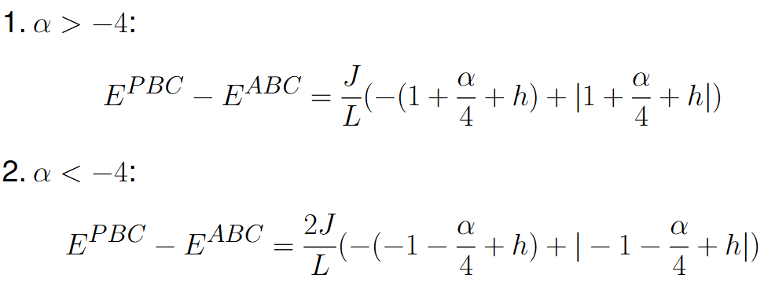
Anisotropic XY model. Periodic-Anti Periodic boundary conditions.
The energy difference is:

Slide 16
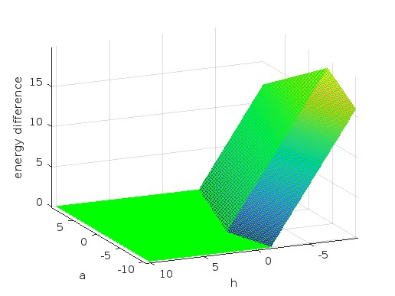
Anisotropic XY model. Periodic-Anti Periodic boundary conditions.
Energy difference dependence on $α and h$
We see that there is a difference but it is very small because in thermodynamical limit L is very large. We can clearly see two lines which we mentioned while talking about topology of effective magnetic field.

Slide 17
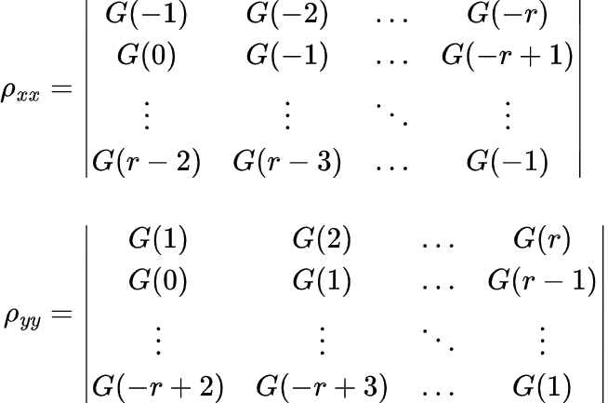
Anisotropic XY model. Magnetization and correlation
The correlations $ρ_{ii}(n)=\frac{\sum_{m}{\left\langle S_{m}^{i}S_{m+n}^{i}\right\rangle }}{N}$can be calculated by Toepitz determinants[4] :

Slide 18
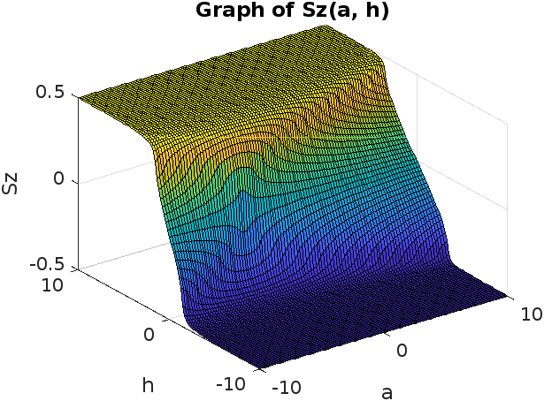
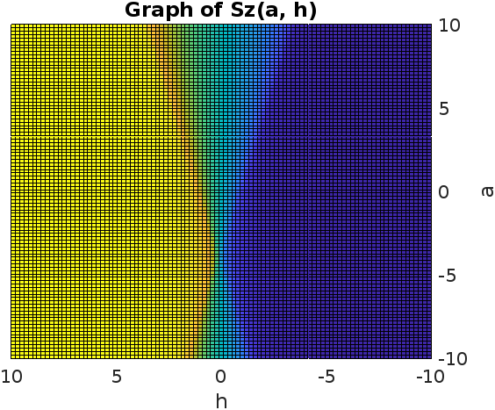
Anisotropic XY model. Magnetization and correlation
Now let us see what is magnetization of the chain:

Slide 19
Anisotropic XY model. Magnetization and correlation
From the graphs presented above, it is evident that we observe ZZ ferromagnetic order outside the lines:

Slide 20
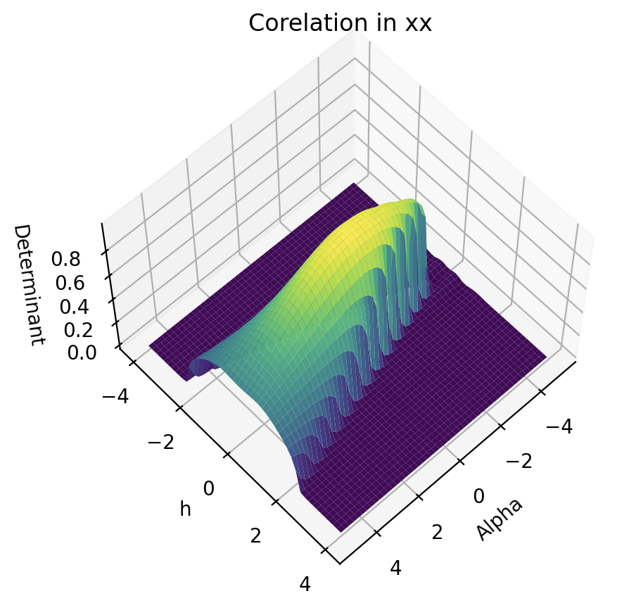
Anisotropic XY model. XX correlation

Slide 21
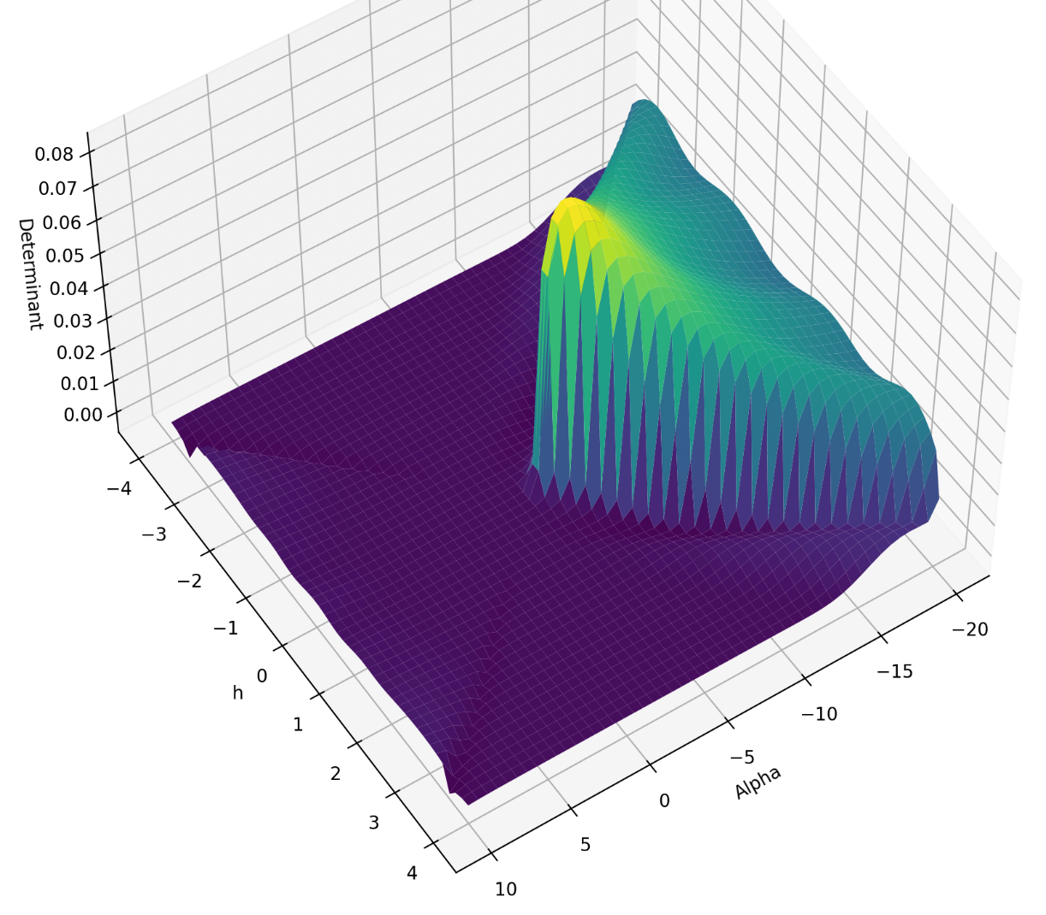
Anisotropic XY model. YY correlation

Slide 22
Anisotropic XY model. Correlations conclusion
XX LONG-RANGE
ZZ LONG-RANGE
ZZ LONG-RANGE
?

Slide 23
Anisotropic XY model. Correlations for $α<−4$
In every former methods the system number (L) was fixed and we were watching $α$and $h$ parameters. From this way we have not seen any order between spins. Now let us change method: fix $α$and $h$ parameters and watch correlations as a function of distance.

Slide 24
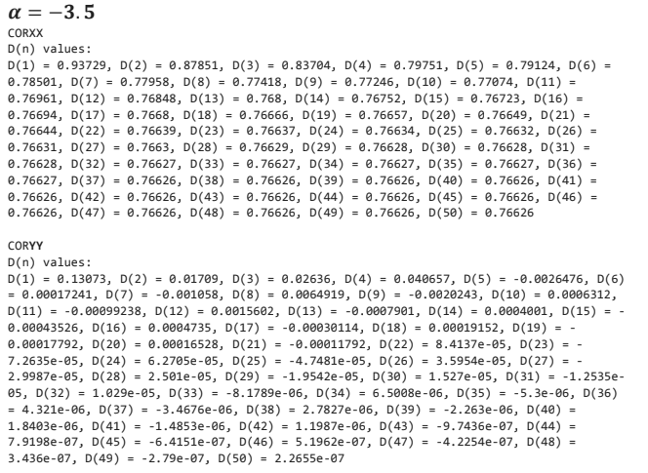
Anisotropic XY model. Correlations for $α=−3.5;h=0$
As you can see:
XX Ferro order
NO YY order

Slide 25
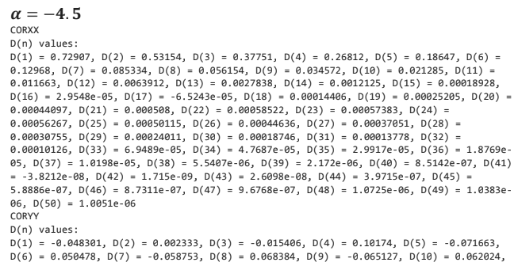
Anisotropic XY model. Correlations for $α=−4.5; h=0$
As you can see:
NO XX order
YY Anti-Ferro order

Slide 26
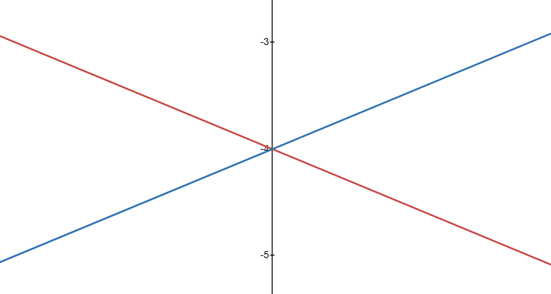
Explanation of the result
XX FERRO
Everthing was clear except what happens in bottom triangle. It is easy to see that when$α<0,$YY term tries to make Anti-Ferro order and below some critical value (-4) we have Anti-Ferro order.
ZZ FERRO
ZZ FERRO
YY ANTI-FERRO

Slide 27
Conclusion
Hamiltonian and spectrum of the system
Topology of the system
Difference between PBC and ABC
Magnetization and correlations of the spins

