Slide 1
Extended XY model with n-(n+3)
interaction
Nika Kurdadze & Giorgi Gogaberishvili

Slide 2
This presentation was inspired by the research of Titvinidze and Japaridze in 2003, which introduced the XY model with an n-(n+2) interaction term.

Slide 4
Spineless Fermion representation
Obtained Hamiltonian:
Energy spectrum:

Slide 5
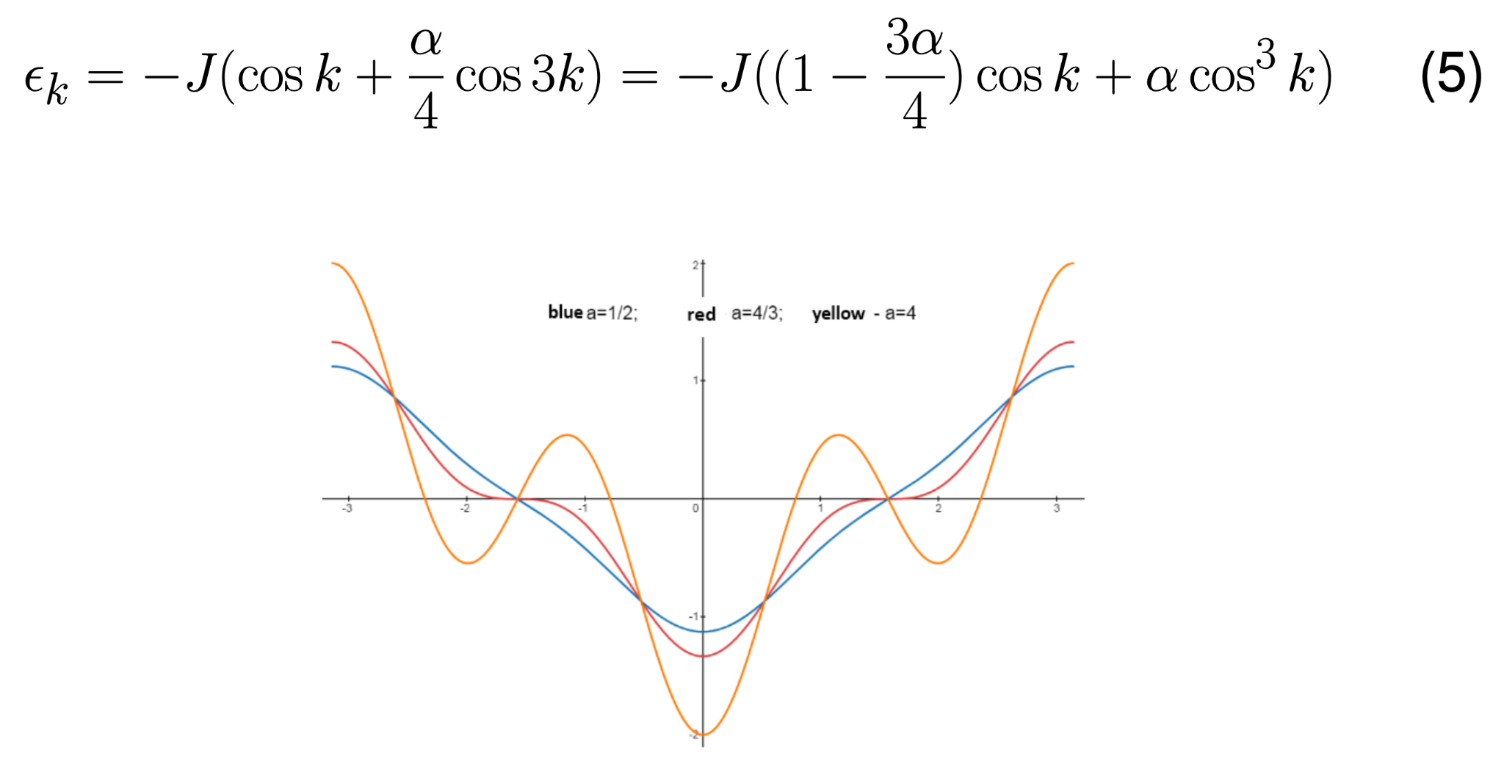
Energy spectrum

Slide 6
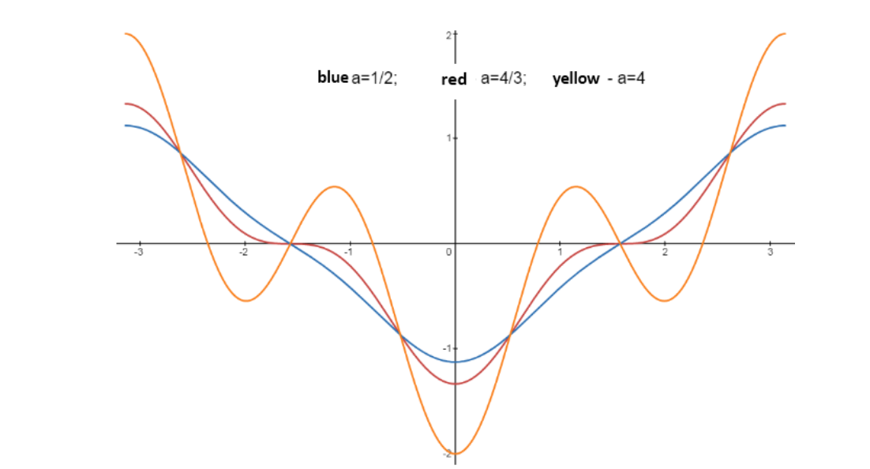
Ground state energy

Slide 7
Ground state energy and phase transition

Slide 8
Magnetization and magnetic susceptibility:
when α < 4/3 the populated region is [−π/2,π/2] which implies that the total magnetization is zero.
When α>4/3, if k_f is the solution of ε(k)=0,so is π−k_f. So, the length of the populated region is 2(kf + π/2 − kf ) = π.
full magnetization is always zero.

Slide 9
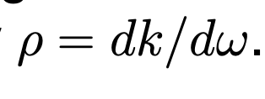
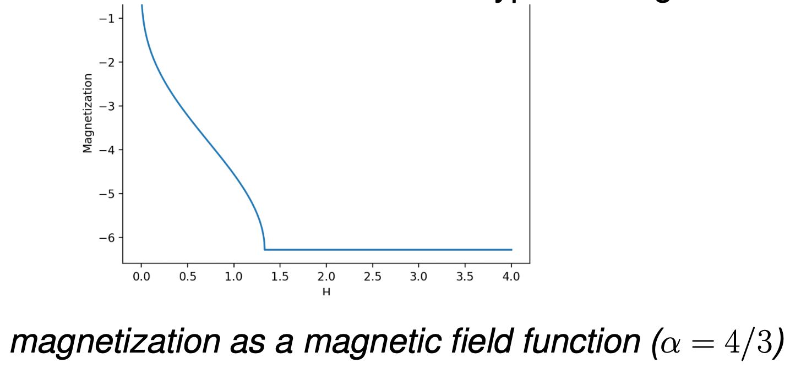
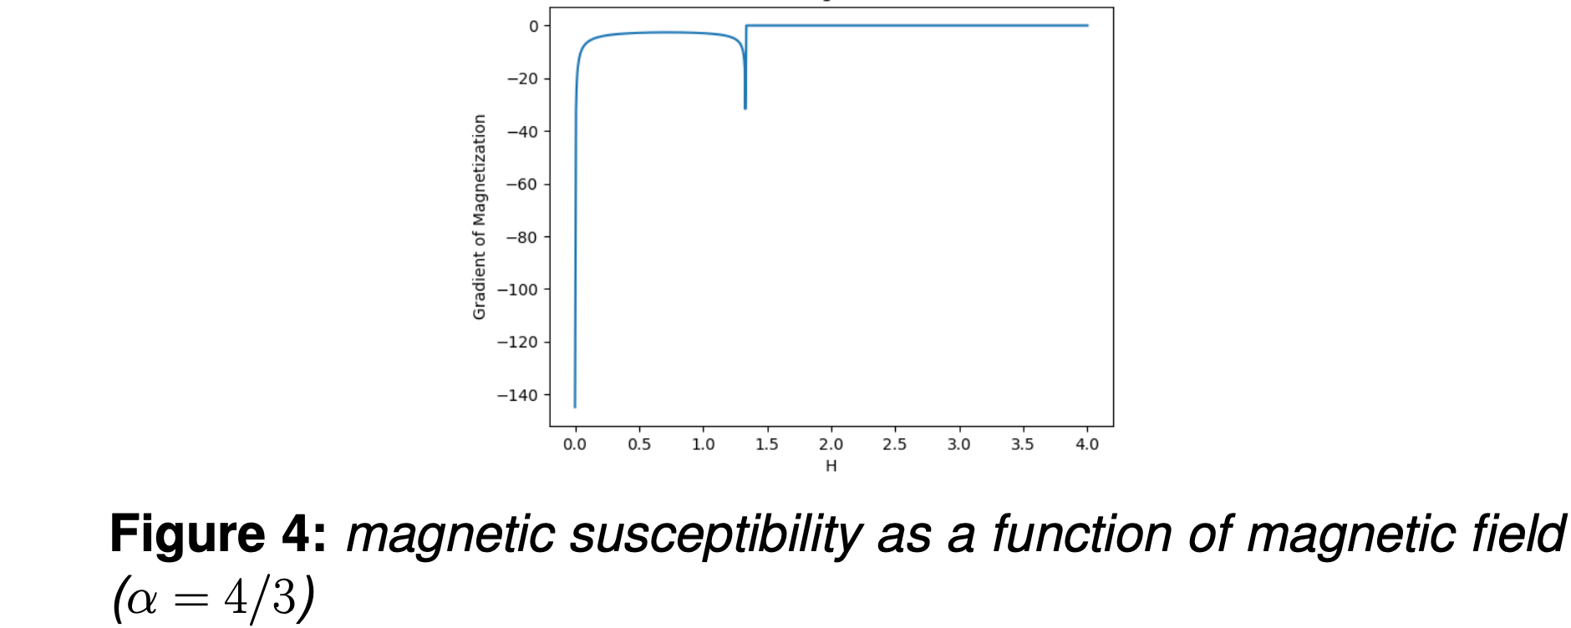
Introducing magnetic field in the system

Slide 10
Correlations

Slide 11
Analyzing correlation function

Slide 12
Properties of the system in the presence of external magnetic field

Slide 13
Constant magnetic field

Slide 14
Staggered magnetic field

Slide 16
Thermodynamics

Slide 17
Heat capacity

Slide 18
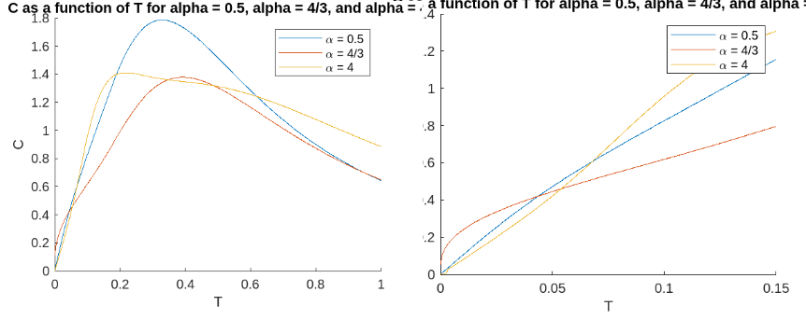
Heat conductivity
If the system lacks order at T = 0, it will persist in a disordered state at temperatures T ̸= 0.

Slide 19
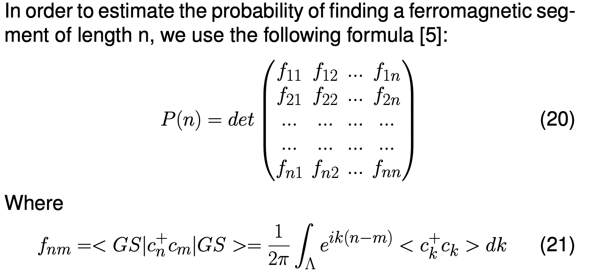
Emptiness formation probability

Slide 20
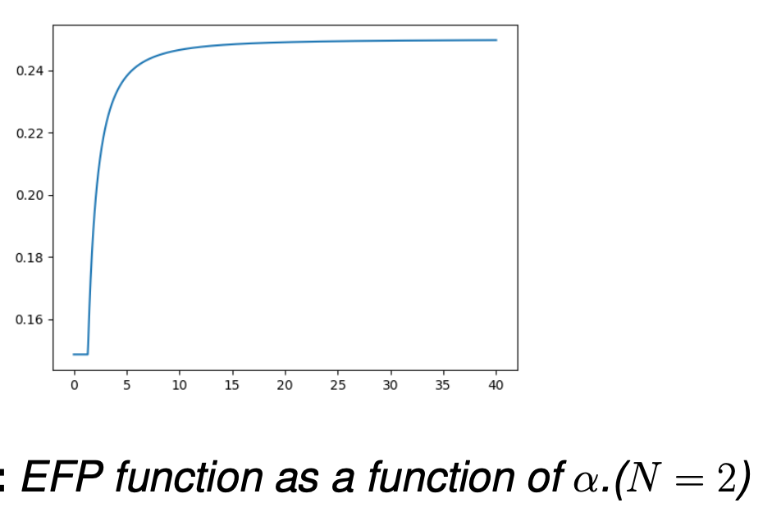
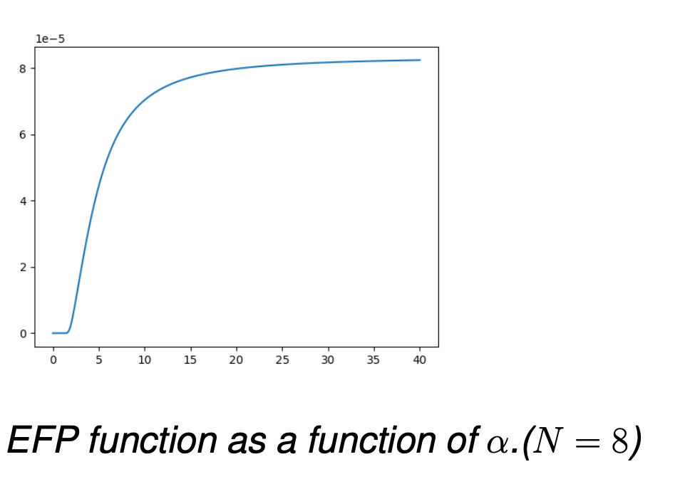
Emptiness formation probability

Slide 22



