Slide 1
Relativistic Fluid Dynamics: A Study on Taylor Flow
Speaker : Ani Ghelekva
Supervisor: prof. Andria Rogava

Slide 2
Topics Covered:
Introduction
Classical Taylor-Couette Flow
Velocity Profile in Taylor-Couette Flow
Taylor’s criterion
Rayleigh’s criterion
Taylor Vortices
Relativistic Taylor-Couette Flow
Important formulas for Special-Relativistic Fluid Dynamics
Relativistic Taylor-Couette Flow description
Viscouss Stress Tensor in Relativism
Velocity Dependence on Radial position in Special-Relativistic Taylor-Couette Flow
Importance of this research and Conclusion

Slide 3
Special-Relativistic
Plane Couette Flow
$$U^{t}=γ;U^{x}=γv_{x}; U^{y},U^{z}=0;v_{x}=const$$
$$v_{x}\left(y\right)= \frac{v_{0}y}{\sqrt{L^{2}\left(1−v_{0}^{2}\right)+v_{0}^{2}y^{2}}}$$
$$γ\left(y\right)=\sqrt{1+{\left(\frac{v_{0}γ_{0}y}{L}\right)}^{2}}$$
$$\overline{v}=\frac{1}{v_{0}}−\frac{\sqrt{1−v_{0}^{2}}}{v_{0}}$$
Plane Poiseuille Flow
$$U^{t},U^{x}=U=f\left(y\right); U^{y},U^{z}=0$$
$$The differential equation is solved in higher$$
$$transcendental functions −Jacobi^{′}s$$
$$elliptical functions$$
$$U\left(ε\right)= U_{max}−{\left(\frac{λ\sin\left(λε\right)}{1+\cos\left(λε\right)}\right)}^{2}$$

Slide 4
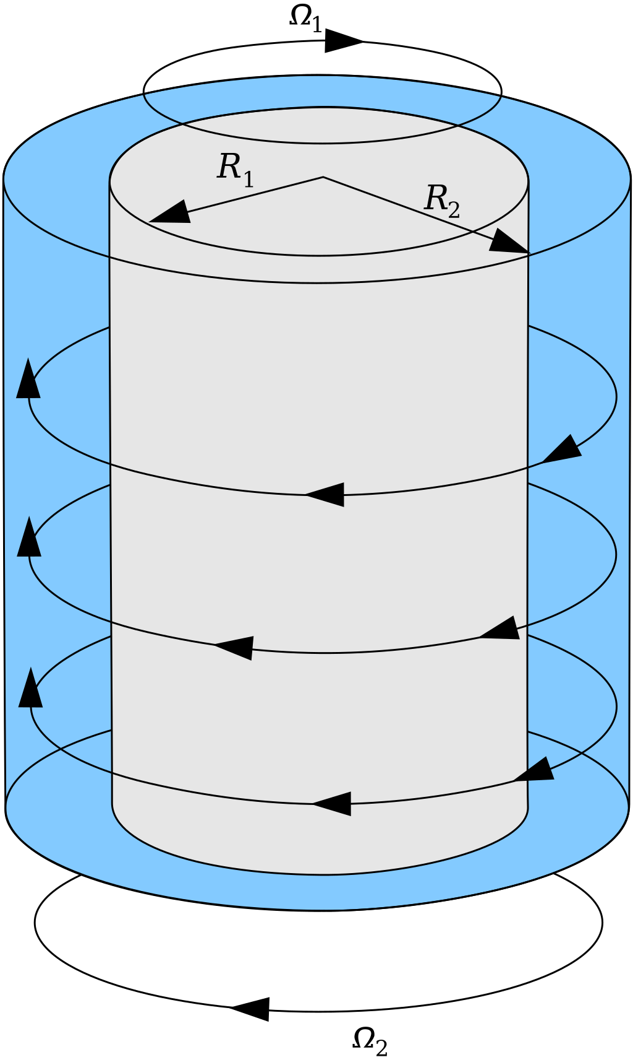
Classical Taylor (Taylor-Couette) Flow

Slide 5
Taylor-Couette Flow
The motion of a fluid between two infinite coaxial cylinders of radii $R_{1},{ R}_{2} \left(R_{2}>R_{1}\right)$rotating about their axis with angular velocities $Ω_{1},{ Ω}_{2}$.
In cylindrical coordinates:
$V_{r}=V_{z}=0$
$V_{θ}=ω\left(r\right)$
$p=p(r)$
Steady flow, Incompressible fluid, $\vec{g }=0$,

Slide 6
Navier-Stokes Equations in Cylindrical Coordinates
The Continuity Equation:
$\frac{∂ρ}{∂t}+\frac{1}{r}\frac{∂(ρrV_{r})}{∂r}$ $+\frac{1}{r}\frac{∂(ρV_{θ})}{∂θ}+$ $\frac{∂(ρV_{z})}{∂z}=0$
The Navier-Stokes Equations:
$$ρ\left(\frac{∂V_{r}}{∂t}+V_{r}\frac{∂V_{r}}{∂r}+\frac{V_{θ}}{r}\frac{∂V_{r}}{∂θ}+V_{z}\frac{∂V_{r}}{∂z}−\frac{V_{θ}^{2}}{r}\right)=−\frac{∂P}{∂r}+ρg_{r}+μ\left(\frac{∂}{∂r}\left(\frac{1}{r}\frac{∂\left(rV_{r}\right)}{∂r}\right)+\frac{1}{r^{2}}\frac{∂^{2}V_{r}}{∂θ^{2}}+\frac{∂^{2}V_{r}}{∂z^{2}}−\frac{V_{r}}{r^{2}}−\frac{2}{r^{2}}\frac{∂V_{θ}}{∂θ}\right)$$
$$ρ\left(\frac{∂V_{θ}}{∂t}+V_{r}\frac{∂V_{θ}}{∂r}+\frac{V_{θ}}{r}\frac{∂V_{θ}}{∂θ}+V_{z}\frac{∂V_{θ}}{∂z}−\frac{V_{θ}V_{r}}{r}\right)=−\frac{1}{r}\frac{∂P}{∂θ}+ρg_{θ}+μ\left(\frac{∂}{∂r}\left(\frac{1}{r}\frac{∂\left(rV_{θ}\right)}{∂r}\right)+\frac{1}{r^{2}}\frac{∂^{2}V_{θ}}{∂θ^{2}}+\frac{∂^{2}V_{θ}}{∂z^{2}}−\frac{V_{θ}}{r^{2}}+\frac{2}{r^{2}}\frac{∂V_{r}}{∂θ}\right)$$
$$ρ\left(\frac{∂V_{z}}{∂t}+V_{r}\frac{∂V_{z}}{∂r}+\frac{V_{θ}}{r}\frac{∂V_{z}}{∂θ}+V_{z}\frac{∂V_{z}}{∂z}\right)=−\frac{∂P}{∂z}+ρg_{z}+μ\left(\frac{∂}{∂r}\left(\frac{1}{r}\frac{∂\left(rV_{z}\right)}{∂r}\right)+\frac{1}{r^{2}}\frac{∂^{2}V_{z}}{∂θ^{2}}+\frac{∂^{2}V_{z}}{∂z^{2}}\right)$$

Slide 7
Navier-Stokes Equations in Cylindrical Coordinates
The Continuity Equation:
$\frac{∂ρ}{∂t}+\frac{1}{r}\frac{∂(ρrV_{r})}{∂r}$ $+\frac{1}{r}\frac{∂(ρV_{θ})}{∂θ}+$ $\frac{∂(ρV_{z})}{∂z}=0$
The Navier-Stokes Equations:
$$ρ\left(\frac{∂V_{r}}{∂t}+V_{r}\frac{∂V_{r}}{∂r}+\frac{V_{θ}}{r}\frac{∂V_{r}}{∂θ}+V_{z}\frac{∂V_{r}}{∂z}−\frac{V_{θ}^{2}}{r}\right)=−\frac{∂P}{∂r}+ρg_{r}+μ\left(\frac{∂}{∂r}\left(\frac{1}{r}\frac{∂\left(rV_{r}\right)}{∂r}\right)+\frac{1}{r^{2}}\frac{∂^{2}V_{r}}{∂θ^{2}}+\frac{∂^{2}V_{r}}{∂z^{2}}−\frac{V_{r}}{r^{2}}−\frac{2}{r^{2}}\frac{∂V_{θ}}{∂θ}\right)$$
$$ρ\left(\frac{∂V_{θ}}{∂t}+V_{r}\frac{∂V_{θ}}{∂r}+\frac{V_{θ}}{r}\frac{∂V_{θ}}{∂θ}+V_{z}\frac{∂V_{θ}}{∂z}−\frac{V_{θ}V_{r}}{r}\right)=−\frac{1}{r}\frac{∂P}{∂θ}+ρg_{θ}+μ\left(\frac{∂}{∂r}\left(\frac{1}{r}\frac{∂\left(rV_{θ}\right)}{∂r}\right)+\frac{1}{r^{2}}\frac{∂^{2}V_{θ}}{∂θ^{2}}+\frac{∂^{2}V_{θ}}{∂z^{2}}−\frac{V_{θ}}{r^{2}}+\frac{2}{r^{2}}\frac{∂V_{r}}{∂θ}\right)$$
$$ρ\left(\frac{∂V_{z}}{∂t}+V_{r}\frac{∂V_{z}}{∂r}+\frac{V_{θ}}{r}\frac{∂V_{z}}{∂θ}+V_{z}\frac{∂V_{z}}{∂z}\right)=−\frac{∂P}{∂z}+ρg_{z}+μ\left(\frac{∂}{∂r}\left(\frac{1}{r}\frac{∂\left(rV_{z}\right)}{∂r}\right)+\frac{1}{r^{2}}\frac{∂^{2}V_{z}}{∂θ^{2}}+\frac{∂^{2}V_{z}}{∂z^{2}}\right)$$

Slide 8
Taylor-Couette Flow
$\frac{dp}{dr}−\frac{ρv^{2}}{r}=0$;
$\frac{d^{2}ω}{dr^{2}}+\frac{1}{r}\frac{dω}{dr} −\frac{ω}{r^{2}}=0$;
Solution format - $r^{n};n=±1$
$$ω=ar+\frac{b}{r}$$
Initial values - $R_{1} R_{2}{ Ω}_{1} Ω_{2}$
$$ω= \frac{Ω_{2}R_{2}^{2}−Ω_{1}R_{1}^{2}}{R_{2}^{2}−R_{1}^{2}}r+\frac{\left(Ω_{1}−Ω_{2}\right)R_{1}^{2}R_{2}^{2}}{R_{2}^{2}−R_{1}^{2}}\frac{1}{r}$$

Slide 9
Angular Velocity Dependence on Radial Position in Taylor–Couette Flow
$inner radius R_{1}=1$
$outer radius R_{2}=2$
$inner cylinder angular velocity Ω_{1}=2$
$outter cylinder angular velocity Ω_{2}=1$

Slide 10
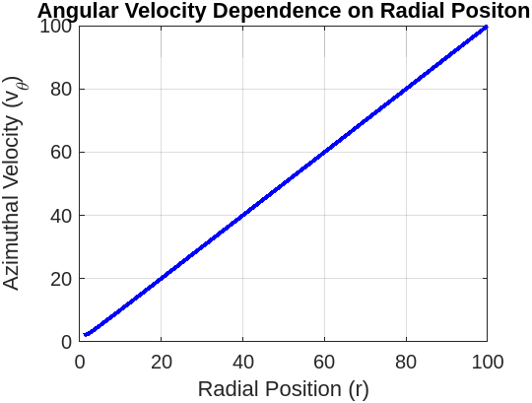
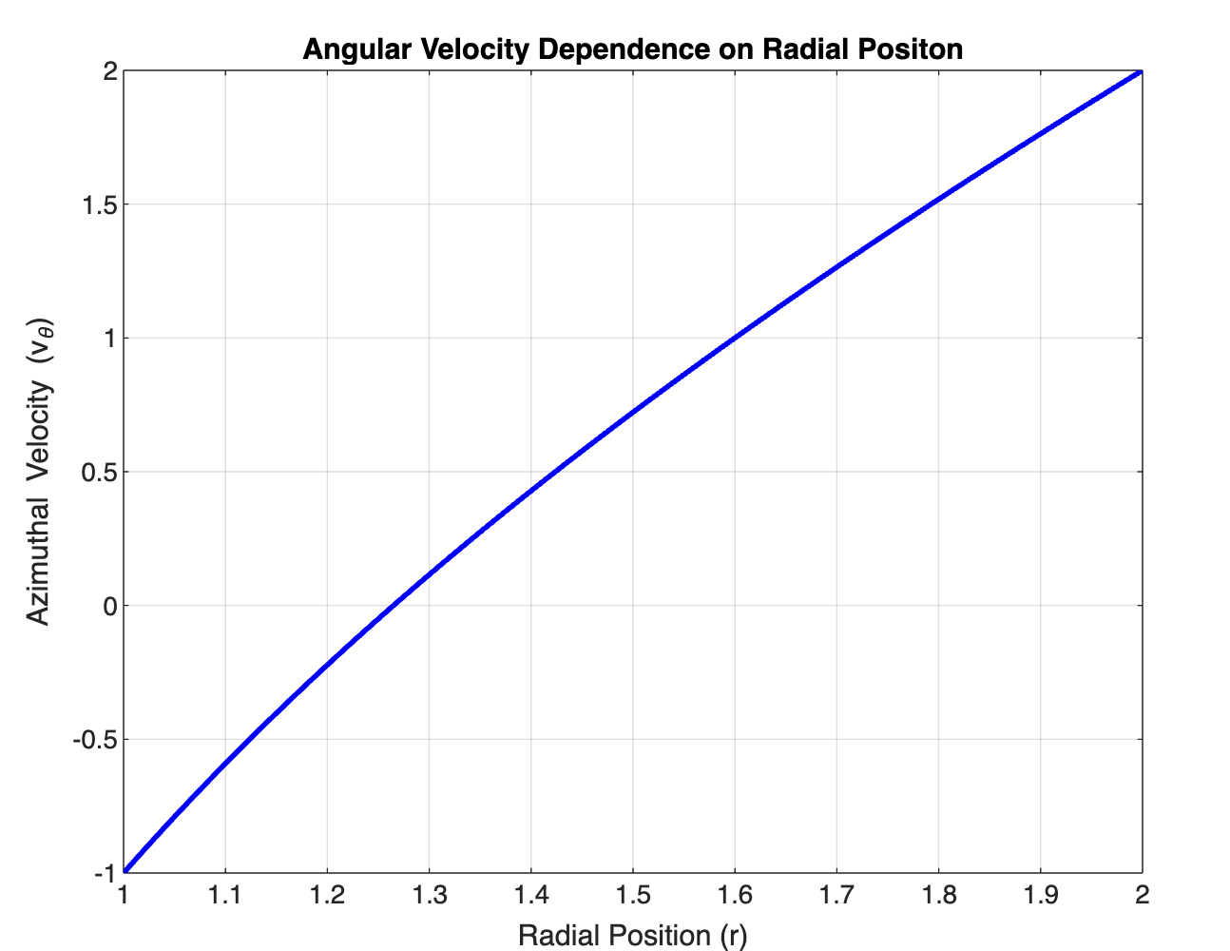
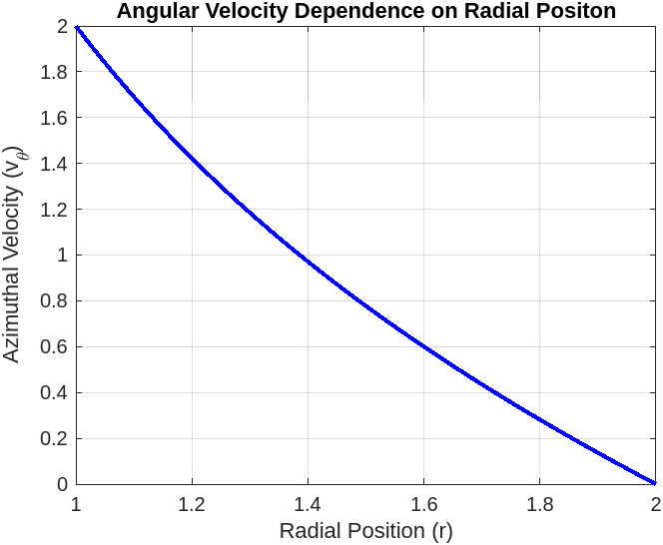
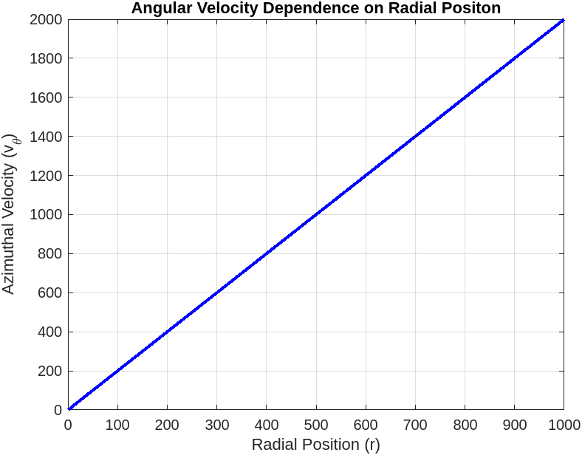
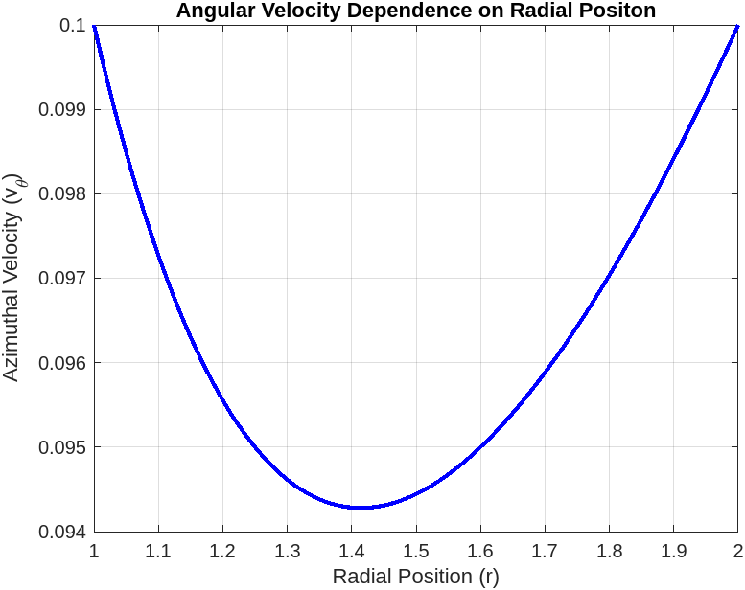
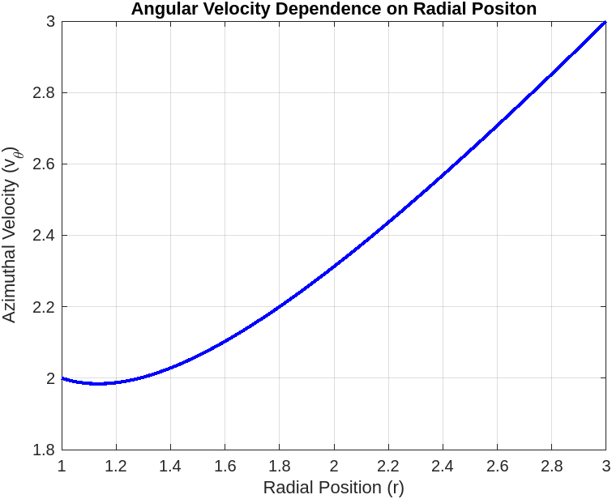
$$R_{1}=1 R_{2}=100 { Ω}_{1}=2 Ω_{2}=1$$
$$R_{1}=1 R_{2}=2 { Ω}_{1}=−1 Ω_{2}=1$$
$$R_{1}=1 R_{2}=2 { Ω}_{1}=2 Ω_{2}=0$$
$$R_{1}=1 R_{2}=1000 { Ω}_{1}=0 Ω_{2}=2$$
$$R_{1}=1 R_{2}=2 { Ω}_{1}=0.1 Ω_{2}=0.05$$
$$R_{1}=1 R_{2}=3 { Ω}_{1}=2 Ω_{2}=1$$

Slide 11
Rayleigh criterion
In the absence of viscosity the necessary and sufficient condition for distribution of azimuthal velocity to be stable is
$Φ=\frac{1}{r^{3}}\frac{d}{dr} {\left(rv_{θ}\right)}^{2}≥0$
everywhere in the interval; and, further, that the distribution is unstable if ${\left(rv_{θ}\right)}^{2}$ should decrease anywhere in the interval.
Taylor-Couette flow is stable if $→$ $μ>η^{2}$
If $0<μ<η^{2}$ $→$ $Φ<0$ Rayleigh's criterion is violated
If $μ<0 and η<\frac{r}{R_{2}}<η_{0} → Φ<0$
where: $η_{0}=η\sqrt{\frac{1+|μ|}{η^{2}+|μ|}}$

Slide 12
Taylor's criterion
The stability is characterized by three parameters, namely $η,μ$ and a Taylor number (Ta).

Slide 13
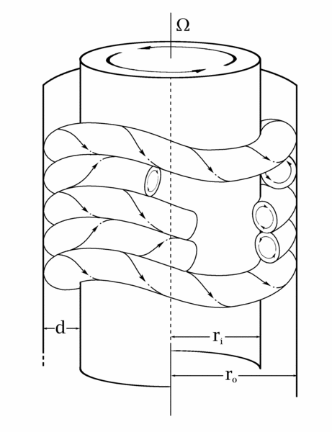
Taylor Vortices
.
Taylor vortices are vortices formed in rotating Taylor–Couette flow when the Taylor number (Ta) of the flow exceeds a critical value.
$Ta>{Ta}_{c}$

Slide 14
Special-Relativistic Taylor (Taylor-Couette) Flow

Slide 15
We shall use geometrical units, so that $G = c = 1$
Greece indices – spacetime components; Roman indices – spatial components;
Minkowski Metric in Cartesian Coordinates with the signature chosen as (- + + +)
$$ds^{2}=−dτ^{2}=−dt^{2}+dx^{2}+dy^{2}+dz^{2}$$
Minkowski metric In Cylinidrical coordinates with the signature chosen as (- + + +)
$$ds^{2}=−dτ^{2}=−dt^{2}+dr^{2}+r^{2}dφ^{2}+dz^{2}$$
$g_{αβ}=diag(−1, +1, {+r}^{2},+1$)

Slide 16
The Stress-Energy Tensor
We are considering motion of the incompressible, viscous fluid so we need the following form of stress-energy tensor:
$$T^{αβ}=eU^{α}U^{β}+Ph^{αβ}−2{ησ}^{αβ}−ξθh^{αβ}$$
WHERE:
e – the density of mass-energy
P – the pressure
$U^{α}$- 4-velocity field of the flow
$η$– coefficient of shear viscosity
$ξ$ – coefficient of bulk viscosity

Slide 17
The Stress-Energy Tensor
We are considering motion of the incompressible, viscous fluid so we need the following form of stress-energy tensor:
$$T^{αβ}=eU^{α}U^{β}+Ph^{αβ}−2{ησ}^{αβ}−ξθh^{αβ}$$
WHERE:
$h^{αβ}$- is the projection tensor
$$h^{αβ}≡ η^{αβ}+U^{α}U^{β}$$
$θ$ – is the ”expansion” of fluid world lines
$$θ=U_{;α}^{α}$$

Slide 18
The Stress-Energy Tensor
We are considering motion of the incompressible, viscous fluid so we need the following form of stress-energy tensor:
$$T^{αβ}=eU^{α}U^{β}+Ph^{αβ}−2{ησ}^{αβ}−ξθh^{αβ}$$
WHERE:
$σ^{αβ}$ - the shear tensor
$σ^{αβ}=\frac{1}{2} (U_{α;μ}h_{β}^{μ}$+ $U_{β;μ}h_{α}^{μ})−\frac{1}{3} θh_{αβ}$

Slide 19
The standard formulation of relativistic hydrodynamics
The Conservation Law of Energy-Momentum tensor
$$∇_{α}Τ^{αβ}=0$$
The Continuity Equation
$$∇_{α}J^{α}=0$$

Slide 20
Special-Relativistic Taylor-Couette Flow
For the fluid with nonrelativistic temperature, density of the mass-energy e = ρ in the proper frame of reference. Since a fluid is thought to be incompressible: ρ = const. and the continuity equation: $∇_{α}J^{α}=0$ clearly leads to θ = 0.
$$T_{α;β}^{α}=0$$
The 4-velocity field $U^{α}$ of Taylor-Couette Flow in Cylindrical Coordinates
$U^{t}=γ$ ${; U}^{r}=U^{z}=0; U^{φ}=γv_{φ}\left(r\right)=$ $γω\left(r\right);$
The Lorentz factor: ($c=1$ and $v=ωr$)
$$γ=\frac{1}{\sqrt{1−r^{2}ω^{2}}}$$

Slide 21
Special-Relativistic Taylor-Couette Flow
$T_{α;β}^{α}=0$; $U^{t}=γ$ ${; U}^{r}=U^{z}=0; U^{φ}=γv_{φ}\left(r\right)=$ $γω\left(r\right);$
Let’s examine azimuthal component of the Energy-Momentum conservation law $T_{α;φ}^{α}=0$
$$\frac{∂T^{φr}}{ ∂r}+\frac{1}{r}\left(T^{φr}\right)=0$$
$h^{φr}=0; σ^{φr}=$ $σ^{rφ}$
$T^{φr}=$ $−2{ησ}^{rφ}$
$T^{φr}$ = -$η(\frac{∂\left(γω\right)}{∂r}−$ $\frac{γω}{r})$
$\frac{∂^{2}\left(γω\right)}{∂r^{2}}−$ $\frac{γω}{r^{2}}=0$

Slide 22
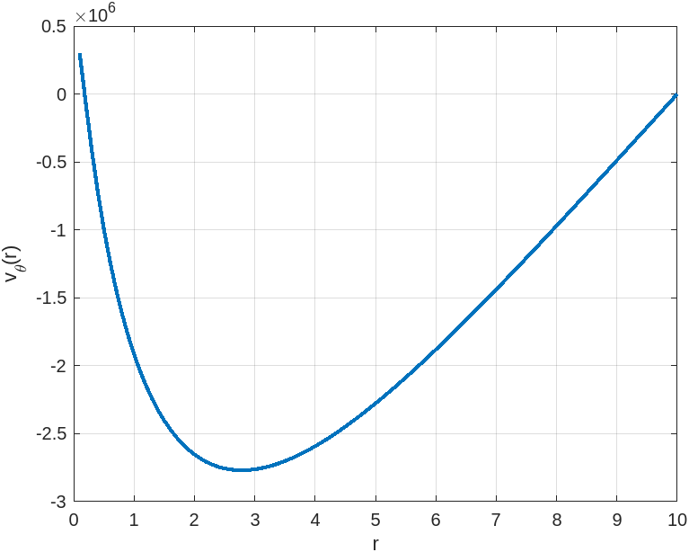
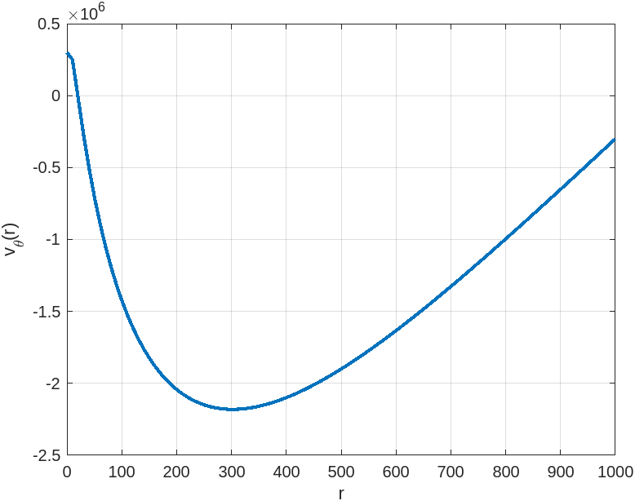
$R_{1}=$ 0.1
$$R_{2}=10$$
$$Ω_{1}=1$$
$$Ω_{2}=0$$
$R_{1}=$ 0.1
$$R_{2}=10$$
$$Ω_{1}=300000$$
$$Ω_{2}=0$$
$R_{1}=$ 0.1
$$R_{2}=1000$$
$$Ω_{1}=300000$$
$$Ω_{2}=−300000$$
$R_{1}=$ 0.1
$$R_{2}=10$$
$$Ω_{1}=0$$
$$Ω_{2}=300000$$

Slide 23
Taylor–Couette Flow for Astrophysical and Other Purposes

Slide 24
Cited Works:
https://resources.system-analysis.cadence.com/blog/msa2022-expressing-the-navier-stokes-equation-in-cylindrical-coordinate-systems
L. D. Landau, and E. M. Lifshitz,Hydrodynamics(Third Ed.) (Pergamon, Oxford, 1976).
N. Straumann, General Relativity and Relativistic Astrophysics (Springer-Verlag, New-York, 1984).
A.D.Rogava, Special-relativistic model flows of viscous fluid (Journal of the Georgian Physical Society)
http://www.scholarpedia.org/article/Taylor-Couette_flow
C. D. Andereck, S. S. Lui, and H. L. Swinney, "Flow regimes in a circular Couette system with independently rotating cylinders," J. Fluid Mech. 164:155, 1986.
H.Ji, J.Goodman, “Taylor–Couette flow for astrophysical purposes”, The Royal Society Publishing, 2023
Illustrations:
https://en.wikipedia.org/wiki/TaylorCouette_flow#/media/File:CouetteTaylorSystem.svg
http://www.scholarpedia.org/article/File:Wave.fin_McDraw.gif

Slide 25
Thank you!
Any Questions?

