Slide 1
Energy and power radiated by primordial black holes
Speaker: Nikoloz Kurthskalia(nkurt22@freeuni.edu.ge)
Supervisor: Zaza osmanov( zosmanov@freeuni.edu.ge)

Slide 2
Some useful parameters:
$$ω_{max}∝\frac{c^{3}}{GM}∝{10}^{6}\sec^{−1}$$
$$T=\frac{2π}{ω}∝{10}^{−5}sec$$
$r_{L}=\frac{c}{ω}$ $∝{10}^{3}m$
$$M={10}^{−1}M_{⊙}$$
$$n_{∞}≈1{cm}^{−3}$$
$$T_{∞}≈10K$$
Black hole mass
$$L=1.2×{10}^{14}{\left(\frac{n_{∞}}{1{სმ}^{−3}}\right)}^{2}{\left(\frac{T_{∞}}{{10}^{4}K}\right)}^{−3}{\left(\frac{M}{M_{\text{☉}}}\right)}^{3}[\frac{erg}{s}/m]$$

Slide 3
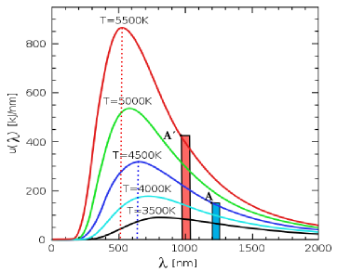
Inverse Compton scattering:
$$λ_{peak}T=2∗{10}^{−3}m∗k$$
$$ε_{ph}=\frac{hc}{λ_{peak}}$$
$$U=\frac{L}{4π{cR}^{2}}$$
$$\frac{γε_{ph}}{mc^{2}}≪1$$
$${P_{ics}=σ}_{T}cγ^{2}\frac{U}{1+\frac{γε_{ph}}{mc^{2}}}$$

Slide 4
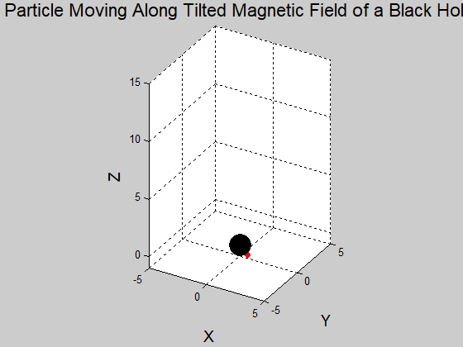
synchrotron radiation
$$ω_{B}=\frac{eB}{mc}$$
$$p=\frac{2e^{2}ω_{B}^{2}γ^{2}}{3c}$$
$$t_{cool}=\frac{γmc^{2}}{p}=\frac{{3m}^{3}c^{5}}{2γe^{4}B^{2}}\sim \frac{{10}^{−5}}{γ}$$
$$t_{cool}≪T$$
$$P=\frac{2}{3}\frac{e^{2}c}{r^{2}}γ^{4}$$

Slide 5
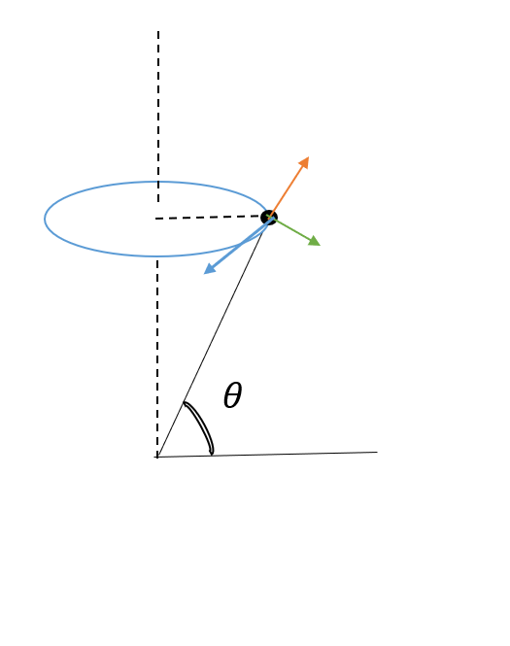
Maximum lorentz factor:
$$\vec{P}=γm\vec{v}$$
$$\frac{d}{dt}\vec{P}=\vec{N}+\vec{F}$$
$$\vec{F}≈−\frac{P_{Total}}{c}\frac{\vec{v}}{v}$$
$$\ddot{r}=ω^{2}r\left(1−\frac{2{\dot{r}}^{2}}{c^{2}−{\left(ωr\right)}^{2}}\right)−\frac{F\dot{r}}{m_{e}vγ^{3}{\left(1−\frac{ωr}{c}\right)}^{2}}$$
$$ρ=\frac{ωr}{c}$$
$$f=\frac{F}{mωc}$$
$$τ=ωt$$
$$\frac{dγ}{dτ}=\frac{2ρ\sqrt{1−γ^{−2}−ρ^{2}}}{1−ρ^{2}}−\frac{1−γ^{−2}−ρ^{2}}{\left(1−ρ^{2}\right)\left(1−γ^{−2}\right)}f$$

Slide 6
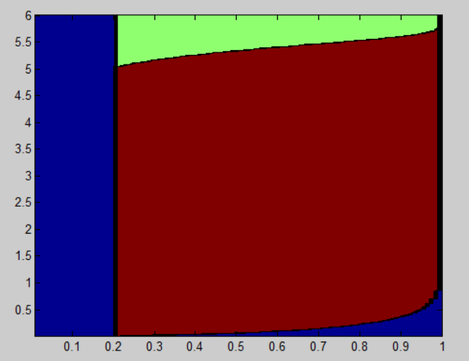
Maximum Lorenz factor:
$$\log_{10}{γ}$$
$$\frac{dγ}{dτ}=0$$
$$f=\frac{2ρ}{\sqrt{1−ρ^{2}}}$$
$$γ={\left(\frac{12πcm_{e}}{μ_{0}e^{2}ω}\right)}^{\frac{1}{4}}ρ^{\frac{3}{4}}{\left(1−ρ^{2}\right)}^{−\frac{1}{8}}$$
$$ρ$$

Slide 7
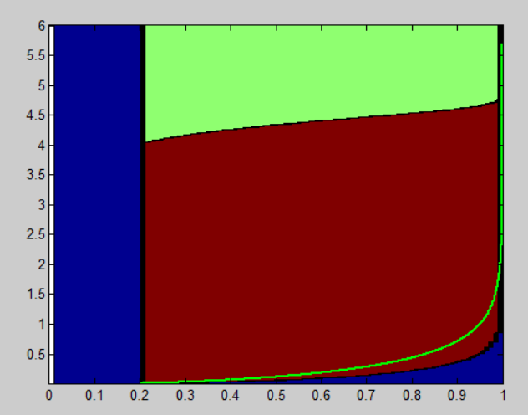
Maximum Lorenz factor:
$$γ≪γ_{cr}$$
$$γ=\frac{\sqrt{1−ρ_{0}^{2}}}{1−ρ^{2}}$$
$$γ_{max}={\left(\frac{12πcm_{e}}{μ_{0}e^{2}ω}\right)}^{\frac{2}{7}}$$
$$γ_{max}={10}^{5}$$

Slide 8
Number of particles:
$$δR$$
$$δR=\frac{γ\left(r\right)}{\frac{dγ}{dr}}$$
$$\}$$
$$δR=\frac{R_{L}}{2γ}$$
$$γ\left(r\right)=\frac{γ_{0}}{1−({\frac{ωr}{c})}^{2}}$$
$$\frac{dγ}{dr}=γ\frac{2ωr}{c^{2}}$$
$$U=\frac{L}{4π{cR}^{2}}$$
$$dV=2πR_{l}rdr$$
$$R_{L}$$
$$U=\frac{B^{2}}{8π}$$
$$n_{GJ}=\frac{ΩBcosθ}{2πec}$$
$$dn=\frac{\sqrt{2L}ωr_{l}}{ec}dr$$
$$N=\int_{R_{l}−δR}^{R_{L}}{dn}\sim {10}^{21}$$

Slide 9
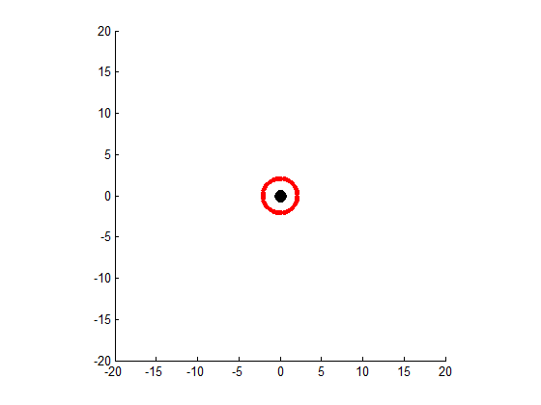
Emmision power:
$$P_{c}=N\frac{2}{3}\frac{e^{2}c}{r^{2}}γ^{4}\sim {10}^{20}erg/sec$$
$$P_{ics}=Nσ_{T}cγ^{2}\frac{U}{1+\frac{γε_{ph}}{mc^{2}}}\sim {10}^{−15}erg/sec$$
$$ε_{ph}=\frac{γ_{max}^{2}}{{10}^{10}}TeV\sim 1TeV$$
$$E_{elevtron}=γ_{max}m_{e}c^{2}\sim 10TeV$$

Slide 10
Detecting pbh:
$$N\frac{P}{4πr^{2}}=I_{T}$$
$$r=\sqrt{\frac{NP}{4πI_{T}}}$$
$I_{T}={10}^{−13} \frac{erg}{{cm}^{2}sec}={10}^{−17}$ $\frac{erg}{m^{2}sec}$
$$r={10}^{2}\sqrt{\frac{N}{4π}} m$$

Slide 11
Thanks for attention

Slide 12
Bibliography:
Centrifugally driven relativistic dynamics on curved trajectories - Andria Rogava , George Dalakishvili, Zaza Osmanov
On the efficiency of particle acceleration by rotating magnetospheres in AGN -Zaza Osmanov , Andria Rogava, Gianluigi Bodo
On particle acceleration and very high energy γ-ray emission in Crab-like pulsars- Z. Osmanov and F. M. Rieger
Relativistic effects of rotation in g-ray pulsars - Invited Review –Zaza Osmanov
https://commons.wikimedia.org/wiki/File:Compton_Effect.gif
https://energyeducation.ca/encyclopedia/Wiens_Law
https://www.researchgate.net/figure/Inverse-Compton-scattering_fig12_275836032

